Slide 1
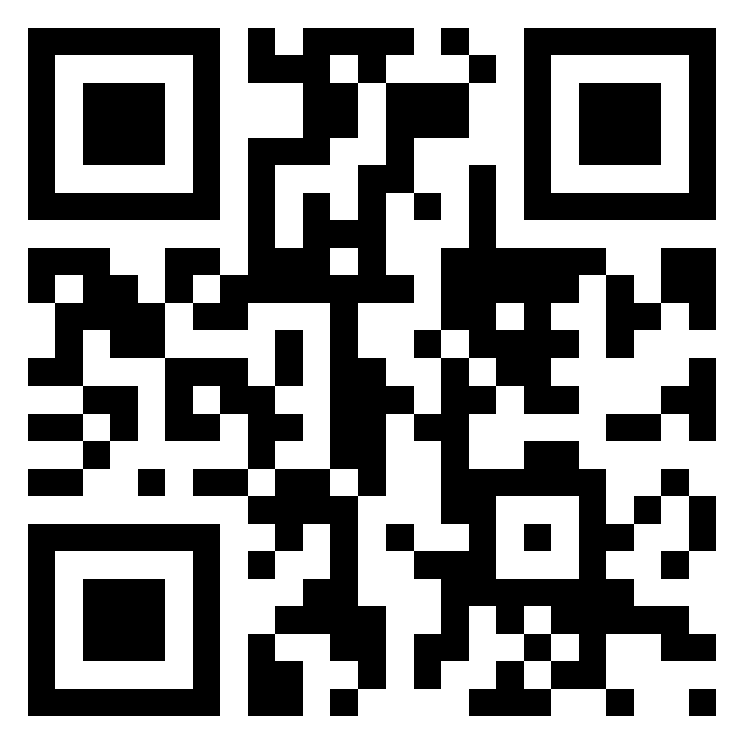
Meet the TI-Innovator Hub
TI-Nspire CXII
Python
Texas Instruments
@ticalculators
www.TIstemProjects.com
Contact stem-team@ti.com with questions

Slide 2
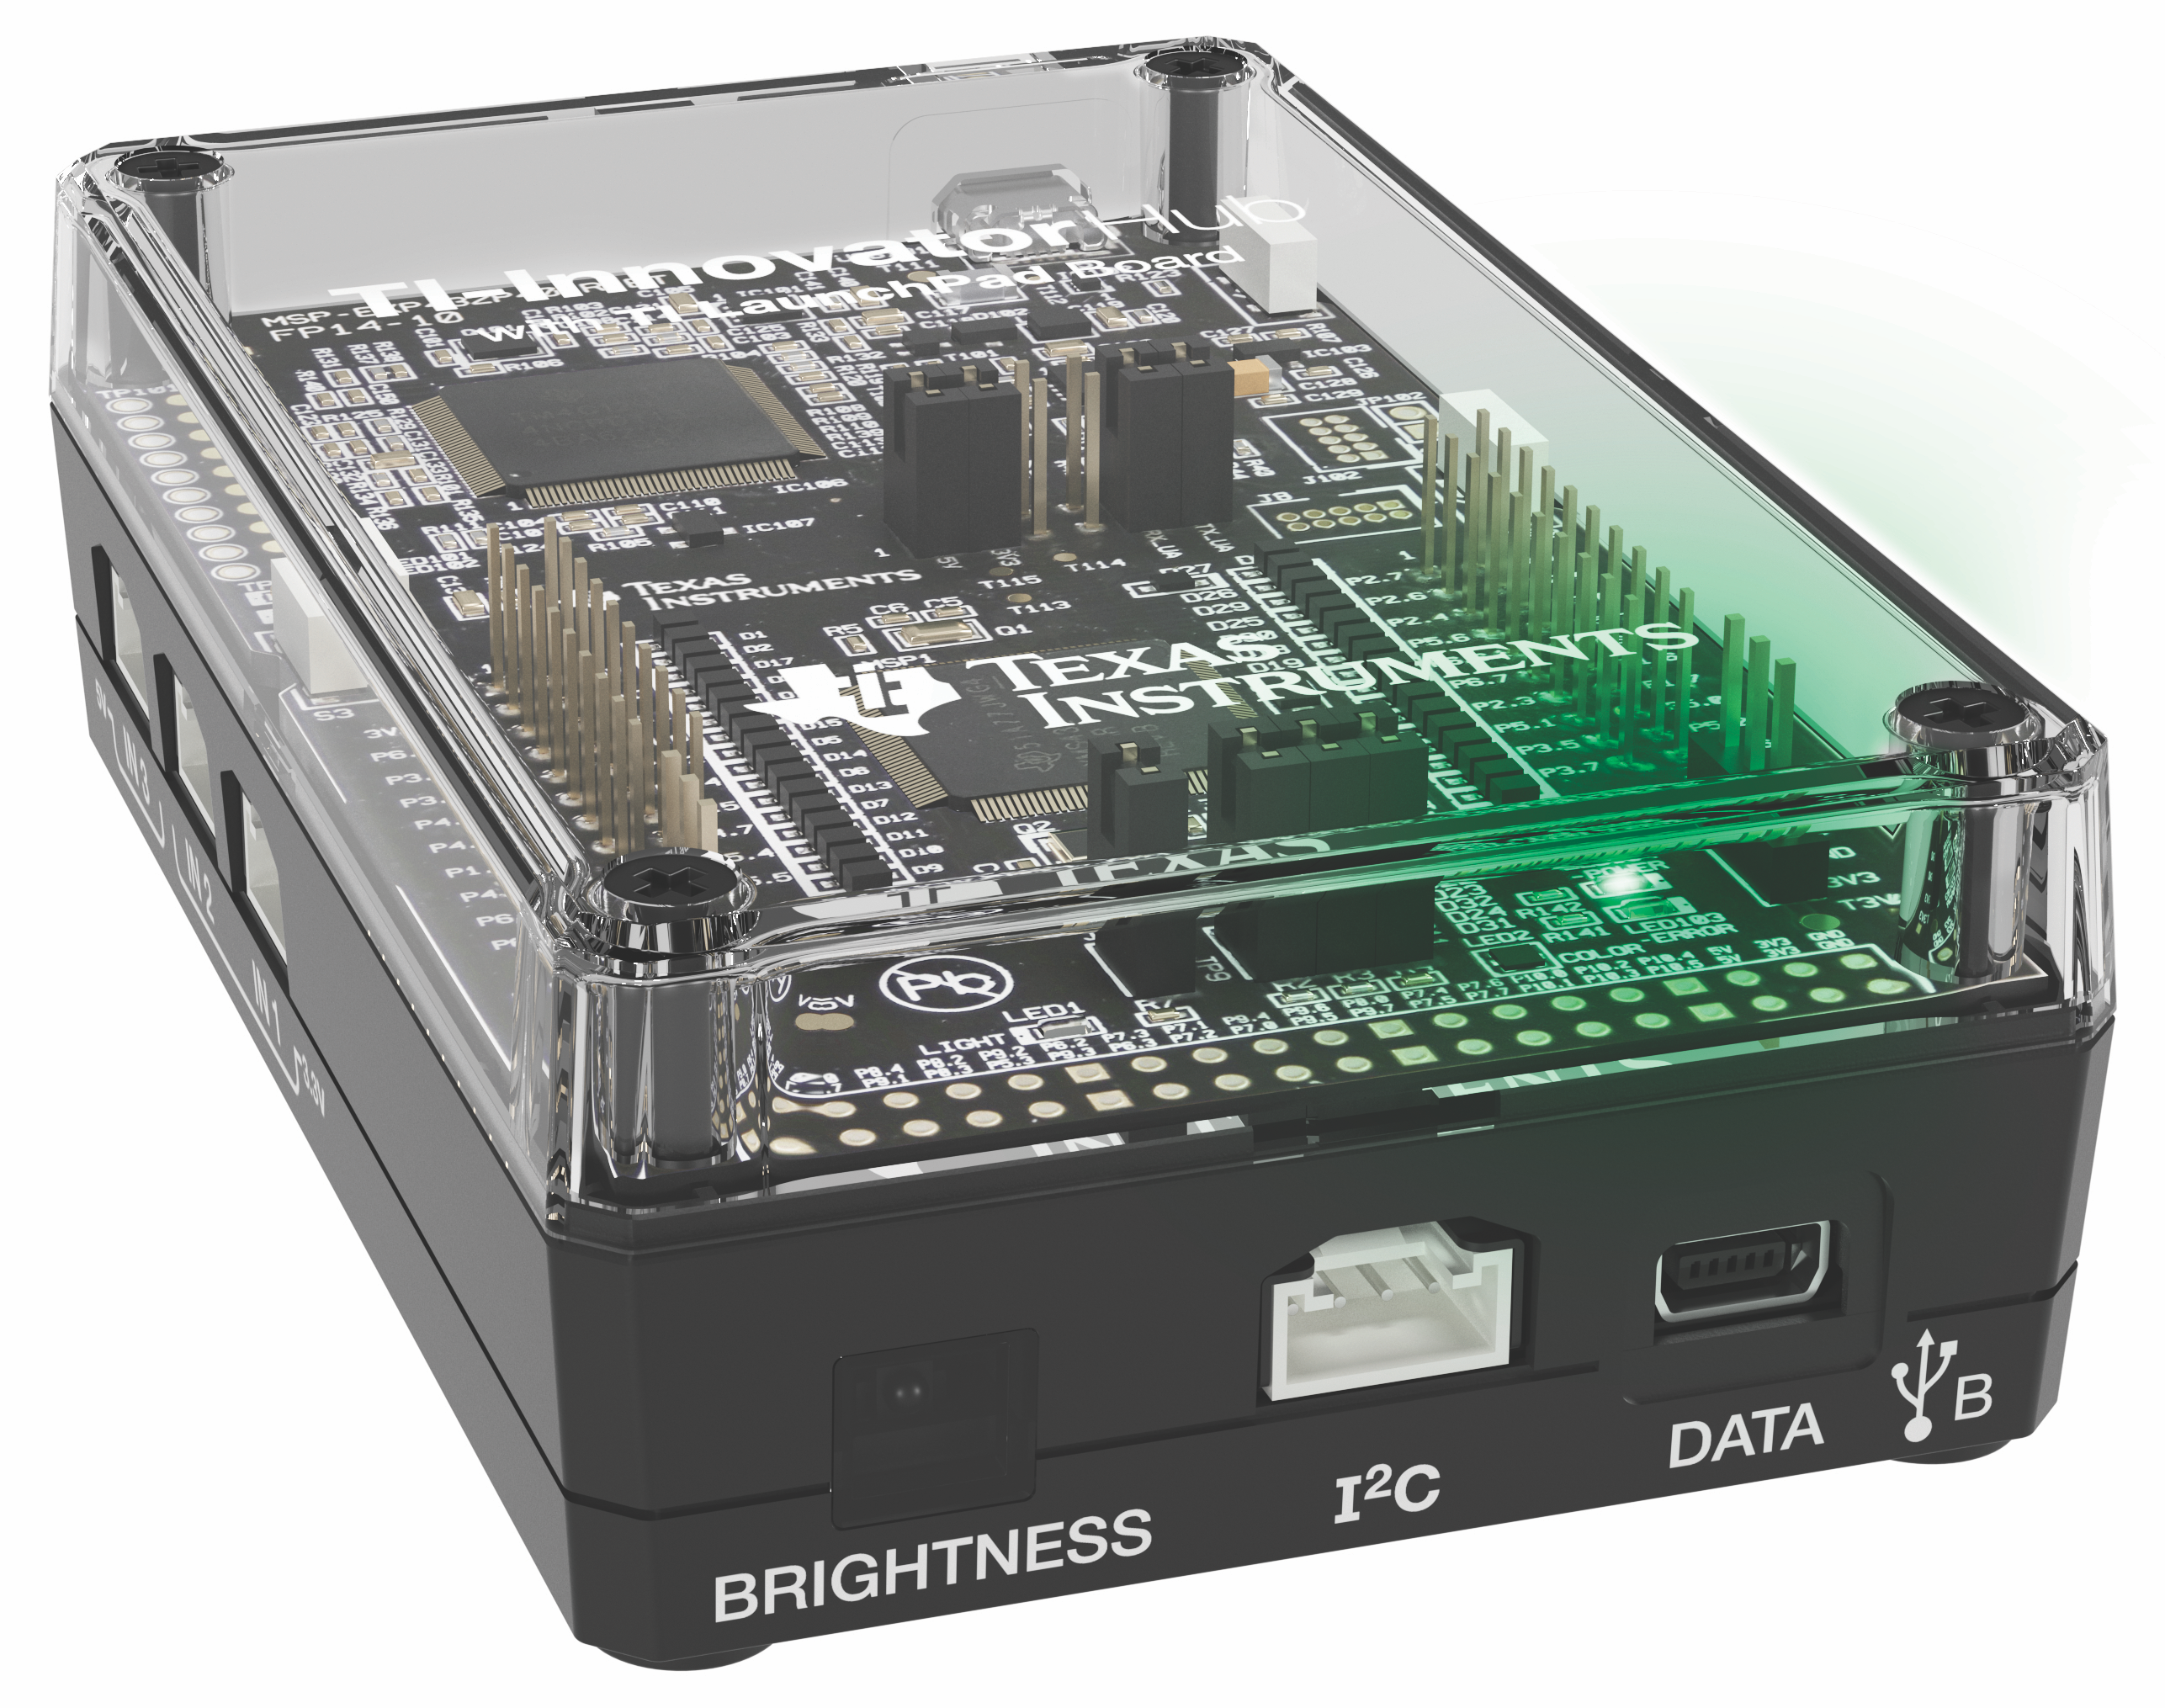
Meet the TI-Innovator Hub

Slide 3
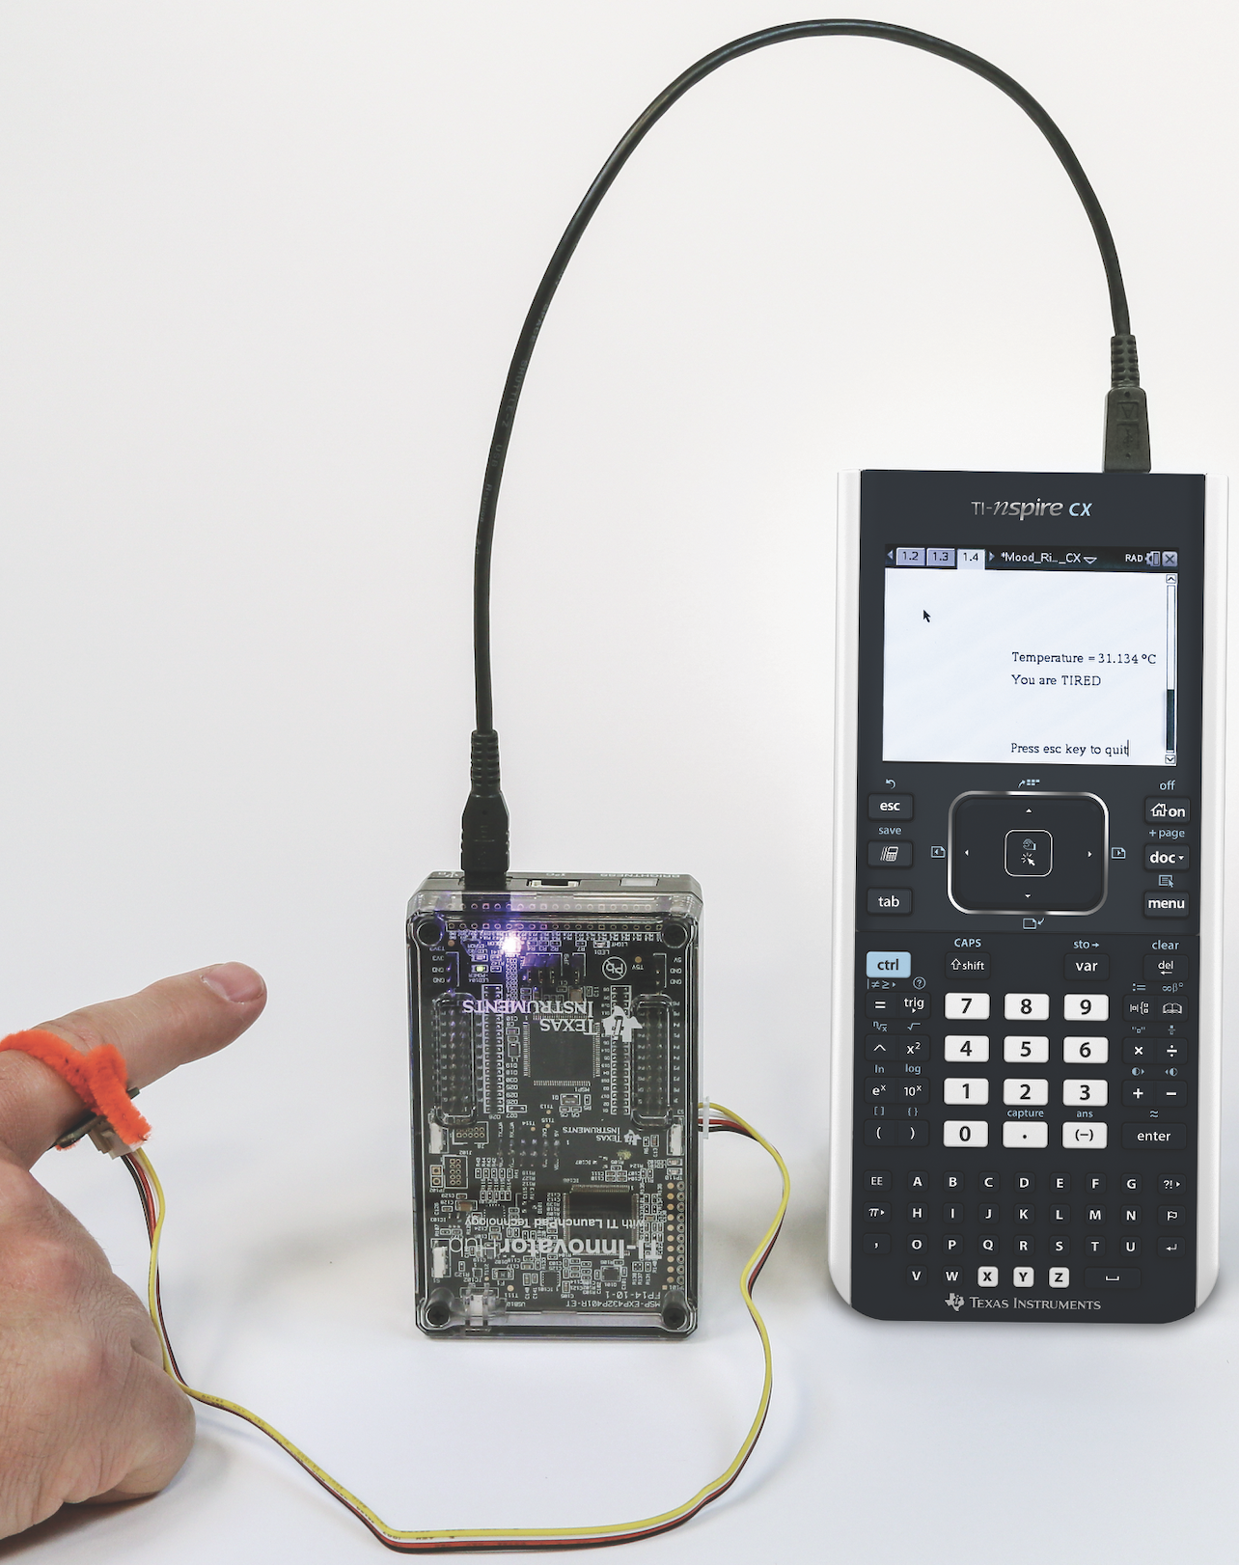
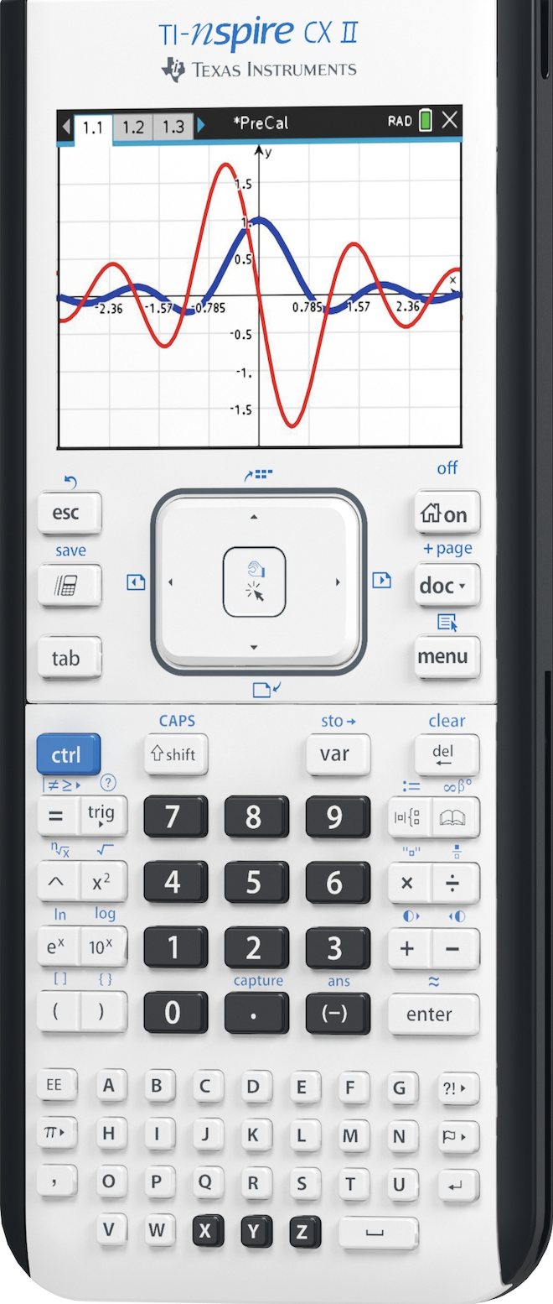
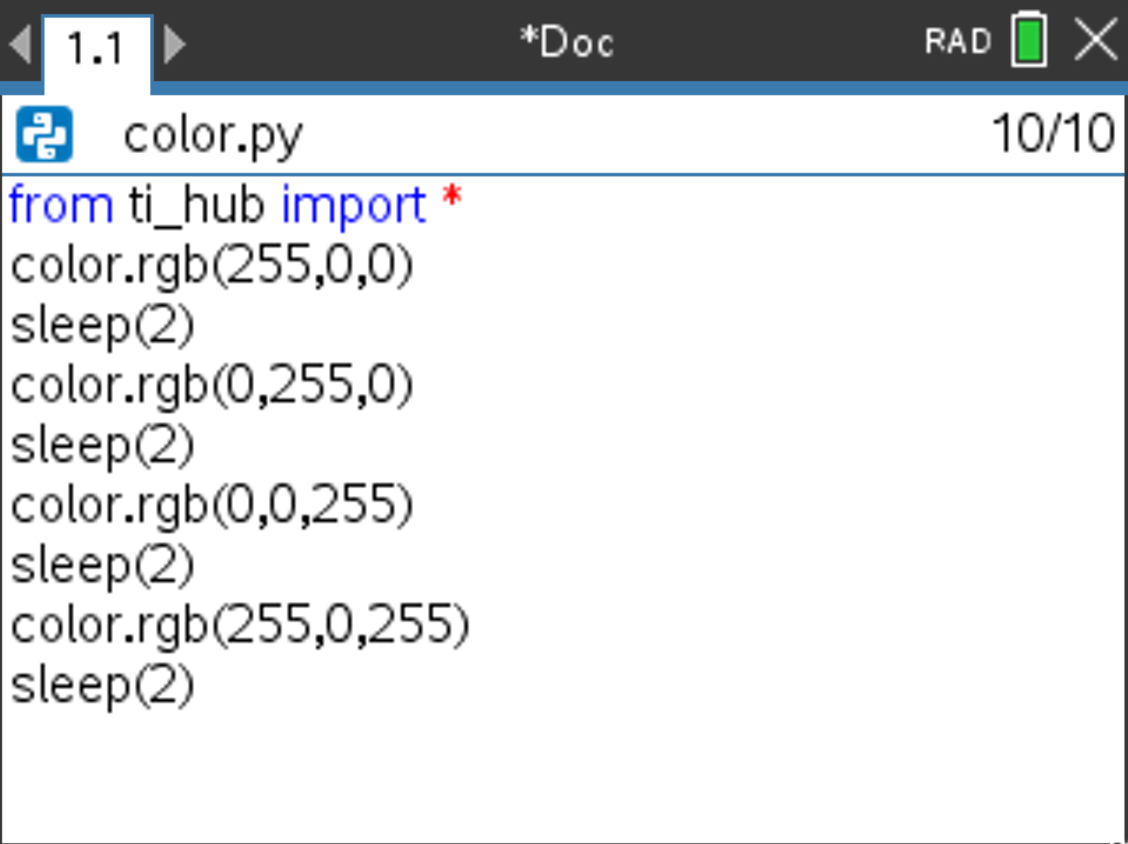
TI Graphing Calculator
Built-in RGB LED Output
TI-Innovator™ Hub
External Sensor Input

Slide 4
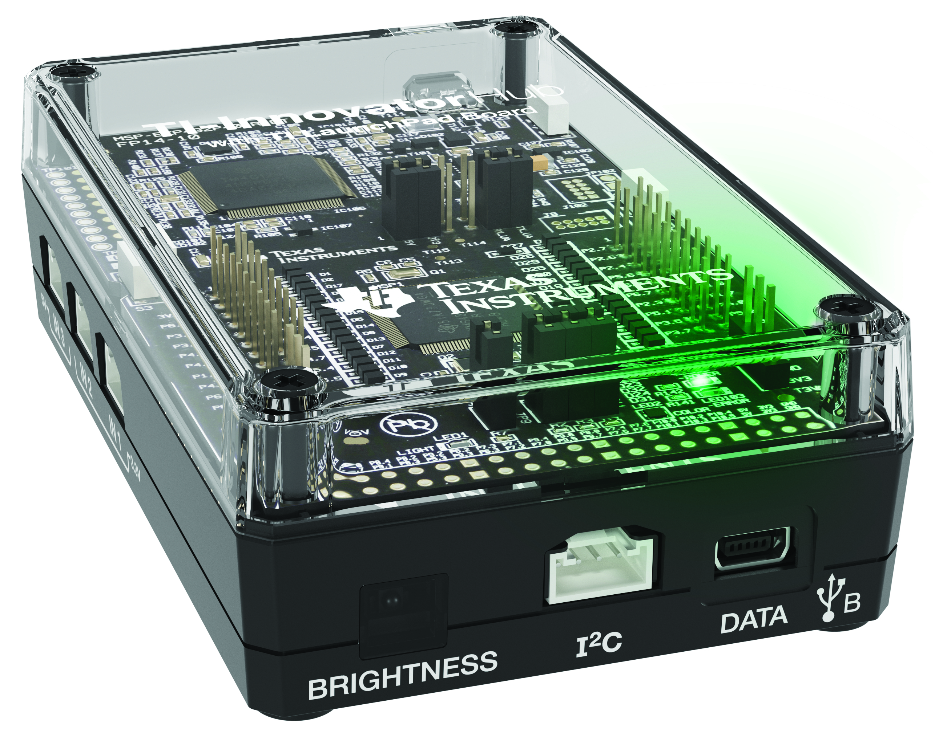
Hub from the Front
Red-Green-Blue (RGB) Color LED
(Built-in)
USB Port (mini) to connect to calculator and computer
Brightness Sensor (Built-in)
I2C Port used to
connect to Rover

Slide 5

Hub from the Bottom
Speaker
(Built-in)

Slide 6
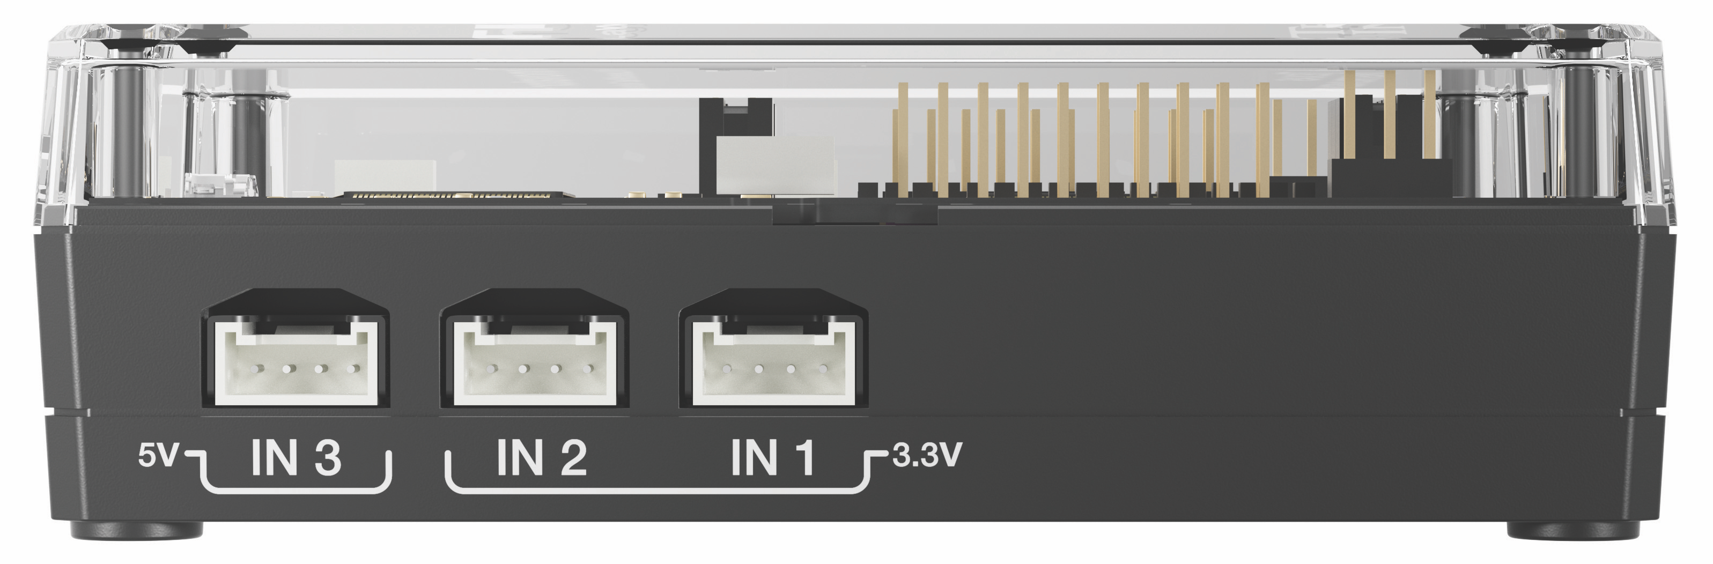
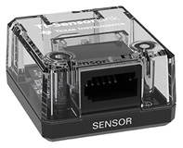
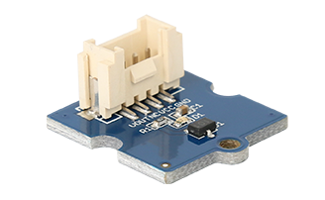
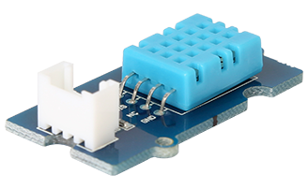
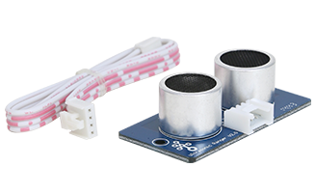
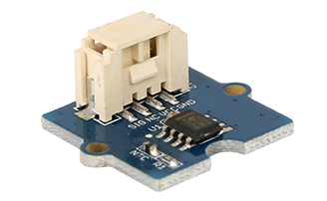
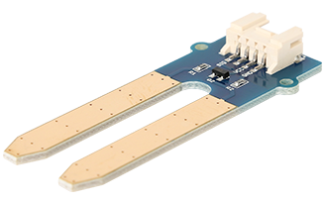
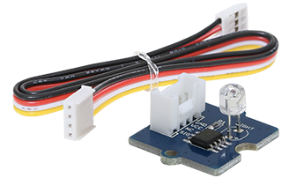
Hub from the side – input ports
Input ports for external sensors with Grove connectors
3.3 Volt ports, IN 1 and IN 2, required for Ranger and DHT
Vernier SensorLink
Adaptor
Magnetic Field (Hall Effect)
Digital Temperature
and Humidity (DHT)
Ranger
Temperature
Moisture
Light Level

Slide 7
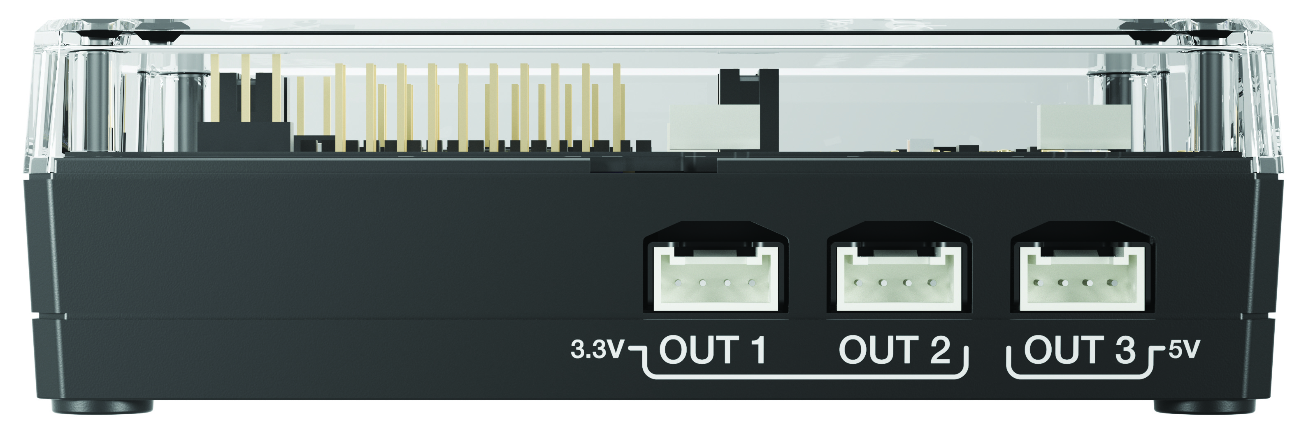
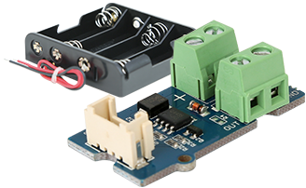
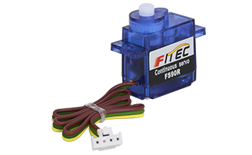
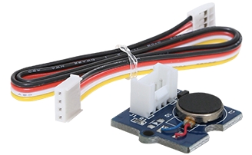
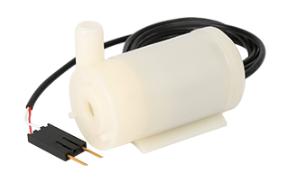
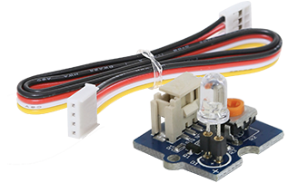
Hub from the side – Output ports
Output ports for external motors and other outputs with Grove connectors
5 Volt port, OUT 3,
required for motors
MOSFET controls power level to pump and other devices
Vibration Motor
External LED
Continuous Servo Motor
Pump

Slide 8
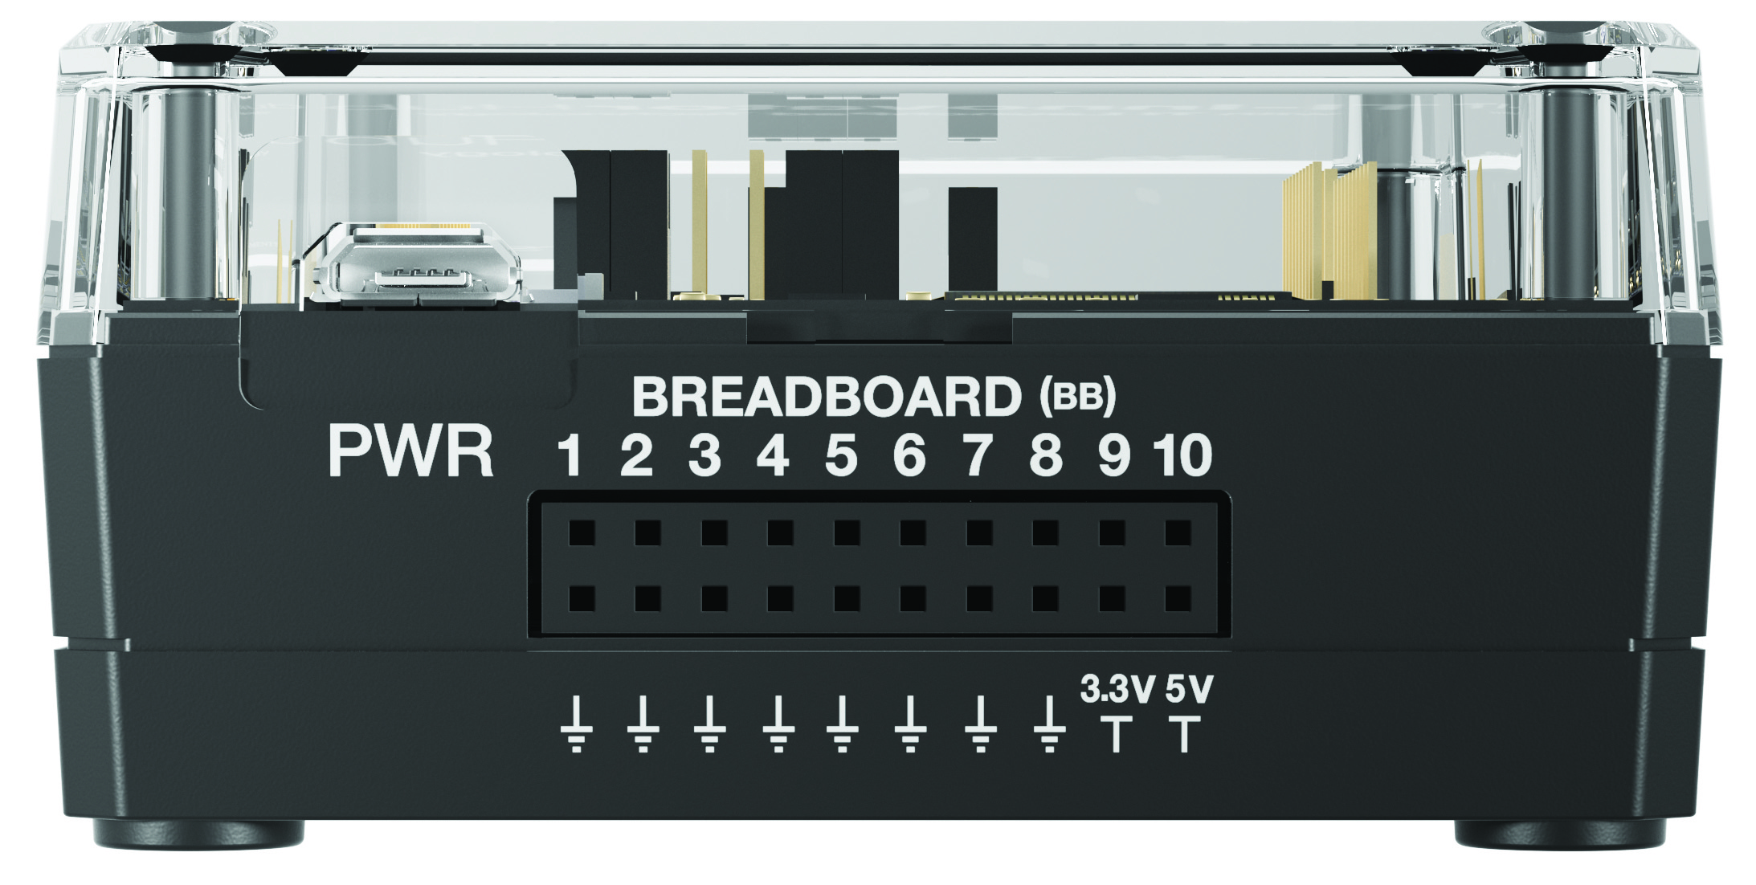
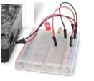
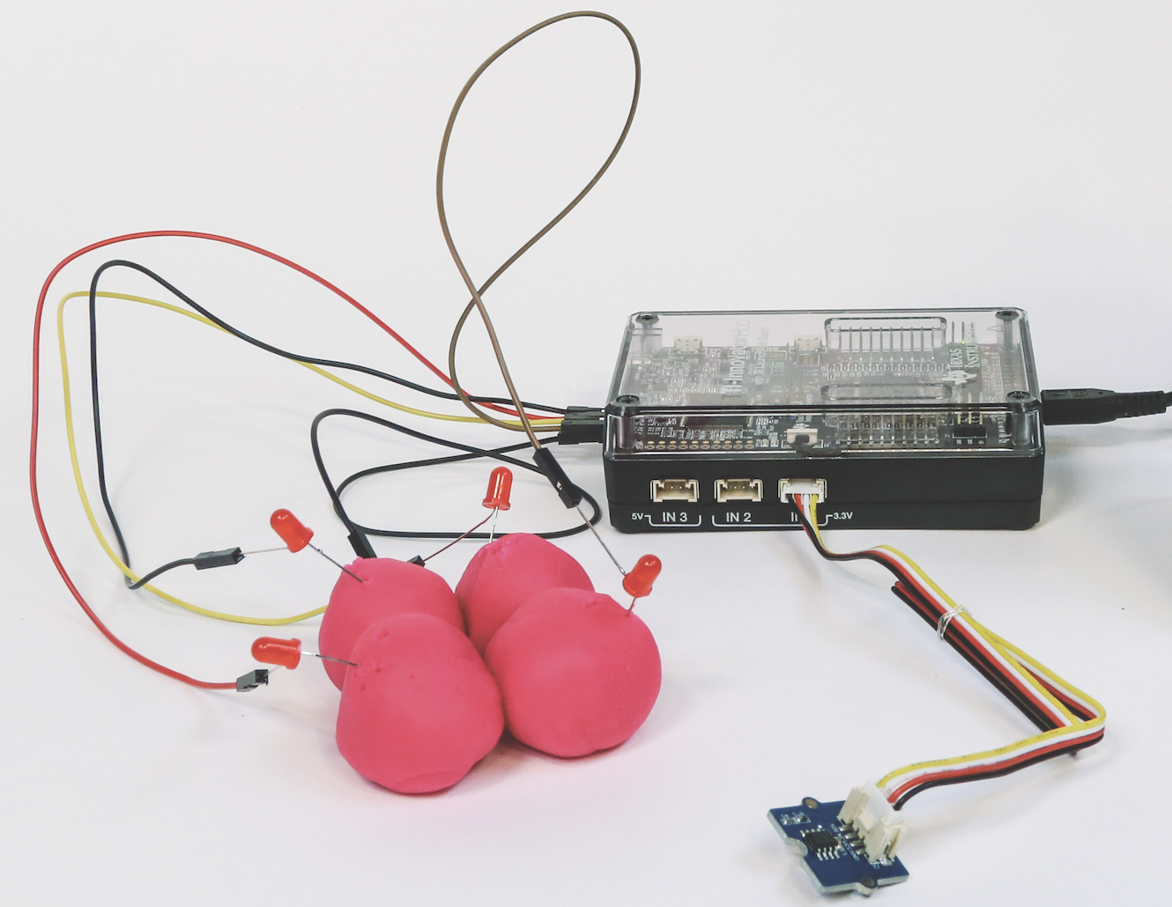

Hub from the Back – breadboard ports
USB Port (micro) connects to external batteries and wall socket.
Connects to computer for updating Hub firmware.
Breadboard ports
Path to STEM Projects with breadboard
RGB Array
Four-Chambered Heart Project

Slide 9
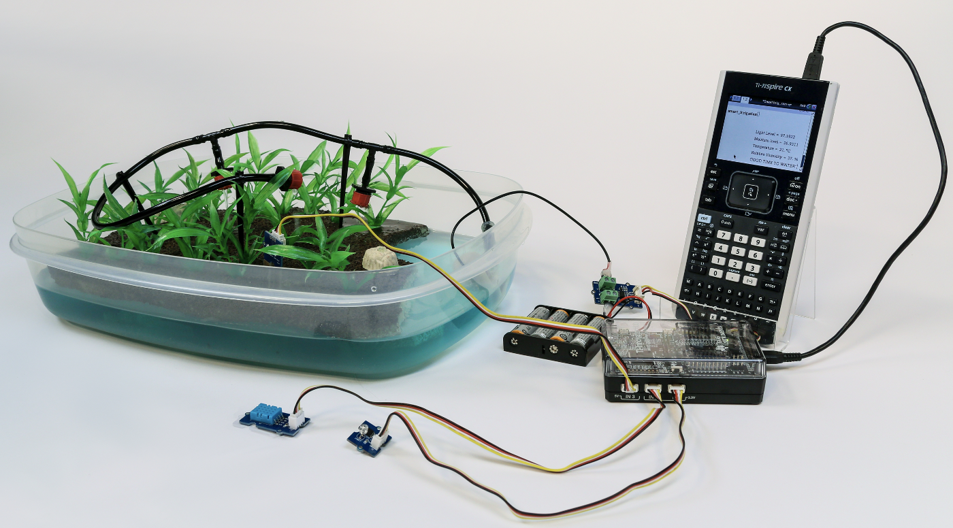
Putting Inputs and Outputs together
in a Smart System
Smart Irrigation Project
Pump
MOSFET
Moisture Sensor
Temperature and Humidity Sensor
Light Level
Sensor

Slide 10
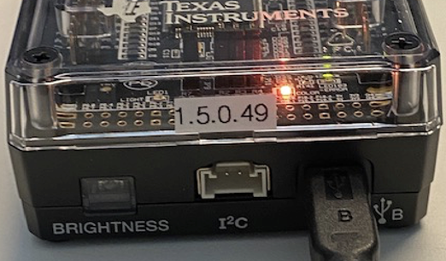
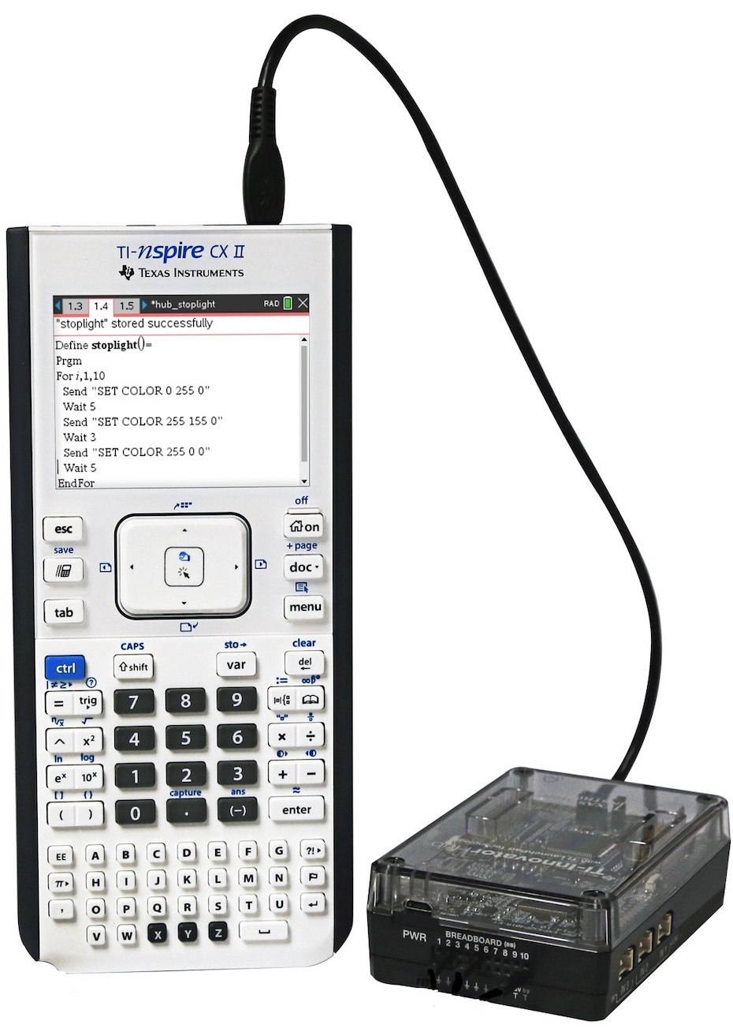
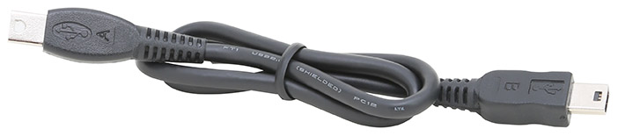
Connecting the Hub to your calculator
Note: The Hub is powered by the calculator. When the cables are connected the Hub goes through a brief “boot-up” process. During the boot-up the RGB LED displays a color that indicates the Hub firmware release, in this case, orange.
1
2
Plug B side of cable into USB B port of the Hub.
Plug A side of cable into port on calculator.
Unit-to-unit cable

Slide 11
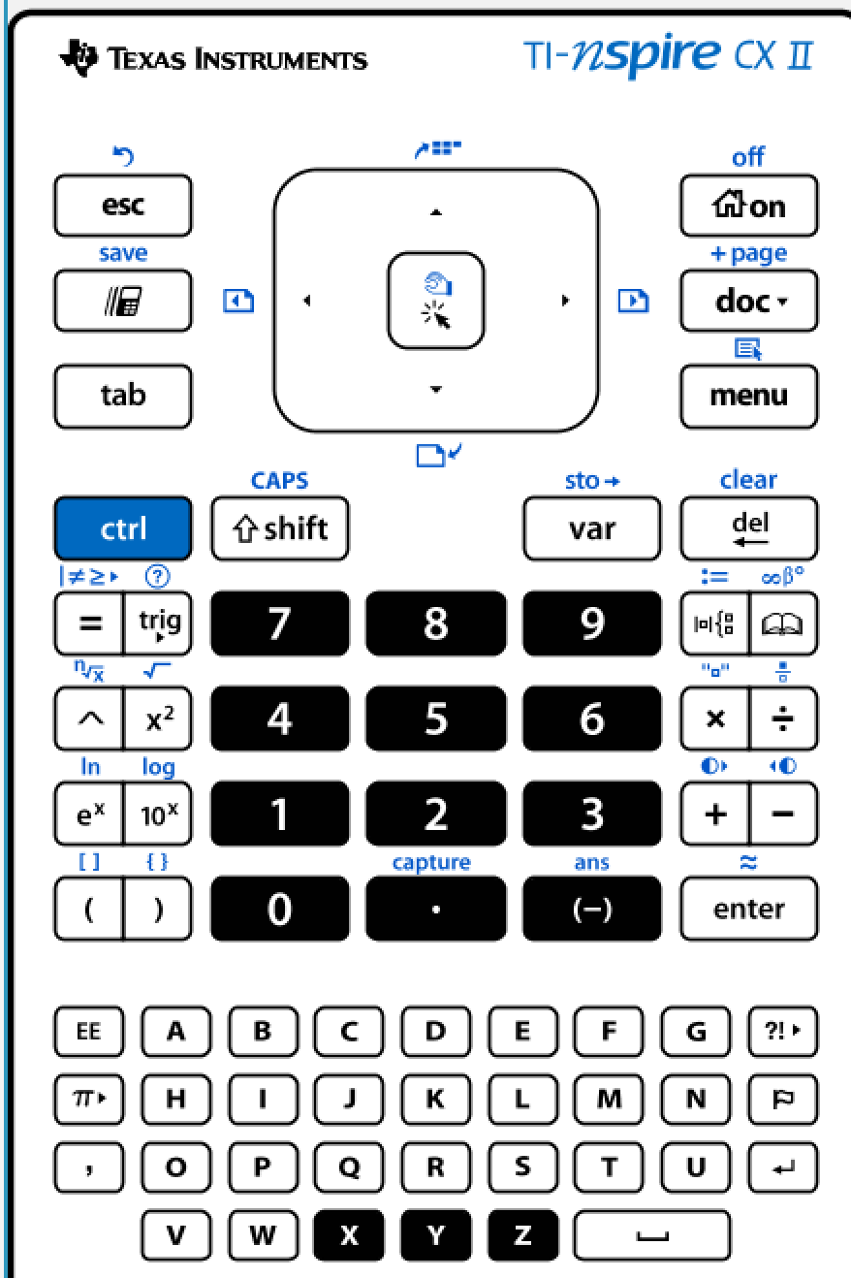
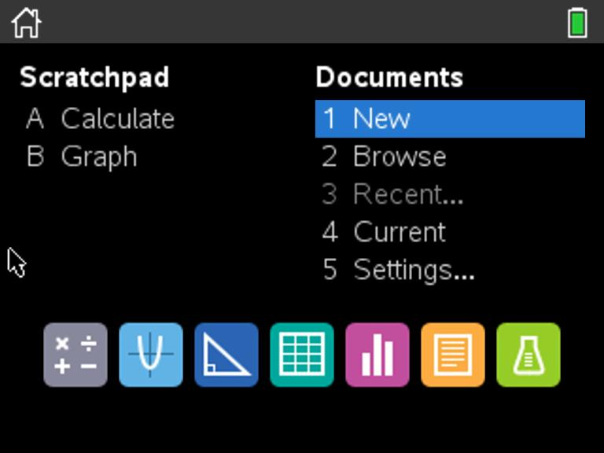
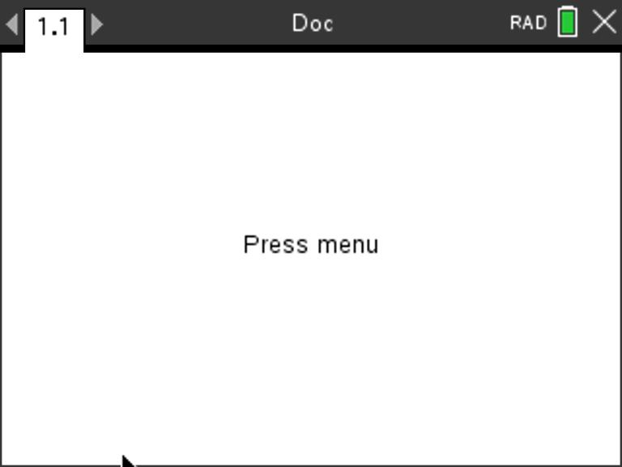
Creating a new TI-Nspire document
1
2
3
Use arrow keys and [enter] or
Press [1] to select 1 New document.
See next slide for steps to add
a program.
Press the [home/on] key to
display the home screen.
Note: If you have a document open, pressing the [home/on] key repeatedly toggles between the home screen and the document.

Slide 12
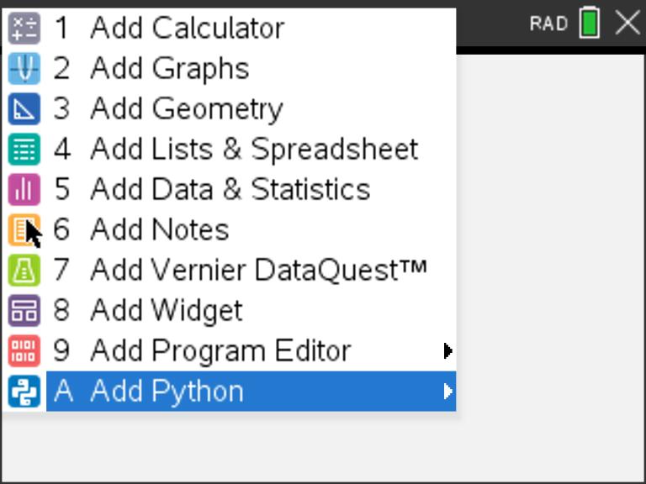
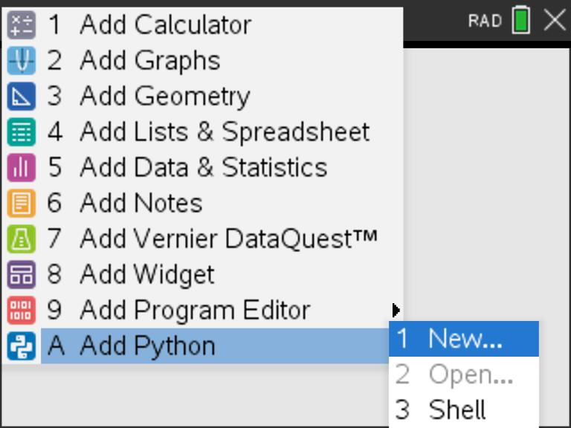
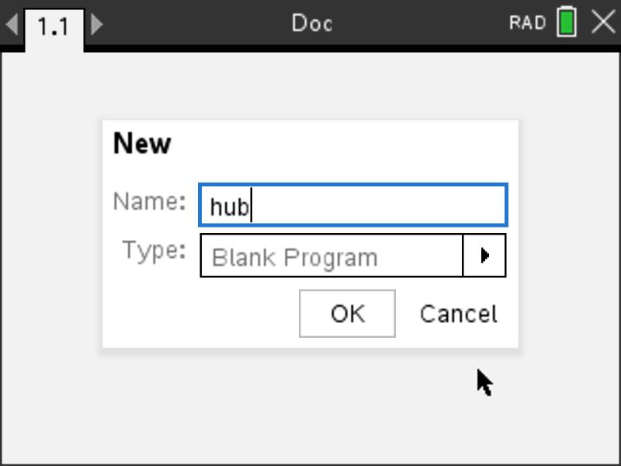
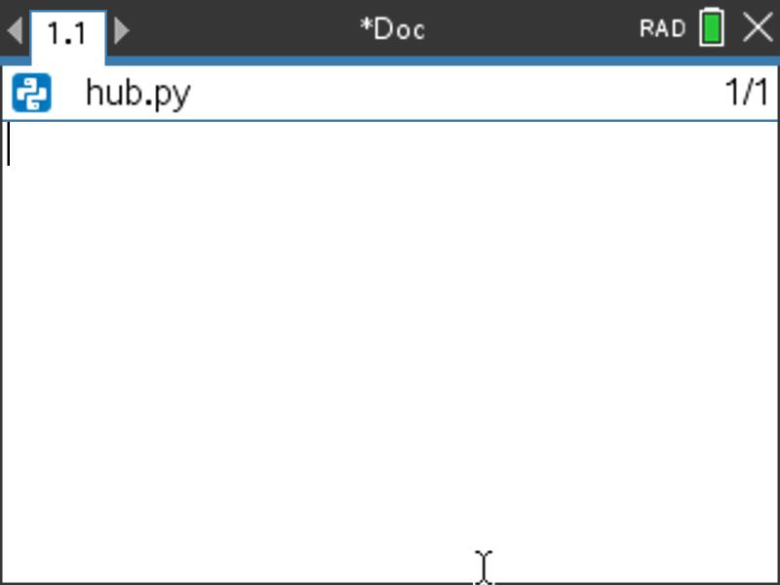
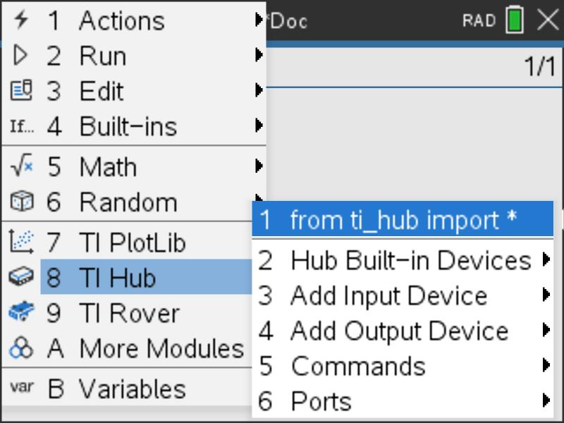
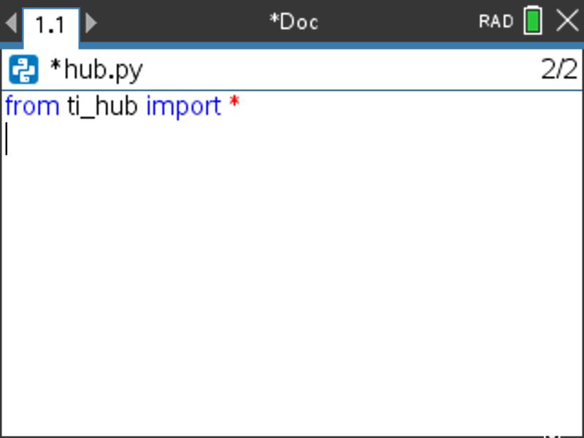
Creating a Hub Program - 1
1
2
3
4
Press [menu] to bring up a menu
of applications to add to the page.
Press down arrow repeatedly then press [enter] or
press [A] to select Add Python.
Select 1: New by pressing [enter] or [1]
Type your program name
and press [enter].
Note: You can also add a new page
to the document by pressing
[ctlr] [doc] +page.
5
6
7
You begin at a blank edit
screen.
Press [menu] then [8] TI Hub [1] Import ti_hub.
Importing the ti_hub module
is required at the beginning of every Hub program.
See step 8 on next page.

Slide 13
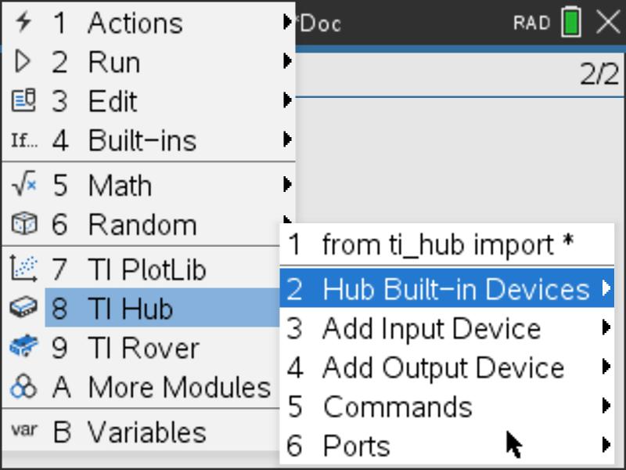
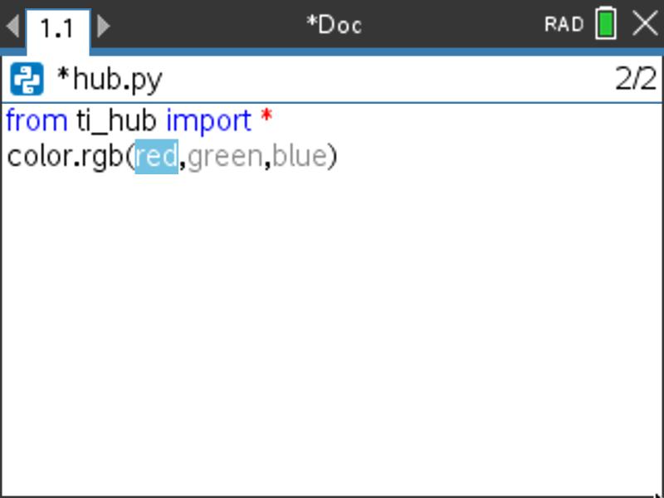
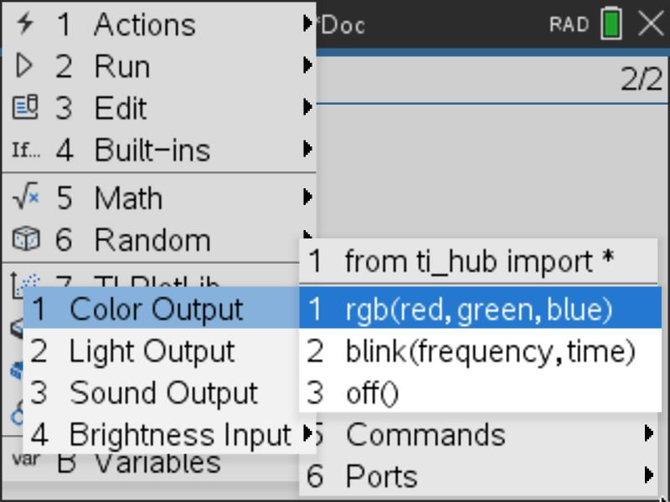
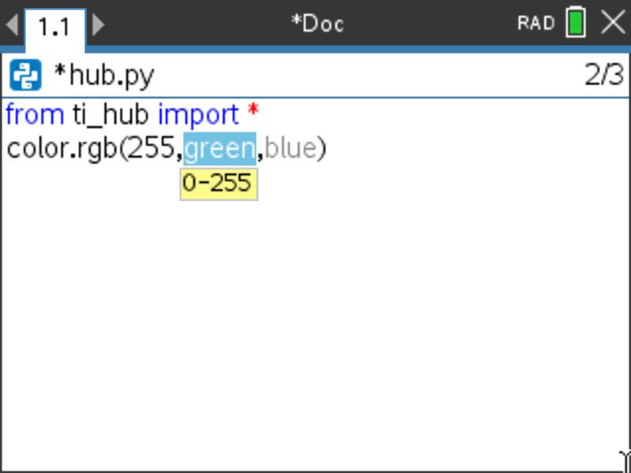
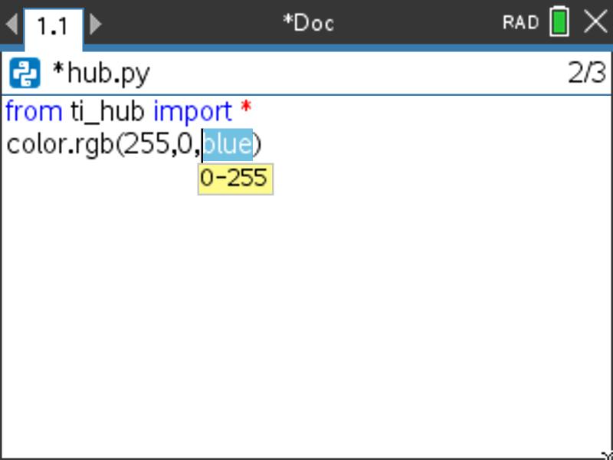
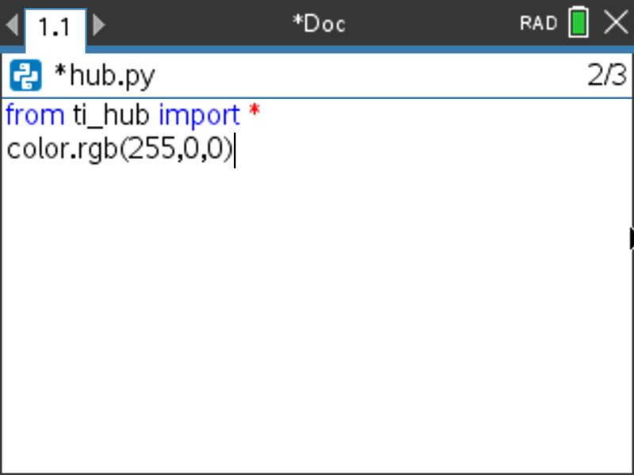
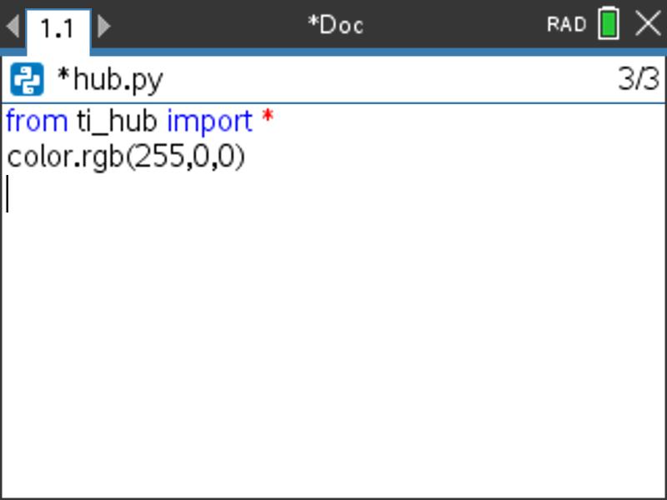
Creating a Hub Program - 2
8
9
Press [menu] then [8] TI Hub
[2] Hub Built-in Devices [1] Color Output
[1] rgb(red,green,blue) to paste to the edit line.
You are prompted to enter values between 0 and 255 for the red, green and blue LED’s.
255 is full power and 0 is off.
Press [tab] to move from prompt to prompt.
10
Right arrow to the end of the line and press [enter] to complete the statement.
A faster approach is to use [ctrl] [enter] from any place on a line to complete the statement and move the cursor to the beginning of the line below.
Note: It is important that each statement begin on a new line.

Slide 14
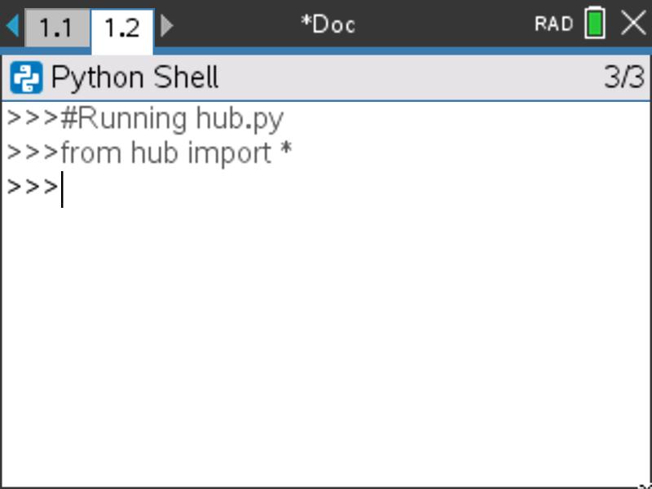
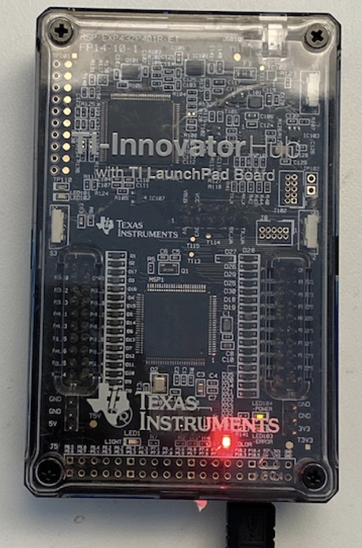

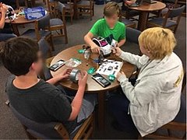
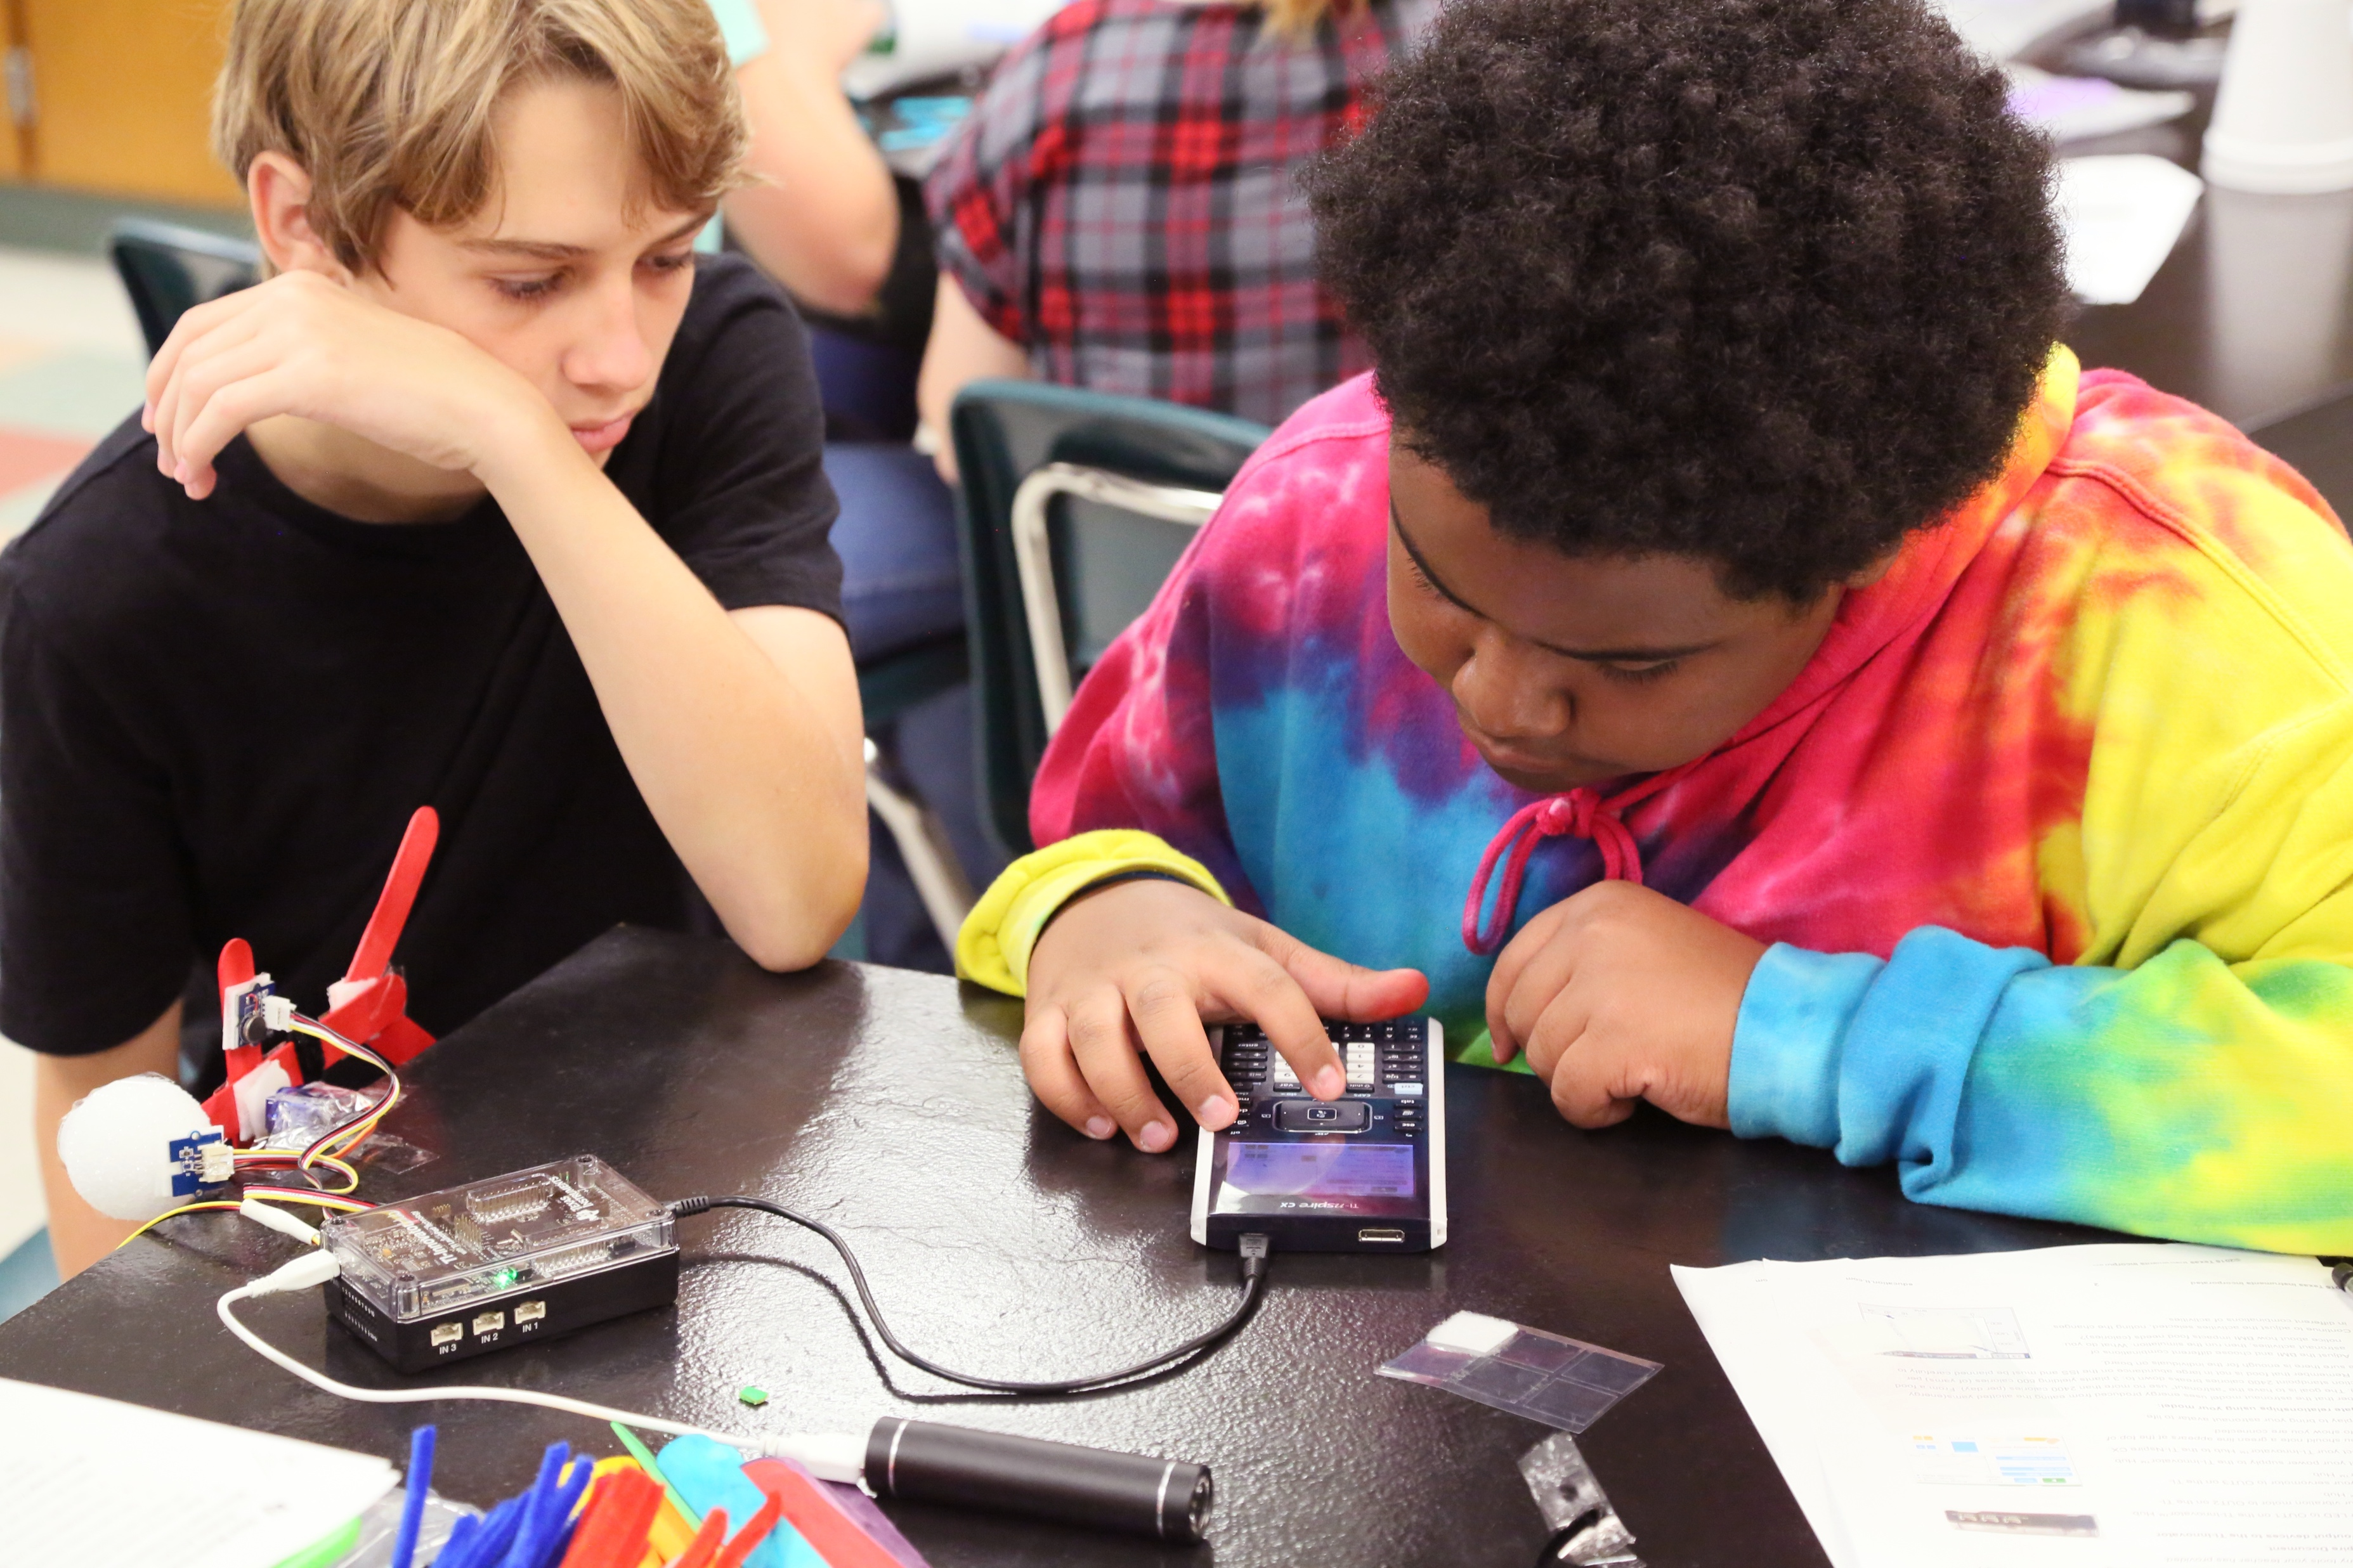
Running a Hub Program
1
2
Press [ctrl] [R] to run the program from a Python shell on the next page.
Note: [ctrl] [R] also checks syntax and stores program changes. [ctrl] [B] is another option for checking syntax and storing. * before the program name indicates that changes have not been stored.
Before running the program
make sure that the calculator and the Hub are connected.
Your program runs in a Python shell.
You can re-run the program from the shell by pressing [ctrl] [R] again.

Slide 15
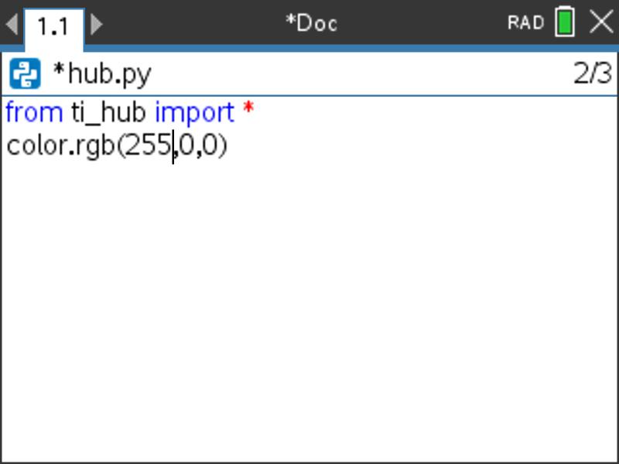
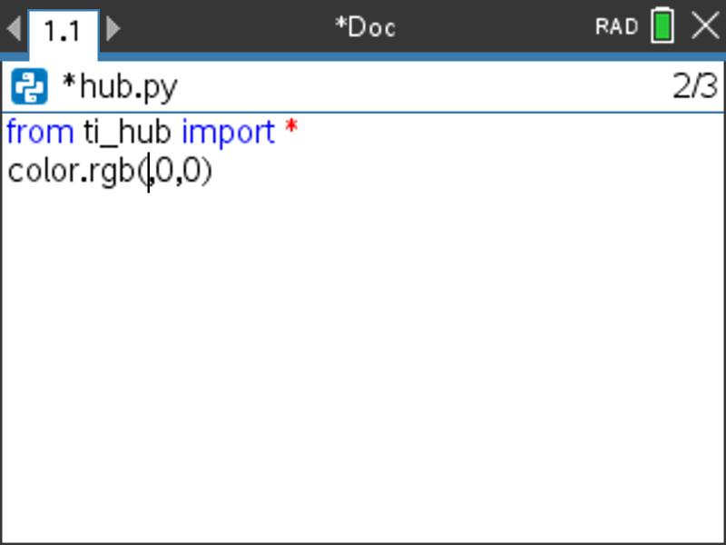
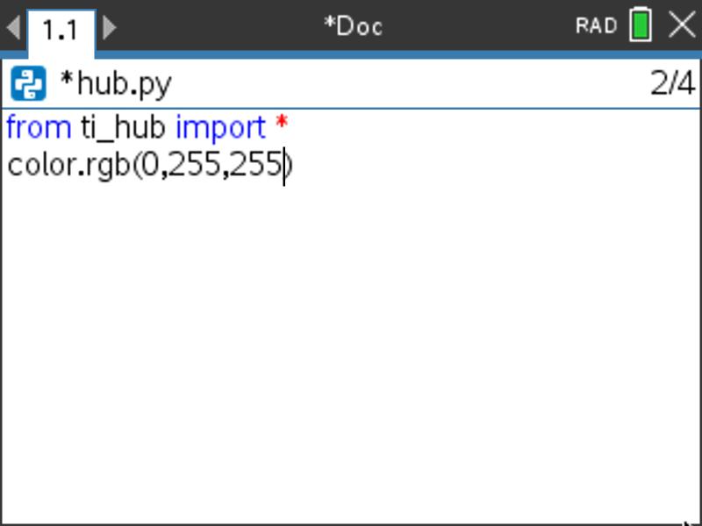



Editing a Hub Program
1
2
3
4
Press [ctrl] left arrow to go back to your Python editor page.
Use the arrow keys to position the cursor to change the red value. Put the cursor just after the current value.
Press [del] repeatedly to backspace over the 255 for the red value.
Type in a new value for red, then
right arrow just past the 0 for
green, use [del] to backspace over the 0 and type a new value for green, then right arrow just past the 0 for blue, use [del] to backspace over the 0 and type a new value for blue.
After entering the last change,
right arrow to the end of the line
and press [enter] to complete the
statement.
Note: A faster approach is to use [ctrl] [enter] from any place on a line to complete the statement and move the cursor to the beginning of the line below.
5
6
Press [ctrl] [R] to run the program again from a Python shell on the next page.

Slide 16




Saving a TI-Nspire document file
Folder where file will be saved.
1
2
3
4
Press [doc] then select 1 File
from the menu by pressing
[enter] or [1].
Select 4 Save or 5 Save As… from the menu.
Type in your file name using alpha and numeric characters.
Note: The name must begin with an alpha character.
Press [enter] to save the file to the
folder indicated above.
To change the folder press the
[UP] arrow key and then use
arrows and [enter] to select a
folder before pressing [enter] to
save the file.
Press [esc] to cancel the save
dialogue.
You can use [ctrl] [S] as a shortcut
to save the TI-Nspire document file.

Slide 17



Copying and Pasting a Block of Code
1
2
3
4
Use arrow keys to move the cursor to the beginning of row below the section of code that you want to copy.
Press and hold [shift] then press UP arrow repeatedly to highlight the rows to be copied. Press [ctrl] [C] to copy the highlighted code.
Use arrow keys to move the cursor to the location that you want to paste from.
Press [ctrl] [V] to paste.
You can paste repeatedly.

Slide 18




Opening an existing TI-Nspire document file
1
2
3
Use arrow keys and [enter] or
Press [2] to select 2 Browse files.
Use arrow keys and [enter] to select a folder and a file.
Note: Pressing the [home/on] key
repeatedly toggles between the home screen and the current document.
Press the [home/on] key to
display the home screen.

Slide 19





Copying a Python Program
1
2
3
Press [ctrl] [B] to compile and save your program.
Note: You will not be able to copy the program if you have made changes since using [ctrl] [R] or [ctrl] [B].
Press [menu] [1] Actions
[3] Create Copy…
Type in your new program name. Press [enter] to complete the dialogue.
The new program is inserted on the page after the original page, in this case page 1.2.

Slide 20

Entry and Edit Tips
Use number key shortcuts or arrow keys and [enter] to select from menus
Use [esc] to back out of a menu or a dialogue.
Use [enter] to complete a dialogue.
Use [tab] to move to the next input when entering a function
Use arrow keys to move the cursor around the screen
Use [del] as a destructive backspace
Use [ctrl] [enter] to complete a statement and move to the next line
Use [ctrl] [Z] to undo an action
Use [ctrl] [S] to save your file
Use [ctrl] [left arrow] and [ctrl] [right arrow] to move from page to page
Use [menu] to see options for the current application.

Slide 21
Color Outputs

Slide 22



Set the color
New Program:
Task: Set the color output of the RGB LED.
Each color takes a value
of (0-255).
Challenge Tasks:
Try to make Yellow
Try to make Cyan
Try to make Magenta
Find the color_rgb( ) function on the Hub Built-in Devices, Color Output menu.
Press [menu] key to see Python Program Editor options.
Press [tab] key to move to the next input in a function.
Press [crtl] [enter] to complete a statement and move to the next line.
Press [ctrl] [R] to run the program from a Python shell on the next page.
Use [ctrl] left to move from the shell page back to the Python editor page.
Notes:
Explain import ti_hyb module
Then demo how to import and how to enter the statements.
Give time to explore.

Slide 23



Create and Name a Color
Add to previous Program:
Task: Create your own color and give it a name.
Challenge Tasks:
Print the name of your color.
Find the print() function on the Hub Built-in Device I/O (Input/Output) menu. Print your message as a text string by enclosing the characters in quotes. Add quote marks by pressing [ctrl] [x] (multiply symbol).
Press [menu] key to see Python Program Editor options.
Press [tab] key to move to the next input in a function.
Press [crtl] [enter] to complete a statement and move to the next line.
Press [ctrl] [R] to run the program from a Python shell on the next page.
Use [ctrl] left to move from the shell page back to the Python editor page.
Notes:
Explain import ti_hyb module
Then demo how to import and how to enter the statements.
Give time to explore.

Slide 24



Display a series of colors.
Extra
Add to previous program:
Task: Display a sequence of colors for 2 seconds each.
Challenge Tasks:
Try to have your LED match the pattern of a traffic light.
Try to have your LED turn off at the end of the sequence.
sleep() causes the program to wait the number of seconds entered before moving to the next statement.
Find the sleep() function on the Hub Commands menu.
Press [menu] key to see Python Program Editor options.
Press [tab] key to move to the next input in a function.
Press [crtl] [enter] to complete a statement and move to the next line.
Press [ctrl] [R] to run the program from a Python shell on the next page.
Use [ctrl] left to move from the shell page back to the Python editor page.
Notes:
Explain import ti_hyb module
Then demo how to import and how to enter the statements.
Give time to explore.

Slide 25




Turn the LED ON and OFF
Extra
Task: Set the RGB LED to a color then keep ON for 2 seconds then turn the LED off for 2 seconds.
Challenge Tasks:
Try to blink (turn on and turn off) 4 times
Try to blink 4 times in 8 seconds
New Program:
What values for the red, green and blue inputs to the color.rgb() function will turn the LED off?
See below for steps to copy and paste a block of code.
Press [menu] key to see Python Program Editor options.
Press [tab] key to move to the next input in a function.
Press [crtl] [enter] to complete a statement and move to the next line.
Press [ctrl] [R] to run the program from a Python shell on the next page.
Use [ctrl] left to move from the shell page back to the Python editor page.
Use arrow keys to move cursor to row below the section you want to copy
Press and hold [shift], press UP arrow to highlight
[ctrl] [C] to copy, move cursor to location to paste from, [ctrl] [V] to paste.
Notes:
Explain import ti_hyb module
Then demo how to import and how to enter the statements.
Give time to explore.

Slide 26



Blink the LED Repeatedly
Extra
New Program:
Task: Set the RGB LED to a color and then blink 10 times
(ON for 2 seconds then OFF for 2 seconds)
Challenge Tasks:
Try to blink 30 times in a minute
Try to blink 60 times in a minute
Find for index in range(size): on the Built-ins Control menu.
Enter n as the loop counter variable and 10 as the value for the loop size. n starts with a value of 0. Each time the loop completes n is increased by 1. If n is less than loop size value looping continues, otherwise looping stops and the program moves to the next statement after the block.
Notes:
Explain import ti_hyb module
Then demo how to import and how to enter the statements.
Give time to explore.

Slide 27
Sound Outputs

Slide 28



Play a Sound Tone
Task: Play a sound tone by entering a value for frequency (sound vibrations per second) and a value for time in seconds to play the tone.
Note: Human voices tend to be in the 85 to 255 Hertz (vibrations per second) range.
What is the lowest tone that you can hear?
What is the highest tone that you
can hear?
New Program:
Find the sound.tone( ) function on the Hub Built-in Devices, sound Output menu.
Press [menu] key to see Python Program Editor options.
Press [tab] key to move to the next input in a function.
Press [crtl] [enter] to complete a statement and move to the next line.
Press [ctrl] [R] to run the program from a Python shell on the next page.
Use [ctrl] left to move from the shell page back to the Python editor page.
Notes:
Explain import ti_hyb module
Then demo how to import and how to enter the statements.
Give time to explore.

Slide 29



Find your Favorite Sound Tone
Task: Play a sound tone by entering a value for frequency (sound vibrations per second) and a value for time in seconds to play the tone.
Find your favorite frequency.
Challenge Tasks:
Give your frequency a name and print the name.
Add to previous Program:
avo
Find the sound.tone( ) function on the Hub Built-in Devices, sound Output menu.
Find the print() function on the Hub Built-in Device I/O (Input/Output) menu. Print your message as a text string by enclosing the characters in quotes. Add quote marks by pressing [ctrl] [x] (multiply symbol).
Press [menu] key to see Python Program Editor options.
Press [tab] key to move to the next input in a function.
Press [crtl] [enter] to complete a statement and move to the next line.
Press [ctrl] [R] to run the program from a Python shell on the next page.
Use [ctrl] left to move from the shell page back to the Python editor page.
Notes:
Explain import ti_hyb module
Then demo how to import and how to enter the statements.
Give time to explore.

Slide 30

Sound Frequencies and
Musical Notes
Extra
Middle C
A440
Sound tone frequencies map to musical notes.
Middle C (C4) on the piano keyboard has a frequency of 261.6 Hertz.
A440 (A4) is used by orchestras for tuning.
See Coding the Sounds of Music project for an in-depth treatment of digital music
with the Hub. https://education.ti.com/en/activities/stem-projects/making-music-with-code

Slide 31

Play a Musical Note
Extra
Task: Enter and play the doorbell tones using the sound.note() function.
Create your own doorbell tone.
New Program:
It is important to pause the program with a sleep() function between sounds. This allows the sound to play completely before the program starts the next sound. (Try playing multiple sounds without sleep() functions.)
If you want to have a short silence between sounds add an additional .1 seconds to the sleep function, sleep(.5+.1) or insert an additional sleep(.1) between sounds.
Find the sleep() function on the Hub Commands menu.
Press [menu] key to see Python Program Editor options.
Press [tab] key to move to the next input in a function.
Press [crtl] [enter] to complete a statement and move to the next line.
Press [ctrl] [R] to run the program from a Python shell on the next page.
Use [ctrl] left to move from the shell page back to the Python editor page.
Notes:
Explain import ti_hyb module
Then demo how to import and how to enter the statements.
Give time to explore.

Slide 32




Play the Notes of an Octave
Extra
New Program:
Task: Write a program to play each note of Do-Re-Mi-Fa-Sol-La-Si-Do as whole notes.
This is an entire octave.
Recall at 100 BPM a whole note lasts for 2.4 seconds. The first note Do is "C4" and the last note Do is "C5".
Include a .1 second rest between notes.
The steps for copying and pasting blocks of code may be helpful.
Press [menu] key to see Python Program Editor options.
Press [tab] key to move to the next input in a function.
Press [crtl] [enter] to complete a statement and move to the next line.
Press [ctrl] [R] to run the program from a Python shell on the next page.
Use [ctrl] left to move from the shell page back to the Python editor page.
Use arrow keys to move cursor to row below the section you want to copy.
Press and hold [shift], press UP arrow to highlight.
[ctrl] [C] to copy, move cursor to location to paste from, [ctrl] [V] to paste.
Notes:
Explain import ti_hyb module
Then demo how to import and how to enter the statements.
Give time to explore.

Slide 33
BRIGHTNESS (LIGHT Level) inputs

Slide 34




Measure Brightness
Task: Enter and run the program to measure brightness.
What is the light level in your room?
Try shining a light on the brightness sensor.
Try covering the brightness sensor.
New Program:
Find while get_key() != "esc": on the Hub Commands menu. This sets up a loop that will run until the escape key is pressed.
Find the brightness.measurement() function on the Hub Built-in Devices, Brightness Input menu.
Store the result to a variable named b.
Start your statements with b=, then add brightness.measurement().
Find print( ) on the Built-ins I/O (Inputs/Outputs) menu.
.
Brightness
sensor
Press [menu] key to see Python Program Editor options.
Press [tab] key to move to the next input in a function.
Press [crtl] [enter] to complete a statement and move to the next line.
Press [ctrl] [R] to run the program from a Python shell on the next page.
Use [ctrl] left to move from the shell page back to the Python editor page.

Slide 35



Control an RGB LED with Brightness Measurements
Extra
Task: Add brightness.range(0,255) to the program to set brightness measurements to be from 0 to 255 instead of 0 to 100.
Use the brightness values stored in variable b as inputs for some or all of the color.rgb(red,green, blue) inputs.
Try shining a light onto the Brightness sensor.
Challenge Task:
Try to make a night light that sets the color.rgb() to gets brighter as the light level dims.
Add to previous Program:
Find the brightness.range() function on the Hub Built-in Devices, Brightness Input menu. If you do not set the range in your program the brightness values will be 0 to 100.
Brightness
sensor
Press [menu] key to see Python Program Editor options.
Press [tab] key to move to the next input in a function.
Press [crtl] [enter] to complete a statement and move to the next line.
Press [ctrl] [R] to run the program from a Python shell on the next page.
Use [ctrl] left to move from the shell page back to the Python editor page.

Slide 36
Thank You
www.TIstemProjects.com
Contact stem-team@ti.com with questions

