Slide 1
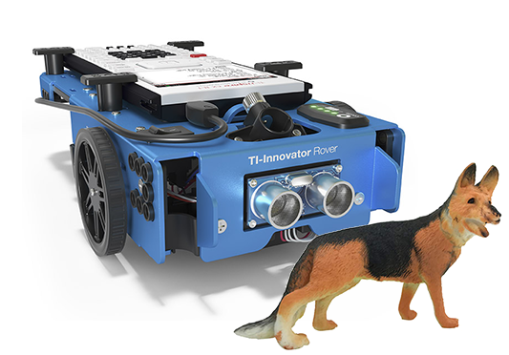
Rover, Watch Out for Rover!
Challenge: Drive Rover as close as you can to the dog without hitting him.
Supplies: Tape measure and masking tape to mark your starting point.
Team Name: The most clever name will be used for tie breaking.
Code: Your program can only use the following drive function.
rv.forward_time(5)
Judging: When your group is ready, the judge will place the pooch in the road at a random distance from Rover’s bumper. You may not move the mutt or Rover once the pet is placed. You may only change the value of time in the Rover drive command. Competition distance between bowser and the bumper will be reported in cm. Don’t hit the hound!
Enter number of seconds to drive Rover forward.

Slide 2
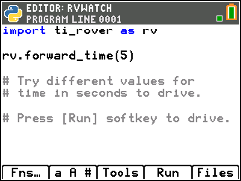
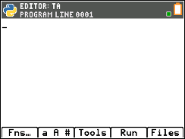
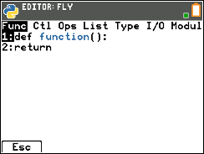
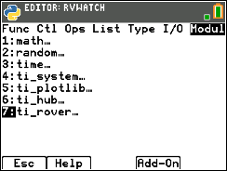
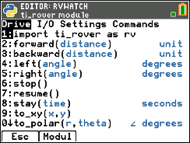
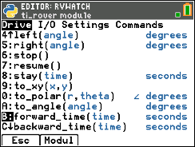
Watch out for Rover Program
import ti_rover as rv
is available from the rover Drive menu.
[Left Arrow]
to Modul
menu
Select
7: ti_rover…
Select 1:import ti_rover as rv
rv.forward_time( )
is available from the rover Drive menu.
Select item B:forward_time( )

