Slide 1
Project Overview

Slide 2
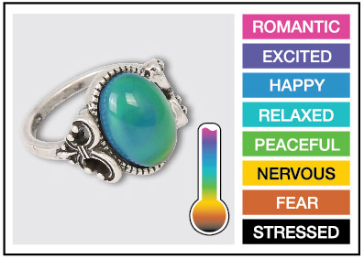
Mood Rings: How do they work?
Background:
The mood ring was invented by Joshua Reynolds. Mood rings enjoyed fad popularity in the 1970s and are still around today. The stone of the ring changes color, supposedly according to the mood of the wearer. The 'stone' of a mood ring is really a hollow glass shell containing thermotropic liquid crystals. Modern mood rings are made from a flat plastic strip containing liquid crystals that is inserted into the hollow glass and mounted within the bezel of the mood ring.
Notes:
Introductory mini-project for feedback and control systems. The project includes external inputs (temperature sensor), decision logic based on the temperature sensor reading and an output (Red-Green-Blue LED).

Slide 3
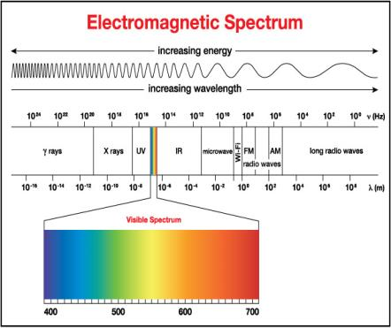
Mood Rings: How do they work?
The crystals respond to changes in temperature by twisting in a regular way. The twisting changes their molecular geometry, which alters the wavelengths of light that are reflected from the crystals.
Wavelengths of light are another way of saying color, so when the temperature of the liquid crystals change, so does the color reflected from the stone. Thus, the ring changes color with the hand temperature of the wearer.

Slide 4
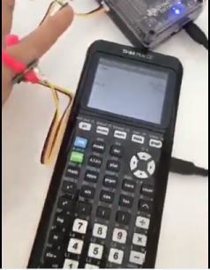
Time to DIY: Digital Mood Ring!
The Design Challenge:
Design and build a digital mood ring using the pipe cleaner that fits snugly on your finger, placement should be similar to any ring worn on the finger. Be sure the flat part of the temperature sensor is touching your skin.
In this project, you will investigate:
temperature measurement using a temperature sensor and then build a digital mood ring that changes the color of the Hub’s Red, Green, and Blue (RGB) light emitting diode (LED) as the temperature your finger changes.
You can even display what mood you are in on your calculator!
Notes:
This project is an ideal introduction for students using the TI-Innovator for the first time. The “DIY- Mood Ring” project includes many of the fundamental concepts that are used in feedback and control projects. The project sets the stage for working through the more advanced Pet Car Alarm and Smart Irrigation projects.
Objectives that will be covered:
Science Concepts: additive color model, electromagnetic spectrum (optional)
TI-Technology Concepts: TI-Innovator™ overview, connecting TI-Innovator™ to handheld with unit-to-unit cable (connector with B label in the DATA port of the TI-Innovator), Hub menu for creating commands to send to the TI-Innovator™
Computing Concepts: physical outputs, numeric arguments for commands

Slide 5
Mood Ring Project Tasks:
Students are acquainted with the Mood Ring project and the graphing calculator platform. Create and execute a program to display “Hello World”.
Students are acquainted with the TI-Innovator Hub. Create and execute a program using COLOR command to display different colors using the Red-Green-Blue LED.
Students create a program that connects an external temperature sensor, reads values from the sensor and then displays values from the sensor. Students use the pipe cleaner to connect the TI-Innovator and temperature sensor to form a “ring.”
Students build on the program from above to use if-then logic to control COLOR outputs based on temperature readings to create a digital mood ring.

Slide 6
Project Concepts

Slide 7
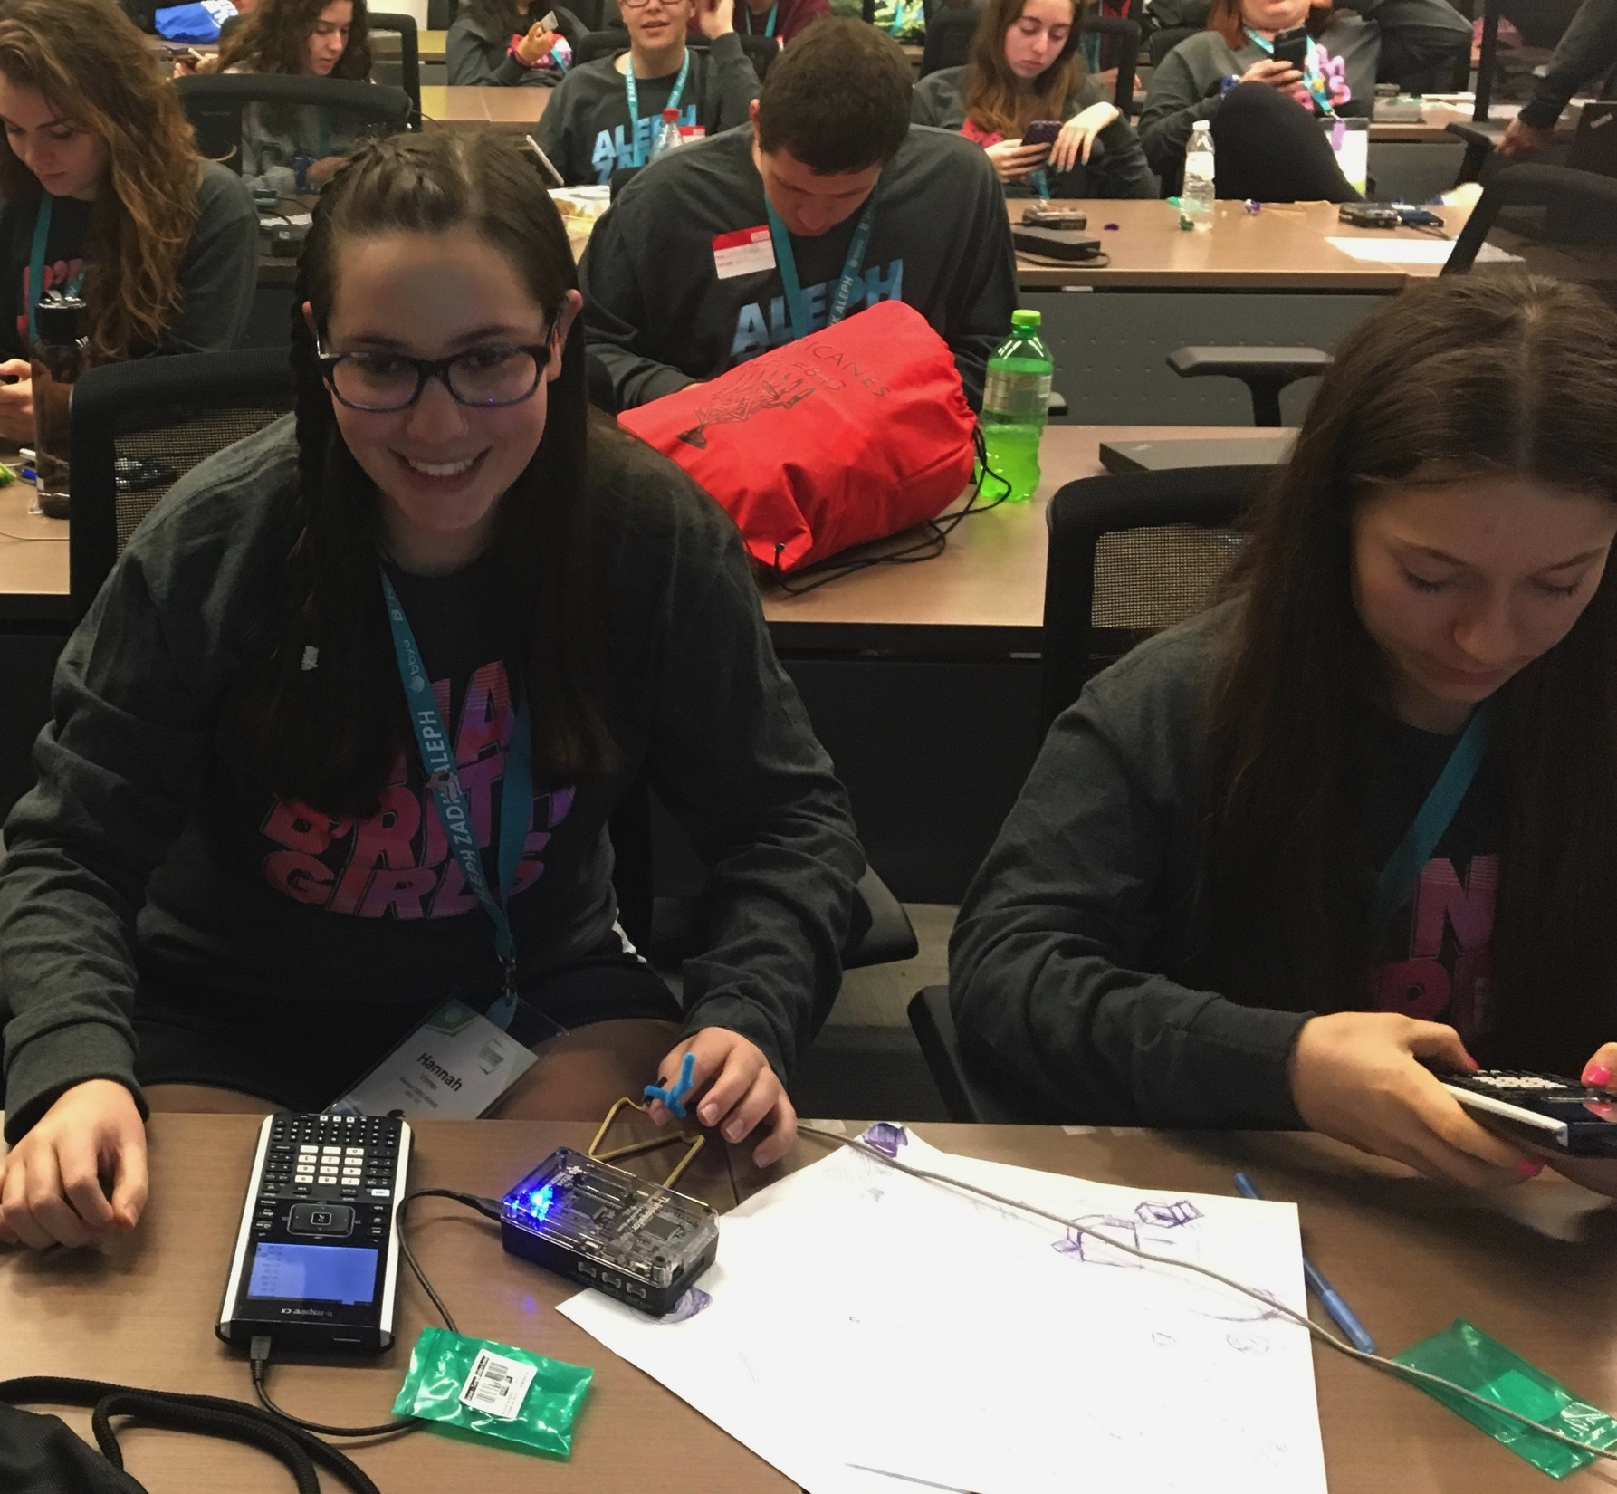
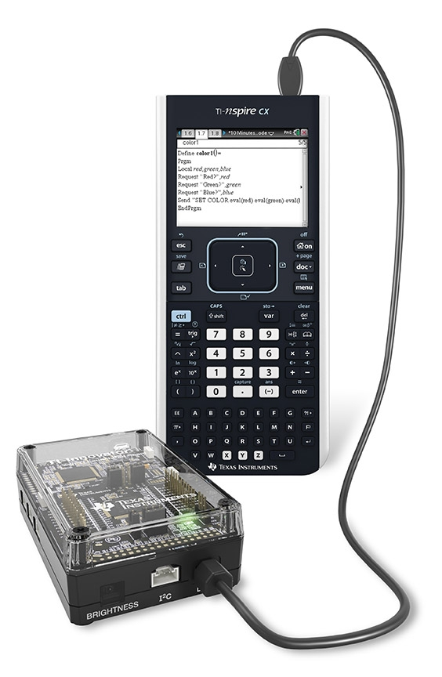
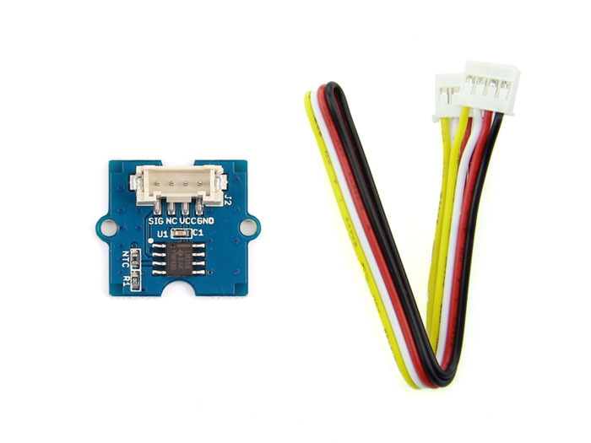
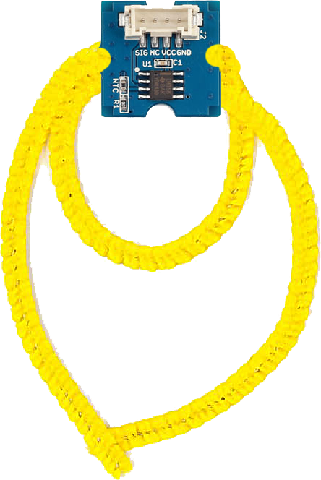
Digital Mood Ring (introduction to STEM and coding Projects for all levels)
Bring science and coding together (no coding experience necessary) while developing a mood ring! Explore the science of color mixing while determining the right body temperature thresholds.
This is an excellent first TI-Innovator STEM and coding project. The project includes variables, loops, conditional statements, Boolean operators and other fundamental programming concepts.
Use “Digital Mood Ring by challenges” document at URL http://bit.ly/2oqU1X8

Slide 8
Digital Mood Ring Challenges
Challenge 1: Use SET COLOR to explore using the color LED. Try to find the RGB values of all the colors in the mood chart.
Challenge 2: Use DispAt command to display your name at several locations on the screen.
Challenge 3: Use a For..EndFor loop to display the numbers 1 through 10.
Challenge 4: Connect a temperature sensor to the TI-Innovator Hub and display the temperature on the calculator.
Challenge 5: Use a loop to read and display temperature.
Challenge 5 Extension (Optional): Use a loop to read, display and log into list arrays for time and temperature. Graph the result.
Challenge 6: Use a While..EndWhile loop along with getKey() command to monitor temperature and make a decision to display a message, “Hot” or “Cold”. Then modify your program to include a 3rd level between hot and cold, “Nice”.
Final Challenge: Build a mood ring to repeatedly read the temperature sensor, determine the mood of the person, display the temperature value and display the mood.
Use “Digital Mood Ring by challenges” document at URL http://bit.ly/2oqU1X8

Slide 9
Summary of programming concepts in the project
Control of a red-green-blue LED output
  Send “SET COLOR 255 0 0”
Display of text strings, variable values and expressions
  DispAt 5,“Temperature=“,t,”°C”
  DispAt 4,”Time=“,n*0.5,”sec”
For loops to repeat a set of commands a specified number of times
  For n,1,10
  commands within loop
  EndFor
Connecting, reading and getting to a variable temperature sensor inputs
  Send “CONNECT TEMPERATURE 1 TO IN 1”
  Send “READ TEMPERATURE 1”
  Get t
Storing variables to variables using the assign operator, :=
  f:=9/5 x t+32
List variables of a set of values and accessing individual elements of the list using the position number.
  time:={0.5,1,1.5,2}
  time[5]:=2.5
  True/False comparison operators used in conditional statements for program control: =,≠,<,≤,>,≥
Assignment of initial values to variables to give the program known starting points.
  key:=“ “
  time:={ }
While loops to repeat a set of commands while a condition is true
  While key≠”esc”
  commands within loop
  EndWhile
Keyboard inputs using the TI-Nspire getKey command that returns a text string of the name of the last key pressed
  key:=getKey()
If-Then conditional statements that do a set of commands if a condition is true and are skipped if the condition is false
  If t<22 Then
  commands within If-Then block
  EndIf
Boolean operator and to require two conditional statements to be true for the entire statement to be true
  If t≥22 and t<25 Then

Slide 10
Summary of TI-Nspire concepts and skills
Home/On key to turn the calculator on and to return to the home screen, which is a jumping off point for managing the calculator.
TI-Nspire document files combine a set of pages containing apps. Apps include calculator, program editor, grapher and others.
Home screen document management includes
  New document to start a new document file
  My Documents to view and manage documents
  Current returns to the document that is open
Select from menus using arrow keys and enter or by the shortcut of the number or letter preceding the menu item
The keyboard is divided into three sections:
  Alpha entry (bottom)
  Math entry (middle)
  Navigation and document management (top)
Press and release the ctrl key to access function labeled above the keys.
esc key to back out of menus and dialogues
ctrl-z to undo, ctrl-c to copy, ctrl-x to cut, ctrl-v to paste
ctrl-s to save the document
The delete key is a destructive backspace
  ctrl-doc key (+page) to add a page to a document
  Move from page to page in a document by using ctrl left arrow and ctrl right arrow or by using the touchpad to move the pointer to the page number tab and center clicking
  The menu key brings up selections that are available in each app
Use the program editor app to create and edit programs.
Use Check Syntax and Store to update changes made to programs before running the program.
  ctrl-r and ctrl-b are useful shortcuts on the Check Syntax and Store menu.
  ctrl-r, Run, checks syntax, stores and pastes the program name to a calculator page
Programs are run on the calculator app
  Type or paste the program name on a blank row, then press enter to run the program
Use the var, variable, key to view and access the variables in a document
Use the catalog (book symbol) key to see a menu of all the functions in the calculator

Slide 11
Standards
NGSS 3-D Standards
  MS-PS1-1 Matter and its Interactions
    PS1-A Structure and Properties of Matter- solids may be formed from molecules, or they may be extended structures with repeating subunits (e.g., crystals
  Science and Engineering Practice:
    Developing and using Models
      Develop a model to predict and/or describe a phenomenon
  Crosscutting Concept:
    Within a natural system, the transfer of energy drives the motion of matter
Notes:
Other Relevant connections/Discussion
:
The physics of the actual liquid crystal address MS-PS1-1
https://www.youtube.com/watch?v=1yrtW9Licdo
The biology of blood flow and mood is a life science topic. The flight or fight autonomic response.
This is a basic example of an engineering feedback and control system, a fundamental programming structure used in all Hub projects.
It has a crosscutting concept with the human body’s homeostasis system.

Slide 12
Background: The Electromagnetic Spectrum

Slide 13
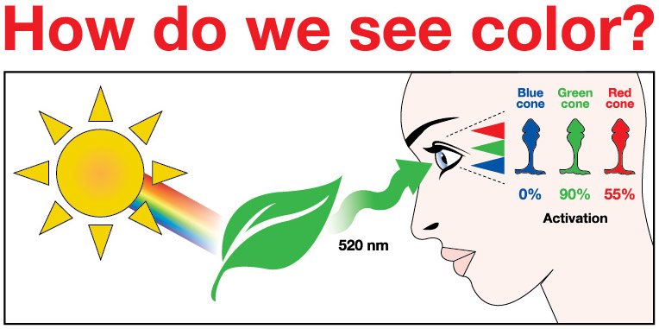
Notes:
The human eye has three different types of ‘cones’ on the retina- Red, Blue, and Green. These cones will be activated differently, by different wavelengths of light.
1. All the colors of the visible light spectrum shine on the leaf, but in this case, only light with 520 nm (green light) bounce off.
2. The surface of a green leaf absorbs all of the other colors of the spectrum, except for green, and reflects green to the human eye. Green light reflected stimulates the eye’s cone cells to varying degrees. Which wavelengths are reflected or absorbed depends on the properties of the object.
3. Humans would not be able to see color or objects without LIGHT! Light has to reflect off an object in order to see it.
Different combinations (%) of activation of the 3 types of rods will allow the brain to perceive signals from the retina as different colors. Some estimate that humans are able to distinguish about 10 million colors.

Slide 14
TI-Nspire CX Resources:
Step-by Step YouTube videos designed for the teacher with a detailed, demonstration of each challenge. The videos are intended to guide those new programming in general, programming on the TI-84 Plus CE and programming with the TI-Innovator Hub.
  https://www.youtube.com/playlist?list=PL17Fe0ZmhCR_j09b202PUI0wfaRYSLQka
10 Minutes of Code Teacher’s Lounge (TI-Nspire CX): For a single download of all lessons for 10 Minute of Codes for the TI-Nspire CX in PDF’s:
  https://education.ti.com/en/activities/ti-codes/nspire/teacher-lounge
TI-Innovator Technology eGuide
  https://education.ti.com/html/webhelp/EG_Innovator/EN/index.html
TI-Innovator Hub Commands
  https://education.ti.com/html/webhelp/EG_Innovator/EN/content/eg_innovsys/resources/pdf/ti-innovator_hub_commands_en.pdf
TI-Nspire CX Programming Editor Guide
  https://education.ti.com/html/webhelp/EG_TINspireCode/EN/index.html
YouTube Video (informal, but TI produced) gives you the basics of writing and running TI-Nspire programs that control the TI-Innovator.
  https://www.youtube.com/watch?v=2jjncu8Aba0

Slide 15
Project Final Challenge

Slide 16
Final Challenge
Digital Mood Ring with TI-Nspire and
TI-Innovator™ Hub student STEM project
Final Challenge: Build a mood ring to repeatedly read a temperature sensor, determine the mood of the person, display the temperature value and display the mood.

Slide 17
Chenille Wire (AKA “Pipe Cleaner”)

Slide 18
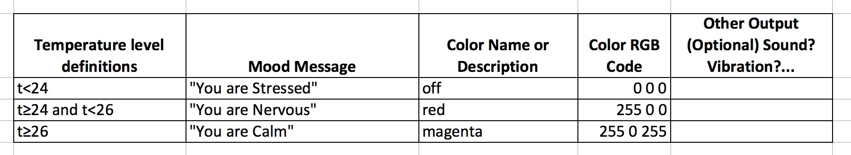
Defining your digital mood ring

Slide 19
Digital Mood Ring for TI-Nspire
Simple Example Program
Send "CONNECT TEMPERATURE 1 TO IN 1"
key:=” "
DispAt 8,”Press esc key to quit”
While key≠"esc”
key:=getKey()
Send "READ TEMPERATURE 1”
Get t
DispAt 4,"Temp =",t,"°C”
If t<24 Then
Send "SET COLOR 0 0 0”
DispAt 5,"You are STRESSED”
EndIf
If t≥24 and t<26 Then
Send "SET COLOR 255 0 0”
DispAt 5,"You are NERVOUS”
EndIf
If t≥26 Then
Send "SET COLOR 255 0 255”
DispAt 5,"You are CALM”
EndIf
Wait 0.5
EndWhile
Send "SET COLOR 0 0 0”

Slide 20
Digital Mood Ring for TI-Nspire
Simple Example Program
Send "CONNECT TEMPERATURE 1 TO IN 1"
key:=” "
DispAt 8,”Press esc key to quit”
While key≠"esc”
key:=getKey()
Send "READ TEMPERATURE 1”
Get t
DispAt 4,"Temp =",t,"°C”
If t<24 Then
Send "SET COLOR 0 0 0”
DispAt 5,"You are STRESSED”
EndIf
If t≥24 and t<26 Then
Send "SET COLOR 255 0 0”
DispAt 5,"You are NERVOUS”
EndIf
If t≥26 Then
Send "SET COLOR 255 0 255”
DispAt 5,"You are CALM”
EndIf
Wait 0.5
EndWhile
Send "SET COLOR 0 0 0”
Setup
Inputs
While Loop
Outputs
Clean up

Slide 21
Process of Engineering DESIGN and COMPUTATIONAL THINKING

Slide 22
Engineering Design Process
Define Problem
Design a proposed solution
Present group’s design to class.
Listen to feedback and make appropriate changes.
Build and test the design.
Use test results to make appropriate and informed changes to design.
Present your solution to class.

Slide 23
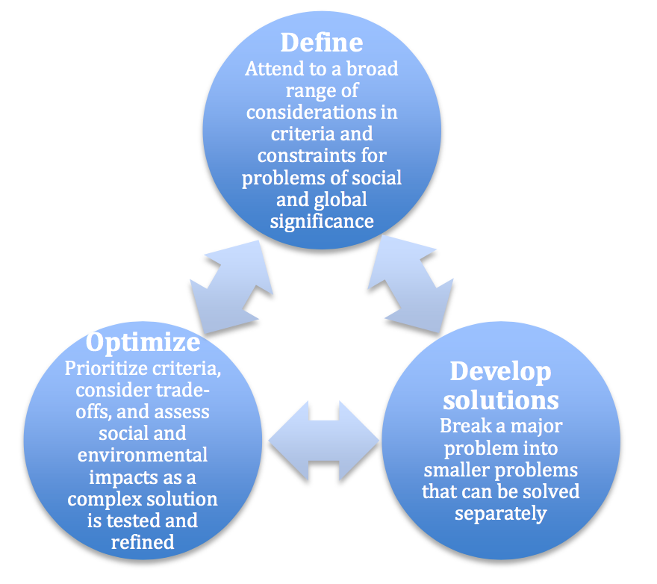
Engineering Design Process
Defining and delimiting engineering problems involves stating the problem to be solved as clearly as possible in terms of criteria for success, and constraints or limits.
Designing solutions to engineering problems begins with generating a number of different possible solutions, then evaluating potential solutions to see which ones best meet the criteria and constraints of the problem.
Optimizing the design solution involves a process in which solutions are systematically tested and refined and the final design is improved by trading off less important features for those that are more important.
It is important to point out that these component ideas do not always follow in order, any more than do the “steps” of scientific inquiry. At any stage, a problem-solver can redefine the problem or generate new solutions to replace an idea that just isn’t working out.
Authors: NGSS Lead States
Title: Next Generation Science Standards: For States, By States – Engineering Design
Copyright Date: 2013
Source: Next Generation Science Standards
http://www.nextgenscience.org/sites/default/files/Appendix%20I%20-%20Engineering%20Design%20in%20NGSS%20-%20FINAL_V2.pdf
Notes:
Permission received from NGSS.

Slide 24
Computational Thinking
NGSS Science and Engineering Practices
Using Mathematics and Computational Thinking
http://ngss.nsta.org/Practices.aspx?id=5

Slide 25
Value of Pseudocode
What is Pseudo code?
Pseudo code is basically written instructions of what a program should do to complete an operation. The pseudo code is written in your speaking language. You simply write down the steps of an algorithm or procedure to make it easier for you or someone else to read it and convert it to a real programming language.
Why was it made/is it used?
It was made to help you specify the steps of a procedure, process or an algorithm without using a programming language. One possible alternative is to use flowcharts.

Slide 26
Planning your program
Important steps in your program | TI-Basic commands to implement steps in your program
1.
2.
3.
4.
5…

Slide 27
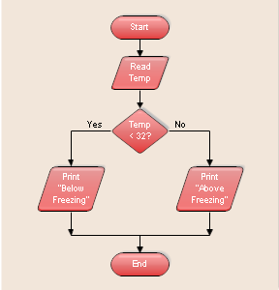
Using a flowchart to plan:
Sample, simple flowchart:
Input
Decision Point
Output
Notes:
Flowcharts can be helpful tools to think through what the program needs to do.
More about using Flowcharts for planning:
https://www.codeavengers.com/notes/planning/flowcharts
draw.io is a good online tool you can use to create flowcharts. You can logon with a Google Drive account.

Slide 28
Quick Code Reference

Slide 29
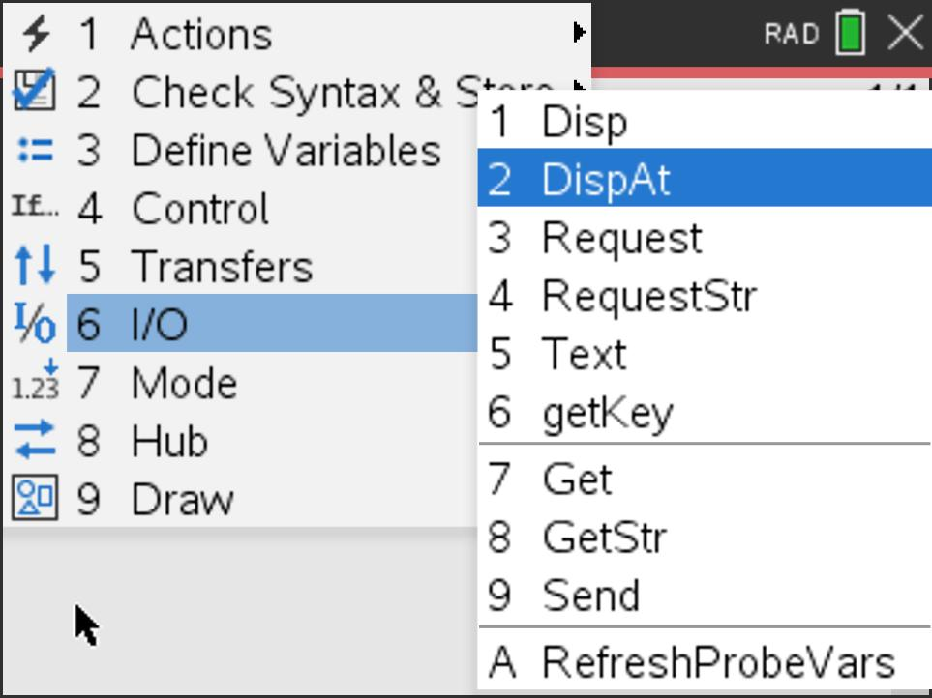
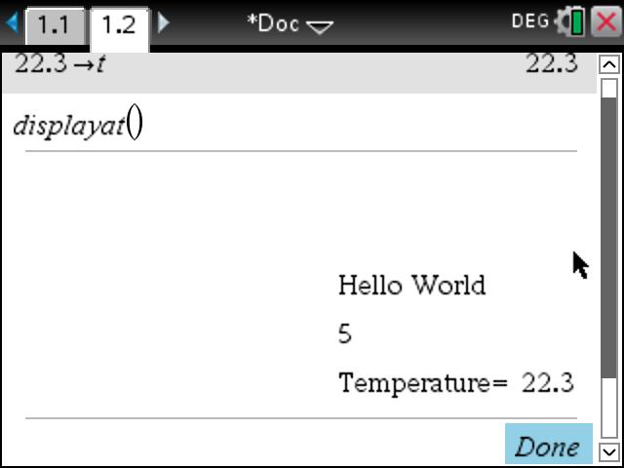
Background: Input/Output Commands for Displaying text strings and numeric values
The DispAt command allows you to control the text and values that are displayed on the rows of the Calculator application.
DispAt row value, text string or numeric value
Notes:
Row values are integers from 1 to 8
Displays string on row 3.
DispAt 3,”Hello World”
DispAt 4, 2+3
DispAt 5,”Temperature= “,t
Displays calculation on row 4
Displays label and variable value on row 5

Slide 30
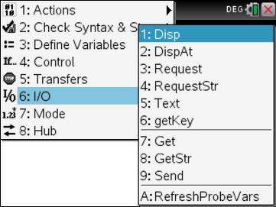
Background: Input/Output Commands for Displaying and Requesting text strings and numeric values
Program Editor Input/Output Menu
Display a string
Disp "hello world”
Disp 2+3
Request "Input a number",n
Disp n
RequestStr "Input a string”,s
Disp s
Display a numeric value
Request a numeric value input
Prompt
Variable for the input numeric value
Request a string input
Prompt
Variable for the input text string

Slide 31
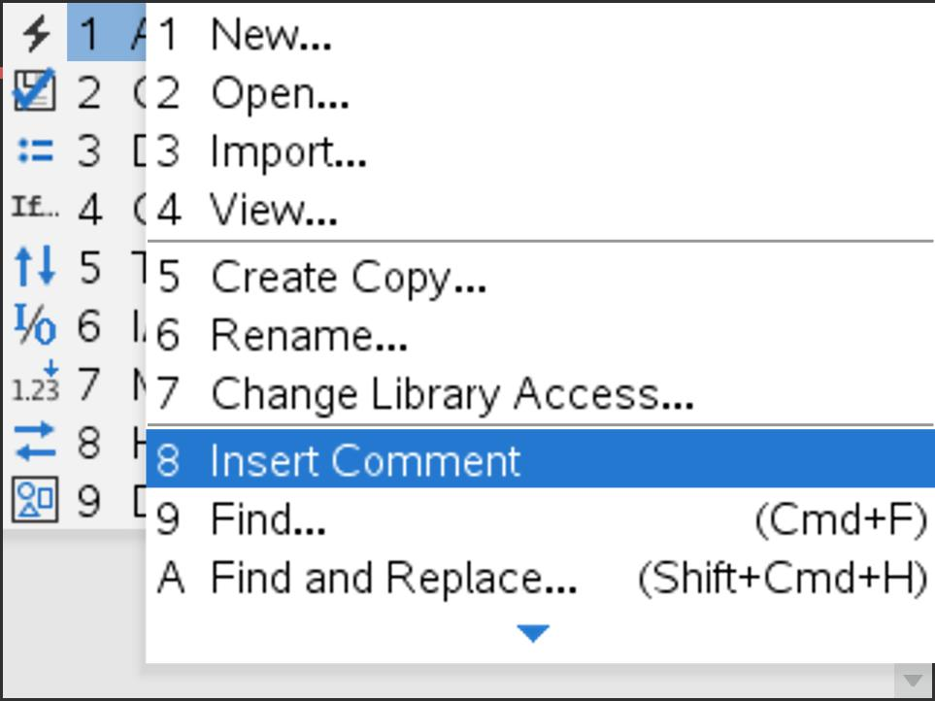
Background: Inserting a Comment from the Actions Menu
Program Editor Actions Menu
Comments are notes to explain your program. Commenting your code is a best practice for programming.
Insert a comment from the Program Editor Actions Menu. The Comment row is indicated by a ©.
When you Run the program comment rows are ignored.
© comment to explain the code

Slide 32
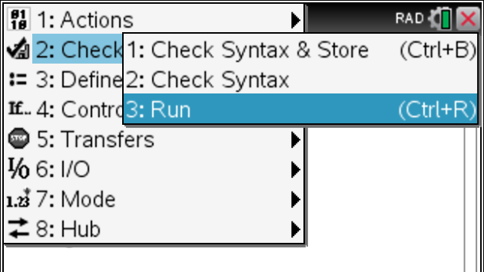
Background: For Loop
Program Editor Control Menu
Control
variable
Initial Value
Ending Value
For c,1,3
© Insert code to be repeated
EndFor

Slide 33
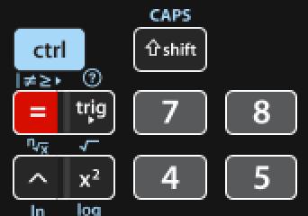
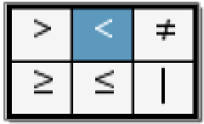
Background: Decision Making and Logic Statements
Decision Making Commands
Logic functions
If-Then command
“and”
If b>10 Then
© set of commands executed if statement is true
EndIf
If b>10 and c>100 Then
© set of commands executed if both statements are true
EndIf
If-Then-Else command
“or”
If b>10 Then
© set of commands executed if statement is true
Else
© set of commands executed if statement is false
EndIf
If b>10 or c>100 Then
© set of commands executed if either of the statements
EndIf
Note: Relational operators can be found on the keyboard using [=] and ctrl [=]. Logic functions, and, or, not, etc. can be typed or found in the catalog.

Slide 34
Background: While…EndWhile loop
The While loop repeats a set of commands as long as the While condition is true.
Command Syntax:
While condition
Commands in While block
EndWhile
b:=1
While b>.25
Send "READ BRIGHTNESS ”
Get b
Disp b
EndWhile
Note: This program uses the BRIGHTNESS sensor as a control for the While loop. If you completely cover the sensor the While loop will stop.

Slide 35
Background: Advanced Version
Ending a loop using a keypress
Initialize default value.
Continually set the value of keys pressed.
key:=“ "
While key≠"esc“
key:=getKey():
© set of commands executed while escape key isn’t pressed
EndWhile

Slide 36
Background: Advanced Version
Storing Data in an Array
Declare an array variable
Inside a loop store a calculation or Store a value from a sensor
myarray:={}
For c,1,3
Send "READ BRIGHTNESS ”
Get b
myarray[c]:=b
EndFor
myarray:={}
For c,1,3
myarray[c]:=c*2:
EndFor
Values can be plotted on a data and statistics page, graphs page, or used in other calculations.

Slide 37
Creating, Editing and Running Programs on the TI-Nspire

Slide 38
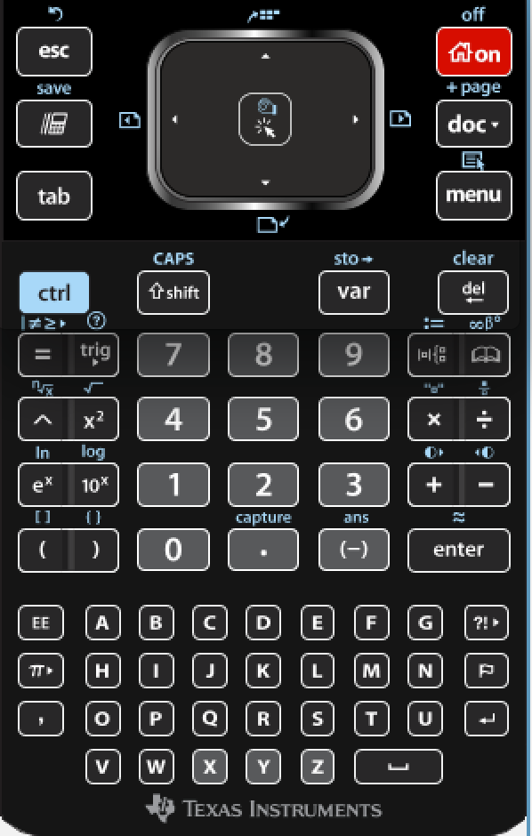
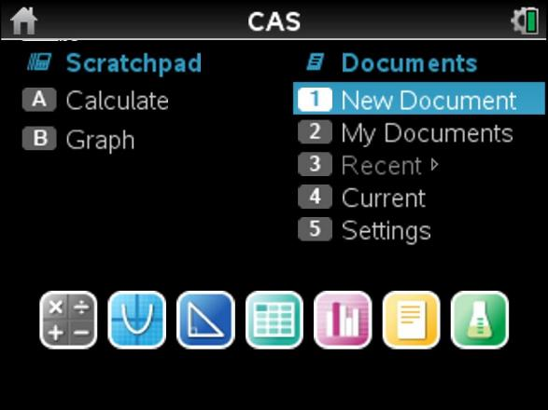
Create a new document
Press [Home] key
Select New Document from home menu

Slide 39
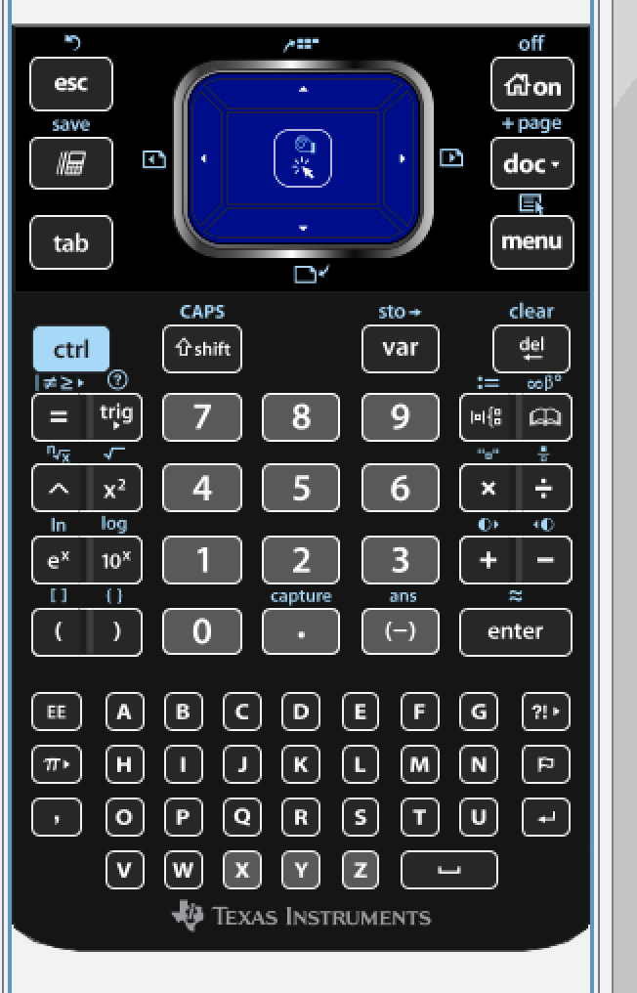
Important Keys
On: (House): Brings you to the Home screen (see next slide)
esc: Gets you out of what you are in
Ctrl doc (+page) : adds a new page
Ctrl z: is undo, just like on a computer
doc: has file commands. Save for example.
Menu: Gives you a list of commands that are relevant for your current application.
ctrl: Allows you to access the blue label functions printed above the keys.
Var: gives you a list of variables, including programs to choose from to insert in your command.
touchpad: is like a mousepad, slide your finger around. Center click when finger icon is showing to select. You can also click the arrows to move the cursor space-by-space.
enter: Completes and entry or selects a menu item or closes a dialogue box.

Slide 40
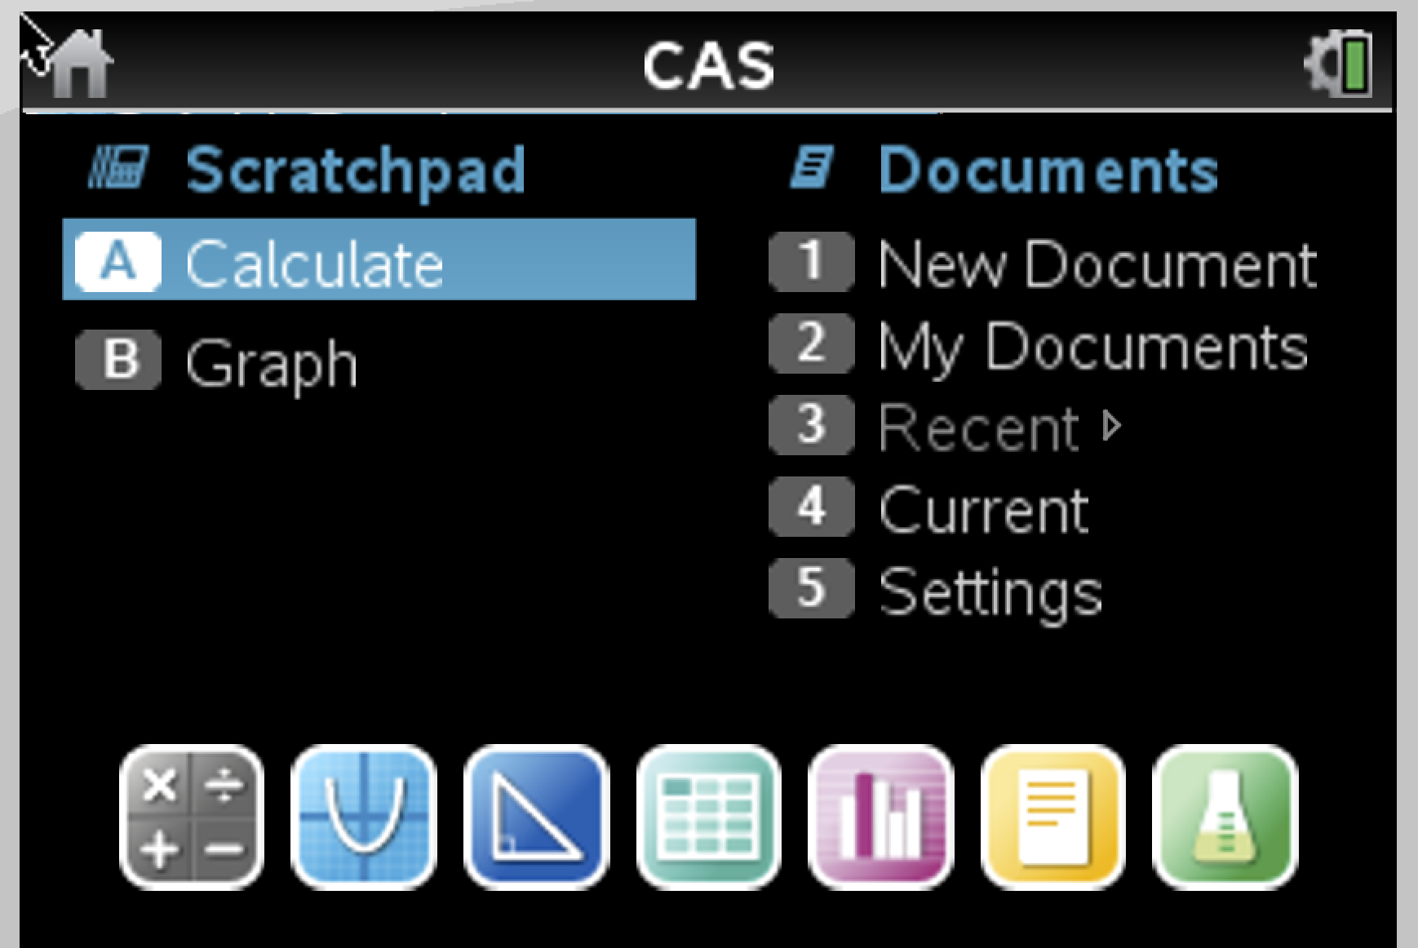
Home Menu
New Document: create a new document file.
My Documents: Brings you to folders with your stored files.
Current: Returns you to the document that you have open.

Slide 41
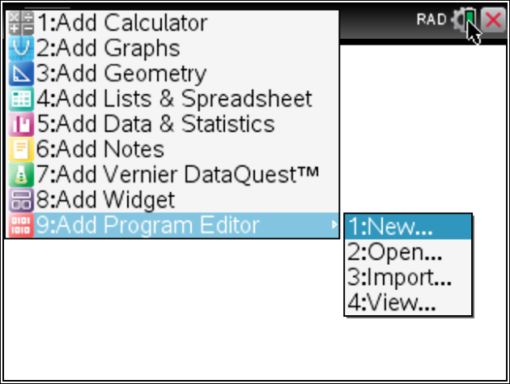
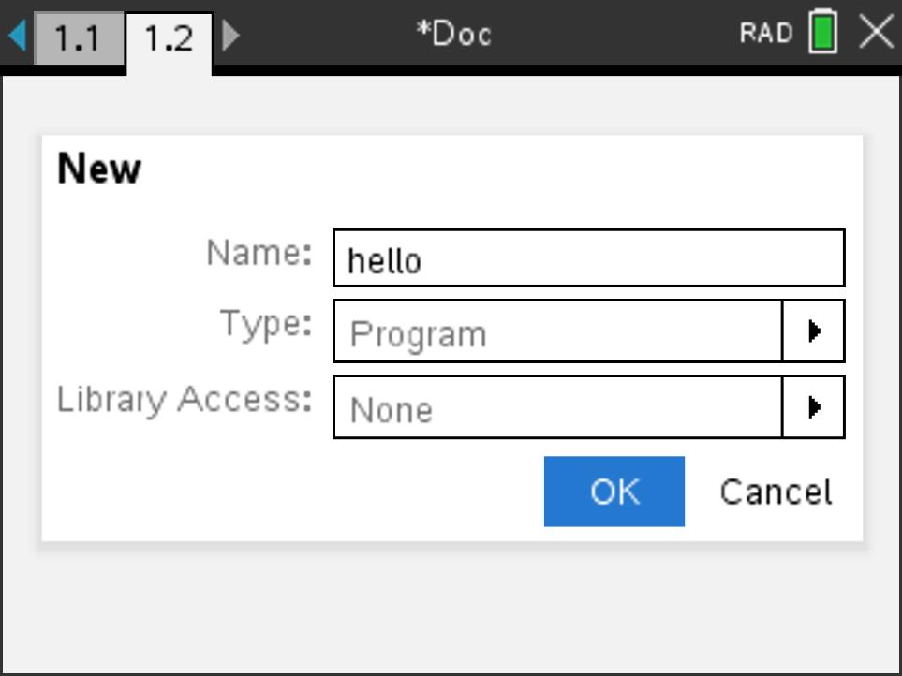
Set up a new Program Editor app
Press the menu key on a blank page or add a new page by pressing ctrl-doc (+page)
Select 9:Add Program Editor then 1:New. Enter your program name then press enter.
Note: Program names must begin with an alpha character.

Slide 42
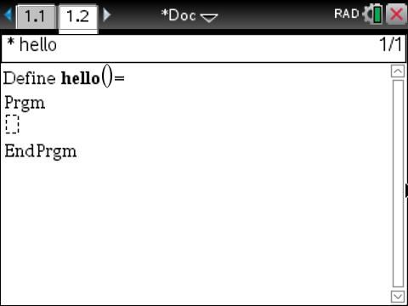
Program Editor app
Remember to move cursor DOWN within the program

Slide 43
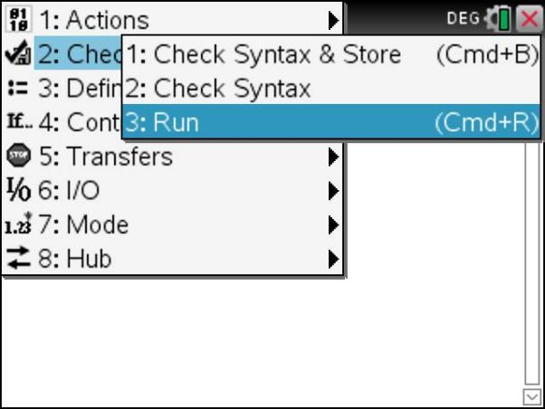
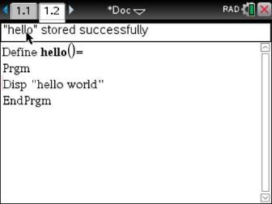
Store your program
Make sure the title says “stored successfully”
Use the Check Syntax & Store Menu to store your program. Look for the “stored successfully” message.
Use 1:Check Syntax & Store to store your program and remain in the editor. The shortcut is ctrl-b.
Use 3:Run to store and automatically paste the program name on a Calculator page. Then press Enter to run the program. The shortcut is ctrl-r.

Slide 44
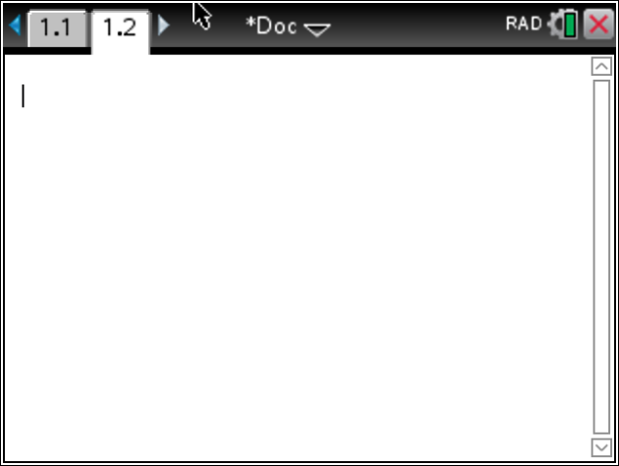
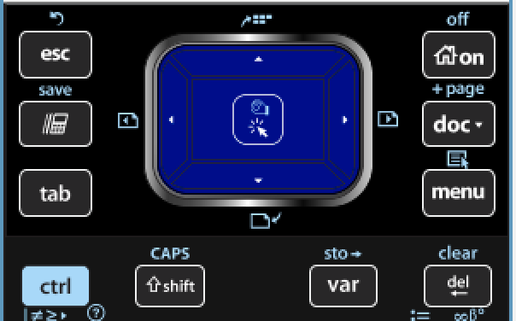
Moving from page to page
You can move from page to page by pressing ctrl-LEFT arrow and ctrl-RIGHT arrow
or by using the touchpad to move the pointer to the desired page then click the center of the touchpad or press ENTER

Slide 45
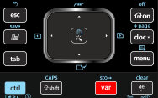
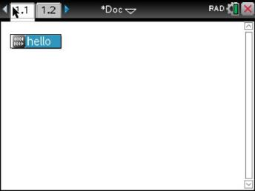
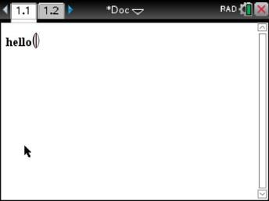
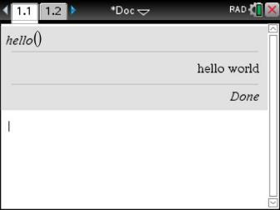
Running your program from the Calculator app
1. Select the program name from the [var] menu.
2. Press [enter] to run the program.
3. “Done” indicates that the program is finished.
Note: The Calculator app ”remembers” your last entry. Pressing [enter] again will re-run your last command.

Slide 46
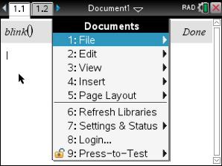
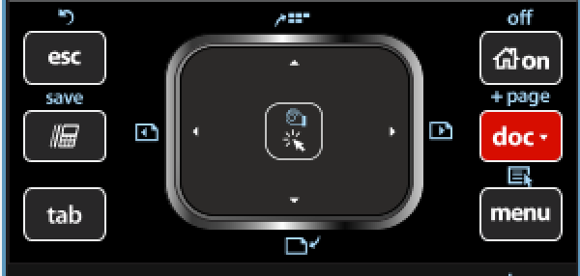
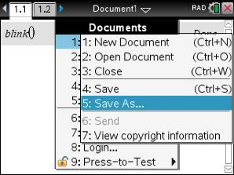
Save the TI-Nspire document file that contains your program
Press the [doc] key
2. Select 1:File Menu
3. Select 5: Save As…

Slide 47
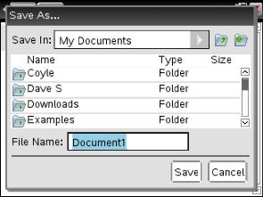
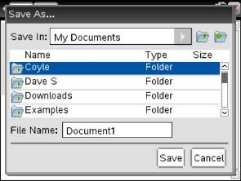
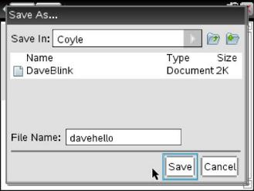
Save the TI-Nspire document with your program
1. Select a Folder with the touchpad and click
ctrl-s is a shortcut to save a file with the current name.
Have your students press ctrl-s periodically to assure that there work is saved.
2. Type in your file name - Press [enter] to save.

