Slide 1
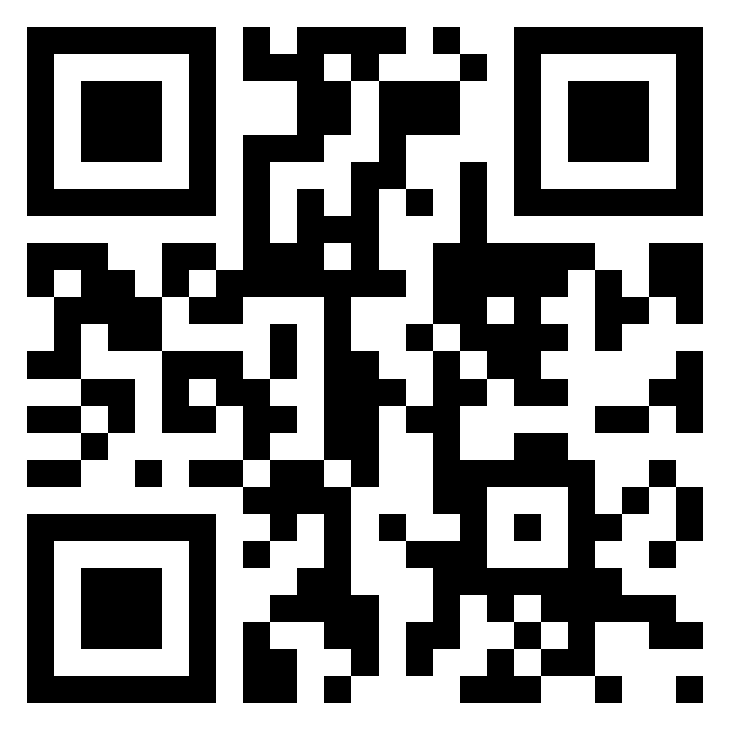
Meet the TI-Innovator Hub TI-84 Plus CE Python
Texas Instruments
@ticalculators
www.TIstemProjects.com
Contact stem-team@ti.com with questions

Slide 2
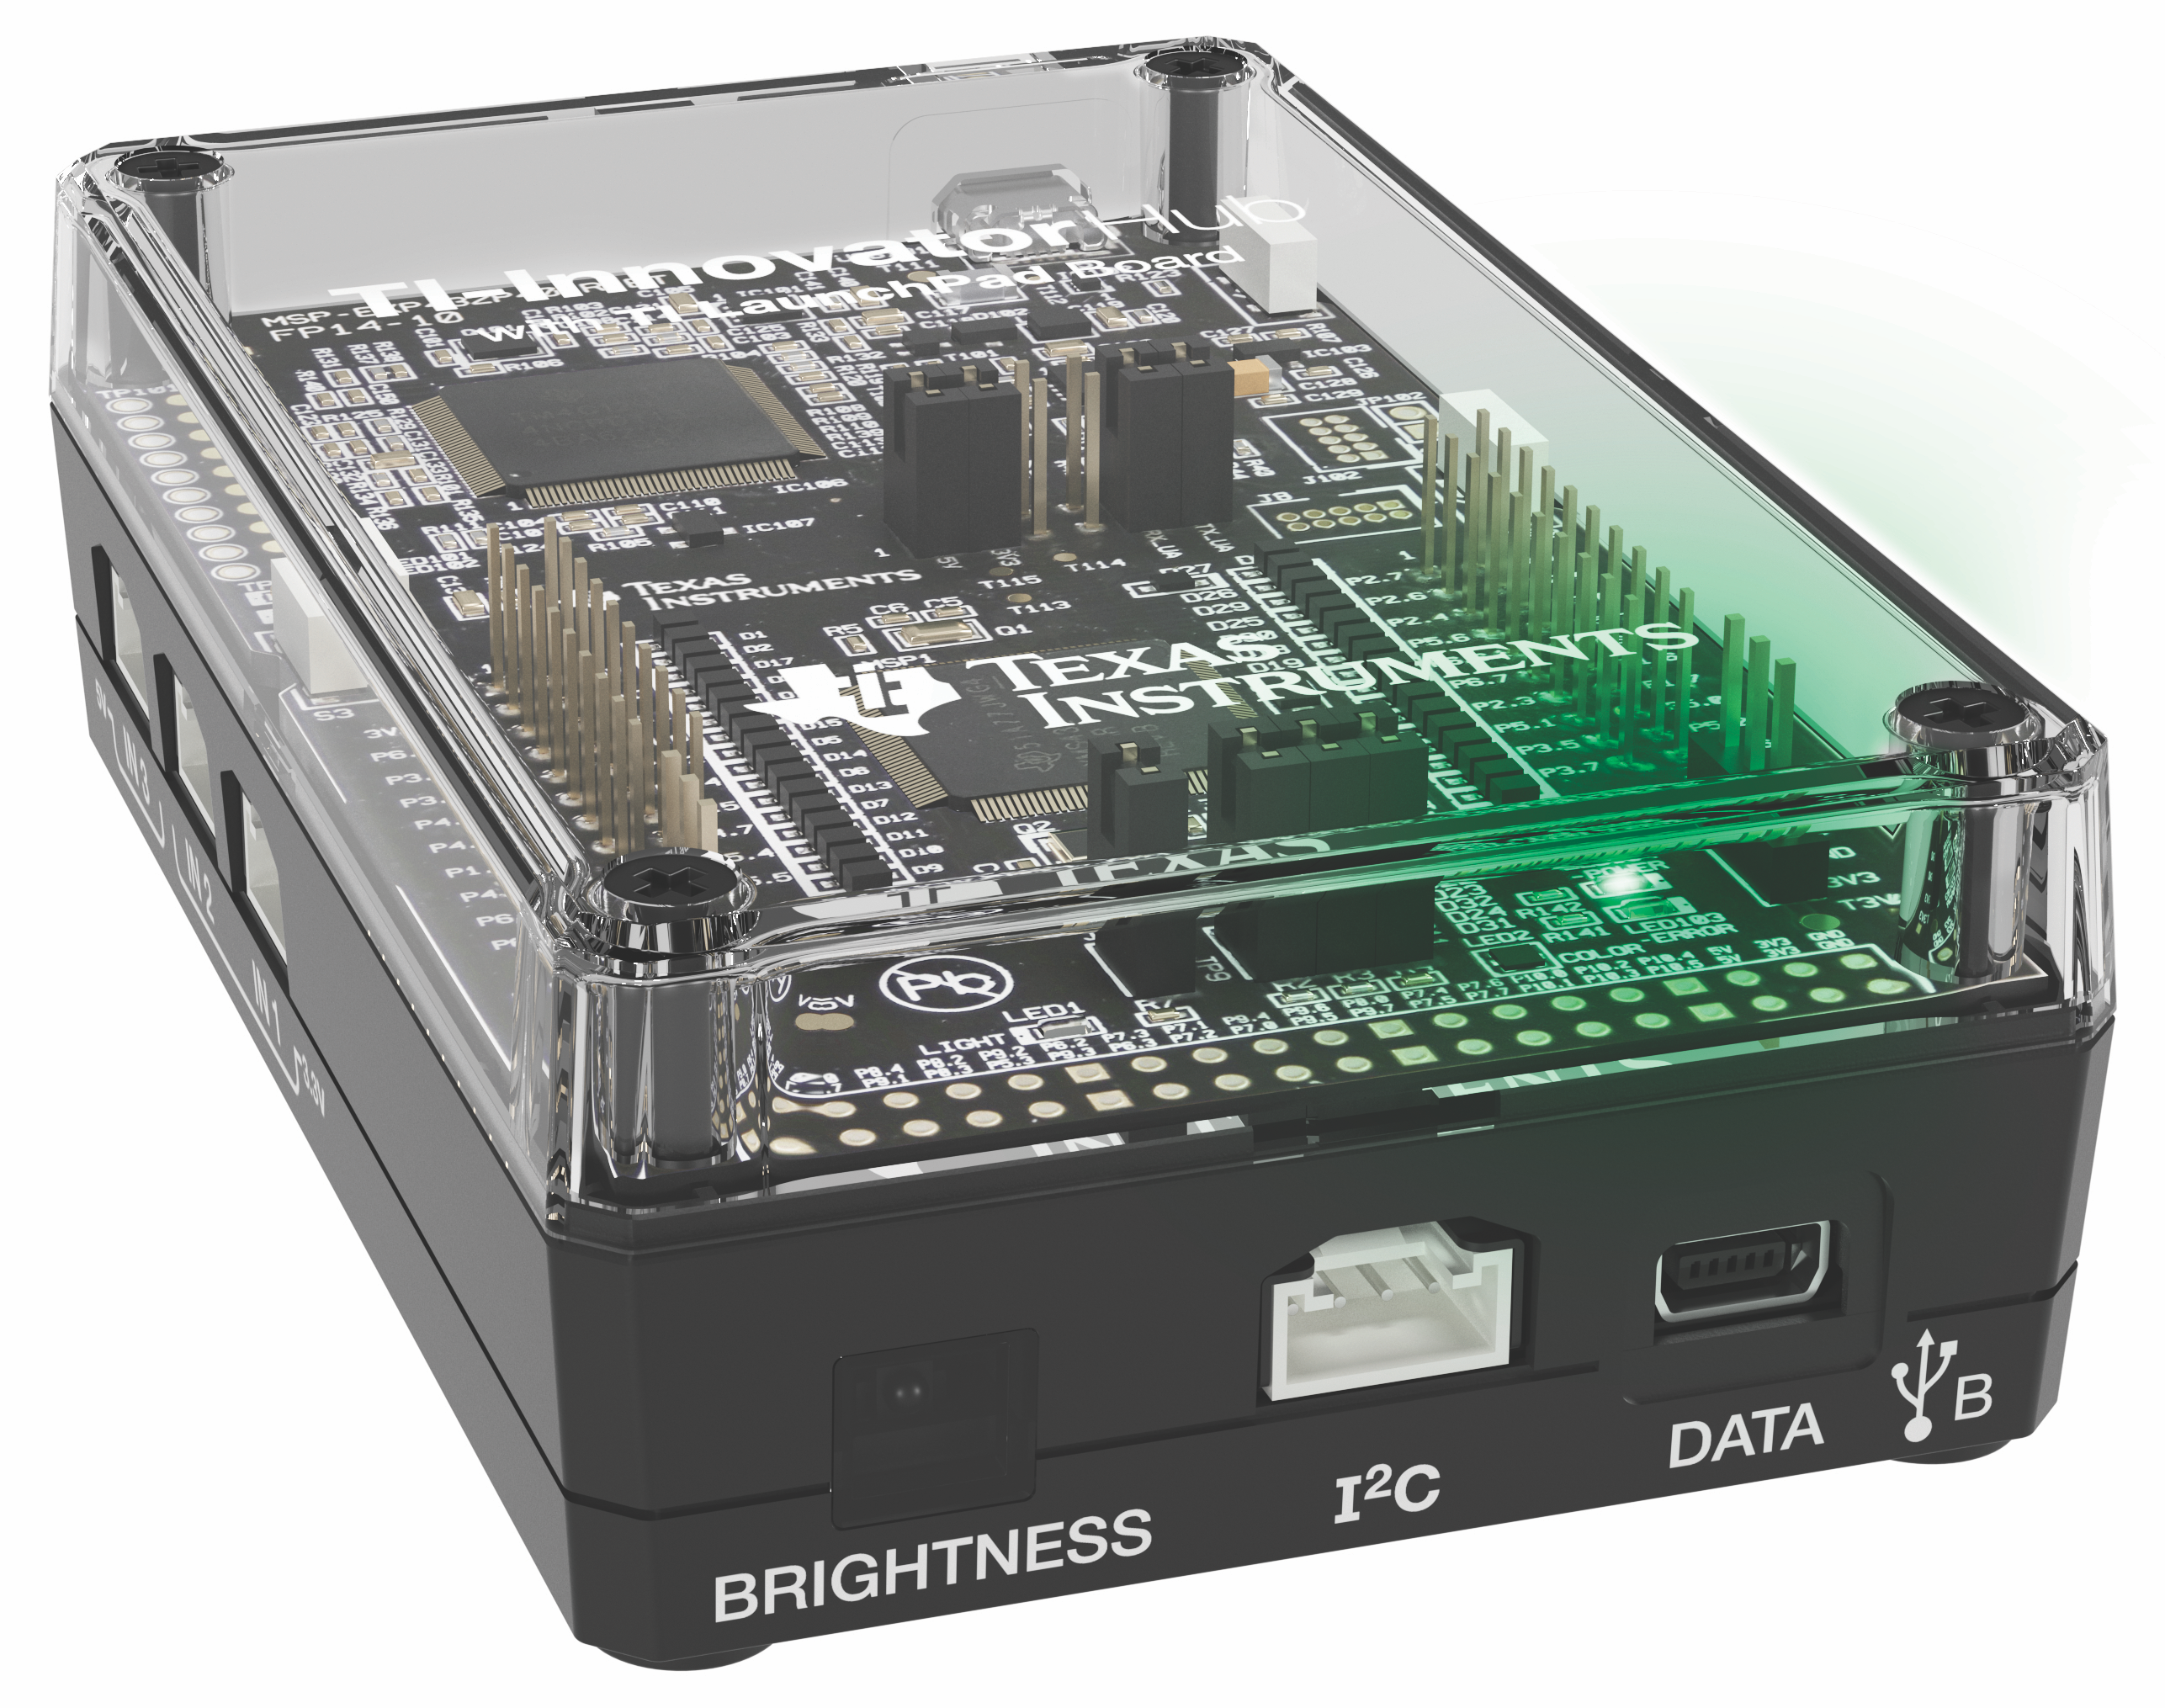
Meet the TI-Innovator Hub

Slide 3
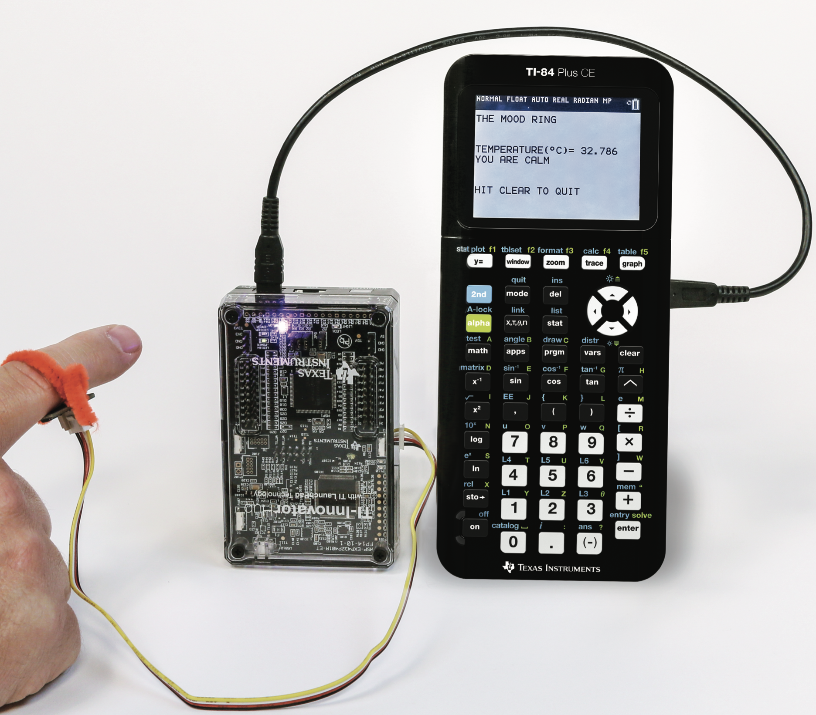
Built-in RGB LED Output
TI-Innovator™ Hub
TI Graphing Calculator
External Sensor Input

Slide 4
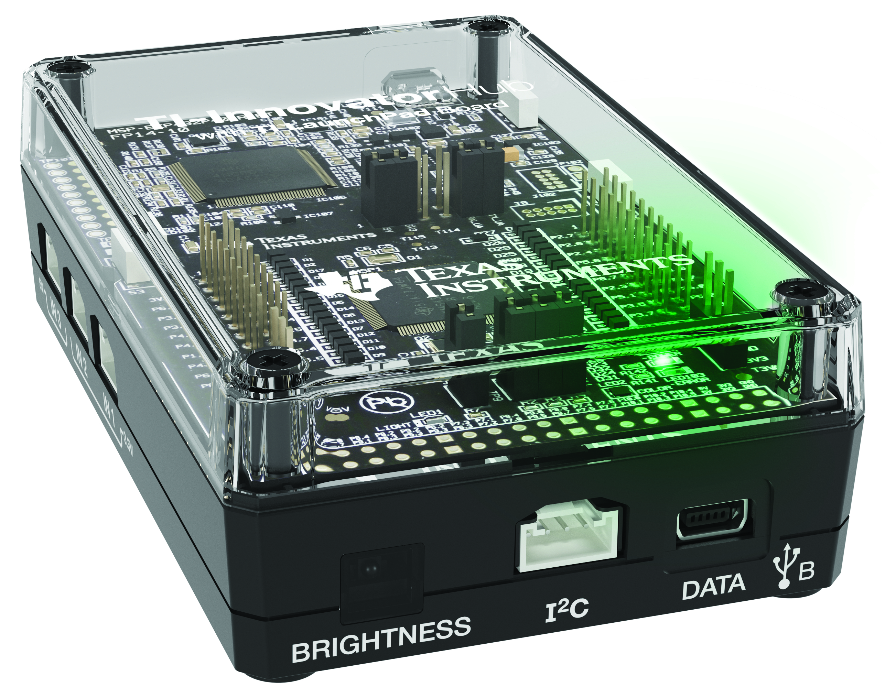
Hub from the Front
Red-Green-Blue (RGB) Color LED
(Built-in)
USB Port (mini) to connect to calculator and computer
Brightness Sensor (Built-in)
I2C Port used to
connect to Rover

Slide 5
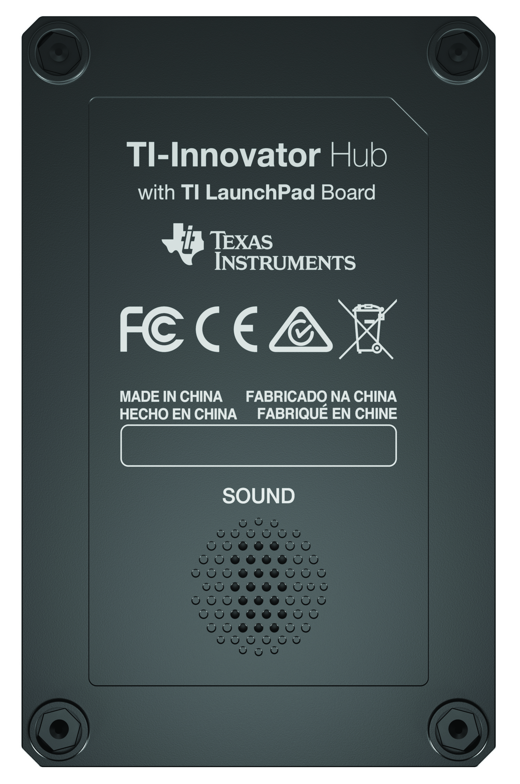
Hub from the Bottom
Speaker
(Built-in)

Slide 6
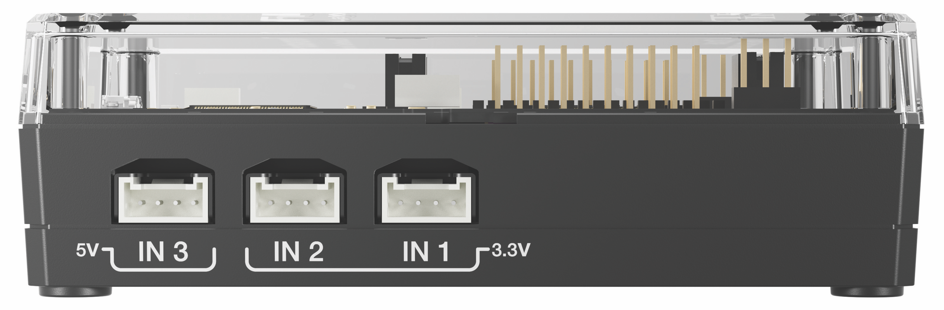
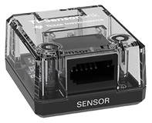
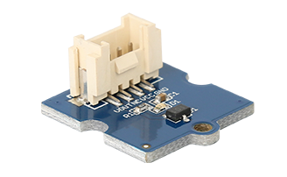
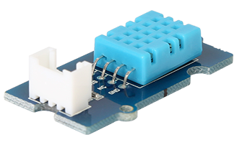
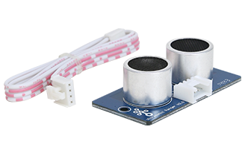
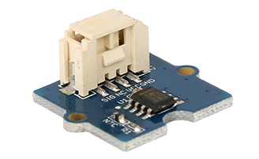
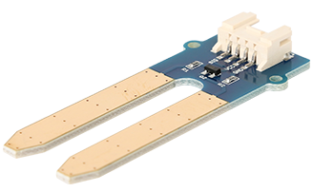
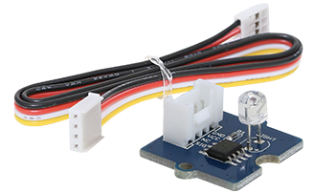
Hub from the side – input ports
Input ports for external sensors with Grove connectors
3.3 Volt ports, IN 1 and IN 2, required for Ranger and DHT
Vernier SensorLink
Adaptor
Magnetic Field (Hall Effect)
Digital Temperature
and Humidity (DHT)
Ranger
Temperature
Moisture
Light Level

Slide 7
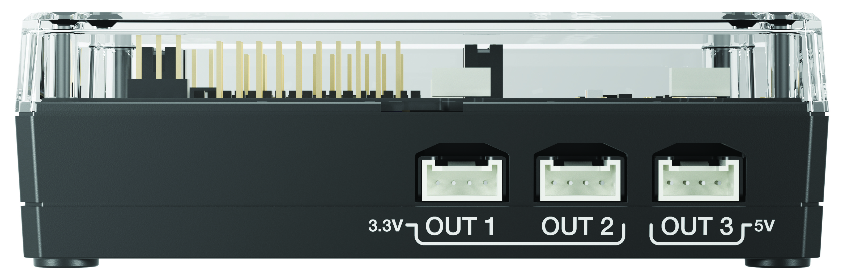
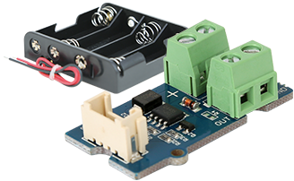
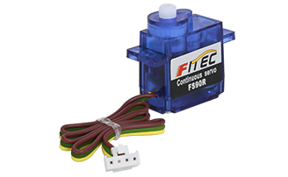
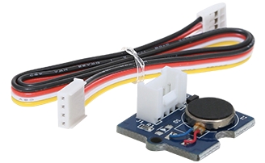
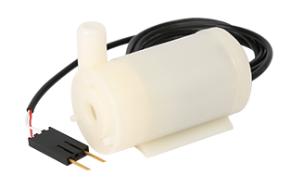
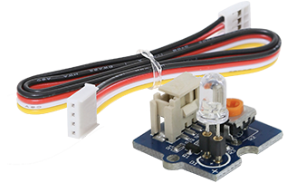
Hub from the side – Output ports
Output ports for external motors and other outputs with Grove connectors
5 Volt port, OUT 3,
required for motors
MOSFET controls power level to pump and other devices
Vibration Motor
External LED
Continuous Servo Motor
Pump

Slide 8
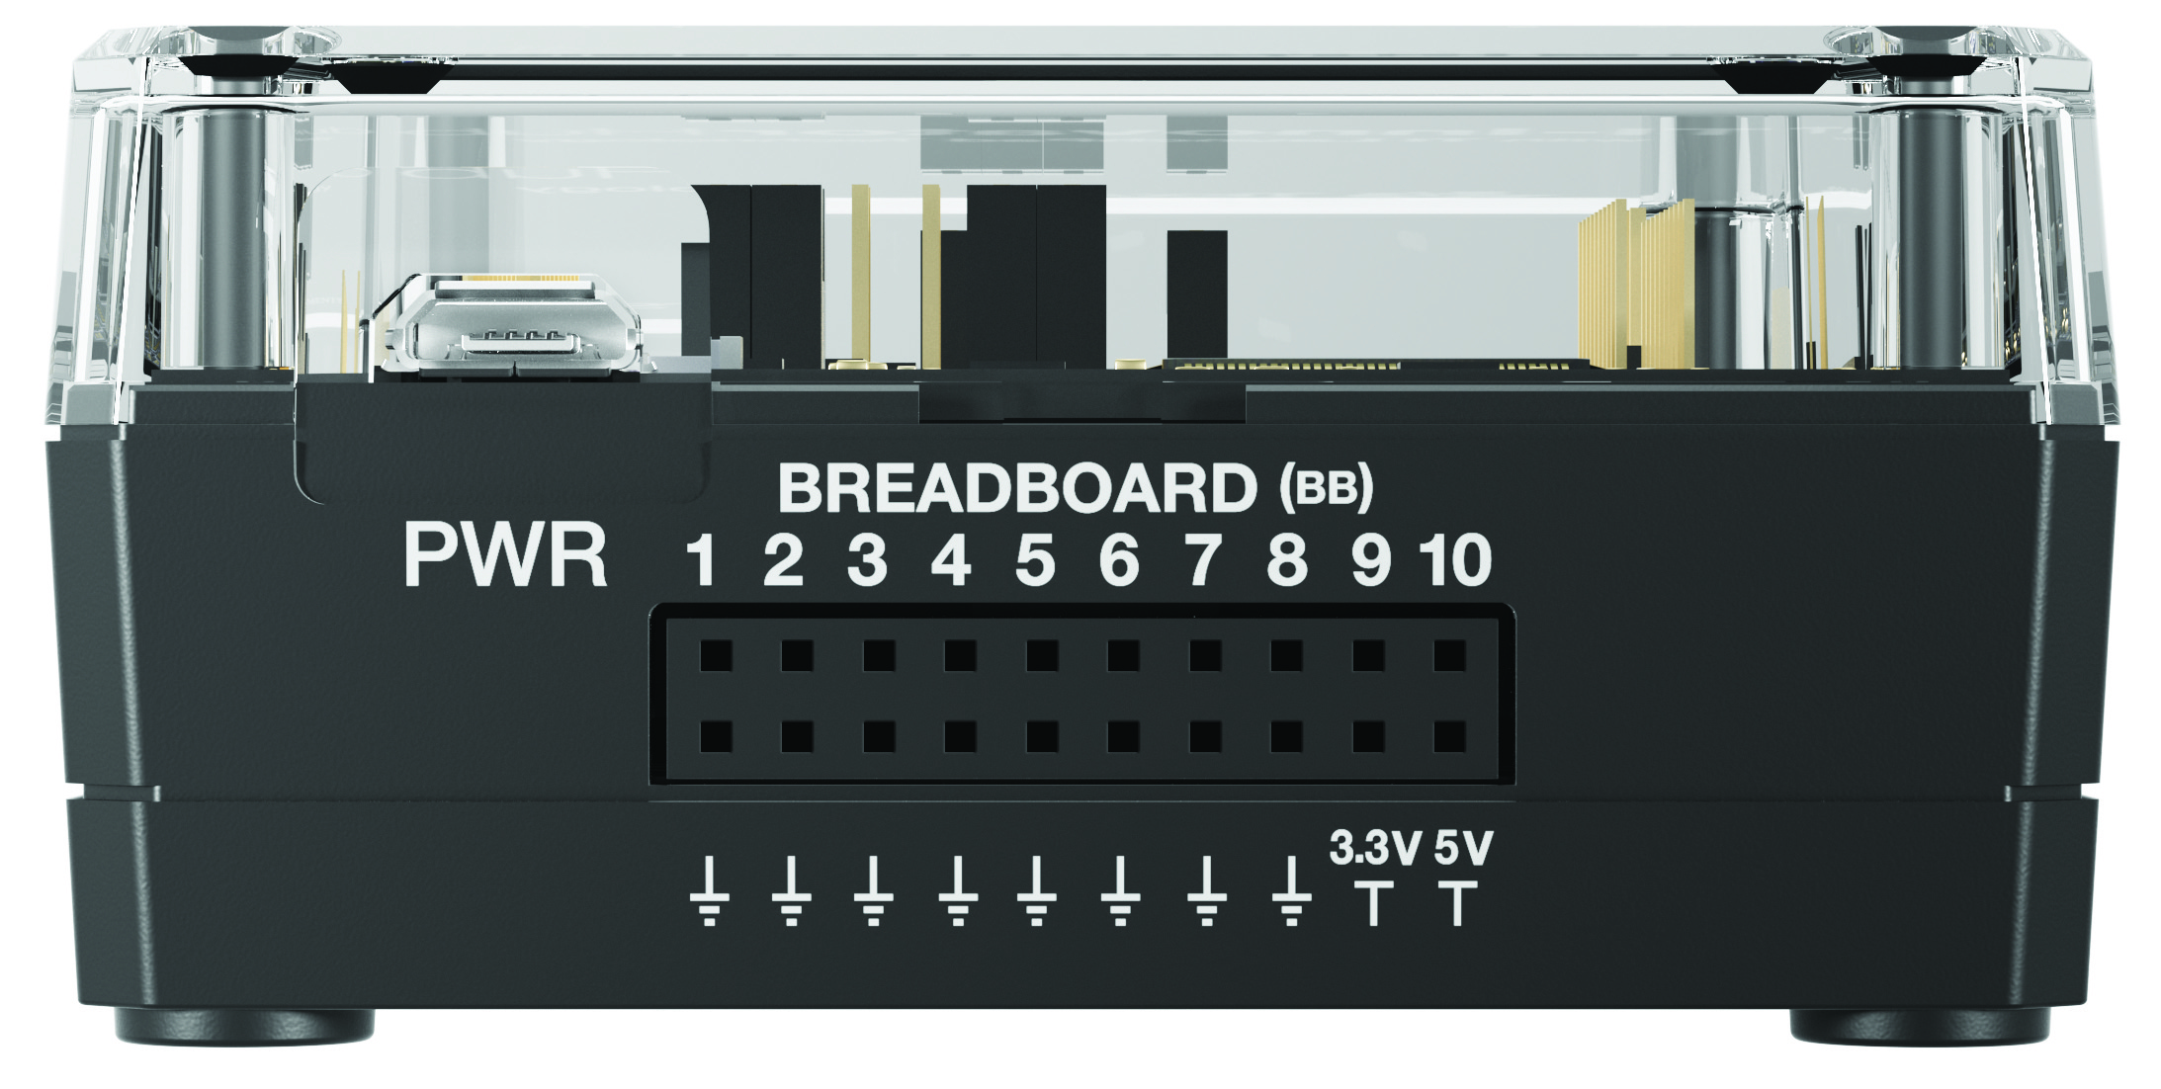
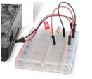
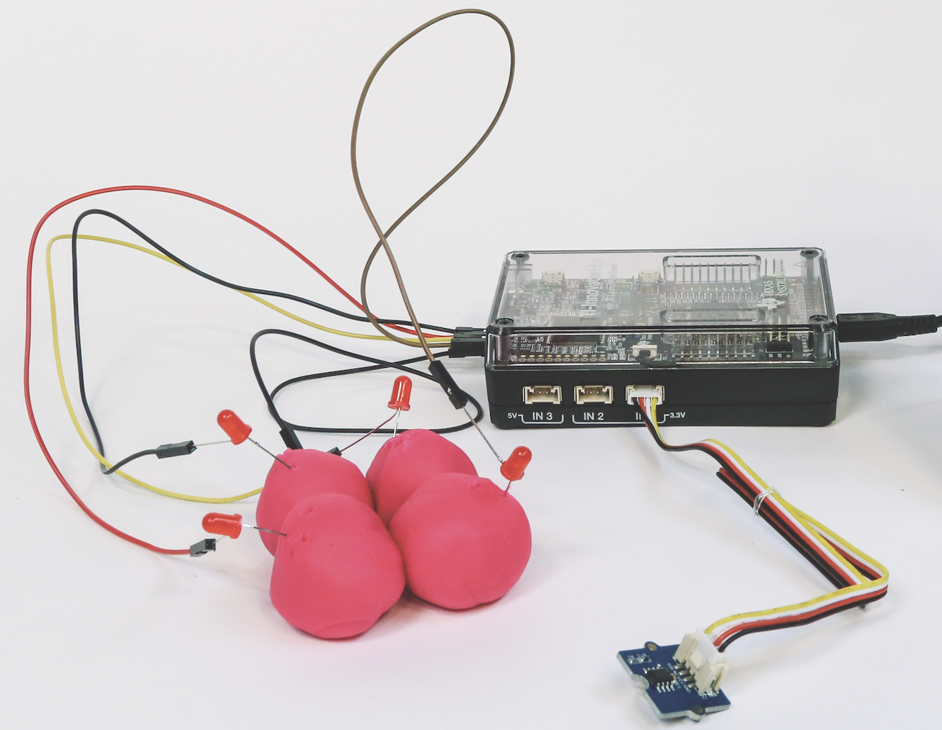

Hub from the Back – breadboard ports
USB Port (micro) connects to external batteries and wall socket.
Connects to computer for updating Hub firmware.
Breadboard ports
Path to STEM Projects with breadboard
RGB Array
Four-Chambered Heart Project

Slide 9
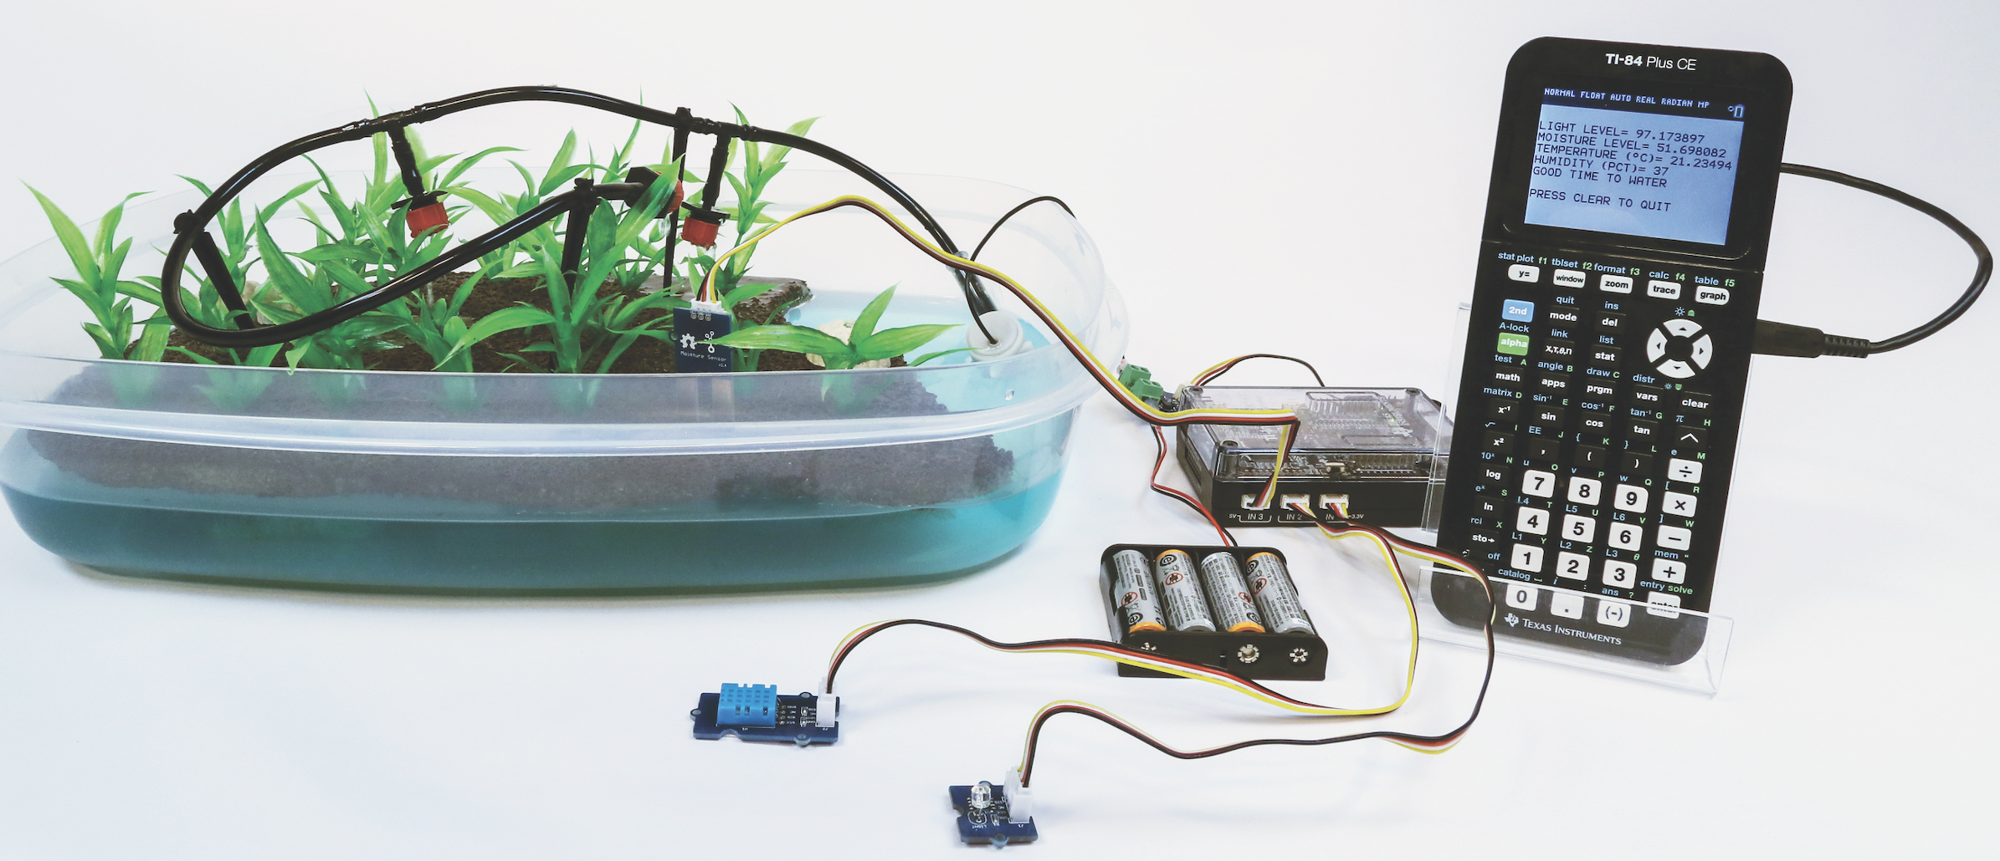
Putting Inputs and Outputs together
in a Smart System
Smart Irrigation Project
Pump
MOSFET
Moisture Sensor
Temperature and Humidity Sensor
Light Level
Sensor

Slide 10
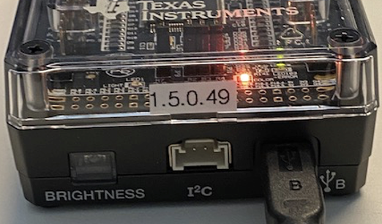
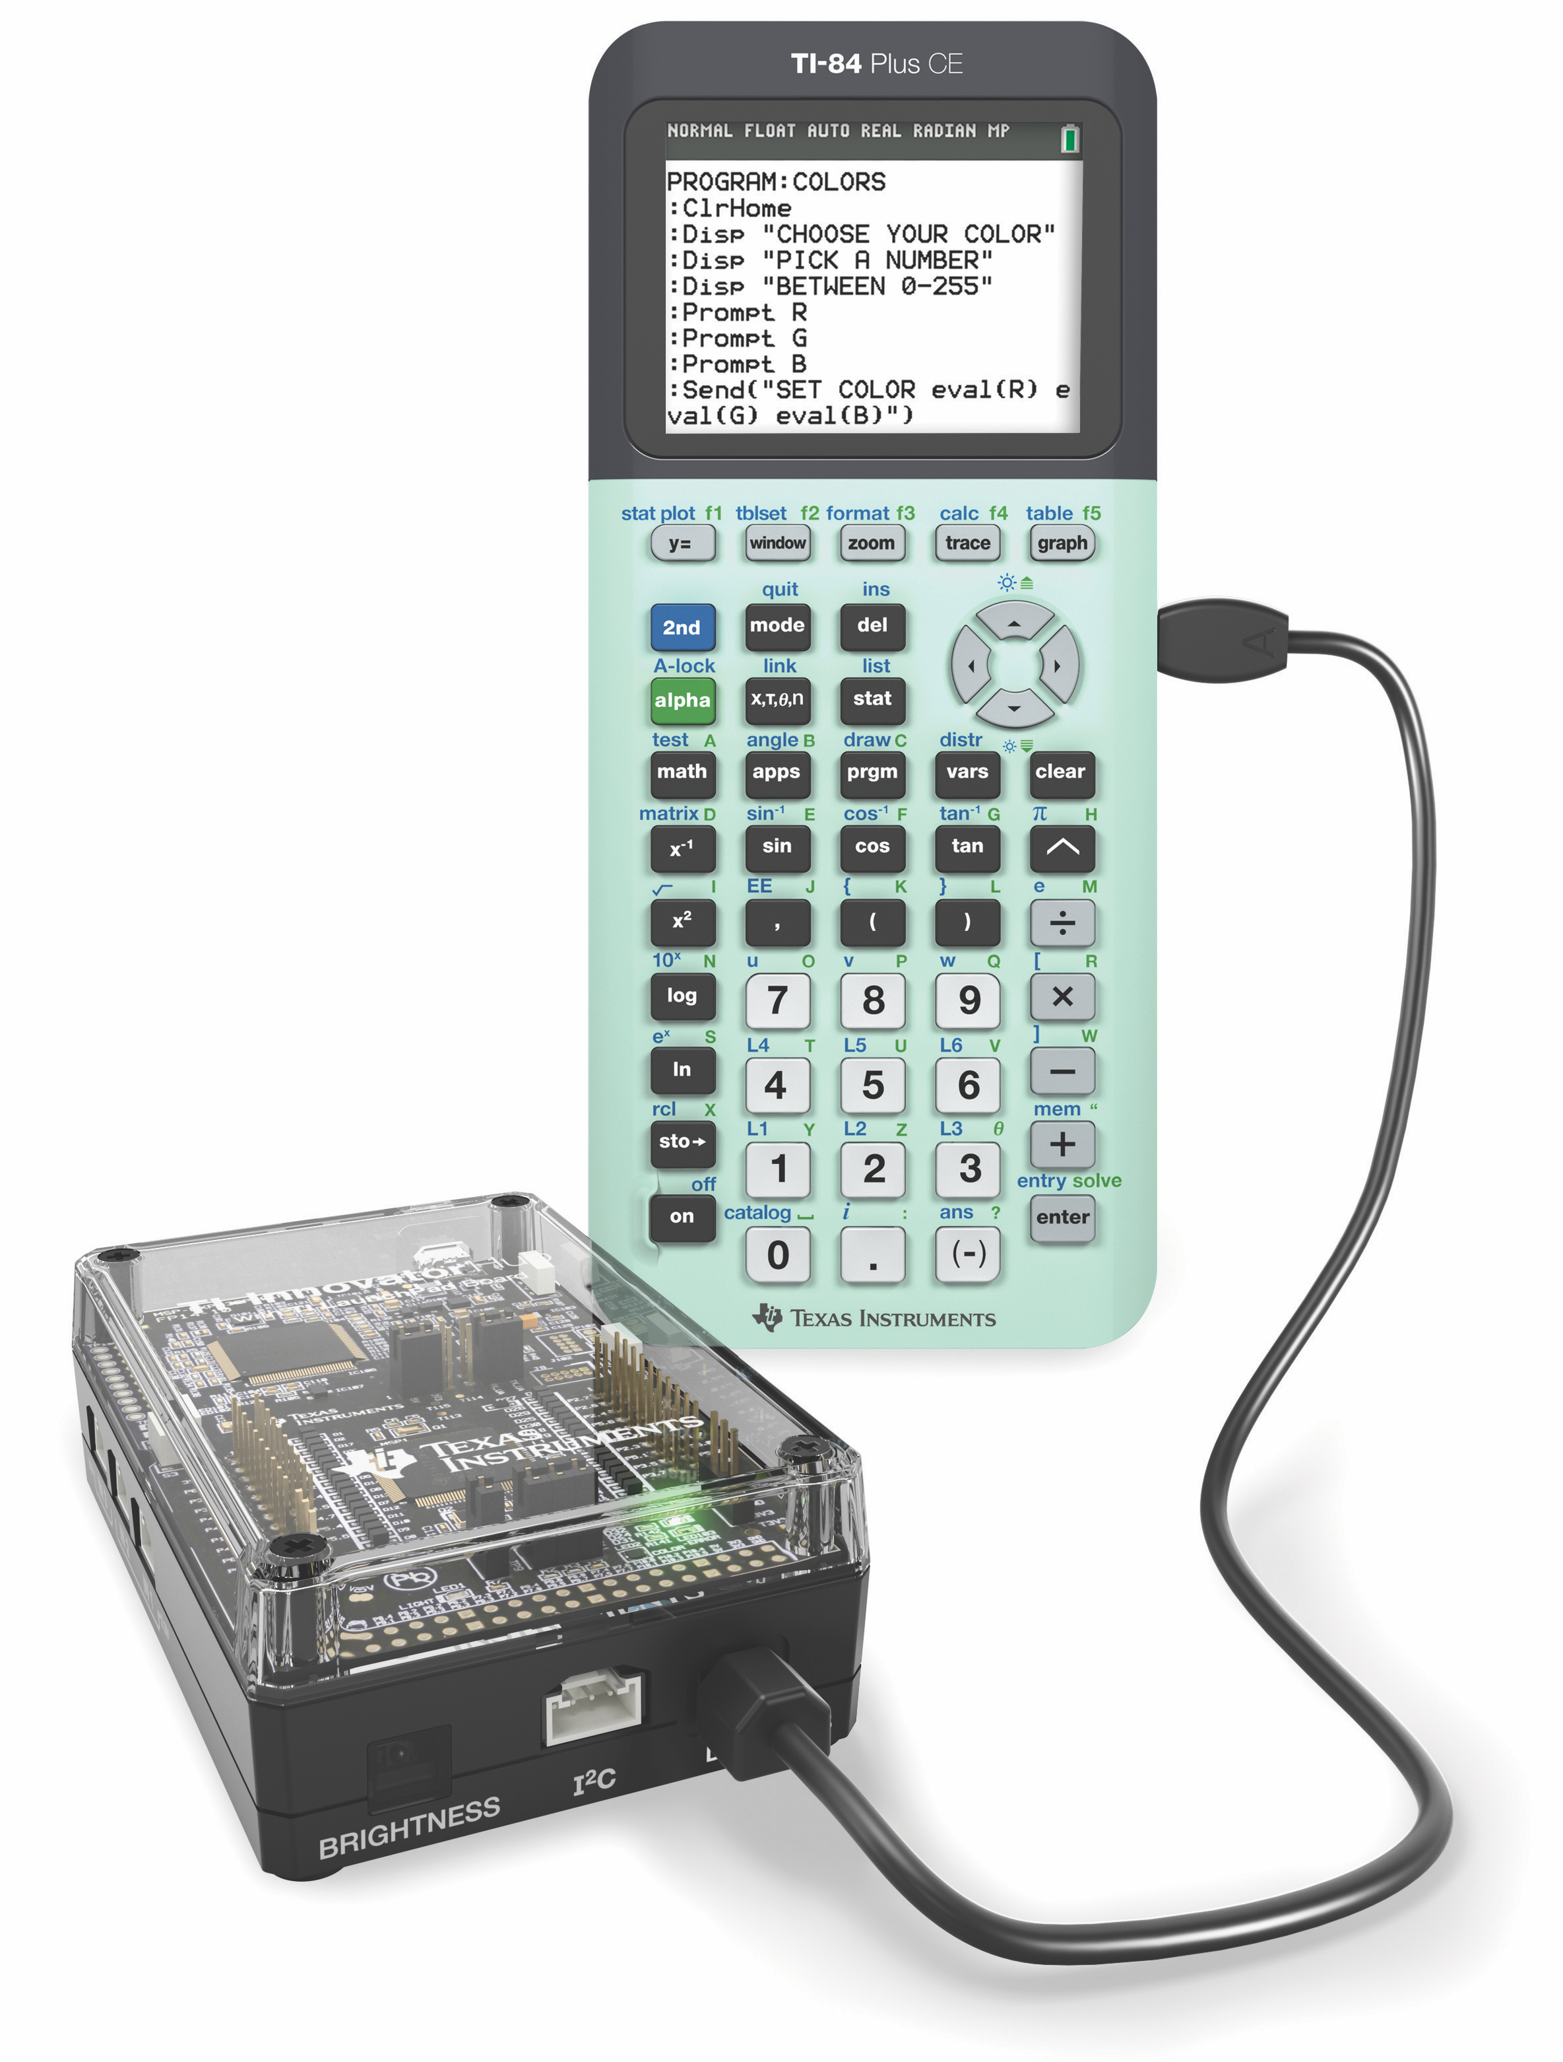
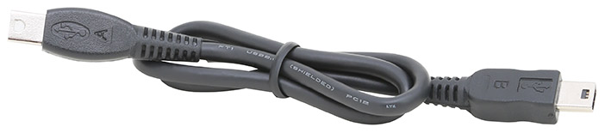
Connecting the Hub to your calculator
Note: The Hub is powered by the calculator. When the cables are connected the Hub goes through a brief “boot-up” process. During the boot-up the RGB LED displays a color that indicates the Hub firmware release, in this case, orange.
2
1
Plug A side of cable into port on calculator.
Plug B side of cable into USB B port of the Hub.
Unit-to-unit cable

Slide 11
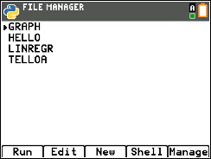
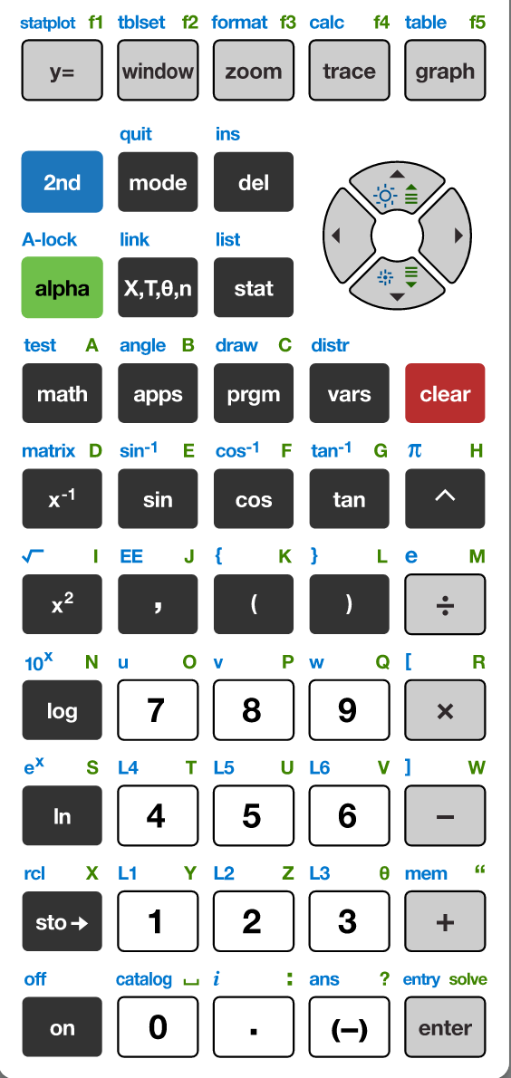
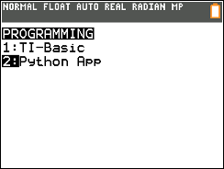
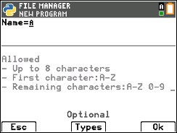
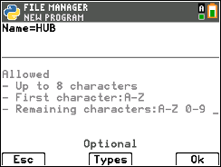
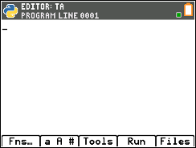
Creating a new Python Program
1
2
3
4
Press down arrow [enter] or press [2] to
select 2: Python App
You have the option to run, edit, create or manage programs.
Press [New] softkey (zoom button)
You are prompted to enter a program name.
The blinking A cursor shows that you are in alpha entry mode. The
green alpha labels on the keys are active.
5
6
Press the [prgm] key to create, edit and execute
TI-Python programs.
Type your program name and press [Ok].
You are now in position to begin entering statements to your program.

Slide 12
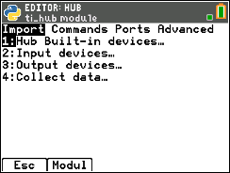
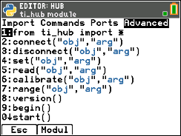
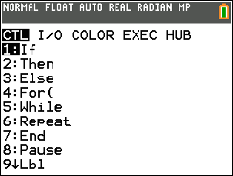
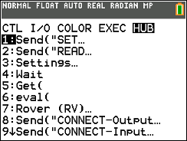
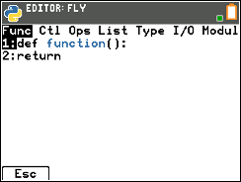
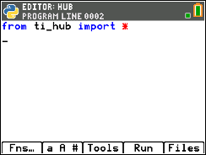
Entering a TI-Innovator Hub Program – 1 importing the ti-hub module
1
2
3
4
The Python program editor uses an insert cursor and a backspace delete.
Press [Fns…] softkey to see functions to use in your program.
Press right arrow repeatedly or
left arrow to move to the Modul
menu.
You will see a menu of installed modules available to use functions from. Select 6:ti_hub…
Press right arrow repeatedly or left arrow to move to the Advanced menu.
5
The ti_hub module import statement is pasted to your program. The ti_hub import statement brings in the functions and statements available on the ti_hub Commands and Advanced menus.
You will include additional import statements for inputs and outputs in your programs.
You are now ready to add statements to complete your program.
See the next slide.

Slide 13
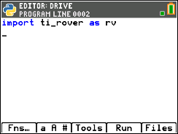
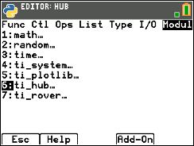
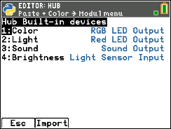
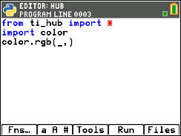
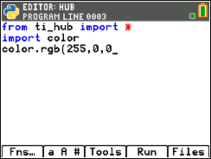
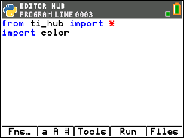
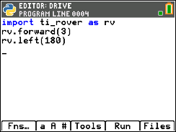
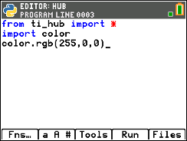
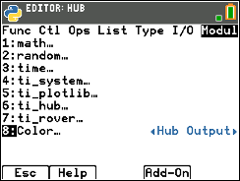
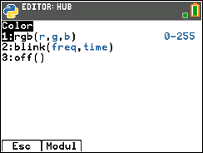
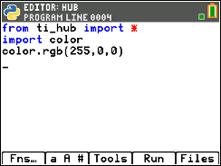
Entering a TI-Innovator Hub Program - 2
1
2
3
4
You are now ready to import modules for specific inputs and outputs. Navigate to the ti_hub menu by pressing [Fns…] then arrow to the Modul menu.
Then select 6:ti_hub... to see options.
Our first program will be to control the built-in Red-Green-Blue color LED. Select 1:Hub Built-in devices…
Select 1:Color to import the Color RGB LED module.
8
5
6
7
The import color statement brings the functions to control the Color RGB LED.
Navigate to the color menu by pressing [Fns…] then arrow to the Modul menu. You will now see a menu item for Color…
Select the Color… menu item to see the functions available for the Color RGB LED.
Select 1:rgb(r,g,b) to paste the function into your editor.
.
Your cursor is positioned just before the first comma ready to enter the input value for red. Values range from 0 (off) to 255 (full power). To display red type 255 then right arrow to position the cursor just before the second comma. Type 0 for the value of green. The right arrow and type 0 for the value for blue.
Right arrow to the end of the line and press [enter] to complete the statement.
A faster approach is to use [2nd] [enter] from any place on a line to complete the statement and move the cursor to the beginning of a blank line below.
Note: It is important that each statement begin on a new line.
.

Slide 14
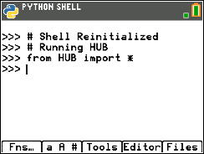




Running a Hub Program
1
2
Press [Run] (trace key) to run the program from the Python shell.
Before running the program
make sure that the calculator and the Hub are connected.
Your program runs in a Python shell.
You can re-run the program from the shell by pressing [Tools] (zoom key) then select 1:Rerun Last Program from the menu.

Slide 15







Editing a Hub Program
1
2
3
4
Press [Editor] to go back to your Python editor page.
To display cyan instead of red, use the arrow keys to position the cursor just after the red input of 255.
Press [del] to backspace over 255.
Type 0 for the red value.
Right arrow to just after the 0 of the green input.
Press [del] to backspace over 0. Type 255 for the green input.
5
6
7
Right arrow to just after the 0 for the blue input.
Press [del] to backspace over 0. Type 255 for the blue input.
Press [2nd] [enter] to complete the statement.
Press [Run] to run the program in the Python shell.

Slide 16














TI-Innovator Hub Module Menus
Import
Commands
Ports
Advanced
Color Menus*
* Importing a Hub object module adds to the Modul menu.
Sound Menus*
Brightness Menus*

Slide 17





Copying and Pasting a Line of Code
1
2
3
4
Use arrow keys to move the cursor to a position anywhere on the line that you would like to copy.
Press [Tools] then select 6:Copy Line from the menu.
After you select you will be returned to the editor.
Use arrow keys to move the cursor to any location on the line above where you would like to insert the copied line.
Press [Tools] then select 7:Paste Line Below from the menu. The copied line will be pasted.
5
You can paste again by returning to the [Tools] menu and selecting 7:Paste Line Below.

Slide 18



Opening an existing Python Program File
1
2
3
4
5
Press [enter] or
Press [2] to
select 2: Python App
To edit an existing program, use the Up and Down Arrow keys to select a program.
Press [Edit] to open with Python Editor with the selected program.
You can now make changes to the program or run the program.
Press the [prgm] key to create, edit and execute
TI-Python programs.

Slide 19





Copying/Replicating a Python Program File
1
2
3
4
Press [Files] to return to the file management screen.
Use the Up and Down Arrow keys to select a program.
Press [Manage] to see file options.
Select 1:Replicate Program to receive a prompt.
5
6
7
Type in the name of the new program using the green alpha key labels.
To use a number in the name, exit alpha mode by pressing [2nd] [alpha] then a number key.
Press [Ok] to finish the dialogue.
You are now in the editor ready to make changes or to run the new program.

Slide 20

Entry and Edit Tips
Use number key shortcuts or arrow keys and [enter] to select from menus
Use arrow keys to move the cursor around the screen.
Use [alpha] repeatedly to cycle from numeric, to lower case alpha to upper case alpha entry mode. The cursor indicates the current mode.
Use [2nd] [A-lock] to lock to alpha entry or to return to numeric entry.
Use [Fns…] softkey to bring up Python function menus, including the Modul (modules) menu.
Use [clear] or [Esc] softkey to back out of a menu.
Use [del] as a destructive backspace
Use [2nd] [enter] from any place on a line to complete the statement and move the cursor to the beginning of a blank line below.
Use [Tools] softkey menu to undo a clear and to copy, cut, paste and more.
Use [Editor] softkey to return to the editor from the Shell.
Use [2nd] [quit] to leave the Python app and return to the calculator.

Slide 21
Color Outputs

Slide 22









Set the color
Task: Set the color output of the
Red, Green, Blue (RGB) LED.
Each color takes a value
of (0-255).
Challenge Tasks:
Try to make Yellow
Try to make Cyan
Try to make Magenta
Press [Fns…] (Functions), Left Arrow to Modul (Modules) menu, select 6:ti_hub…, then arrow to Advanced to import ti_hub.
Press [Fns…] (Functions), Left Arrow to Modul (Modules) menu, select 6:ti_hub…, Import 1: Hub Built-in Devices, 1:Color to import Color.
New Program:
Press [Fns…] (Functions), Left Arrow to Modul (Modules) menu, select Color…, select 1: rgb(r,g,b). Type in values for red, green and blue between commas. When done with number entry, press [2nd[ [enter[ to complete the statement and move the cursor to the next row.

Slide 23



Create and Name a Color
Task: Create your own color and give it a name.
Challenge Tasks:
Print the name of your color.
To add the print() function to the bottom of your program,
move your cursor to the beginning of the empty row at the bottom of your program.
Press [Fns…] (Functions), Right Arrow to I/O (Inputs/Outputs) menu, select 1:print().
Press [2nd] [A-lock] to lock into alpha entry mode. Enclose your color name in quotes [+] key. Space is the [0] key.
Press [2nd] [enter] to complete the statement and move to the next line.
Add to previous Program:

Slide 24




Display a series of colors
Task: Display a sequence of colors for 2 seconds each.
Challenge Tasks:
Try to have your LED match the pattern of a traffic light.
Try to have your LED turn off at the end of the sequence.
To remove the print statement, move your cursor to the row with print() and press [clear].
The sleep() function pauses the program for the number of seconds that you enter as an input.
Press [Fns…] (Functions), Left Arrow to Modul (Modules) menu, select 6:ti_hub…, then arrow to Commands and select 2:sleep().
Enter a value for the number of seconds to pause the program. You can use decimal values.
Edit previous Program:
You can use copy line and paste to line below from the [Tools] menu to speed up editing.

Slide 25

Turn the LED ON and OFF
Extra
Task: Set the RGB LED to a color then keep ON for 2 seconds then turn the LED OFF for 2 seconds.
Challenge Tasks:
Try to blink (turn on and turn off) 4 times
Try to blink 4 times in 8 seconds
The sleep() function pauses the program for the number of seconds that you enter as an input.
What values for the red, green and blue inputs to the color.rgb() function will turn the LED off?
Press [Fns…] (Functions), Left Arrow to Modul (Modules) menu, select 6:ti_hub…, then arrow to Commands and select 2:sleep().
Enter a value for the number of seconds to pause the program. You can use decimal values.
New Program:
You can use copy line and paste to line below from the [Tools] menu to speed up editing.

Slide 26




Blink the LED Repeatedly
Extra
Task: Set the RGB LED to a color then keep ON for 2 seconds then turn the LED OFF for 2 seconds.
Challenge Tasks:
Try to blink (turn on and turn off) 4 times
Try to blink 4 times in 8 seconds
for i in range(size): sets up a loop that will repeat the statements in a block of code for the number of times that you enter for the size variable.
Press [Fns…] (Functions), Right Arrow to Ctl (Control) menu, select 4:for I in range(size):
Enter a value for the variable size. Size sets the number of times that the loop will repeat.
After entering the value for size press [2nd] [enter] to complete the the statement and move to the beginning of the next row.
The next row is indented. The indented rows are part of the loop block of statements that will be repeated.
New Program:
Note: i is the loop counter variable. Enter 10 as the value for the loop size. i starts with a value of 0. Each time the loop completes i is increased by 1. If i is less than loop size value looping continues, otherwise looping stops and the program moves to the next statement after the block.

Slide 27
Sound Outputs

Slide 28






Play a Sound Tone
Task: Play a sound tone by entering a value for frequency (sound vibrations per second) and a value for time in seconds to play the tone.
Note: Human voices tend to be in the 85 to 255 Hertz (vibrations per second) range.
What is the lowest tone that you can hear?
What is the highest tone that you
can hear?
Press [Fns…] (Functions), Left Arrow to Modul (Modules) menu, select 6:ti_hub…, then arrow to Advanced to import ti_hub.
Press [Fns…] (Functions), Left Arrow to Modul (Modules) menu, select 6:ti_hub…, Import 1: Hub Built-in Devices, 3:Sound to import Sound.
New Program:
Press [Fns…] (Functions), Left Arrow to Modul (Modules) menu, select Sound…, select 1: tone(freq,time). Type in values for sound frequency and time duration separated by commas. When done with number entry, press [2nd] [enter] to complete the statement and move the cursor to the next row.

Slide 29


Find your Favorite Sound Tone
Task: Play a sound tone by entering a value for frequency (sound vibrations per second) and a value for time in seconds to play the tone.
Find your favorite frequency.
Challenge Tasks:
Give your frequency a name and print the name.
To add the print() function to the bottom of your program,
move your cursor to the beginning of the empty row at the bottom of your program.
Press [Fns…] (Functions), Right Arrow to I/O (Inputs/Outputs) menu, select 1:print().
Press [2nd] [A-lock] to lock into alpha entry mode. Enclose your color name in quotes [+] key. Space is the [0] key.
Press [2nd] [enter] to complete the statement and move to the next line.
Add to previous Program:

Slide 30

Sound Frequencies and Musical Notes
Extra
Middle C
A440
Sound tone frequencies map to musical notes.
Middle C (C4) on the piano keyboard has a frequency of 261.6 Hertz.
A440 (A4) is used by orchestras for tuning.
See Making Music with Code project for an in-depth treatment of digital music
with the Hub. https://resources.tistemprojects.com/tistemprojects-home/?resource_id=2403

Slide 31





Play a Musical Note
Extra
Task: Enter and play the doorbell tones using the sound.note() function.
Create your own doorbell tone.
sound.note() is on the Sound menu.
Press [alpha] then the key corresponding with the desired letter to enter notes. The number represents the octave.
It is important to pause the program with a sleep() function between sounds.
This allows the sound to play completely before the program starts the next sound. (Try playing multiple sounds without sleep() functions.)
If you want to have a short silence between sounds add an additional .1 seconds to the sleep function, sleep(.5+.1) or insert an additional sleep(.1) between sounds.
sleep() is on the Hub Commands menu.
New Program:
Note: 6:Copy Line and 7:Paste to Line Below from the Tools menu may help you enter your program faster.

Slide 32


Play the Notes of an Octave
Extra
Task: Write a program to play each note of Do-Re-Mi-Fa-Sol-La-Si-Do as whole notes.
This is an entire octave.
Recall at 100 BPM a whole note lasts for 2.4 seconds. The first note Do is ”c4" and the last note Do is ”c5".
Include a .1 second rest between notes.
sound.note() is on the Sound menu.
Press [alpha] then the key corresponding with the desired letter to enter notes. The number represents the octave.
New Program:
sleep() is on the Hub Commands menu.
Note: 6:Copy Line and 7:Paste to Line Below from the Tools menu may help you enter your program faster.

Slide 33
BRIGHTNESS (LIGHT Level) inputs

Slide 34












Measure Brightness
Task: Enter and run the program to measure brightness.
What is the light level in your room?
Try shining a light on the brightness sensor.
Try covering the brightness sensor.
Brightness
sensor
To import brightns, the Hub built-in light level sensor, press [Fns…] (Functions), Left Arrow to Modul (Modules) menu, select 6:ti_hub…, Import 1: Hub Built-in Devices, 4:Brightness.
Find while not escape(): on the Hub Commands menu. This sets up a loop that will run until the [clear] key is pressed. To use while not escape(): you will need to import the ti-system module that is available on the Commands menu. You may use the Insert Line Above command from the Tools menu. sleep() is also available from the Hub Commands menu.
New Program:
The measurement value is stored to a variable named b.
= is available from the test menu at [2nd][math] or by pressing [sto ->].
brightns.measurement() is available from the brightness menu.
print() is available from the I/O menu. Quotes are available by pressing [alpha] [+].

Slide 35








Control an RGB LED with Brightness Measurements
Extra
Task: Add brightness.range(0,255) to the program to set brightness measurements to be from 0 to 255 instead of 0 to 100.
Use the brightness values stored in variable b as inputs for some or all of the color.rgb(red,green, blue) inputs.
Try shining a light onto the Brightness sensor.
Challenge Task:
Try color.rgb(255-b,0,0). How does the behavior change?
Brightness
sensor
Set the range of brightness measurements to match the output range values of the color.rgb LED, 0-255.
Find the brightness.range() function on the Hub Built-in Devices, Brightness Input menu.
Note: The default brightness range is 0 to 100.
Add to previous Program:
You will also need to import color from the Hub, Built-in devices… menu.
Then you will insert a color.rgb() statement into the program.
You may use the Insert Line Above command from the Tools menu.

Slide 36
Thank You
www.TIstemProjects.com
Contact stem-team@ti.com with questions

