Slide 1
Project Overview

Slide 2
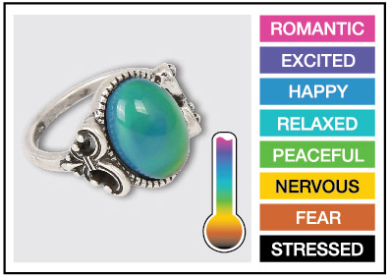
Mood Rings: How do they work?
Background:
The mood ring was invented by Joshua Reynolds. Mood rings enjoyed fad popularity in the 1970s and are still around today. The stone of the ring changes color, supposedly according to the mood of the wearer. The 'stone' of a mood ring is really a hollow glass shell containing thermotropic liquid crystals. Modern mood rings are made from a flat plastic strip containing liquid crystals that is inserted into the hollow glass and mounted within the bezel of the mood ring.
Notes:
Introductory mini-project for feedback and control systems. The project includes external inputs (temperature sensor), decision logic based on the temperature sensor reading and an output (Red-Green-Blue LED).

Slide 3
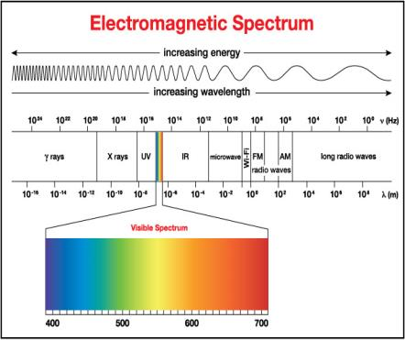
Mood Rings: How do they work?
The crystals respond to changes in temperature by twisting in a regular way. The twisting changes their molecular geometry, which alters the wavelengths of light that are reflected from the crystals.
Wavelengths of light are another way of saying color, so when the temperature of the liquid crystals change, so does the color reflected from the stone. Thus, the ring changes color with the hand temperature of the wearer.

Slide 4
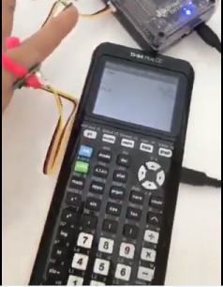
Time to DIY: Digital Mood Ring!
The Design Challenge:
Design and build a digital mood ring using the pipe cleaner that fits snugly on your finger, placement should be similar to any ring worn on the finger. Be sure the flat part of the temperature sensor is touching your skin.
In this project, you will investigate:
temperature measurement using a temperature sensor and then build a digital mood ring that changes the color of the Hub’s Red, Green, and Blue (RGB) light emitting diode (LED) as the temperature your finger changes.
You can even display what mood you are in on your calculator!
Notes:
This project is an ideal introduction for students using the TI-Innovator for the first time. The “DIY- Mood Ring” project includes many of the fundamental concepts that are used in feedback and control projects. The project sets the stage for working through the more advanced Pet Car Alarm and Smart Irrigation projects.
Objectives that will be covered:
Science Concepts: additive color model, electromagnetic spectrum (optional)
TI-Technology Concepts: TI-Innovator™ overview, connecting TI-Innovator™ to handheld with unit-to-unit cable (connector with B label in the DATA port of the TI-Innovator), Hub menu for creating commands to send to the TI-Innovator™
Computing Concepts: physical outputs, numeric arguments for commands

Slide 5
Mood Ring Project Tasks:
Students are acquainted with the Mood Ring project and the graphing calculator platform. Create and execute a program to display “Hello World”.
Students are acquainted with the TI-Innovator Hub. Create and execute a program using COLOR command to display different colors using the Red-Green-Blue LED.
Students create a program that connects an external temperature sensor, reads values from the sensor and then displays values from the sensor. Students use the pipe cleaner to connect the TI-Innovator and temperature sensor to form a “ring.”
Students build on the program from above to use if-then logic to control COLOR outputs based on temperature readings to create a digital mood ring.

Slide 6
Project Concepts

Slide 7
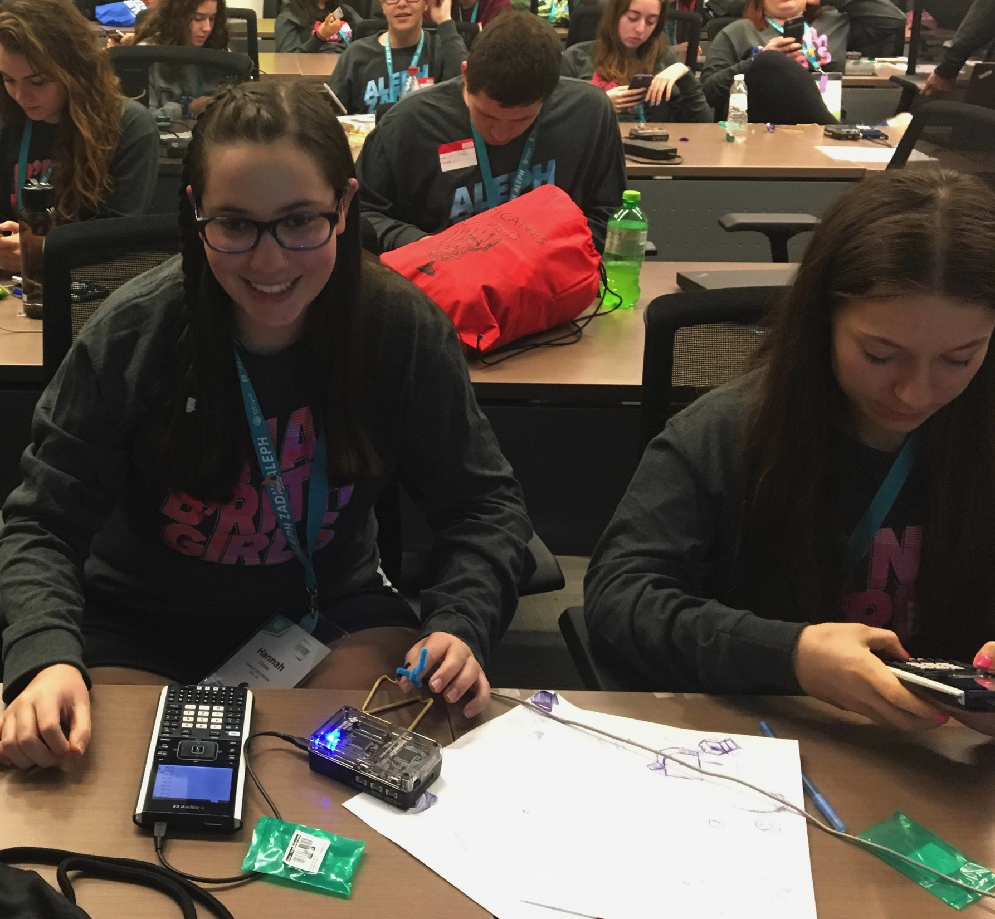
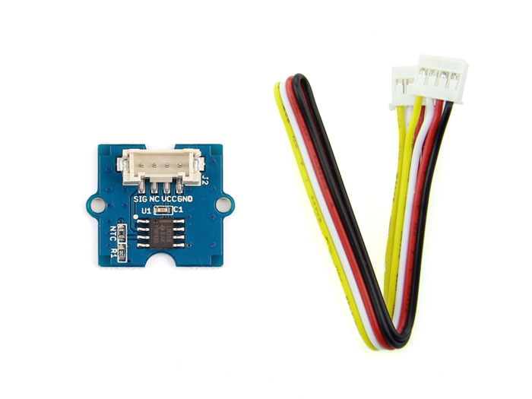
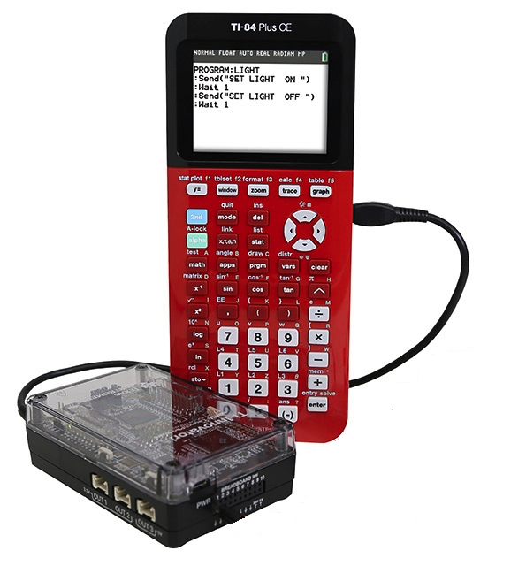
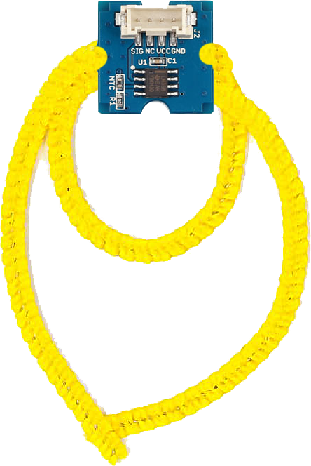
Digital Mood Ring (introduction to STEM and coding Projects for all levels)
Bring science and coding together (no coding experience necessary) while developing a mood ring! Explore the science of color mixing while determining the right body temperature thresholds.
This is an excellent first TI-Innovator STEM and coding project. The project includes variables, loops, conditional statements, Boolean operators and other fundamental programming concepts.
Use “Digital Mood Ring by challenges” document at URL http://bit.ly/2GBIsUN

Slide 8
Digital Mood Ring Challenges
Challenge 1: Use SET COLOR to explore using the color LED. Try to find the RGB values of all the colors in the mood chart.
Challenge 2: Use DispAt command to display your name at several locations on the screen.
Challenge 3: Use a For..EndFor loop to display the numbers 1 through 10.
Challenge 4: Connect a temperature sensor to the TI-Innovator Hub and display the temperature on the calculator.
Challenge 5: Use a loop to read and display temperature.
Challenge 5 Extension (Optional): Use a loop to read, display and log into list arrays for time and temperature. Graph the result.
Challenge 6: Use a While..End loop along with getKey function to monitor temperature and make a decision to display a message, “Hot” or “Cold”. Then modify your program to include a 3rd level between hot and cold, “Nice”.
Final Challenge: Build a mood ring to repeatedly read the temperature sensor, determine the mood of the person, display the temperature value and display the mood.
Use “Digital Mood Ring by challenges” document at URL http://bit.ly/2GBIsUN

Slide 9
Summary of programming concepts in the project
Control of a red-green-blue LED output
  Send(“SET COLOR 255 0 0”)
Display of text strings, variable values and expressions
  Output(4,1,“TIME (SEC) =“)
  Output(4,13,N*0.5)
For loops to repeat a set of commands a specified number of times
  For(N,1,10)
  commands within loop
  End
Connecting, reading and getting to a variable temperature sensor inputs
  Send(“CONNECT TEMPERATURE 1 TO IN 1”)
  Send(“READ TEMPERATURE 1”)
  Get(T)
Storing variables to variables using the store operator.
  9/5 x T+32➔F
List variables of a set of values and accessing individual elements of the list using the position number.
  {0.5,1,1.5,2}➔L₁
  2.5➔L₁(5)
  True/False comparison operators used in conditional statements for program control: =,≠,<,≤,>,≥
Assignment of initial values to variables to give the program known starting points.
  0➔K
  0➔dim(L₁)
While loops to repeat a set of commands while a condition is true
  While K≠45
  commands within loop
  End
Keyboard inputs using the TI-84 Plus CE getKey command that returns a two-digit number for the row and column (top left key, y=, is 11) of the last key pressed.
  getKey➔K
If-Then conditional statements that do a set of commands if a condition is true and are skipped if the condition is false
  If T<22
  Then
  commands within If-Then block
  End
Boolean operator and to require two conditional statements to be true for the entire statement to be true
  If T≥22 and T<25
  Then

Slide 10
Summary of TI-84 Plus CE concepts and skills
ON starts at the home screen. The home screen is used for calculations, running programs and for program display commands.
2nd Quit will return you to the home screen from any situation on the calculator.
Select from menus using arrow keys and enter or by the shortcut of the number or letter preceding the menu item
clear key to back out of menus and dialogues
The keyboard is divided into three sections:
  Scientific calculator and math functions (bottom)
  Entry, navigation and setup (middle)
  Graphing and function keys (top)
Press and release the 2nd key to access function labeled above the keys. The input cursor changes to an up arrow to indicate 2nd entry mode. Press the 2nd key again to toggle back to normal entry mode.
Press and release the Alpha key to access Alpha characters labeled above the keys. The input cursor changes to an Alpha to indicate Alpha entry mode. Press the Alpha key again to toggle back to normal entry mode.
The delete key deletes the character at the current cursor location.
2nd Insert sets insert mode to enter characters before the current cursor location. Insert mode is indicated by an underline cursor. 2nd Insert or arrow key toggles back to normal entry mode.
  Pressing the prgm key while on the home screen gives you options to select a program to run on the home screen, to edit an existing program or to create a new program.
  Editing a program or creating a new program puts you in the program editor. Pressing the prgm key while in the program editor brings up menus with programming functions.
  Alpha f5 while in the program editor brings up a menu of editor tools, including copy, paste and insert line and execute program.
  2nd Quit while in the program editor exits the editor and returns you to the home screen.
  The Sto➔ key stores values to variables.
  The calculator has single variable values of A-Z and Θ and list variables of L1 and L6.
2nd catalog brings up a list of the functions of the calculator.

Slide 11
Standards
NGSS 3-D Standards
  MS-PS1-1 Matter and its Interactions
    PS1-A Structure and Properties of Matter- solids may be formed from molecules, or they may be extended structures with repeating subunits (e.g., crystals
  Science and Engineering Practice:
    Developing and using Models
      Develop a model to predict and/or describe a phenomenon
  Crosscutting Concept:
    Within a natural system, the transfer of energy drives the motion of matter
Notes:
Other Relevant connections/Discussion
:
The physics of the actual liquid crystal address MS-PS1-1
https://www.youtube.com/watch?v=1yrtW9Licdo
The biology of blood flow and mood is a life science topic. The flight or fight autonomic response.
This is a basic example of an engineering feedback and control system, a fundamental programming structure used in all Hub projects.
It has a crosscutting concept with the human body’s homeostasis system.

Slide 12
Background: The Electromagnetic Spectrum

Slide 13
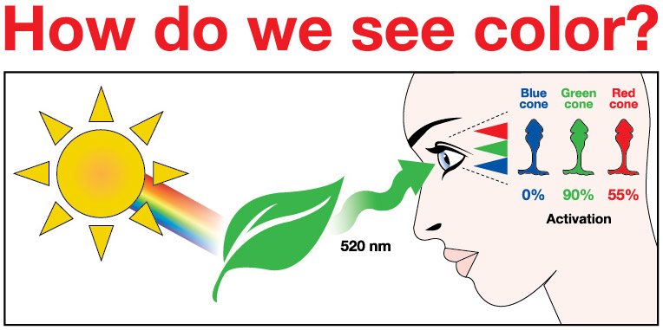
Notes:
The human eye has three different types of ‘cones’ on the retina- Red, Blue, and Green. These cones will be activated differently, by different wavelengths of light.
1. All the colors of the visible light spectrum shine on the leaf, but in this case, only light with 520 nm (green light) bounce off.
2. The surface of a green leaf absorbs all of the other colors of the spectrum, except for green, and reflects green to the human eye. Green light reflected stimulates the eye’s cone cells to varying degrees. Which wavelengths are reflected or absorbed depends on the properties of the object.
3. Humans would not be able to see color or objects without LIGHT! Light has to reflect off an object in order to see it.
Different combinations (%) of activation of the 3 types of rods will allow the brain to perceive signals from the retina as different colors. Some estimate that humans are able to distinguish about 10 million colors.

Slide 14
TI-84 Plus CE Resources:
Step-by-Step YouTubevideos designed for the teacher with a detailed, demonstration of each challenge.
The videos are intended to guide those new programming in general, programming on the TI-84 Plus CE and programming with the TI-Innovator Hub.
  https://www.youtube.com/playlist?list=PL17Fe0ZmhCR-PAuv5pw85vxrtLu5YGeWl
10 Minutes of Code with TI-Innovator:
https://education.ti.com/en/activities/ti-codes/84/10-minutes-innovator
10 Minutes of Code Teacher’s Lounge (TI-84 Plus CE): Select link to download zip files with PDF’s of all of the 10 Minutes of code lessons, teacher and student documents.
  https://education.ti.com/en/activities/ti-codes/84/teacher-lounge
TI-Innovator Technology eGuide
  https://education.ti.com/html/webhelp/EG_Innovator/EN/index.html
TI-Innovator Hub Commands
  https://education.ti.com/html/webhelp/EG_Innovator/EN/content/eg_innovsys/resources/pdf/ti-innovator_hub_commands_en.pdf
TI-84 Plus CE TI-Basic Programming Guide
  https://education.ti.com/html/webhelp/EG_TI84PlusCECode/EN/index.html
TI-84 Plus CE Reference Guide
  https://education.ti.com/html/webhelp/EG_TI84PlusCECode/EN/index.html

Slide 15
Project Final Challenge

Slide 16
Final Challenge
Digital Mood Ring with TI-Nspire and
TI-Innovator™ Hub student STEM project
Final Challenge: Build a mood ring to repeatedly read a temperature sensor, determine the mood of the person, display the temperature value and display the mood.

Slide 17
Chenille Wire (AKA “Pipe Cleaner”)

Slide 18
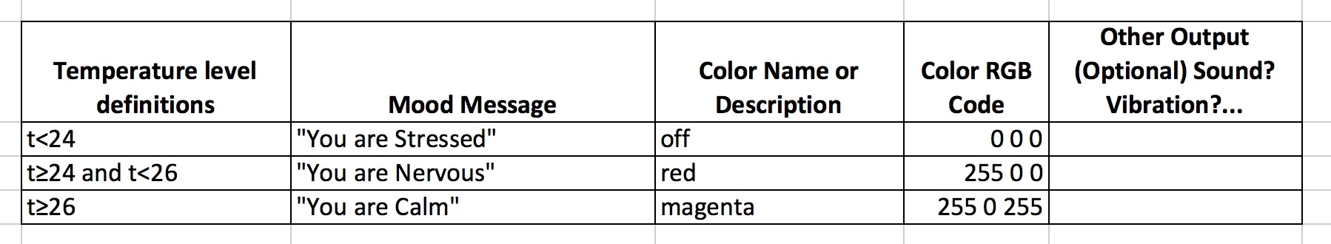
Defining your digital mood ring

Slide 19
Digital Mood Ring for TI-84 Plus CE
Simple Example Program
Send("CONNECT TEMPERATURE 1 TO IN 1”)
0➔K
Output(8,1,”PRESS CLEAR TO QUIT”)
While K≠45
getKey➔K
Send("READ TEMPERATURE 1”)
Get(T)
Output(4,1,”TEMP(°C)= ”)
Output(4,11,T)
If T<24
Then
Send("SET COLOR 0 0 0”)
Output(5,1,”YOU ARE STRESSED”)
End
If T≥24 and T<26
Then
Send("SET COLOR 255 0 0”)
Output(5,1,”YOU ARE NERVOUS ”)
End
If T≥26
Then
Send "SET COLOR 255 0 255”
Output(5,1,”YOU ARE CALM ”)
End
Wait 0.5
EndWhile
Send "SET COLOR 0 0 0”

Slide 20
Digital Mood Ring for TI-84 Plus CE
Simple Example Program
Send("CONNECT TEMPERATURE 1 TO IN 1”)
0➔K
Output(8,1,”PRESS CLEAR TO QUIT”)
While K≠45
getKey➔K
Send("READ TEMPERATURE 1”)
Get(T)
Output(4,1,”TEMP(°C)= ”)
Output(4,11,T)
If T<24
Then
Send("SET COLOR 0 0 0”)
Output(5,1,”YOU ARE STRESSED”)
End
If T≥24 and T<26
Then
Send("SET COLOR 255 0 0”)
Output(5,1,”YOU ARE NERVOUS ”)
End
If T≥26
Then
Send "SET COLOR 255 0 255”
Output(5,1,”YOU ARE CALM ”)
End
Wait 0.5
EndWhile
Send "SET COLOR 0 0 0”
Setup
Inputs
While Loop
Outputs
Clean up

Slide 21
Process of Engineering DESIGN and COMPUTATIONAL THINKING

Slide 22
Engineering Design Process
Define Problem
Design a proposed solution
Present group’s design to class.
Listen to feedback and make appropriate changes.
Build and test the design.
Use test results to make appropriate and informed changes to design.
Present your solution to class.

Slide 23
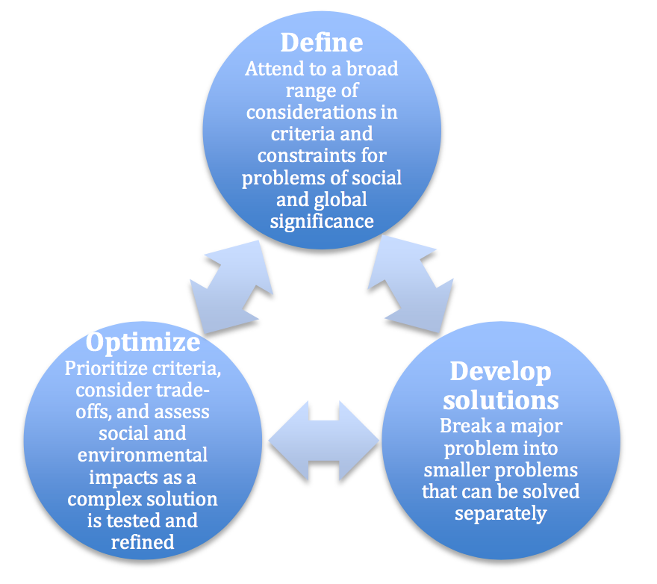
Engineering Design Process
Defining and delimiting engineering problems involves stating the problem to be solved as clearly as possible in terms of criteria for success, and constraints or limits.
Designing solutions to engineering problems begins with generating a number of different possible solutions, then evaluating potential solutions to see which ones best meet the criteria and constraints of the problem.
Optimizing the design solution involves a process in which solutions are systematically tested and refined and the final design is improved by trading off less important features for those that are more important.
It is important to point out that these component ideas do not always follow in order, any more than do the “steps” of scientific inquiry. At any stage, a problem-solver can redefine the problem or generate new solutions to replace an idea that just isn’t working out.
Authors: NGSS Lead States
Title: Next Generation Science Standards: For States, By States – Engineering Design
Copyright Date: 2013
Source: Next Generation Science Standards
http://www.nextgenscience.org/sites/default/files/Appendix%20I%20-%20Engineering%20Design%20in%20NGSS%20-%20FINAL_V2.pdf
Notes:
Permission received from NGSS.

Slide 24
Computational Thinking
NGSS Science and Engineering Practices
Using Mathematics and Computational Thinking
http://ngss.nsta.org/Practices.aspx?id=5

Slide 25
Value of Pseudocode
What is Pseudo code?
Pseudo code is basically written instructions of what a program should do to complete an operation. The pseudo code is written in your speaking language. You simply write down the steps of an algorithm or procedure to make it easier for you or someone else to read it and convert it to a real programming language.
Why was it made/is it used?
It was made to help you specify the steps of a procedure, process or an algorithm without using a programming language. One possible alternative is to use flowcharts.

Slide 26
Planning your program
Important steps in your program | TI-Basic commands to implement steps in your program
1.
2.
3.
4.
5…

Slide 27
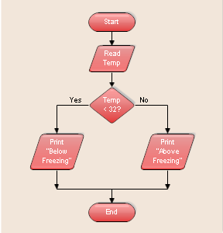
Using a flowchart to plan:
Sample, simple flowchart:
Input
Decision Point
Output
Notes:
Flowcharts can be helpful tools to think through what the program needs to do.
More about using Flowcharts for planning:
https://www.codeavengers.com/notes/planning/flowcharts
draw.io is a good online tool you can use to create flowcharts. You can logon with a Google Drive account.

