Slide 1
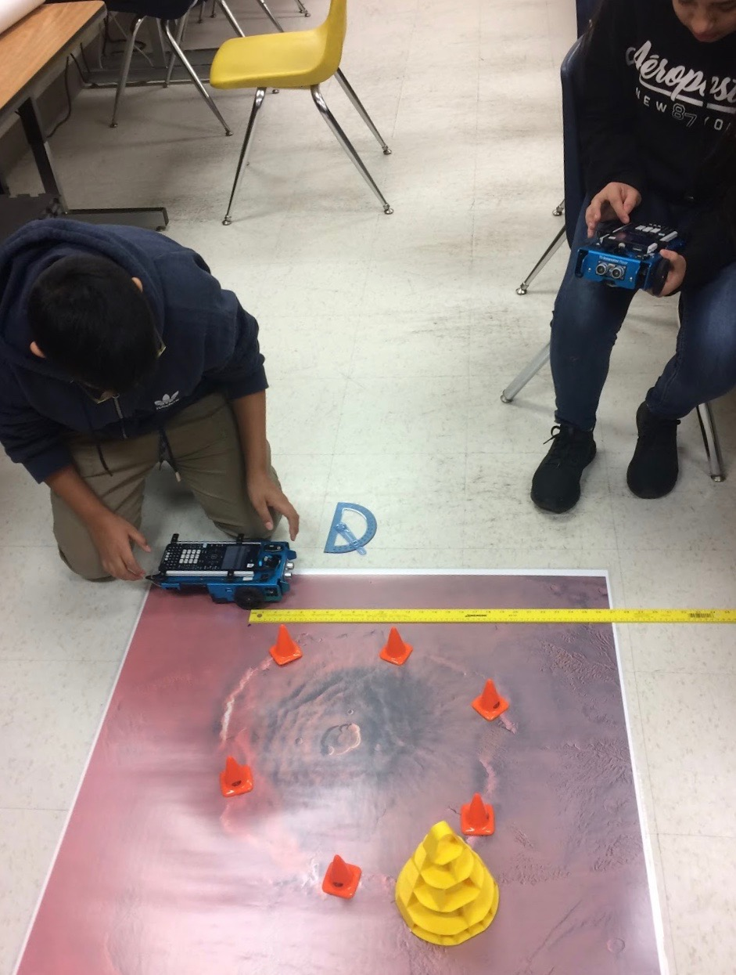
Mars Rover Challenge – Path around Olympus Mons
(middle and early high school)
Olympus Mons on the surface of Mars at 69,841 feet (more than twice the height of Mt Everest) is considered to be the tallest mountain on a planet in the solar system. Students will learn and use basic concepts for robotic vehicle control along with math concepts to write a program to drive their Rover around the base of the mountain.
Note: Also, includes concepts to give students an on-ramp to participating on robotics teams.
Project Overview: Prepare for the final challenge by working with basic concepts for moving a robotic vehicle: setting direction and power for the motor controlling each wheel, moving forward and backward, turning. You will apply math concepts of distance-rate-time and angles as part of writing programs to set the vehicle path.
Your challenge: Plot a course and write a program to drive your Rover around the base of the Olympus Mons. Who can have their Rover complete the course in the fastest time?

Slide 2
On-Ramp to Robotics: Unit 1 Motion Skill Builders
TI-Nspire CX
Skill Builder 1: Moving Forward
Control of motor power level and spin direction in relation to vehicle movement.
  Example Rover command: Send "RV.MOTORS LEFT CCW 200 RIGHT CW 200 TIME 10”
Mini-Challenge: Drive Rover in a straight line for a specified distance.
Skill Builder 2: Turning
Turning Left and Right
  Example Rover Command: Send "RV RIGHT 45”
For Loop
Mini-Challenge: Write a program to have your Rover move around the hours of a clock.
Skill Builder 3: Turtle Commands
Creating a path using Forward, Backward, Left, Right Commands
  Send "RV RIGHT 30”
  Send "RV FORWARD .7 M"
Measurement of distance and angles
Mini-Challenge: Create a path to navigate around obstacles.

Slide 3
On-Ramp to Robotics: Unit 1 Motion Skill Builders
TI-84 Plus CE
Skill Builder 1: Moving Forward
Control of motor power level and spin direction in relation to vehicle movement.
  Example Rover command: Send(“RV.MOTORS LEFT CCW 200 RIGHT CW 200 TIME 10”)
Mini-Challenge: Drive Rover in a straight line for a specified distance.
Skill Builder 2: Turning
Turning Left and Right
  Example Rover Command: Send(“ RV RIGHT 45”)
For Loop
Mini-Challenge: Write a program to have your Rover move around the hours of a clock.
Skill Builder 3: Turtle Commands
Creating a path using Forward, Backward, Left, Right Commands
  Send("RV RIGHT 30”)
  Send("RV FORWARD .7 M”)
Measurement of distance and angles
Mini-Challenge: Create a path to navigate around obstacles.

Slide 4
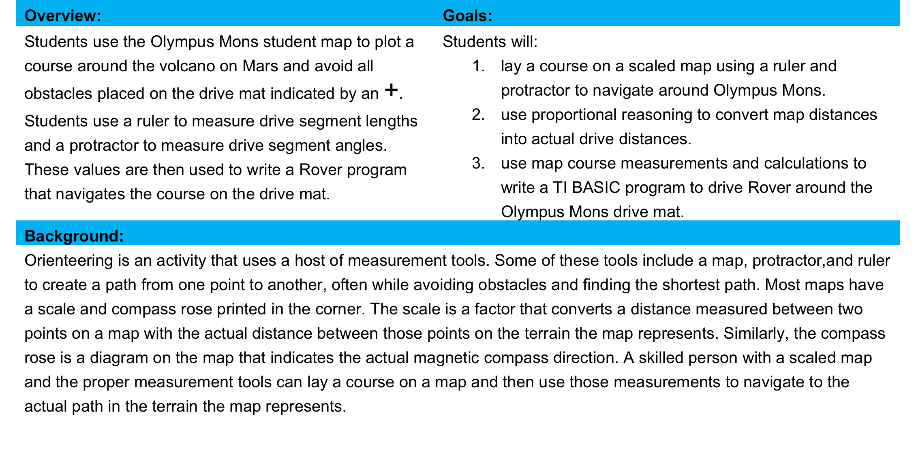
On-Ramp to Robotics: Unit 1 Motion Final Challenge

Slide 5
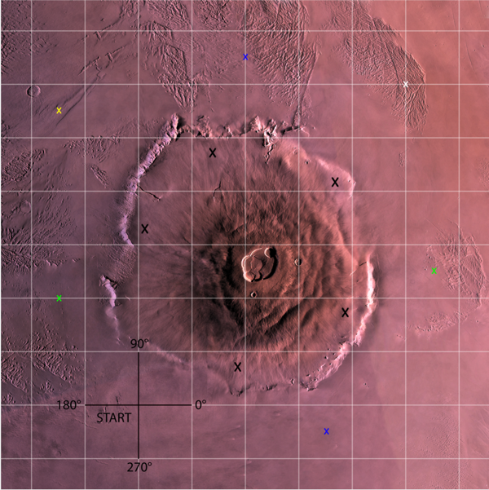
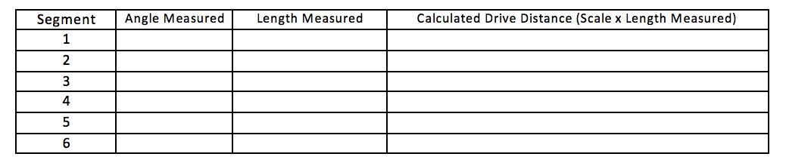
Olympus Mons Challenge Student Document
Note: Use Black X’s. Color X’s are for Unit 2 Mineral Challenge

Slide 6
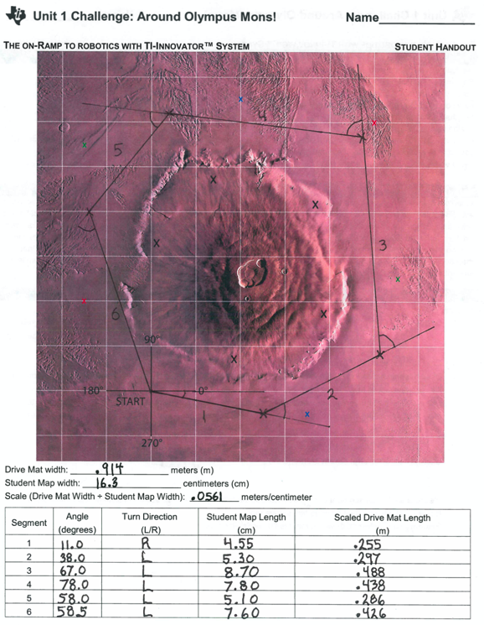
Olympus Mons Challenge Student – Example Solution

