Slide 1
Meet Wonder Workshop™ Dash with Geometry Challenges TI-84 Plus CE Python
Texas Instruments
@ticalculators

Slide 2
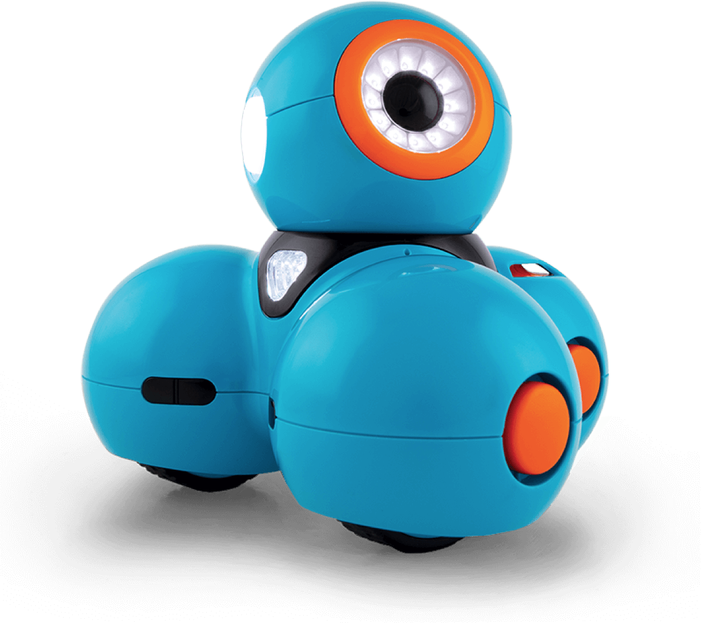
Meet the Wonder Workshop™ Dash

Slide 3
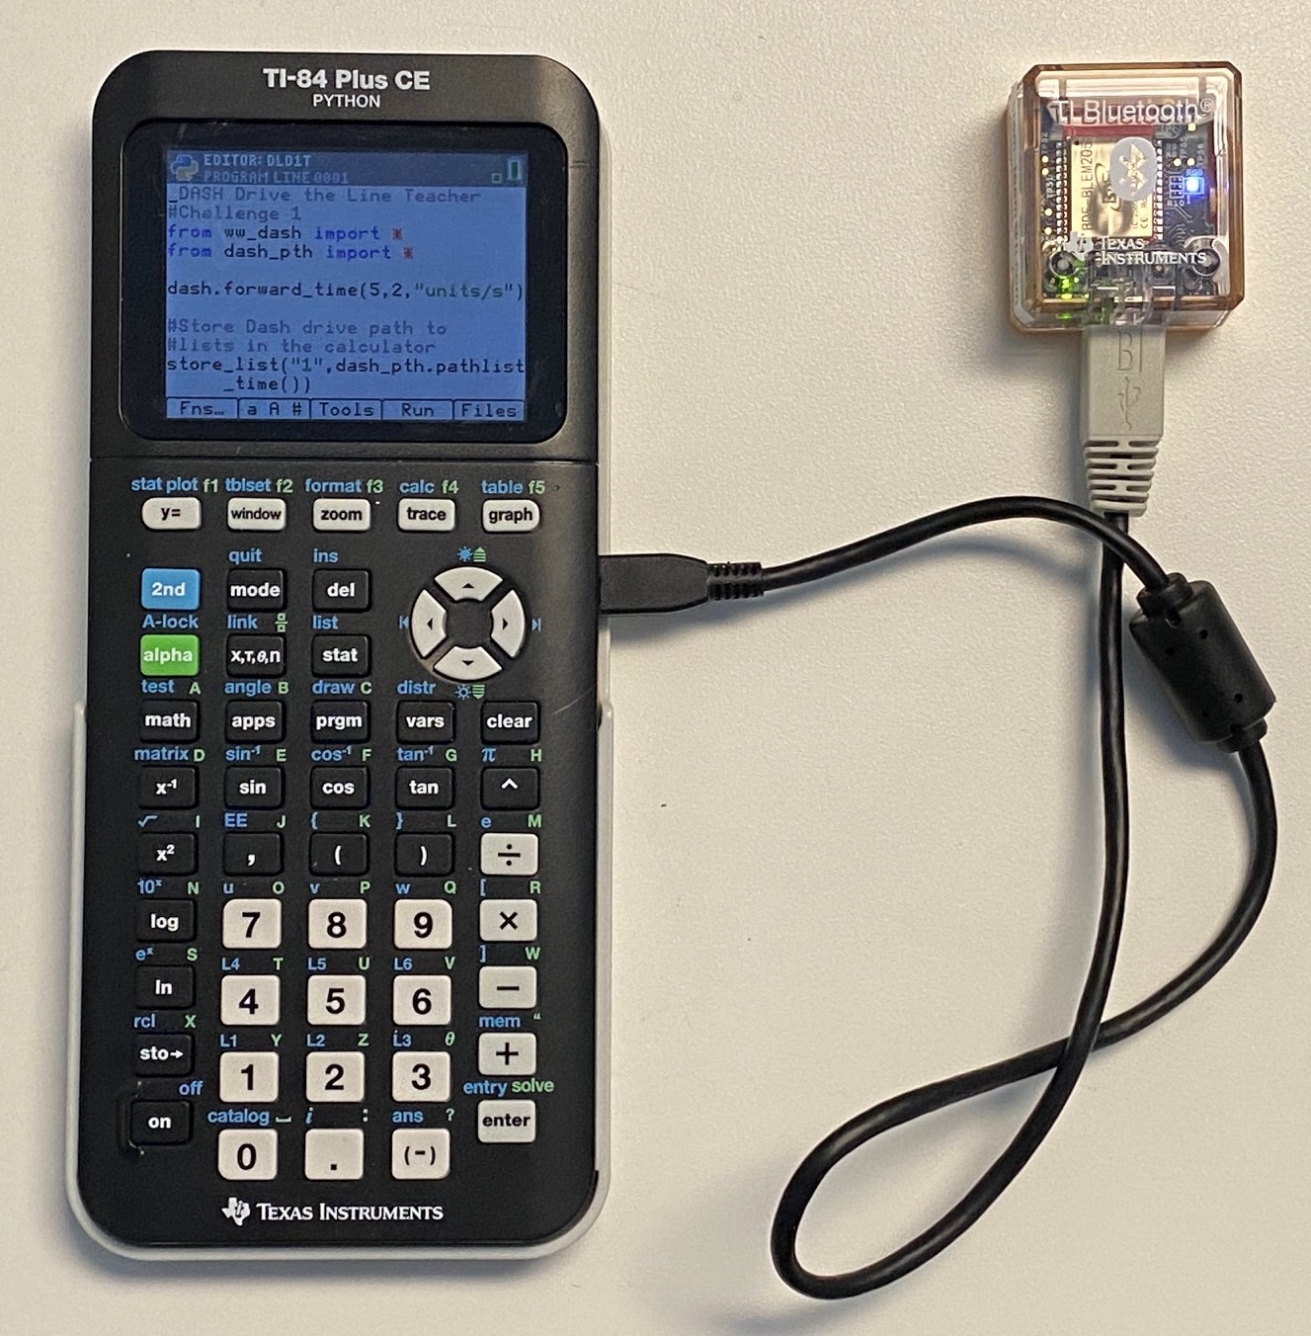

Control the Dash using Python from the TI-84 Plus CE over Bluetooth Wireless
TI Bluetooth Adapter
Wonder Workshop™ Dash
TI-84 Plus CE
Python

Slide 4
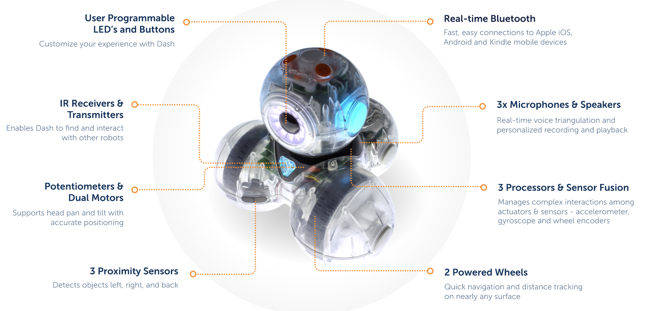
Meet the Wonder Workshop™ Dash

Slide 5
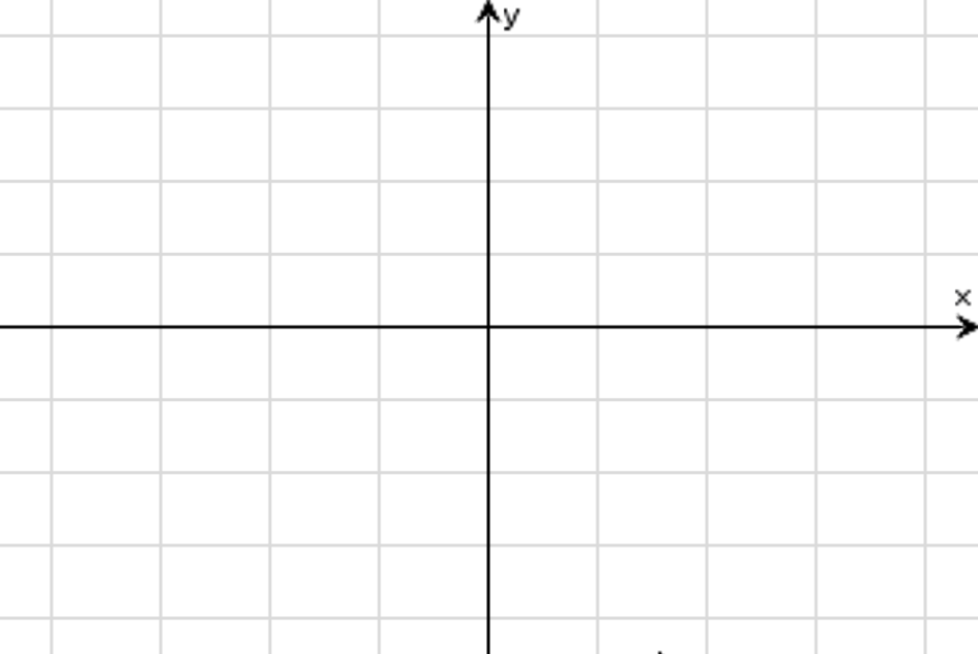
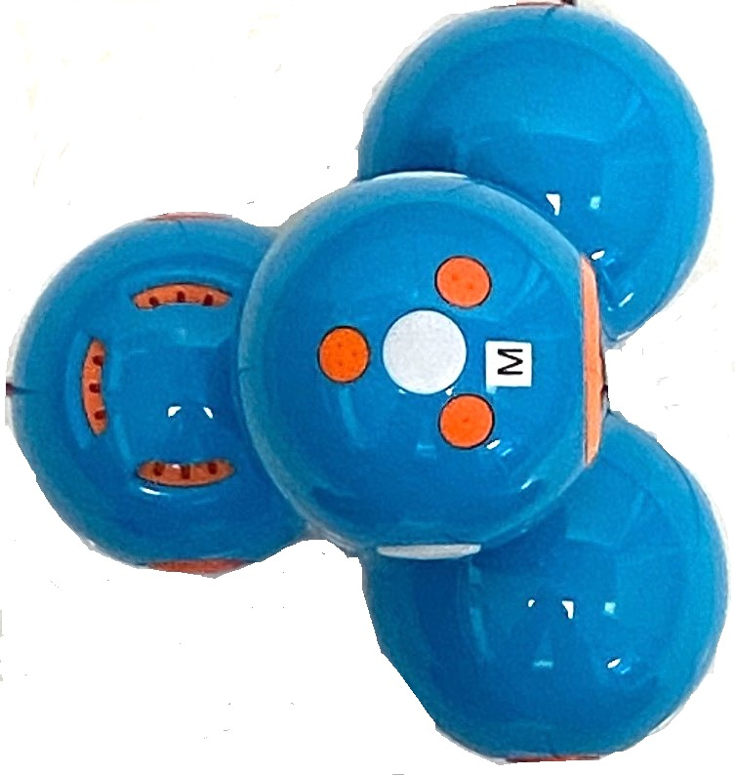
Dash orientation and virtual grid
90º
0º
180º
270º
Dash programs set the initial position as the origin and the heading as 0 degrees measured from the x-axis.
Note: The Dash tracks its position on a virtual coordinate grid with a unit value of 10 cm. The coordinate grid position applies to the to_xy(x,y), to_polar(r,theta_degrees) and to_angle(angle, “unit”) functions on the Dash Drive menu. The virtual grid also applies to Path menu functions.

Slide 6
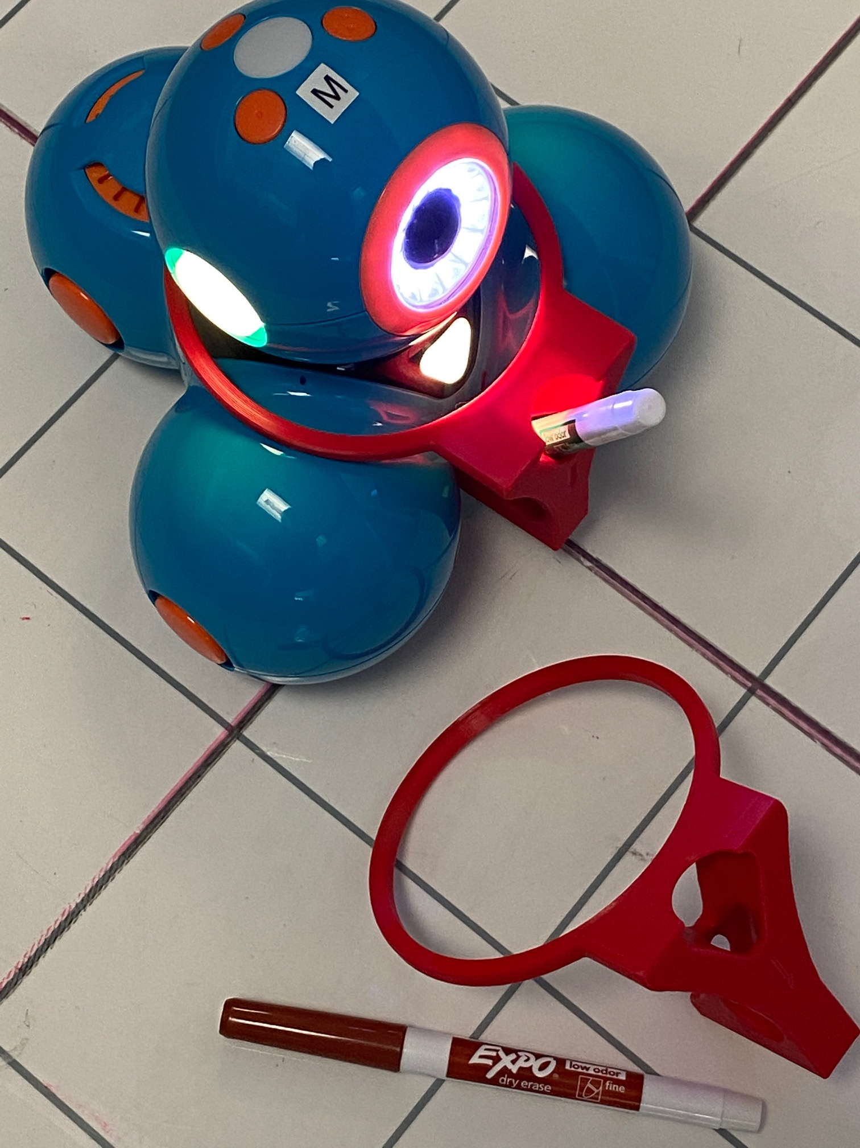
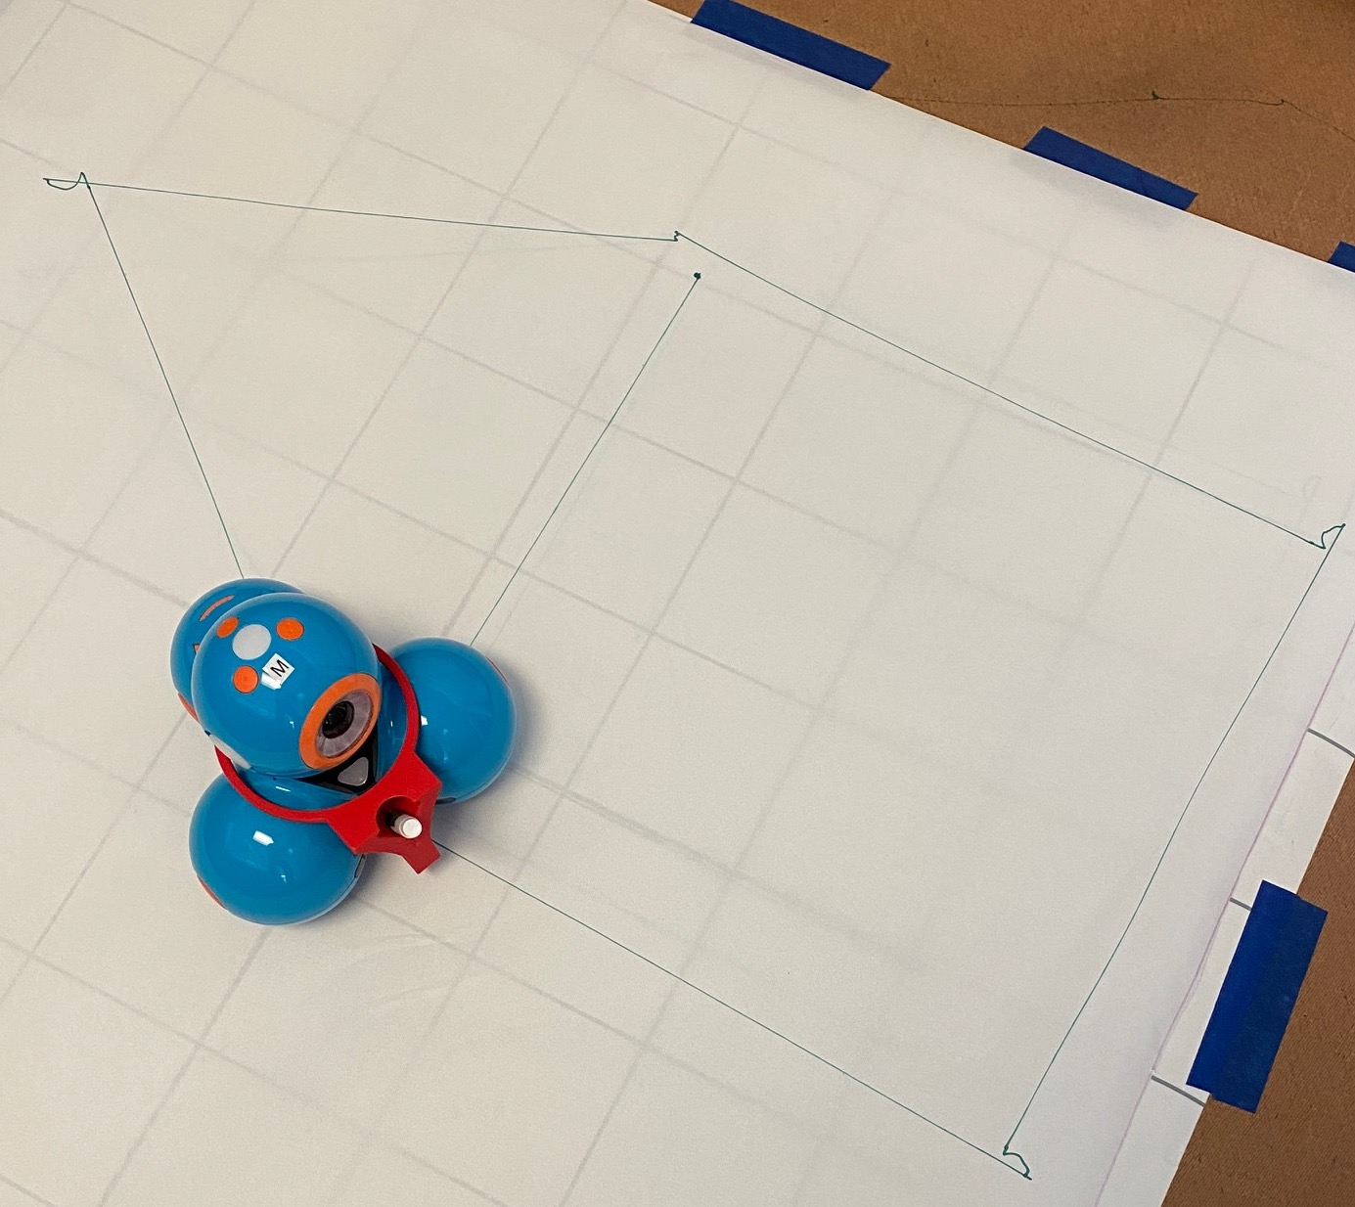
Draw with your Dash
Optional
3D Print a snap-on attachment to hold Expo Fine dry erase markers for your Dash.
Step 1: Download .stl file at this link.
Step 2: 3D print following these recommendations.
Material PLA
Supports not recommended.
20% infill
3 to 4 shells
0.2mm layer height

Slide 7
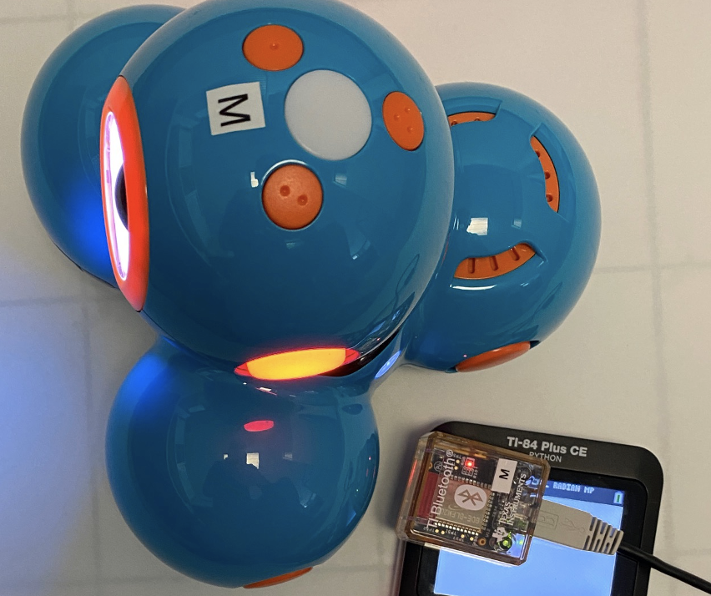
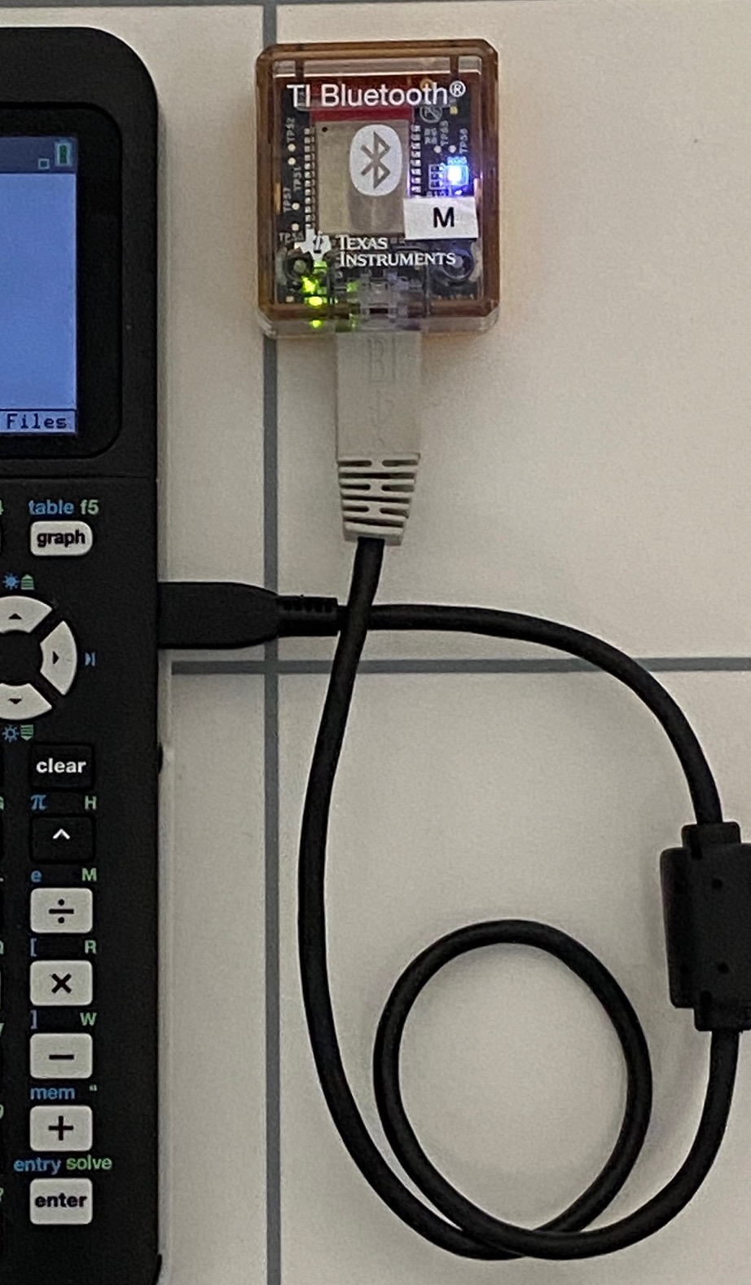
Setting up your calculator and TI Bluetooth adapter to run Dash Find step-by-step directions in the Getting Started Guide at education.ti.com/dash
3
Turn on a Dash.
Use the SetDash App to search for and select a Dash to pair with the TI Bluetooth Adapter.
The Adapter “remembers” the Dash that it is paired with until you use the SetDash App to make a change.
Students can share a Dash by passing a paired Adapter to plug into their calculator.
Use stick-on letters or names to identify Dash/Adapter pairs. (”M” is used in the photo.)
Note: The color of the adapter LED and the paired Dash LED’s match (Red in the Photo.). Use the SetDash App to control the Dash color.
Follow the steps below to put the necessary files onto your calculator and to pair your TI Bluetooth Adapter with a Dash.
1
Download the ww_dash Python module and the SetDash App files to your calculator using the CE Connect computer application.
2
Plug the TI Bluetooth Adapter into your calculator.
4
Quit the SetDash App. You are now ready to write and run Python programs to control the Dash.

Slide 8
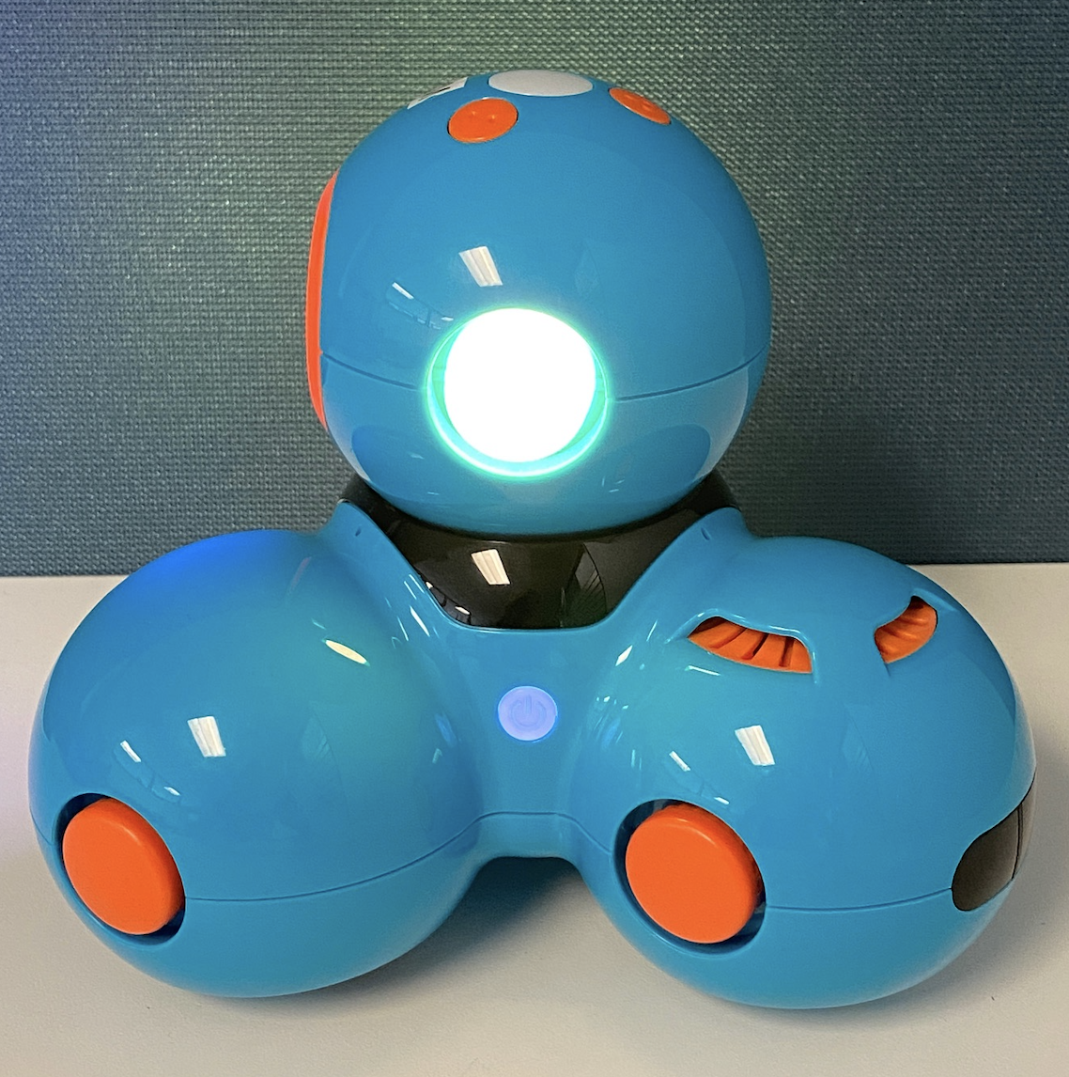
Getting ready to run a Dash program
1
Make sure that your Dash is switched on.
2
Plug the Bluetooth Adapter that is paired with the Dash into the calculator.
You are now ready to run Python programs that control the Dash.

Slide 9
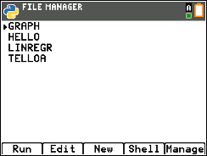
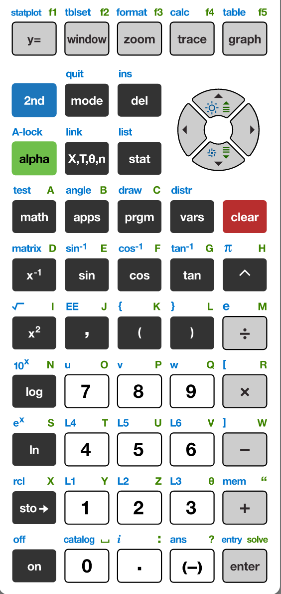
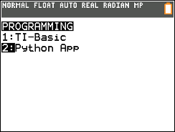
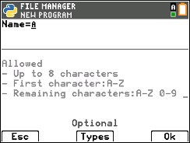
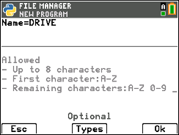
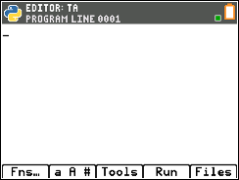
Creating a new Python Program
1
2
3
4
Press down arrow [enter] or Press [2] to
select 2: Python App
You have the option to run, edit, create or manage programs.
Press [New] softkey (zoom button)
5
6
7
Press the [prgm] key to create, edit and execute
TI-Python programs.
You are prompted to enter a program name.
The blinking A cursor shows that you are in alpha entry mode. The
green alpha labels on the keys are active.
Type your program name and press [Ok].
You are now in position to begin entering statements to your program.

Slide 10
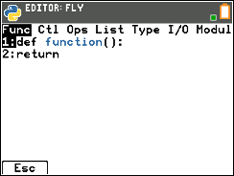
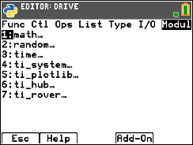
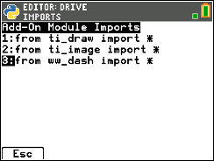
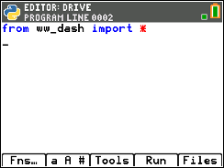
Entering a Dash Program – importing the Dash module
1
2
3
4
The Python program editor uses an insert cursor and a backspace delete.
Press [Fns…] softkey to see functions to use in your program.
Press right arrow repeatedly or left arrow to move to the Modul menu.
You will see a menu of installed modules available to use functions from.
You will need to add ww_dash to the installed module list.
Press [Add-On] softkey (trace button).
Select from ww_dash import * from the Add-On menu.
Use down arrow, if necessary, to move to the selection, then Press [enter].
5
The ww_dash module import statement is pasted to your program.
The ww_dash import statement is required at the beginning of every Dash program.
This import statement brings in Dash functions to use in your program, sets Dash’s initial position and sets up communication between the calculator and the Bluetooth Adapter.

Slide 11
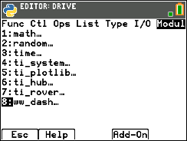
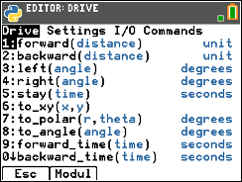
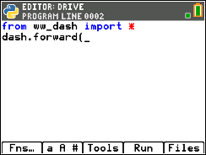
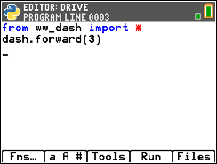
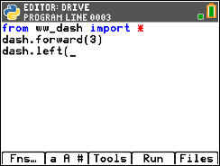
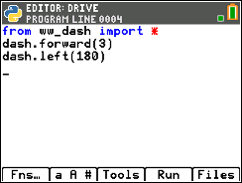
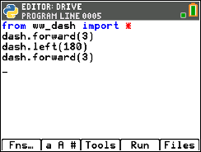
Entering a Dash Program
1
2
3
4
You are now ready to enter functions to control your Dash. Navigate to the Dash menus by pressing [Fns…] then arrow to the Modul menu.
Then select ww_dash... to see options.
You begin on the Drive menu. Select the 1:forward() function.
Enter a value for the number of Dash units to drive forward. Arrow to the end of the statement and press [enter] to move to the next statement.
A faster approach is to use [2nd] [enter] from any place on a line to complete the statement and move the cursor to the beginning of a blank line below.
Note: It is important that each statement begin on a new line.
5
6
7
8
Navigate to the Drive menu again by press [fns…], left arrow, select ww_dash...,3:left() to select the left turn function.
Enter a value for the angle to turn in degrees. Press [2nd] [enter] to complete the statement and move to the beginning of new statement on the line below.
Navigate to the Drive menu again, then select 1:forward(). After the function is pasted enter the Dash units to drive.
Press [2nd] [enter] to complete the statement.
You are now ready to run your Dash program.
.

Slide 12
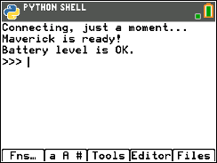
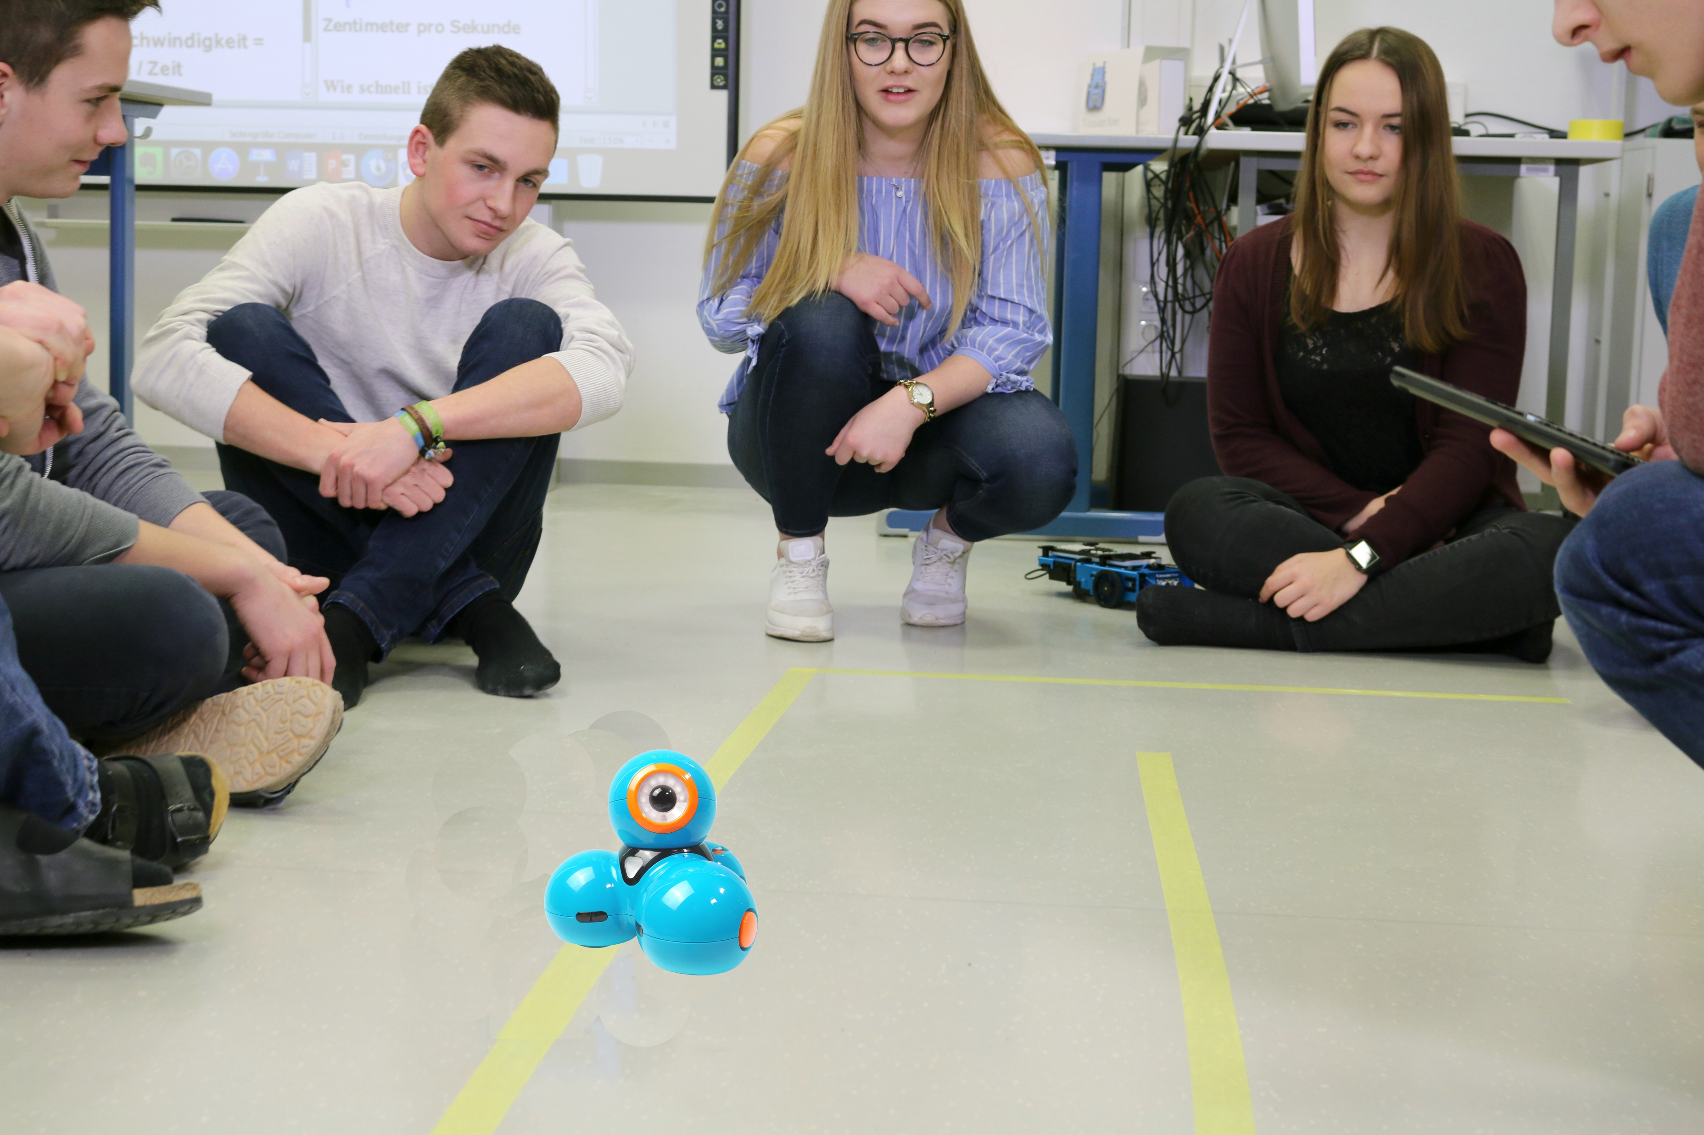
Running a Dash Program
1
2
You are now ready to run your program.
Before pressing [Run], go through the pre-drive checklist.
Make sure that Dash is turned ON.
Make sure that the calculator is connected to the Bluetooth Adapter.
Press [Run].
The program will run in the Python shell. You will receive messages on the status of the program.
You can run the program again by pressing [Tools] and selecting 1:Rerun Last Program from the menu.
You can return to the program editor by pressing [Editor].

Slide 13
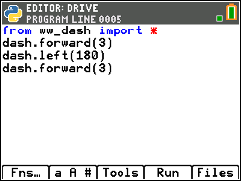
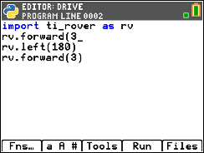



Editing a Dash Program
1
2
3
4
Press [Editor] to go back to your Python editor page.
Use the arrow keys to position the cursor to change the value of the forward distance.
Press [del] to backspace over the 3.
Type in a new value for distance,
right arrow to the end of the line,
then down arrow to position the
cursor to change the value of
the second forward() function.
5
6
7
Press [del] to backspace over the current distance value. Type in a new value for distance.
Press [2nd] [enter] to complete the statement.
Press [Run] to run the program in the Python shell.

Slide 14
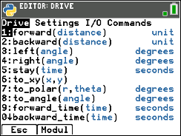
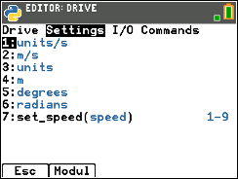
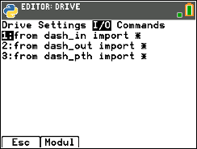
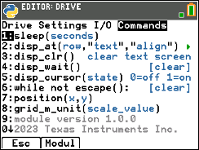
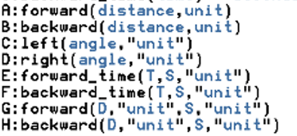
Dash Module Menus
Drive
Settings
Input/Output (I/O)
Commands

Slide 15
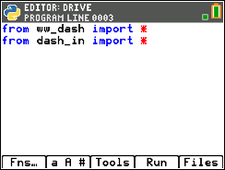
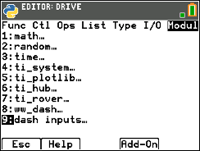
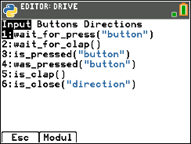
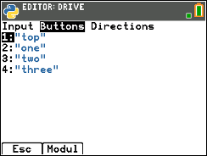
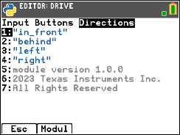
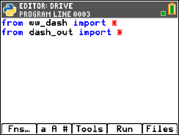
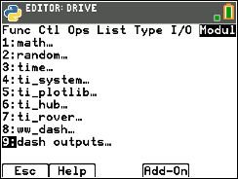
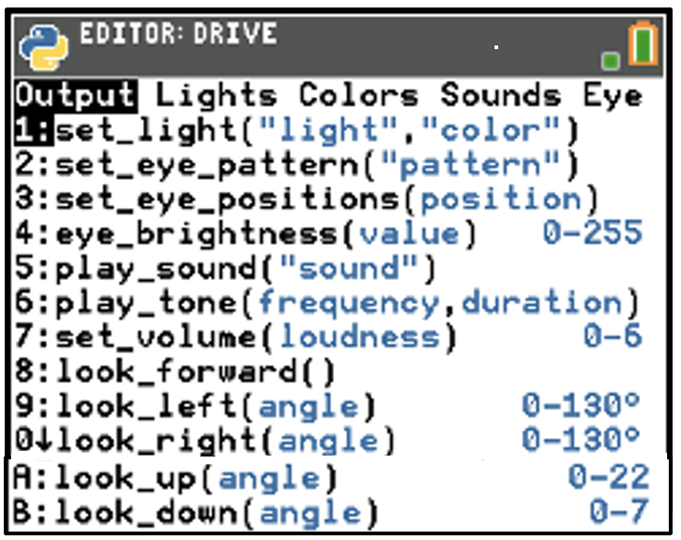
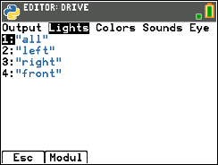
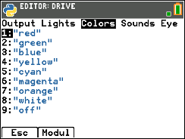
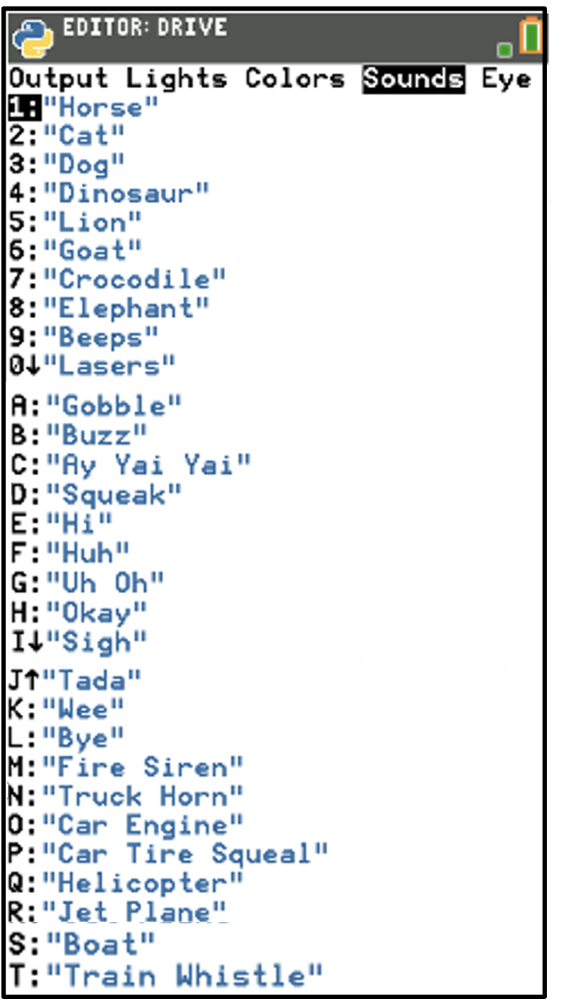
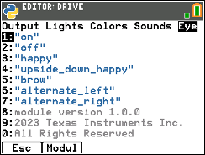
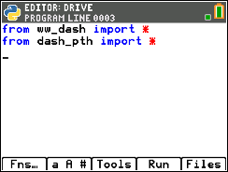
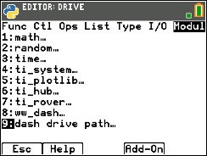


Dash Module Menus – I/O
Input/Output (I/O)
Inputs
Outputs
Path

Slide 16





Copying and Pasting a Line of Code
1
2
3
4
Use arrow keys to move the cursor to a position anywhere on the line that you would like to copy.
Press [Tools] then select 6:Copy Line from the menu.
After you select you will be returned to the editor.
Use arrow keys to move the cursor to any location on the line above where you would like to insert the copied line.
Press [Tools] then select 7:Paste Line Below from the menu. The copied line will be pasted.
5
You can paste again by returning to the [Tools] menu and selecting 7:Paste Line Below.

Slide 17



Opening an existing Python Program File
1
2
3
4
5
Press [enter] or
Press [2] to
select 2: Python App
To edit an existing program, use the Up and Down Arrow keys to select a program.
Press [Edit] to open with Python Editor with the selected program.
You can now make changes to the program or run the program.
Press the [prgm] key to create, edit and execute
TI-Python programs.

Slide 18




Copying/Replicating a Python Program File
1
2
3
4
Press [Files] to return to the file management screen.
Use the Up and Down Arrow keys to select a program.
Press [Manage] to see file options.
Select 1:Replicate Program to receive a prompt.
5
6
7
Type in the name of the new program using the green alpha key labels.
To use a number in the name, exit alpha mode by pressing [2nd] [alpha] then a number key.
Press [Ok] to finish the dialogue.
You are now in the editor ready to make changes or to run the new program.

Slide 19





Creating a new Dash Python Program using WW Dash Helpers…
Use the Dash Helper menu when creating new programs to automatically paste import module statements and the necessary functions for different types of applications.
1
2
3
4
5
6
Press down arrow [enter] or Press [2] to
select 2: Python App
You have the option to run, edit, create or manage programs.
Press [New] softkey (zoom button)
Type your program name.
Then press the [Types] softkey to see options.
7
8
9
10
11
Press the [prgm] key to create, edit and execute
TI-Python programs.
select 9: WW Dash Helpers… from the menu.
Dash Helpers are optional activities and examples that will paste the necessary module import statements
You have options to choose from a Menu of Activities that will paste the necessary module import statements and functions to begin your program.
Right arrow to see a list of example programs.
Selecting from this menu will paste the necessary statements for different programs that you may be of interest.
Press [3] to select 3:Drive a rectangle.
Your Example selection is displayed on the screen just above the [Types] softkey label.
Press [Ok] to create the program using the Drive the Rectangle example.
The program is ready to edit or run.

Slide 20


Entry and Edit Tips
Use number key shortcuts or arrow keys and [enter] to select from menus
Use arrow keys to move the cursor around the screen.
Use [alpha] repeatedly to cycle from numeric, to lower case alpha to upper case alpha entry mode. The cursor indicates the current mode.
Use [2nd] [A-lock] to lock to alpha entry or to return to numeric entry.
Use [Fns…] softkey to bring up Python function menus, including the Modul (modules) menu.
Use [clear] or [Esc] softkey to back out of a menu.
Use [del] as a destructive backspace
Use [2nd] [enter] from any place on a line to complete the statement and move the cursor to the beginning of a blank line below.
Use [Tools] softkey menu to undo a clear and to copy, cut, paste and more.
Use [Editor] softkey to return to the editor from the Shell.
Use [2nd] [quit] to leave the Python app and return to the calculator.

Slide 21
MAKE IT MOVE!
Task: Discover how far Dash drives per unit.
Use differing values (1-20) to determine what 1 Dash unit is
New Program:
Press [Run] to run the program in the Python shell.
From the Python shell, press [Editor] to move from the shell to the Python editor.
Press [Fns…], left arrow, then select 8: ww_dash… from the menu. Then select 1:forward() function.
Press [Fns…], left arrow, then press the [Add-On] softkey to import the ww_dash Python module.

Slide 22












Have Dash make a sound
Task: Have your Dash play a sound while driving.
Challenge Task: Have your Dash make a “Fire Siren” sound.
Import the dash_out Python module, which includes sound capabilities. Move your cursor to the beginning of the row with the forward function. Press [Fns…], left arrow, then 8:ww_dash… then right arrow to the I/O menu and select 2:from dash_out import *
Add the play_sound function to the program.
Insert a blank row: Press [Tools] 4:Insert Line Above ].
Then Press [Fns…], left arrow, then 9:dash_out…for the Dash output menus.
Select 5:play_sound( )
Edit Program:
Select a sound to play.
Then Press [Fns…], left arrow, then 9:dash_out… Then right arrow to the Sounds menu. Use the up and down arrow keys and [enter] or number and letter keys to choose your sound.
Press [Run] to run your program.

Slide 23









Set the color
Task: Set the color output of the
Red, Green, Blue (RGB) LED.
Each color takes a value
of (0-255).
Challenge Tasks:
Try to make Yellow or Cyan or Magenta.
Extra Challenge: Make your own color and give the color a fun name.
Import the ww_dash Python module. Press [Fns…], left arrow, then press the [Add-On] softkey.
Import the dash_out Python module. Press [Fns…], left arrow, then 8:ww_dash… then right arrow to the I/O menu and select 2:from dash_out import *
Add the set_light function to the program. Press [Fns…], left arrow, then 9:dash_out…for the Dash output menus. Select 1:set_light( )
New Program:
Select which Dash lights to change and set the color of the lights.
Press [Fns…], left arrow, then 9:dash_out… Right arrow to the Lights Menu. Select 1:”all”.
Then right arrow past the comma to begin entering the Red, Green and Blue values to create your color. Enter a value for the Red component of the color followed by a comma, then enter Green followed by a comma, then enter Blue followed by [2nd] [enter] to complete the statement.

Slide 24


Explore angles
New Program:
Task: Drive a square.
Challenge Task: Try to drive an equilateral triangle.
See the inputs for the most common drive functions below.
Press [Fns…], left arrow, then press the [Add-On] softkey to import the ww_dash Python module.
Press [Fns…], left arrow, then 8:ww_dash… for the Dash menus.
Press [Run] to run the program in the Python shell.
Notes:
Explain import ww_dashmodule
Then demo how to import and how to enter the statements.
Give time to explore.

Slide 25


Quick Math Reminders
Complementary Angles:
Sum to 90 degrees
Supplementary Angles:
Sum to 180 degrees

Slide 26


Quick Math Reminders
Exterior angles:
Interior Angles:

Slide 27
Logic Challenge
Task: Draw the figure shown large enough for Dash to drive.
Note: Try side lengths of ~ .4 Meters
Write a program to have your Dash drive the figure without crossing any lines or going back over a line.
When your Rover on the drawing
Notes:
First challenge is to drive the shape without crossing any lines and without picking up the pen.

Slide 28
Logic Challenge
Marker version
Task: Drive the figure shown without crossing any lines or going back over a line and without picking up the pen.
Note: Try side lengths of ~ .4 Meters
When you are ready, put the pen in and trace your path.
Note: For more information about marker holder 3D Print file see the earlier slide in this deck.
Notes:
First challenge is to drive the shape without crossing any lines and without picking up the pen.

Slide 29







Where can you go next with TI-Rover and Dash?
Drive an obstacle course
Drive a design
Draw artwork
Use a For loop
to draw polygons
Write your name
Navigate a map
Park your Rover

Slide 30

Quick Math Reminders
Pythagorean Theorem

Slide 31



Logic Challenge 2
Task: Draw the figure shown large enough for Dash to drive.
Write a program to have your Dash drive the figure without crossing any lines. or going back over a line.
Import the Python Math module in addition to the Rover module for this challenge.
Notes:
We will need to import the math library
First challenge is to drive the shape without crossing any lines and without picking up the pen.
Second will be to drive at least one segment in reverse direction.

Slide 32
Logic Challenge 2
Marker version
Task: Drive the figure shown without crossing any lines or going back over a line and without picking up the pen.
When you are ready, put the pen in and trace your path.
Note: For more information about marker holder 3D Print file see the earlier slide in this deck.
Import the Python Math module in addition to the Rover module for this challenge.
Notes:
We will need to import the math library
First challenge is to drive the shape without crossing any lines and without picking up the pen.
Second will be to drive at least one segment in reverse direction.

Slide 33
Logic Challenge 2 – example solution
3
2
4
5
6
1
7
9
8
10
Notes:
First challenge is to drive the shape without crossing any lines and without picking up the pen.
Second will be to drive at least one segment in reverse direction.

Slide 34

Logic Challenge 3
Task: Drive the figure shown without crossing any lines or going back over a line.
Now match the colors using the RGB LED. Don’t worry about using a marker.
Import the Python Math module in addition to the Rover module for this challenge.
Put the set_light color statement before the drive statement that you want to match.
Note: The LED’s stay the same color until another set_light color statement is run.
Notes:
We will need to import the math library
First challenge is to drive the shape without crossing any lines and without picking up the pen.
Second will be to drive at least one segment in reverse direction.

Slide 35

Thank You
www.TIstemProjects.com
Contact stem-team@ti.com with questions

