Slide 1
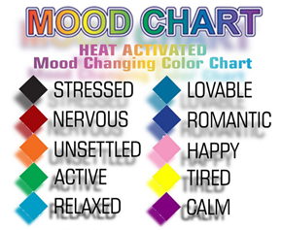

Directions: Use the Hub and other simulations to find the RGB values that make the colors of the Mood Ring. Fill the values into the chart and the code.
If T<24
Then
Send "SET COLOR 0 0 0"
Output(5,1,"YOU ARE STRESSED ")
End
If 24≤T and T<25
Then
Send("SET COLOR _ _ _")
Output(5,1,"YOU ARE NERVOUS ")
End
If 25≤T and T<26
Then
Send("SET COLOR _ _ _")
Output(5,1,"YOU ARE UNSETTLED")
End
If 26≤T and T<27
Then
Send(“SET COLOR _ _ _”)
Output(5,1,"YOU ARE ACTIVE ")
End
If 27<=T and T<28
Then
Send(“SET COLOR _ _ _”)
Output(5,1,"YOU ARE RELAXED ")
End
If 28≤T and T<29
Then
Send(“SET COLOR _ _ _”)
Output(5,1,"YOU ARE LOVEABLE ")
End
If 29≤T and T<30
Then
Send(“SET COLOR _ _ _”)
Output(5,1,"YOU ARE ROMANTIC ")
End
If 30≤T and T<31
Then
Send(“SET COLOR _ _ _”)
Output(5,1,"YOU ARE HAPPY ")
End
If 31≤T and T<32
Then
Send(“SET COLOR _ _ _”)
Output(5,1,"YOU ARE TIRED ")
End
If T≥32 Then
Send(“SET COLOR _ _ _”)
Output(5,1,"YOU ARE CALM ")
End
Color | RGB Values
Black | 0 0 0
Red
Orange
Green
Turquoise
Cyan
Blue
Pink
Yellow
Purple
Directions: Use colored pencils that match the mood color to draw in the inequalities used in the code above.

