Slide 1



Steve De Domenico
Workshop Title

Slide 2
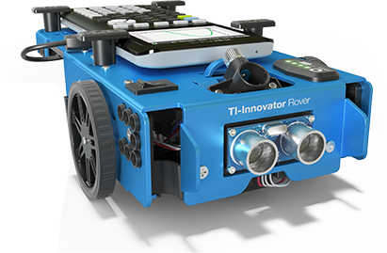
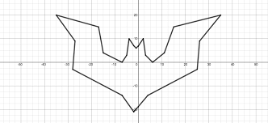
Activity – 3 (x,y) plotter dot to dot using a Rover

Slide 3
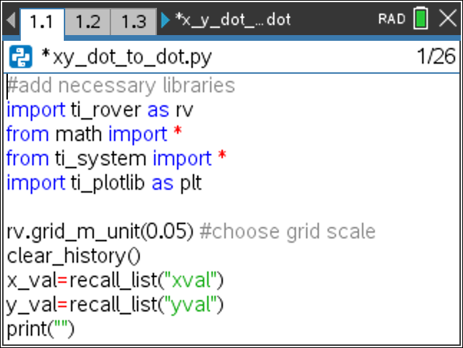
The code – page 1

Slide 4
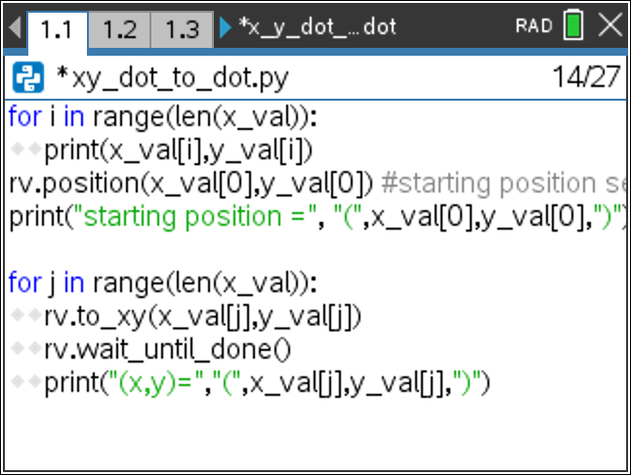
The code – page 2

