Slide 1



Sandi Leslie and Pam Durrant
Getting started: Calculator & Graphs apps

Slide 2
Contact us:
sandi.leslie@wesleycollege.edu.au
pam.durrant@wesleycollege.edu.au

Slide 3
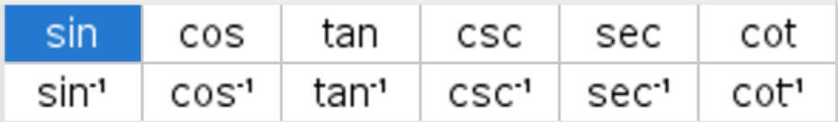
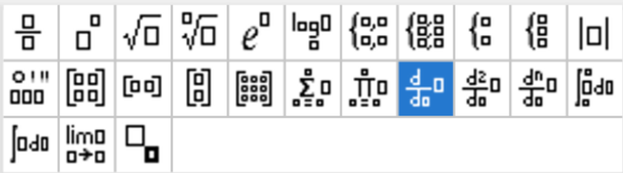
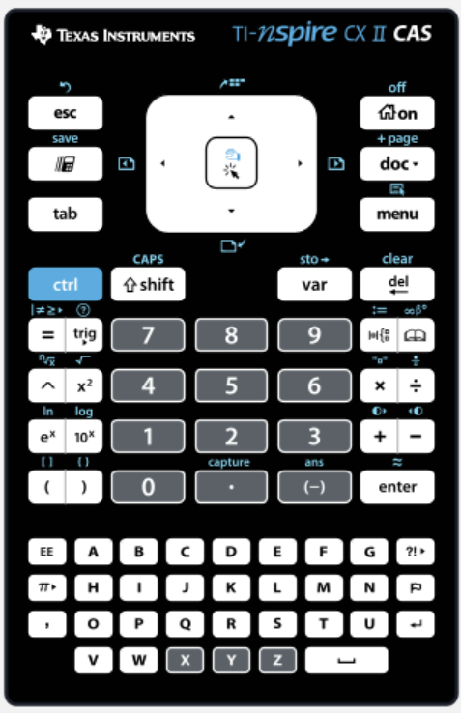
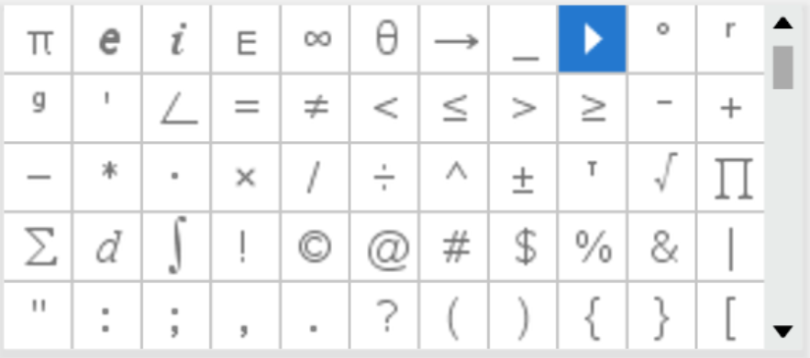
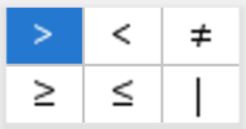
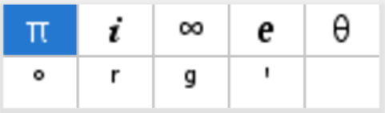
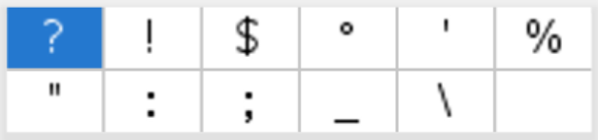

Slide 4
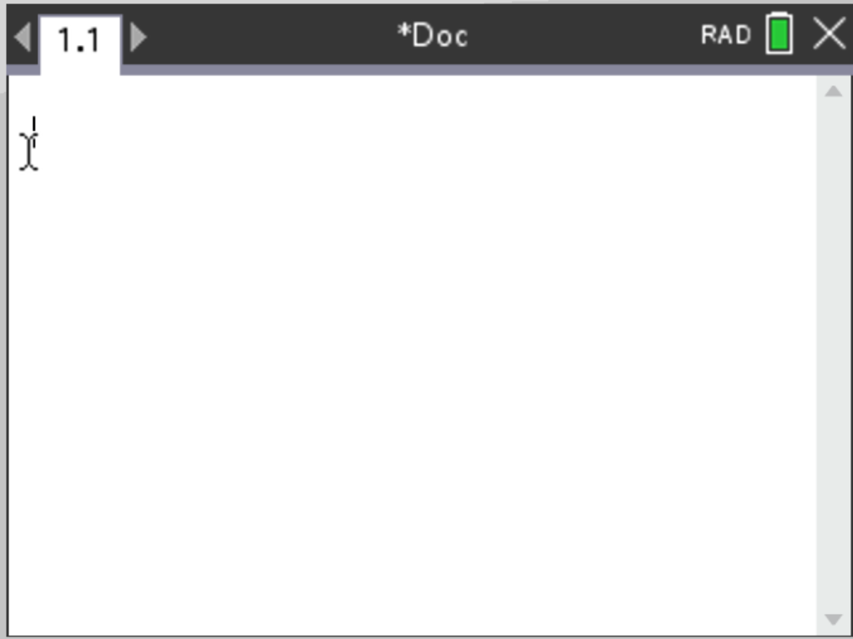
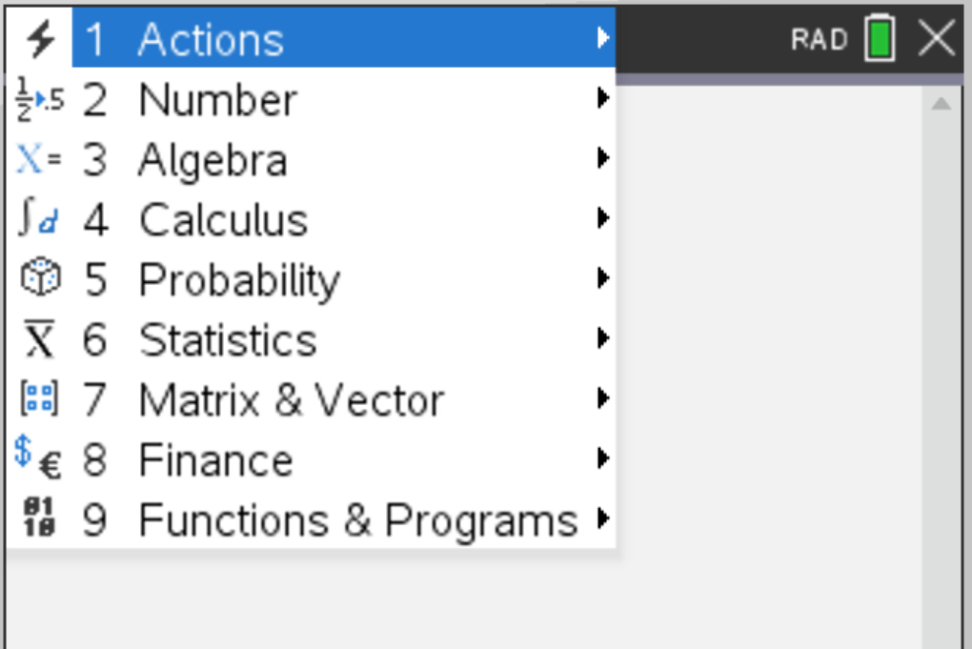

The Calculator Application
Settings on the Home screen

Slide 5
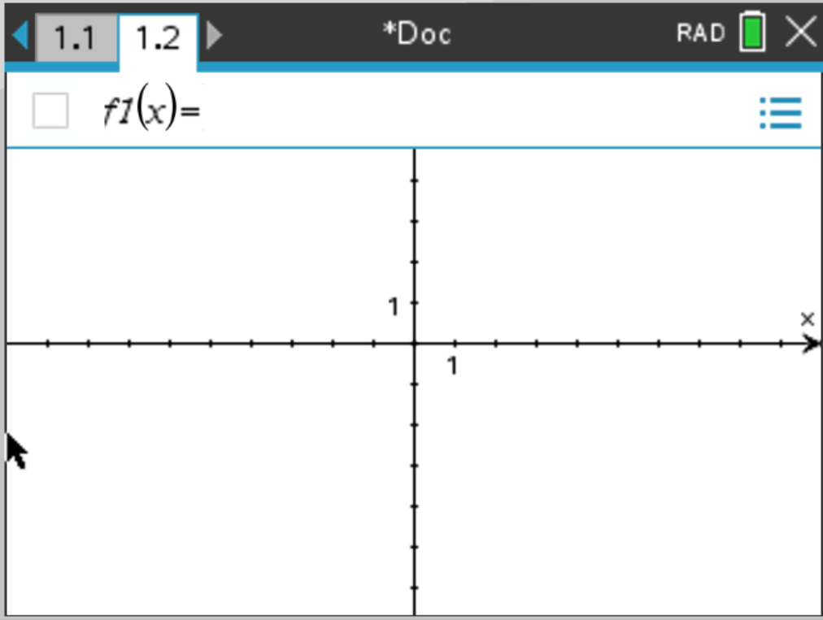
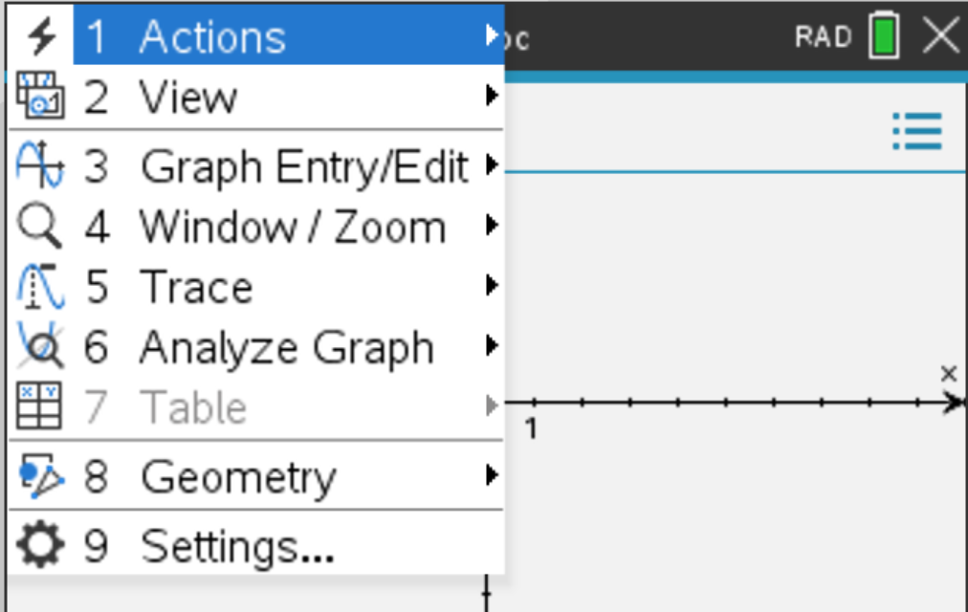
The Graphs Application
Settings are in the Graphs menu

Slide 6


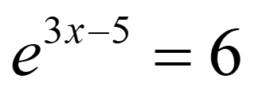
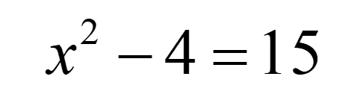

Slide 7
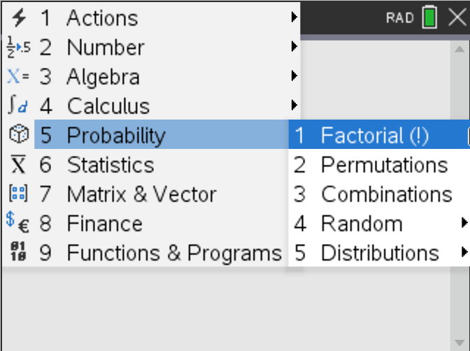

Slide 8
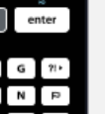
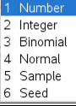
5! Also can use the ?! Key on the right hand side under the enter button
Permutations and combinations
Random numbers

Slide 9
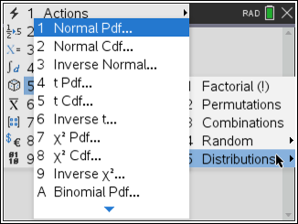
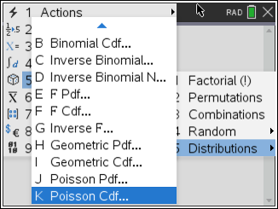







These are the ones I use

Slide 10
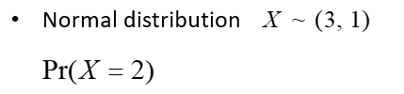


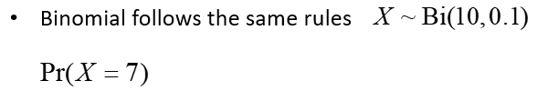



Pdf is a point where Cdf is an interval

Slide 11
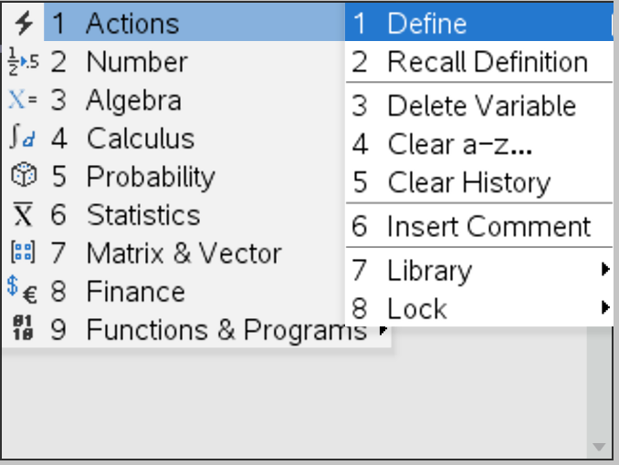
I mostly use …

Slide 12
Define
Store
Links to graph page
Edit to
Clear history and Clear a – z …

Slide 13
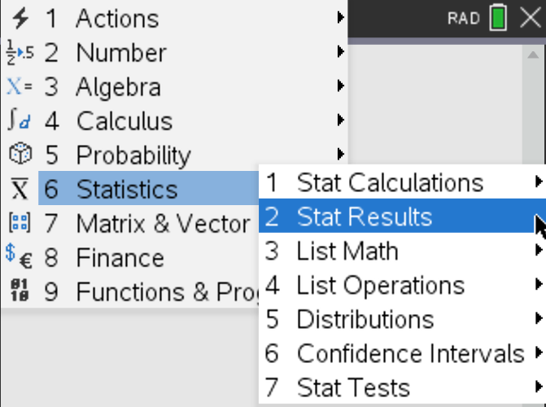

Slide 14
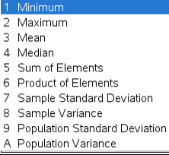
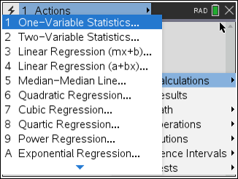
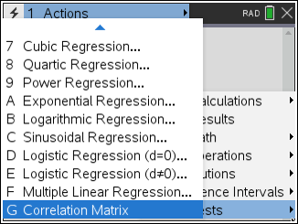
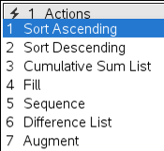
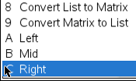
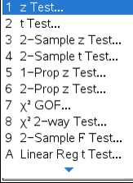
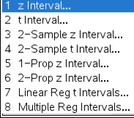










Stat Calculations
All entries must be a list
Can use lists and spreadsheets
2. Stat results
3. List Math
List Operations
Distributions – same as Probability distributions
Confidence Intervals - z interval for MM and SM
Stat tests – for SM

Slide 15
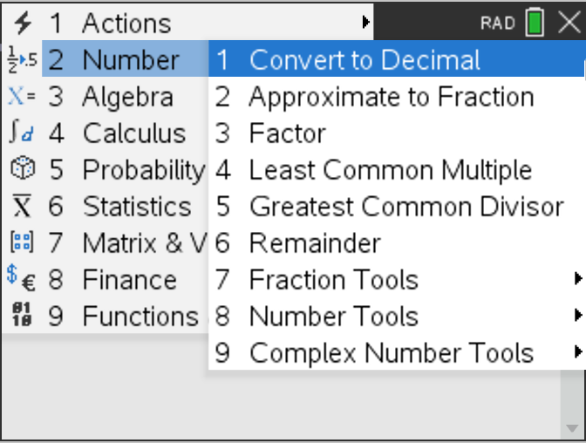
I mostly use …

Slide 16
Convert the following
Convert to decimal alternatives
Least Common Multiple and Greatest Common Divisor gcd(45,460)
Fraction Tools > Proper Fraction (Also repeated in Algebra menu)

Slide 17
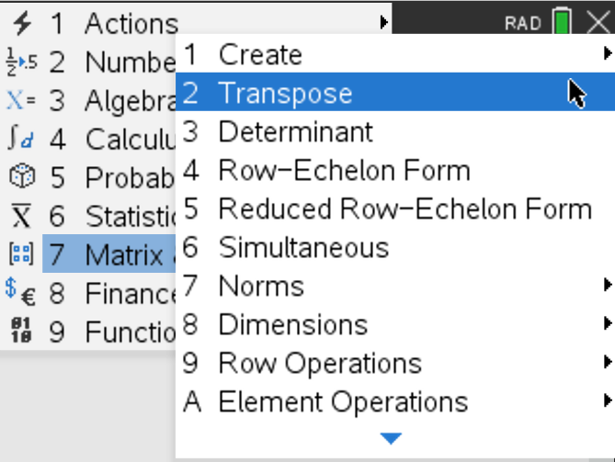





The ones I use

Slide 18
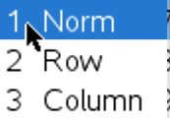
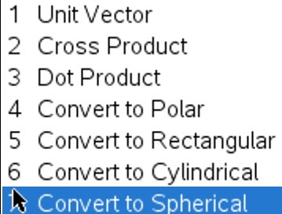






2. Transpose
3. Determinant
7. Norms
C. Vector

Slide 19
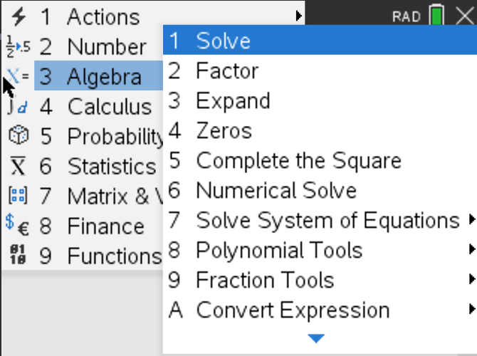
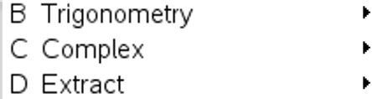
All of these are great!

Slide 20
Solve, Zeros and Numerical Solve
Factor and Expand
Complete the Square
Solve System of Equations
Polynomial Tools
Convert Expression – ln, logbase, sin, cos
Trigonometry – Expand, Collect

Slide 21
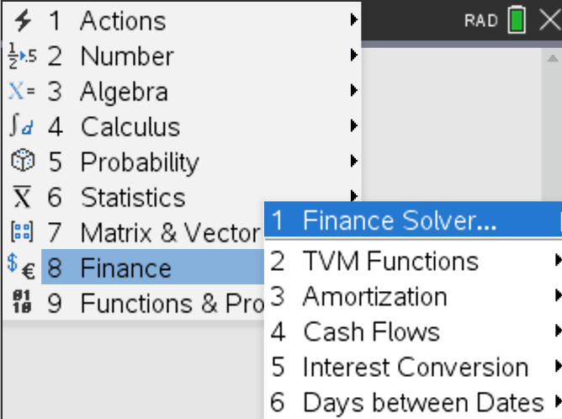

The ones I use

Slide 22
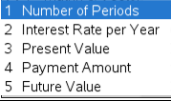
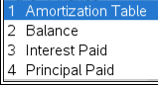
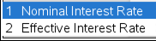
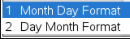
Finance Solver - the best!!!!
TVM Functions
Amortisation
Interest Conversion
Day between Dates
FINANCE SOLVER
N = Total Number of payments
I(%)= Interest rate per annum
PV= Present Value (starting amount)
Pmt 0= (Payment amount per compounding period)
FV= Future Value
PpY= Number of payments made per year
CpY= Number of compounds per year
PmtAt END Do NOT change this!
** PpY and CpY must be the same value**

Slide 23
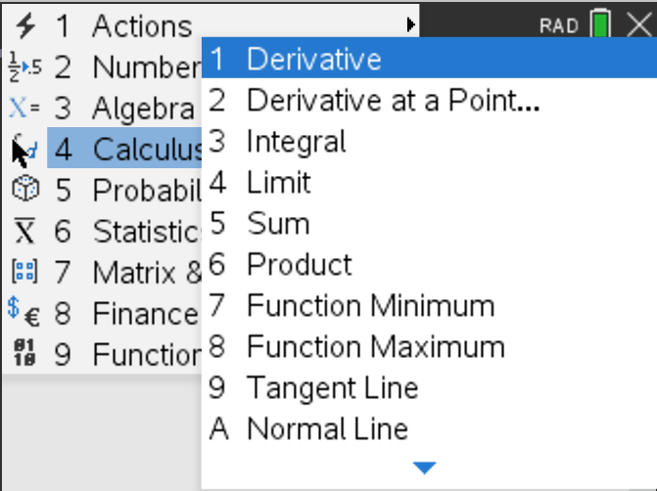
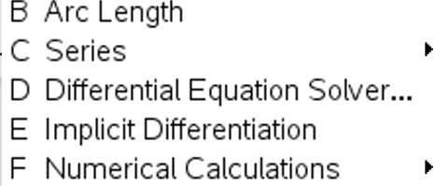

Slide 24
The Calculus Menu
Could take a whole workshop to do it justice!
See detailed appendix in the handout for step-by-step guidance.

Slide 25
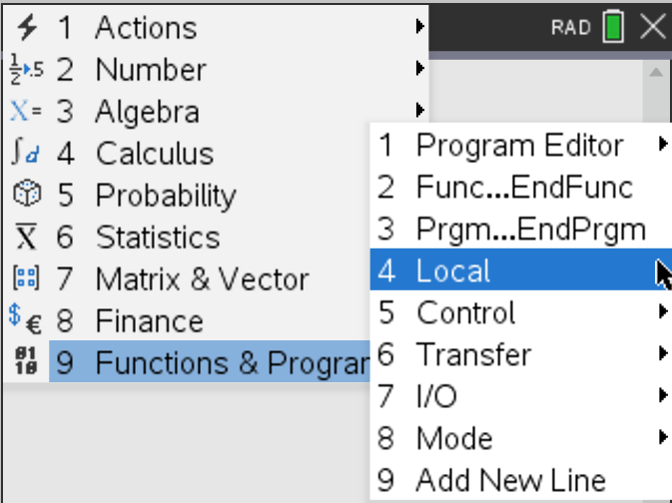

Slide 26
Back to the Graphs Application
Settings are in the Graphs menu

Slide 27
Let’s have a quick look at some of these
Actions
View
Graph Entry/Edit
Window/Zoom
Trace

Slide 28
Entering a function in the Graph Entry Line defines it in all applications for that problem
Find the y value when x = 3
Find the coordinates of the x - intercepts

Slide 29
Graph Entry/Edit > Relation
Great for vertical lines
Students who cannot transpose!

Slide 30
Window/Zoom >
1: Window Settings
5: Zoom - Standard
8: Zoom – Trig
9: Zoom - Data
A: Zoom - Fit

Slide 31
Trigonometric Functions
8: Zoom – Trig
1: Window Settings

Slide 32
Graph Entry/Edit > Scatter Plot
Let’s use our lists from earlier xx and yy

Slide 33
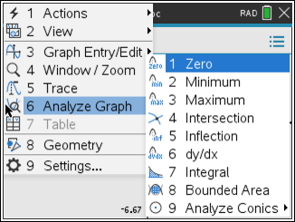


Slide 34
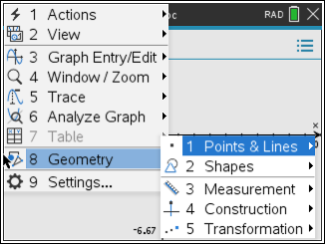
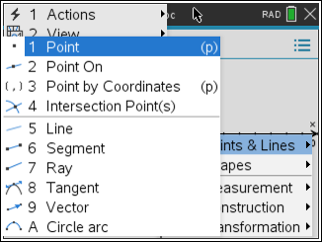

I mainly use this one

Slide 35
Questions?

