Slide 1



Mikaela Sawyer
TI-84Plus CE™
QCAA Mathematical Methods
Exploring Functions and Polynomial Operations

Slide 2
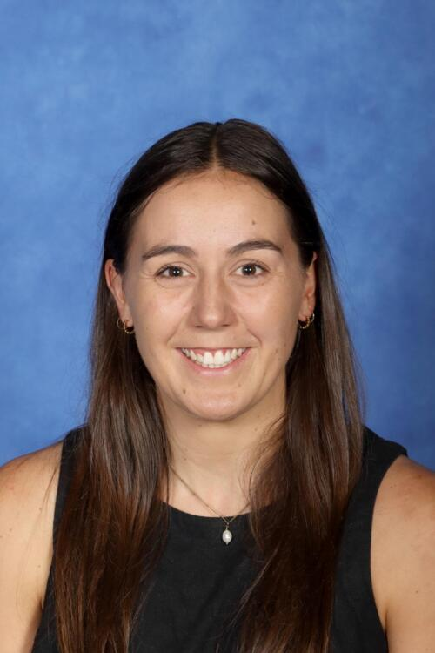
Mikaela Sawyer
Mathematics Teacher - Saint Andrew’s Catholic College
T³ Instructor
Mikaela is a dedicated and innovative Mathematics educator with a strong passion for Senior Mathematics. Her teaching journey has taken her across South Australia, the Northern Territory, New Zealand, and now Queensland, where she has gained valuable experience in both rural and metropolitan settings. This diverse background shapes her student-centred approach and fuels her commitment to making mathematics engaging, relevant, and accessible to all learners. As a woman in mathematics, Mikaela is particularly passionate about inspiring and empowering young women to approach the subject with confidence and curiosity.

Slide 3
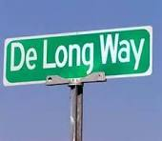
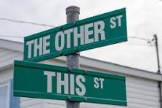
Personal Polynomials - Hook
Who gets excited when they see a street sign with their own name or last name?
The most common street name in Australia is George Street, followed by William Street and Church Street.
So clearly everyone does not have their own personal street sign, but everyone does has their own personal polynomial.

Slide 4
Personal Polynomials - Today’s aim
What does your own personal polynomial look like?
In this activity you will change your name into a set of points and determine the polynomial that passes through these points, your personal polynomial.
How does your personal polynomial compare and interact with others? How much can you tell about someone's polynomial by just looking at their name?

Slide 5
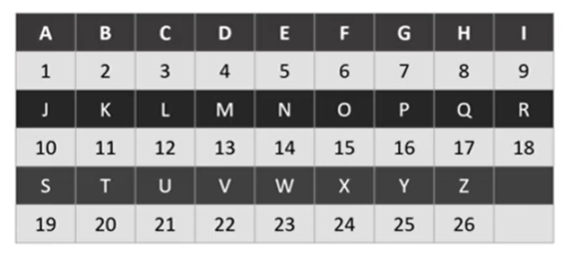
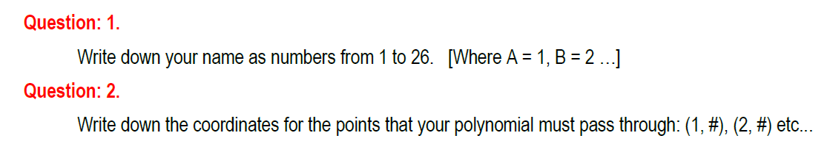
M I K A E L A
(1, ) ( 2, ) (3, ) (4, ) (5, ) (6, ) (7, )
(1, 13) (2,9 ) (3,11) (4, 1) (5, 5) (6,12) (7,1 )

Slide 6
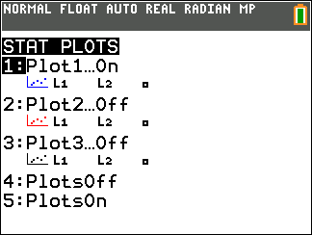
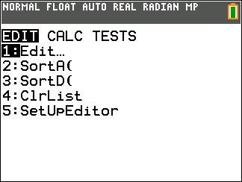
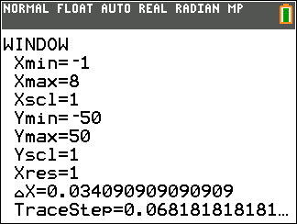
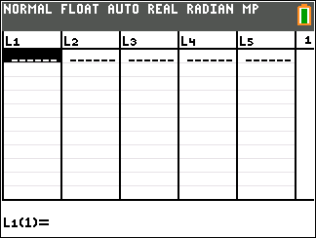
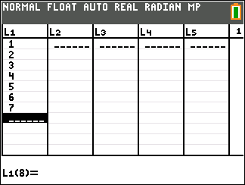
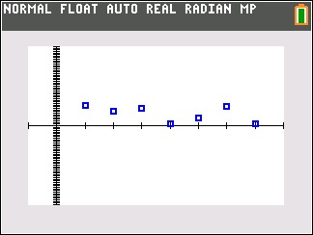
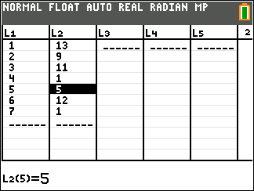

Slide 7
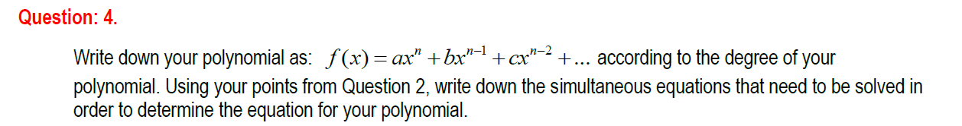


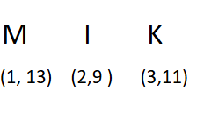
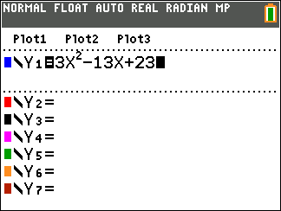
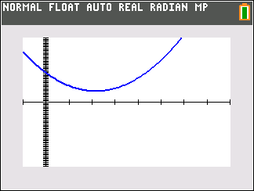

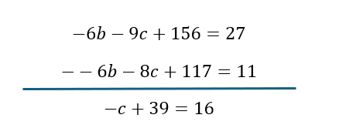



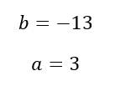

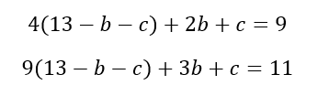


Slide 9
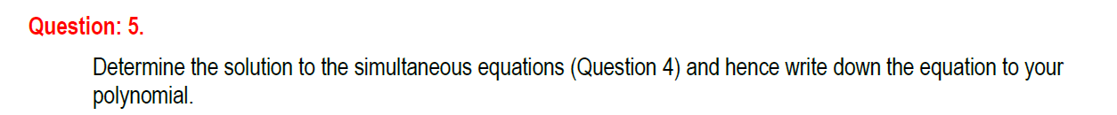
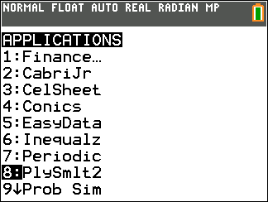
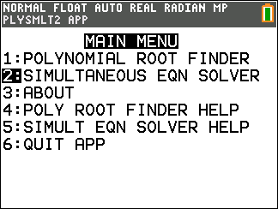
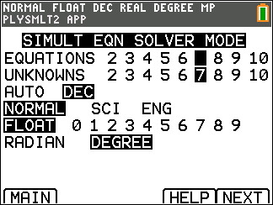
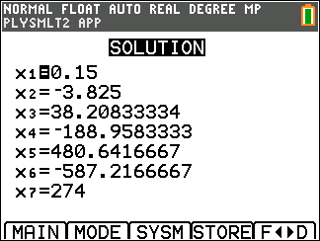
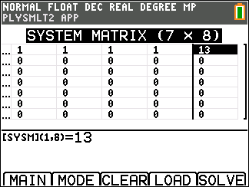
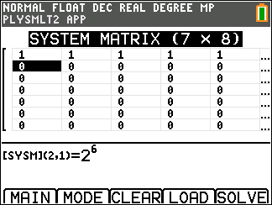
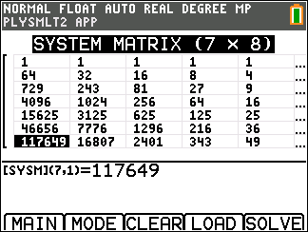
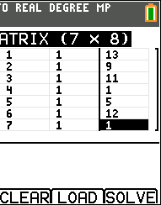

Slide 10
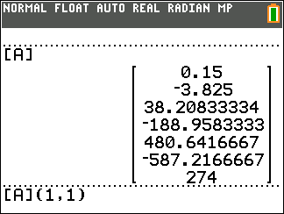
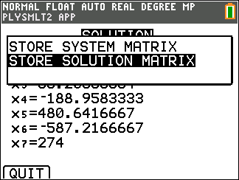
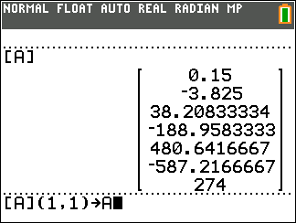
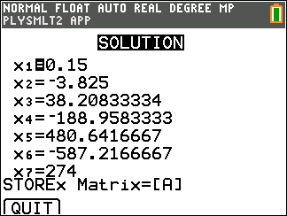
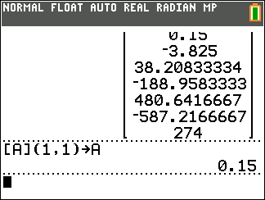
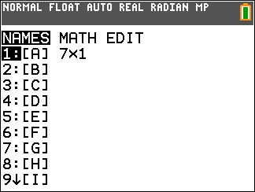
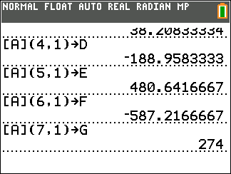
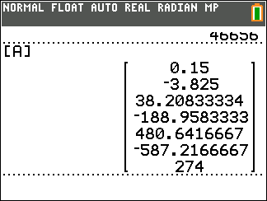

Slide 11
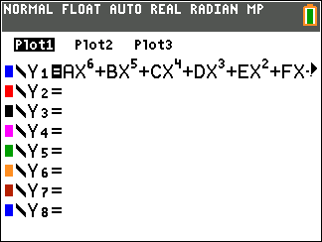
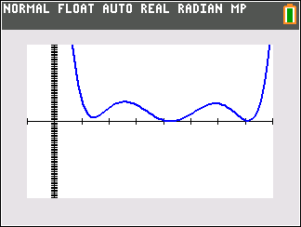
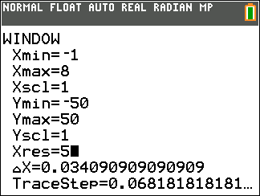

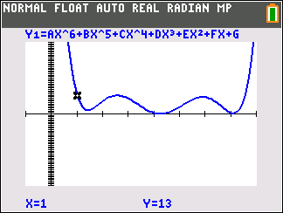

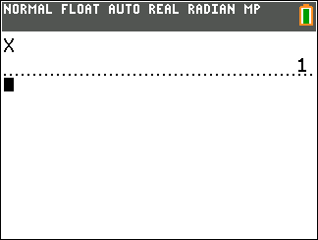
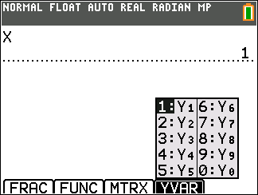
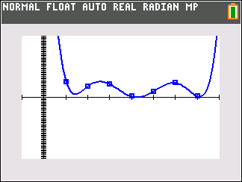
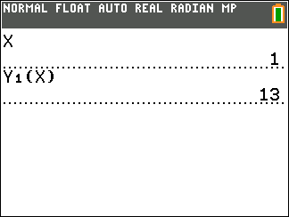

Slide 12

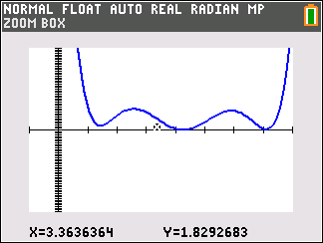
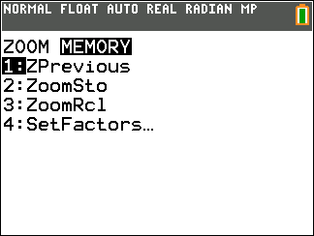
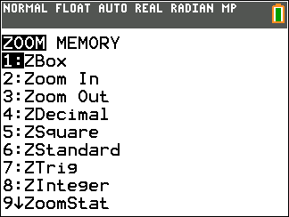
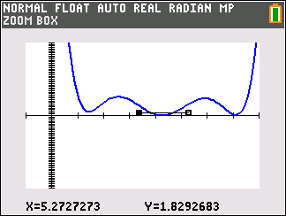
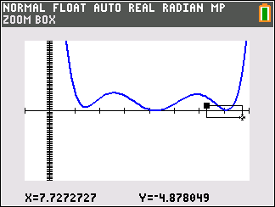

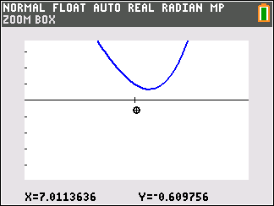


Slide 13





Slide 14










Other cool things!

Slide 15










Cool things continued..

Slide 16
Exploring more personal polynomials
H A N N A H
(1, 8) (2,1) (3,14) (4, 14) (5, 1) (6,8)

Slide 17









Slide 18

Do we need to find out there final equations?

Slide 19


Thank you for your time
I hope you enjoyed the workshop
mikjsawyer@gmail.com

