Slide 1
Methods Unit 1 & 2
By Evan McGarrity

Slide 2

About me
Evan McGarrity
Middle School Mathematics
Mathematical Methods
Specialist Mathematics
Teacher at Coomera Anglican College
Coordinated Year 10 Maths Course for past 2 years.
Coordinated Year 11 (2022, 2023) & Year 12 (2023, 2024) Specialist Mathematics
Lead marker of Year 11 and 12 Specialist Internal Assessments

Slide 3
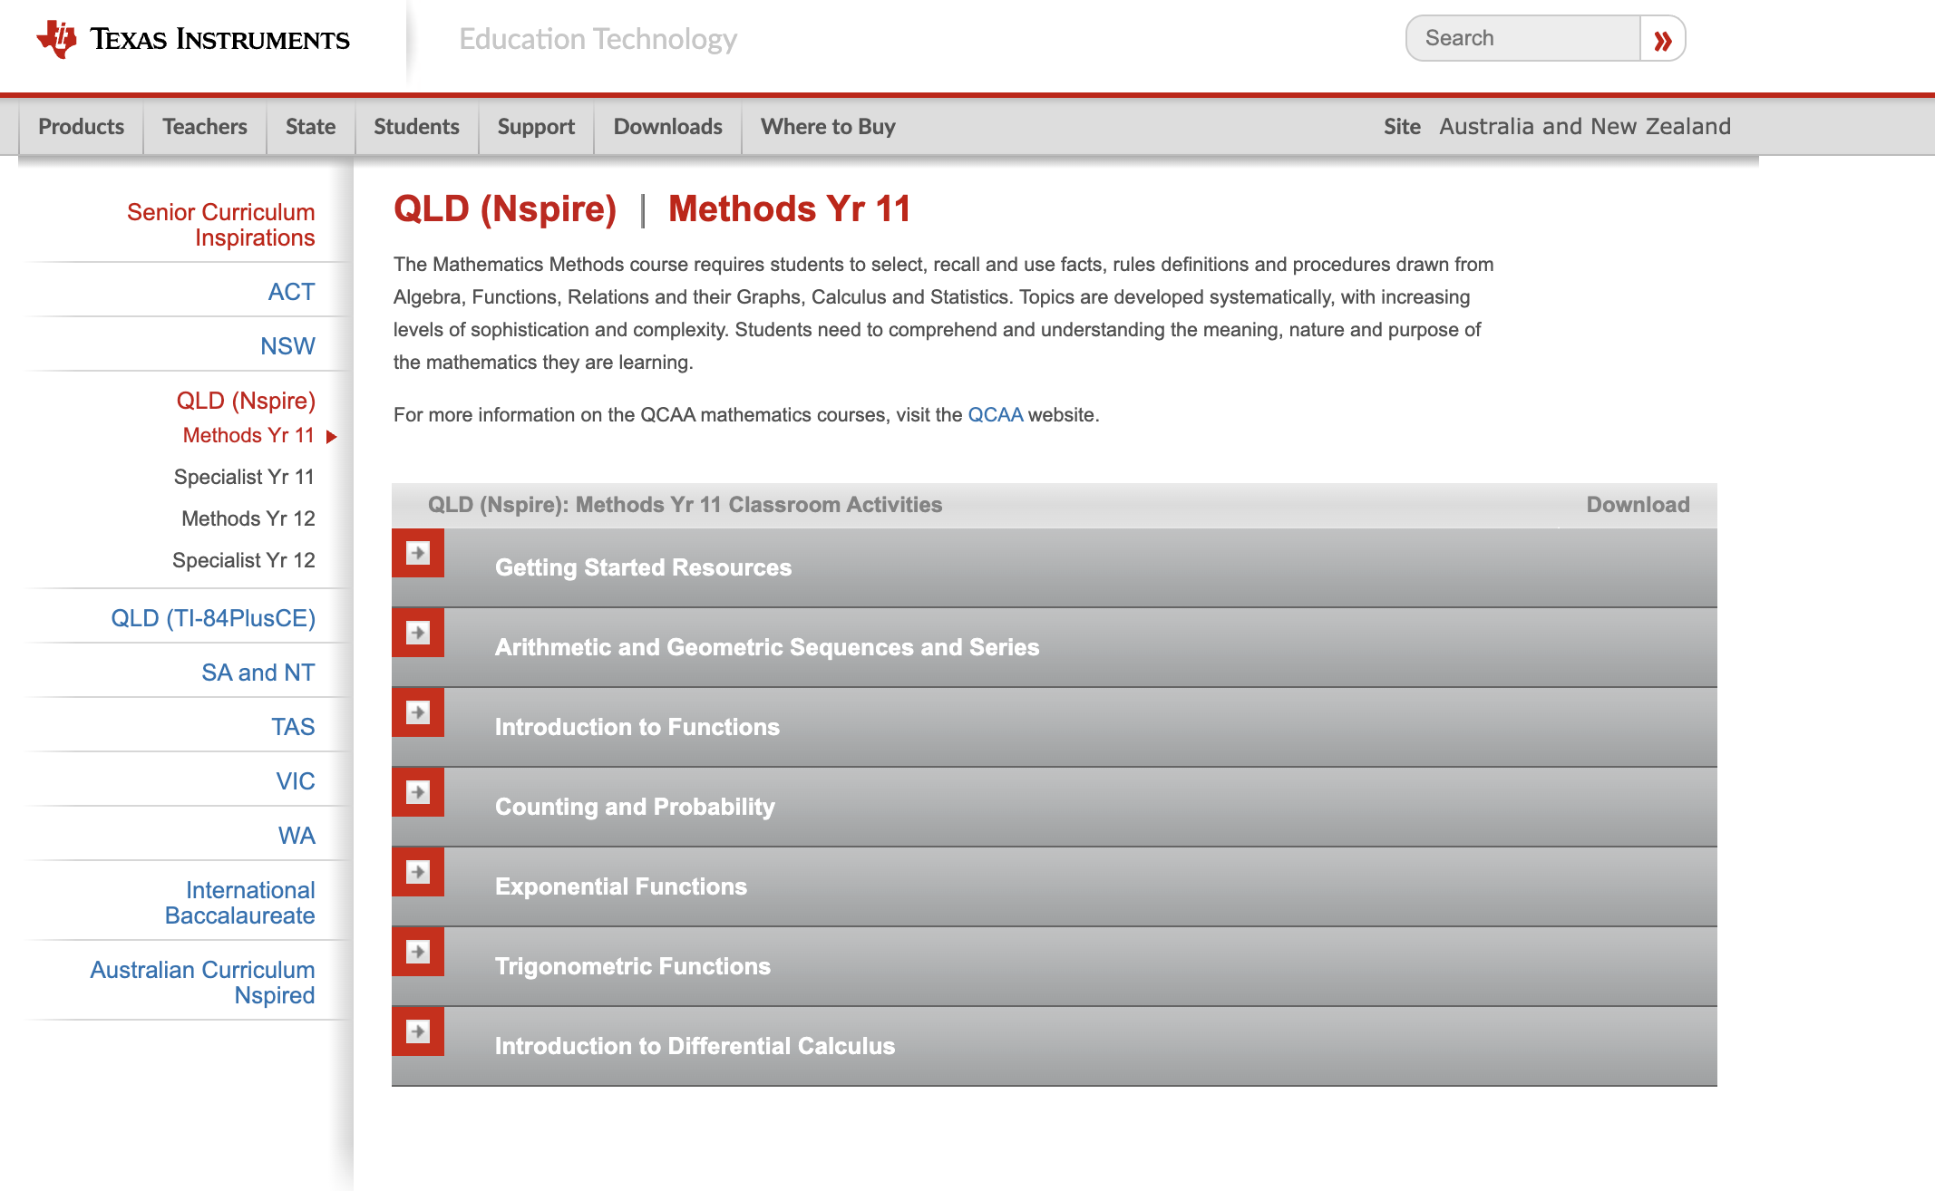

Slide 4
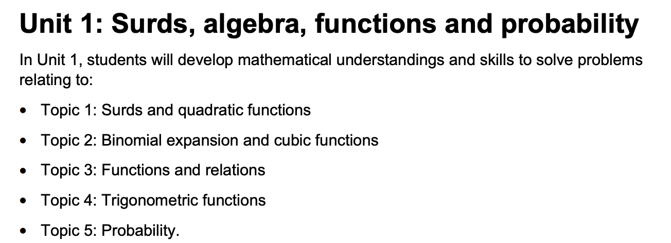

Slide 5
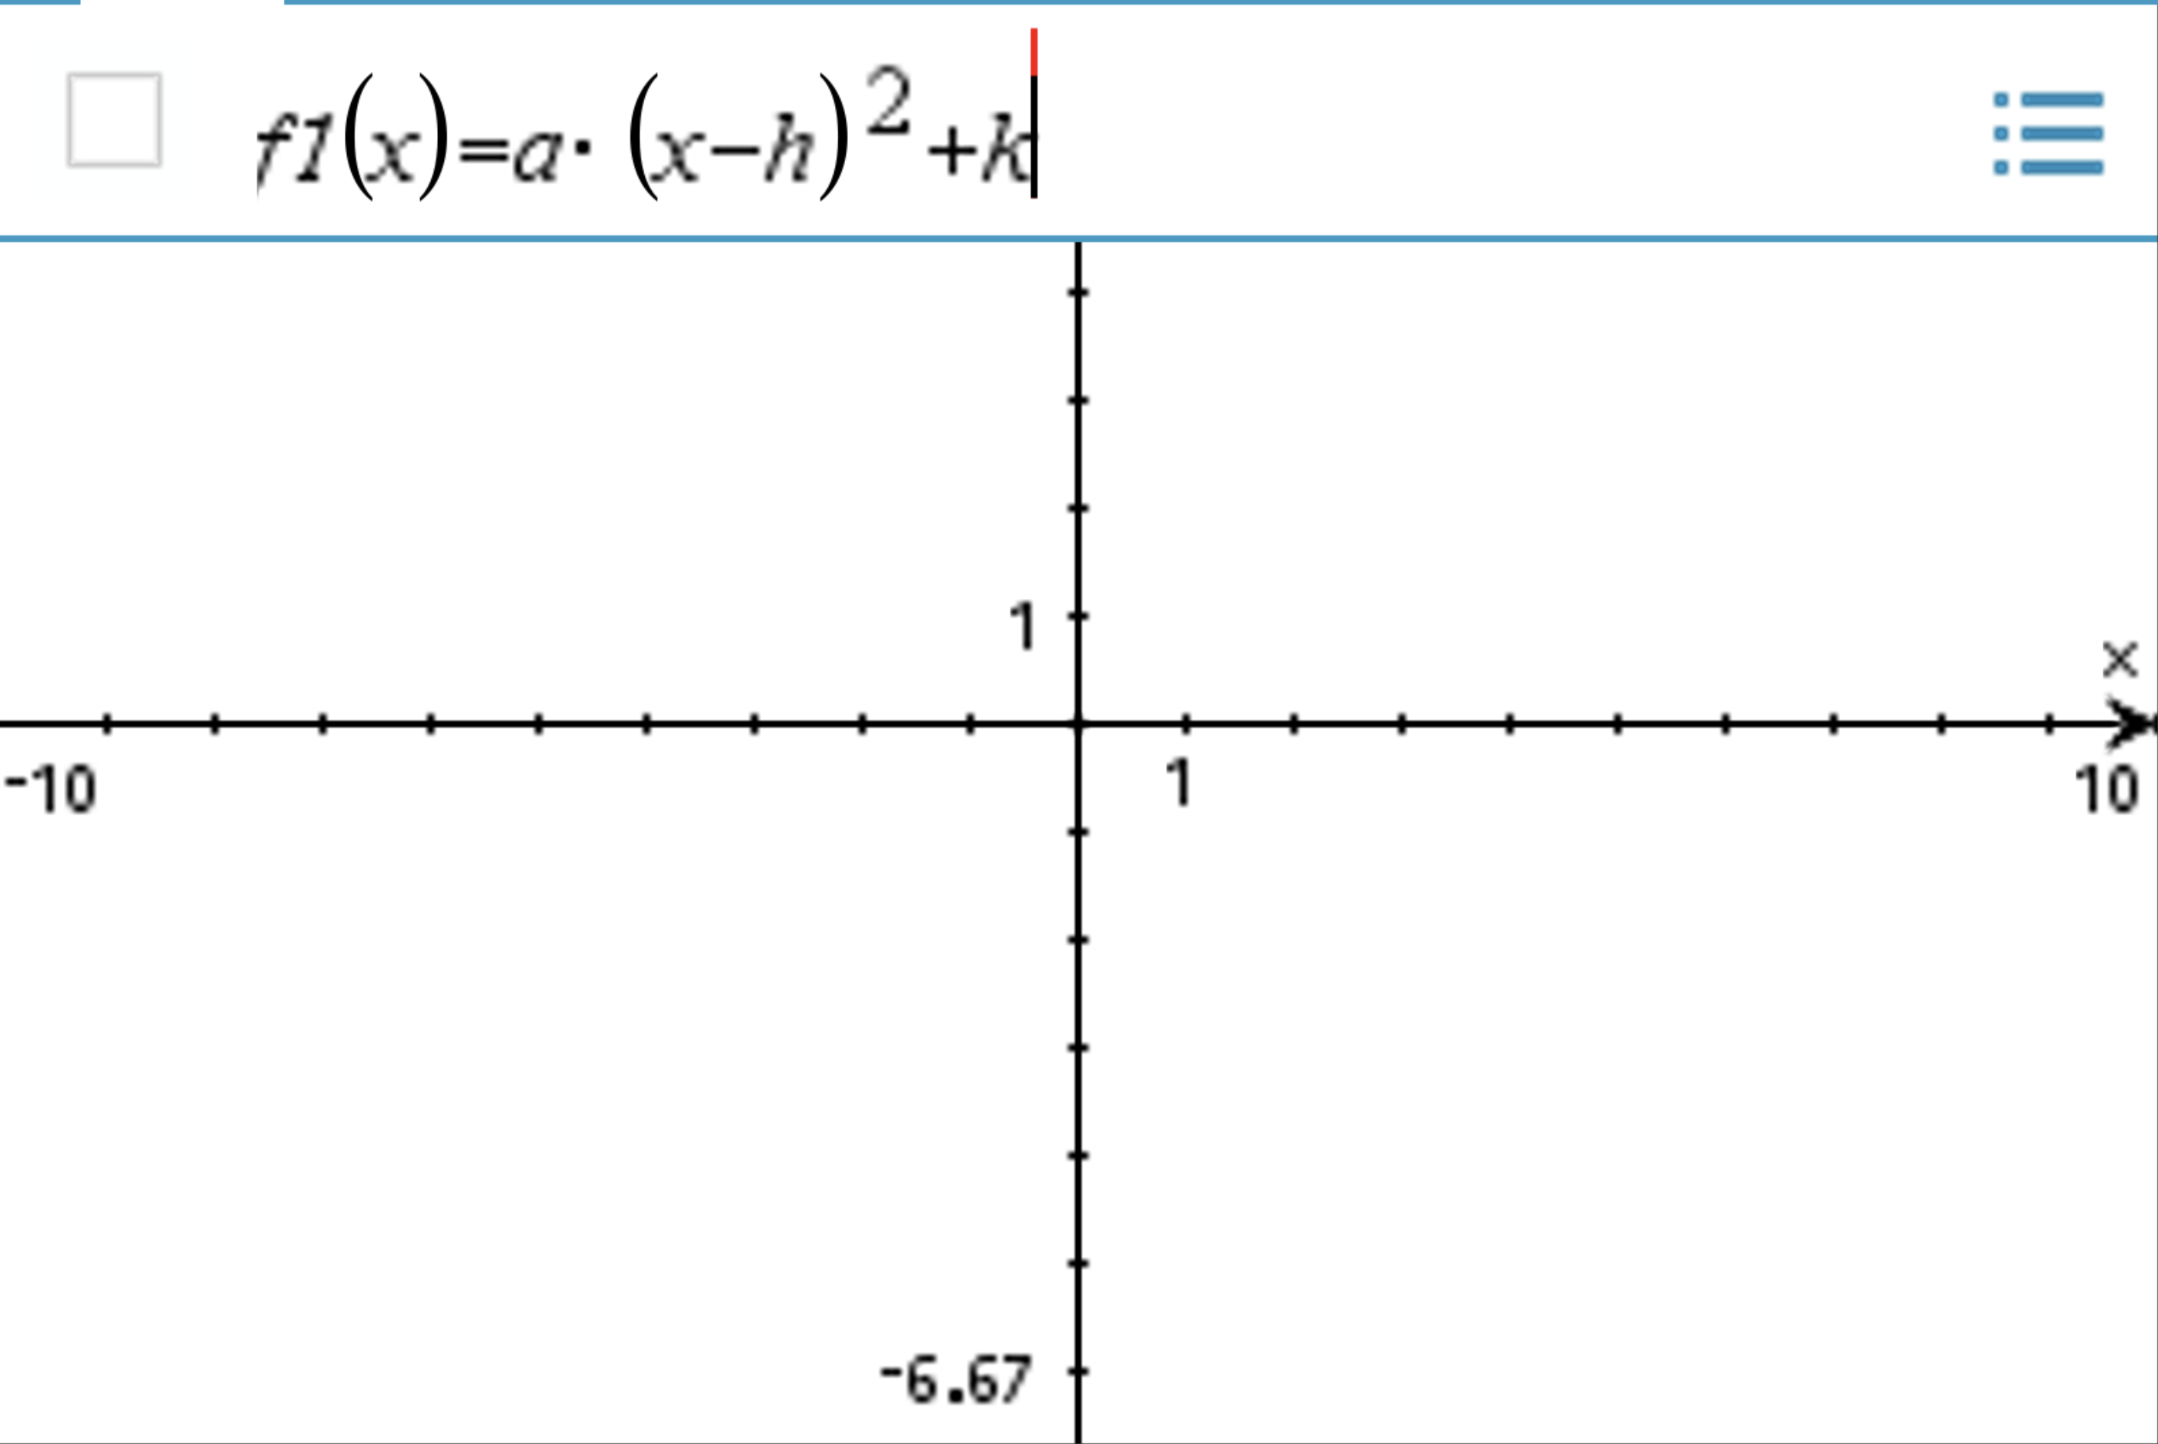
Using Sliders

Slide 6
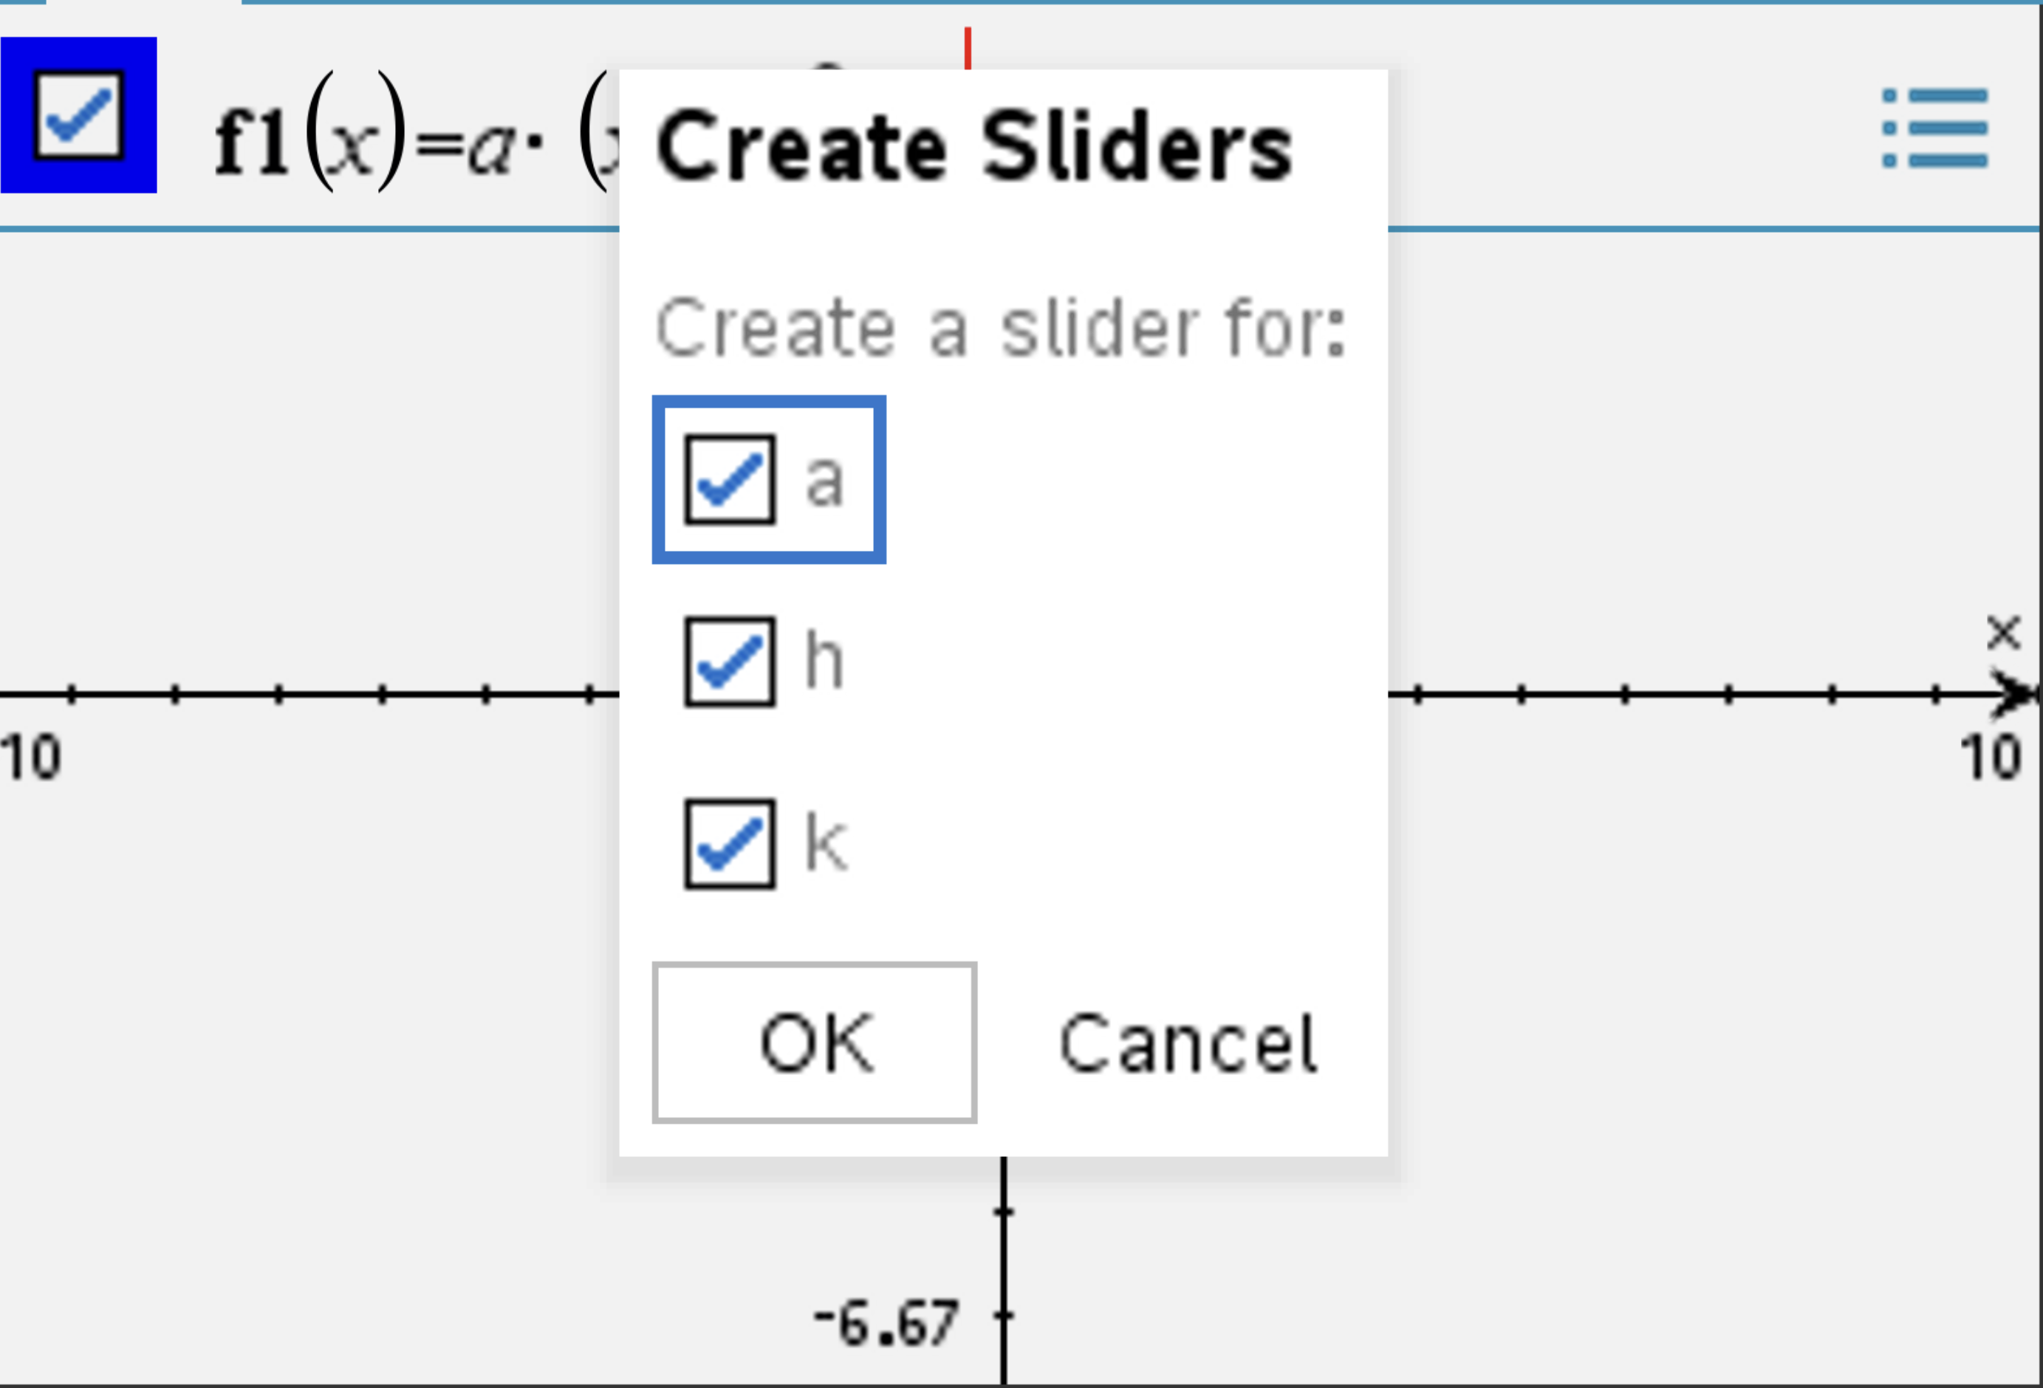

Slide 7
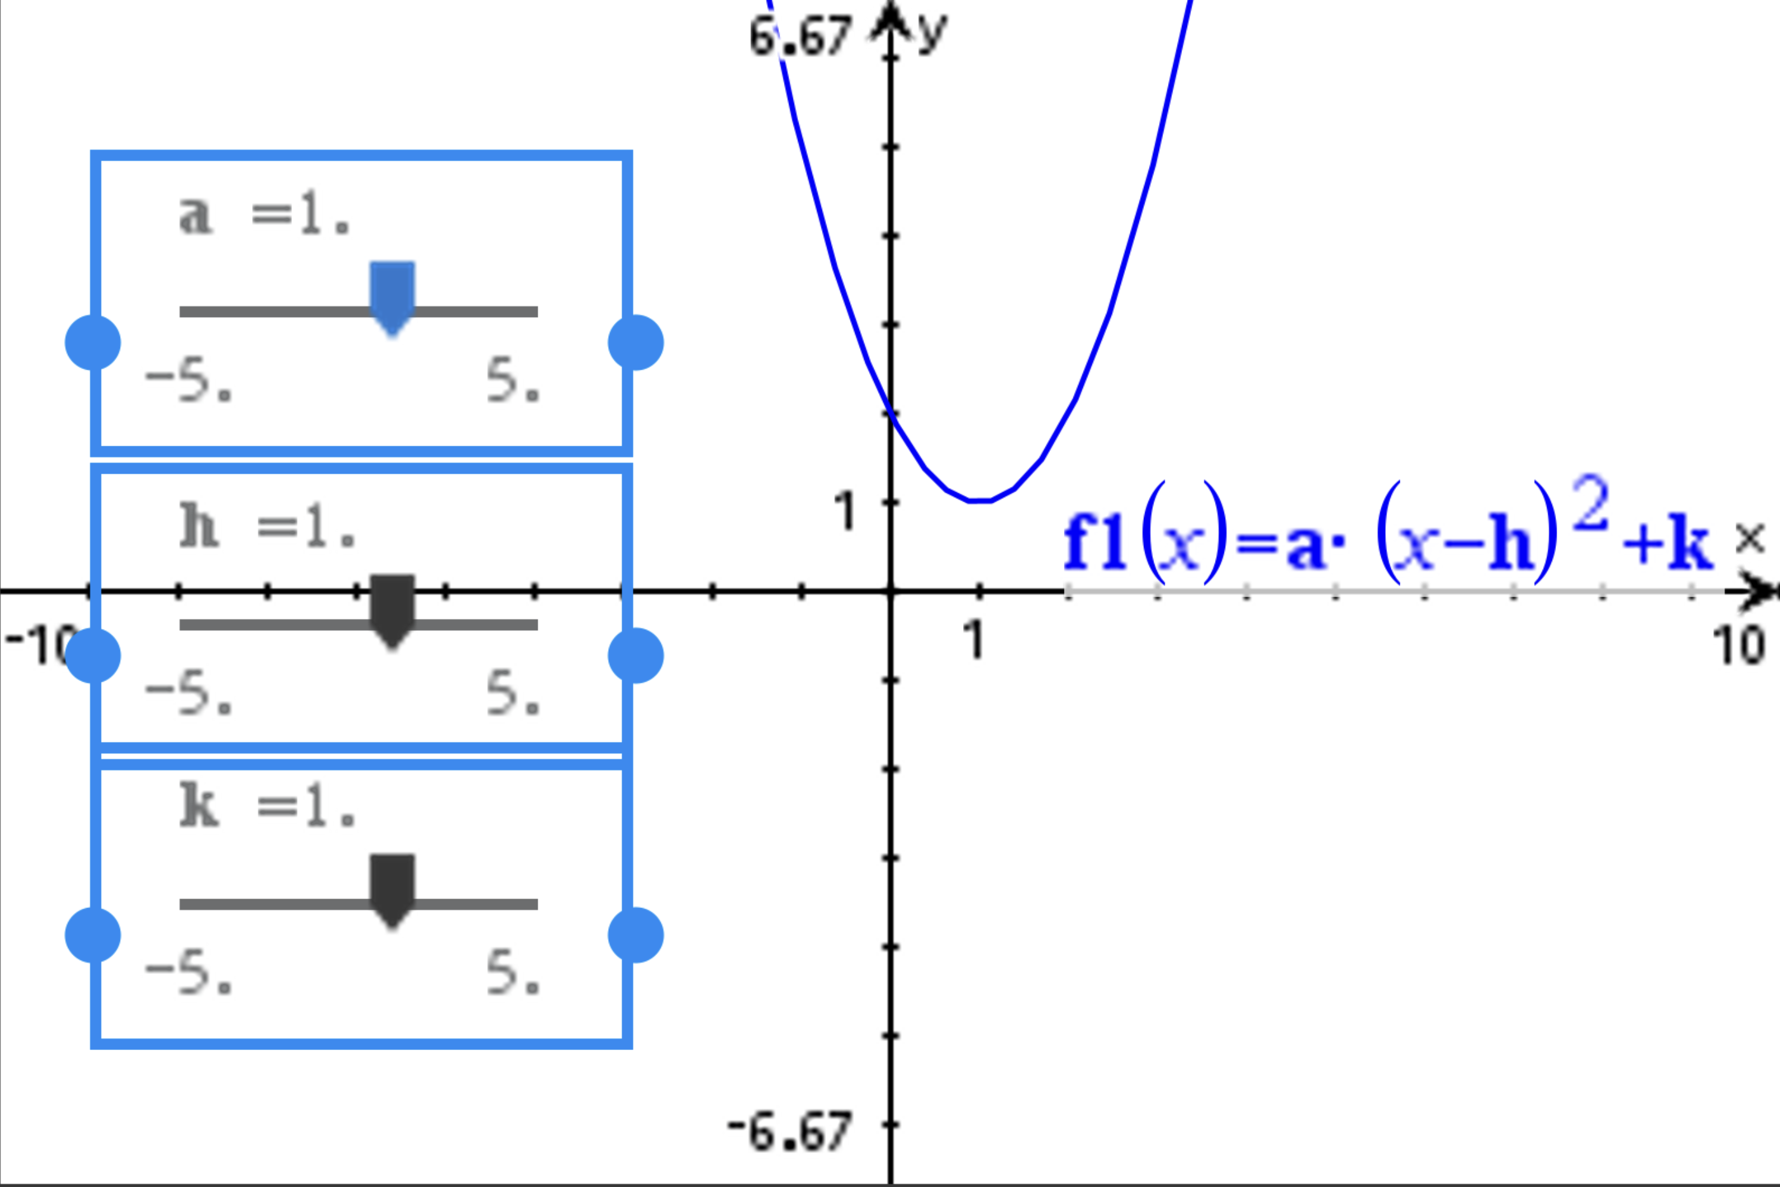

Slide 8
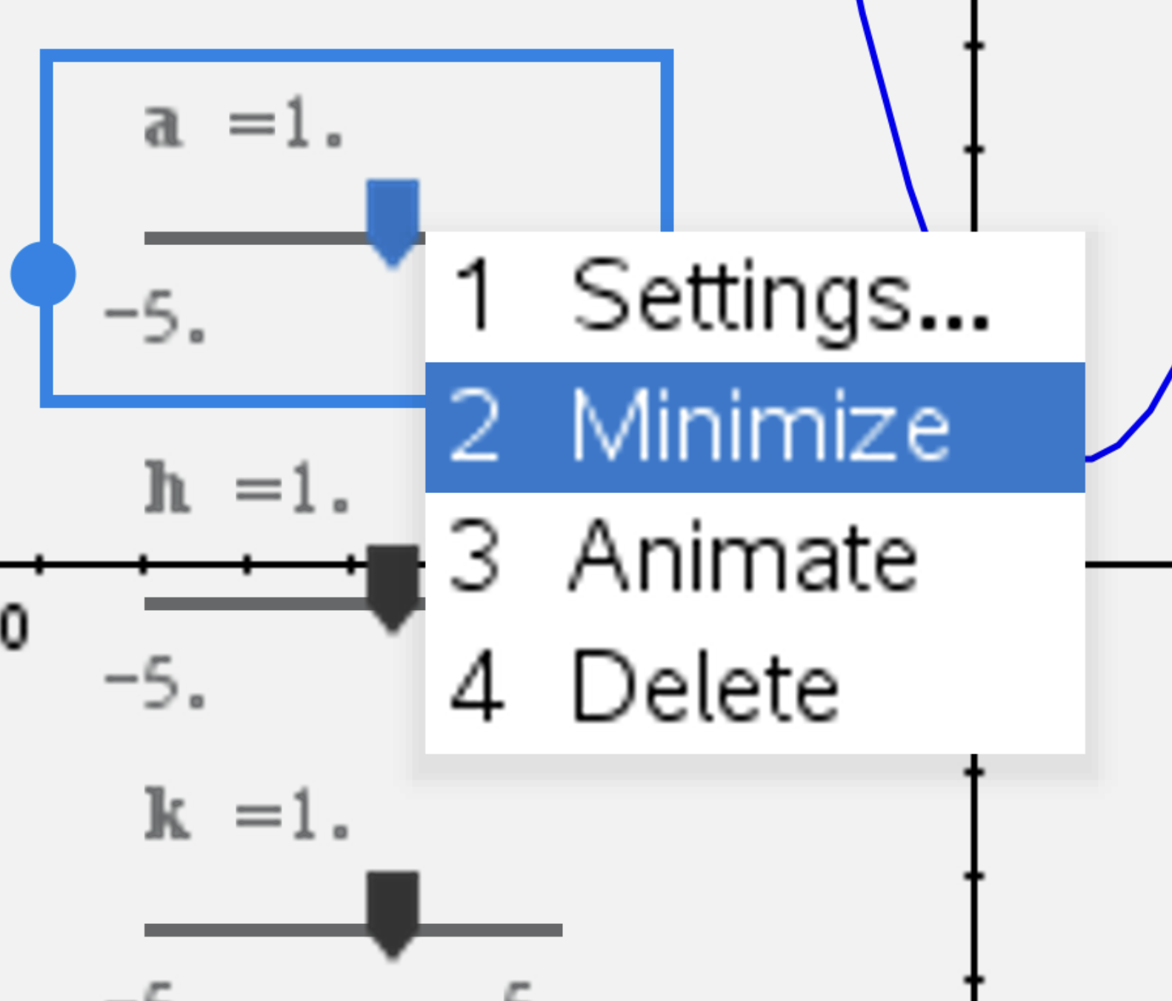

Slide 9
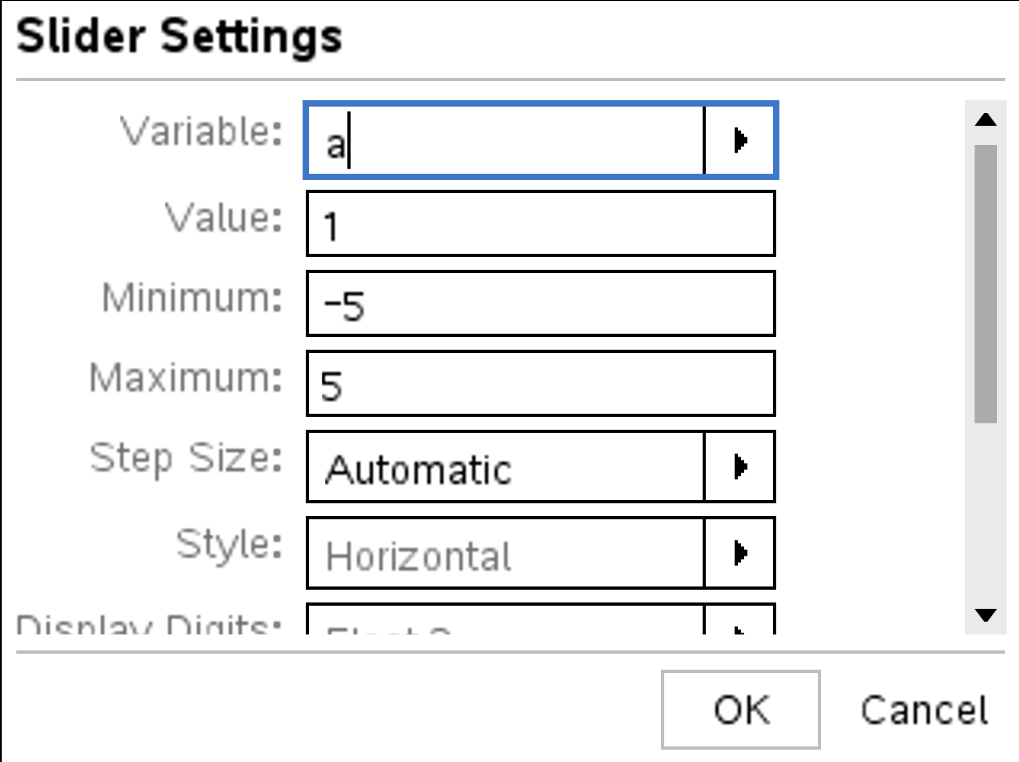

Slide 10
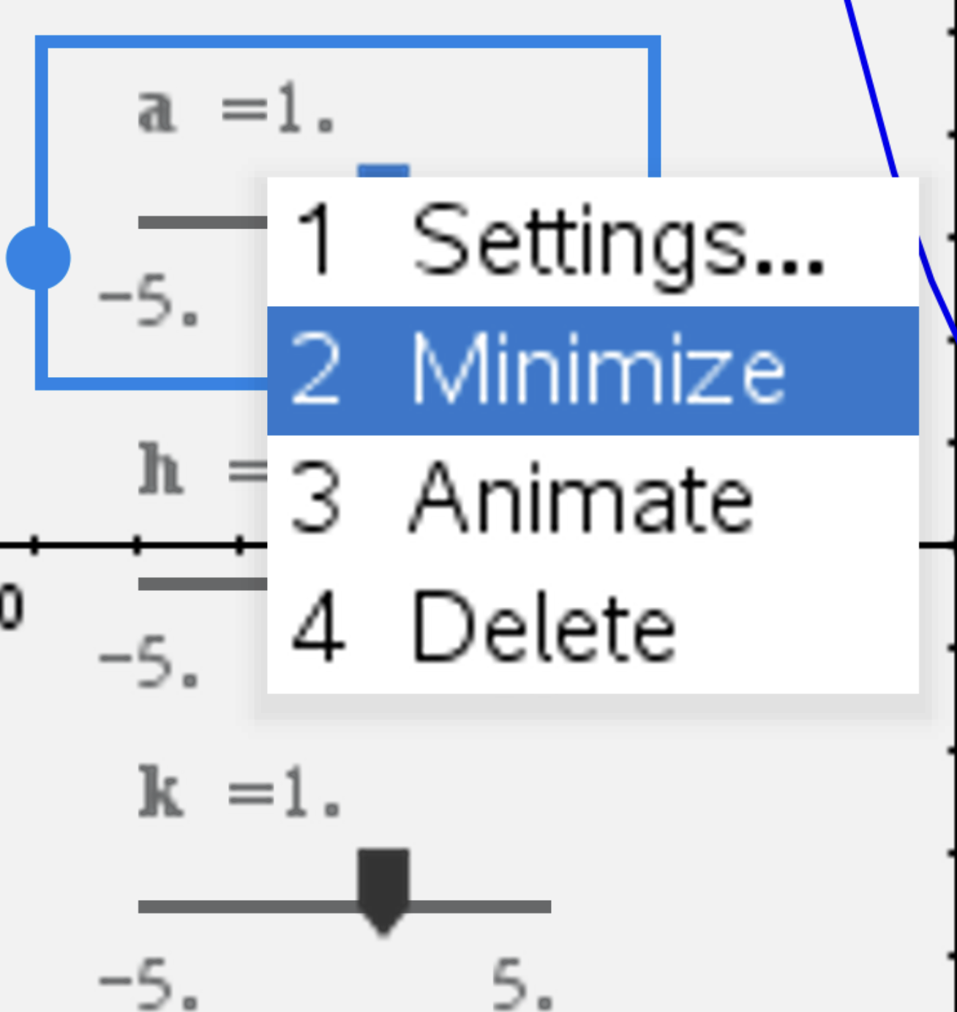

Slide 11
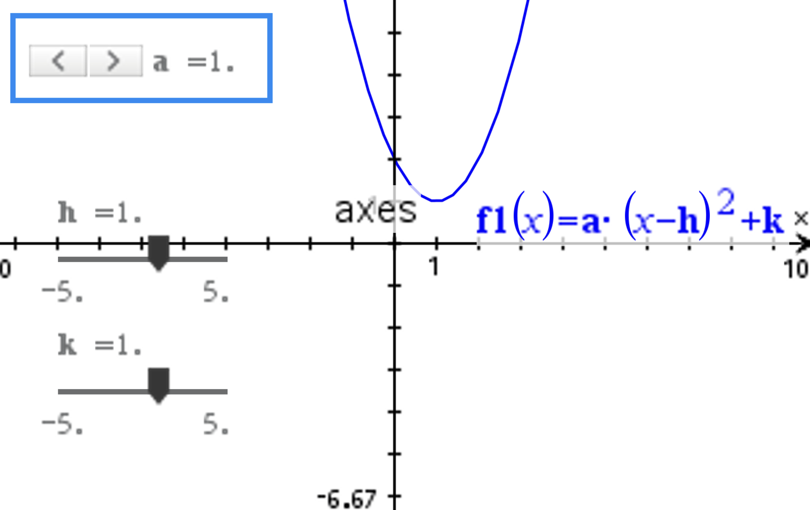

Slide 12
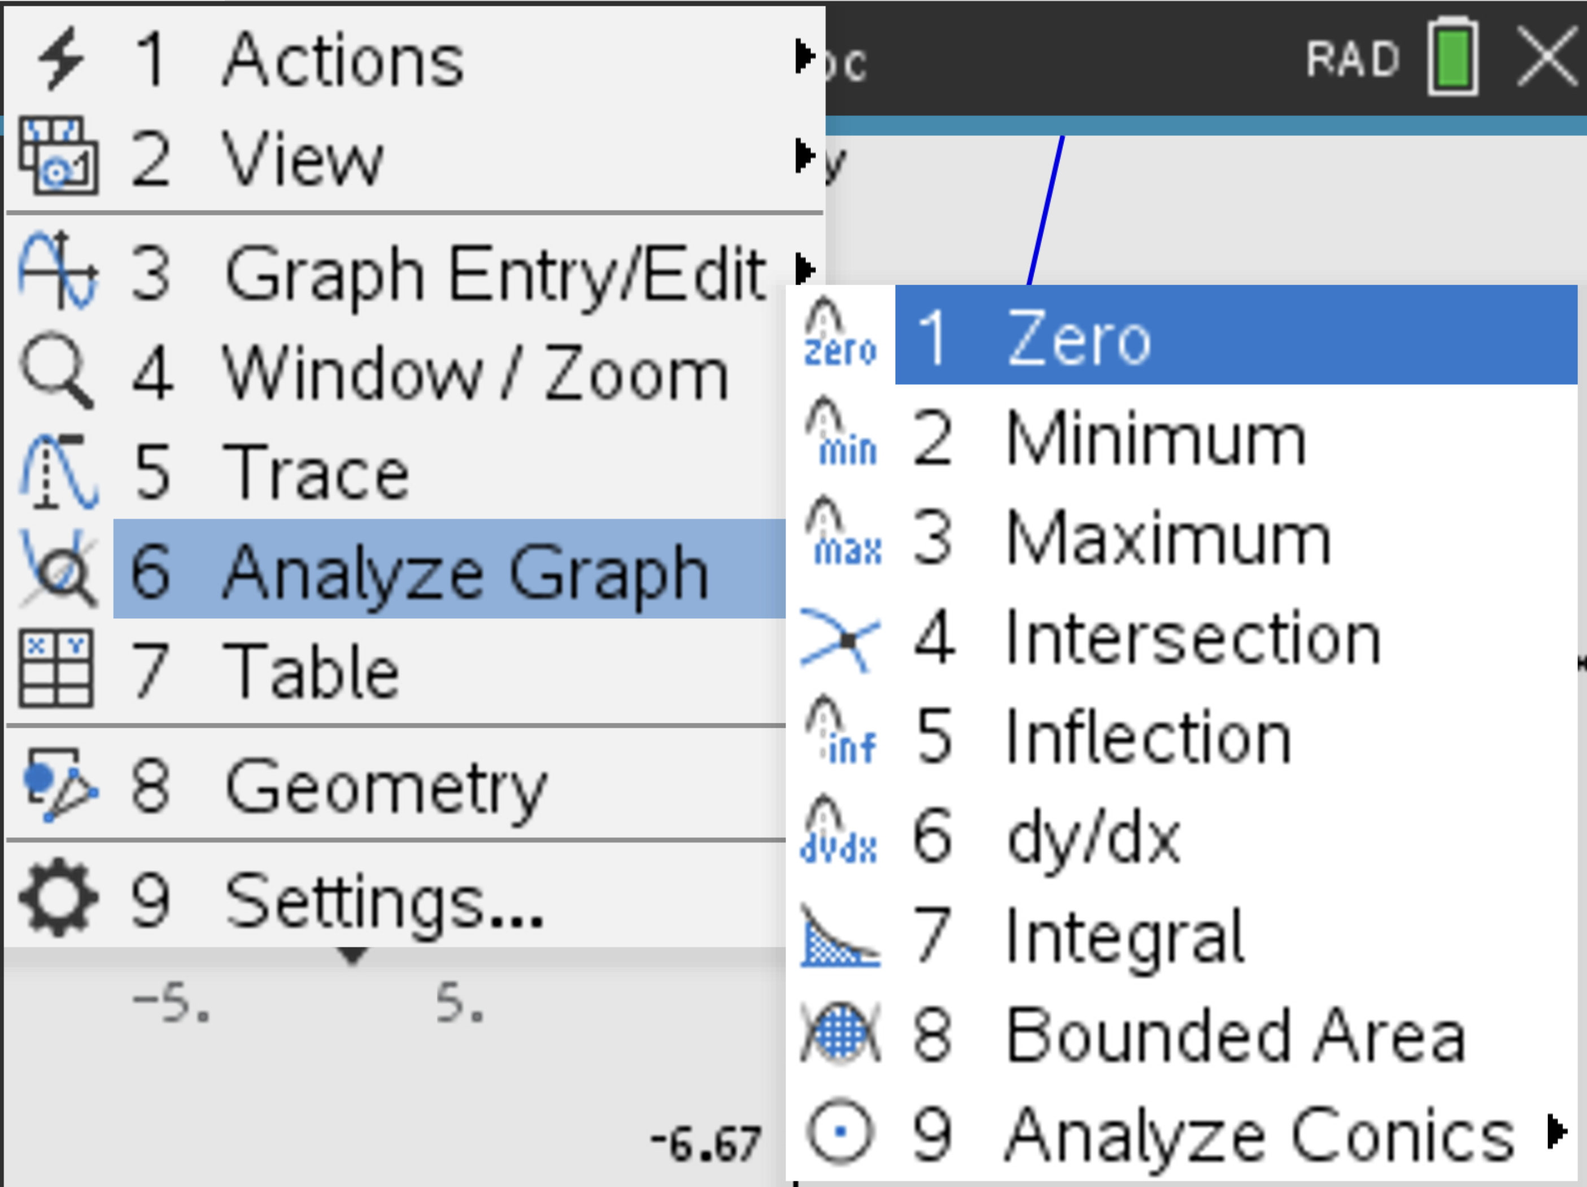

Slide 13
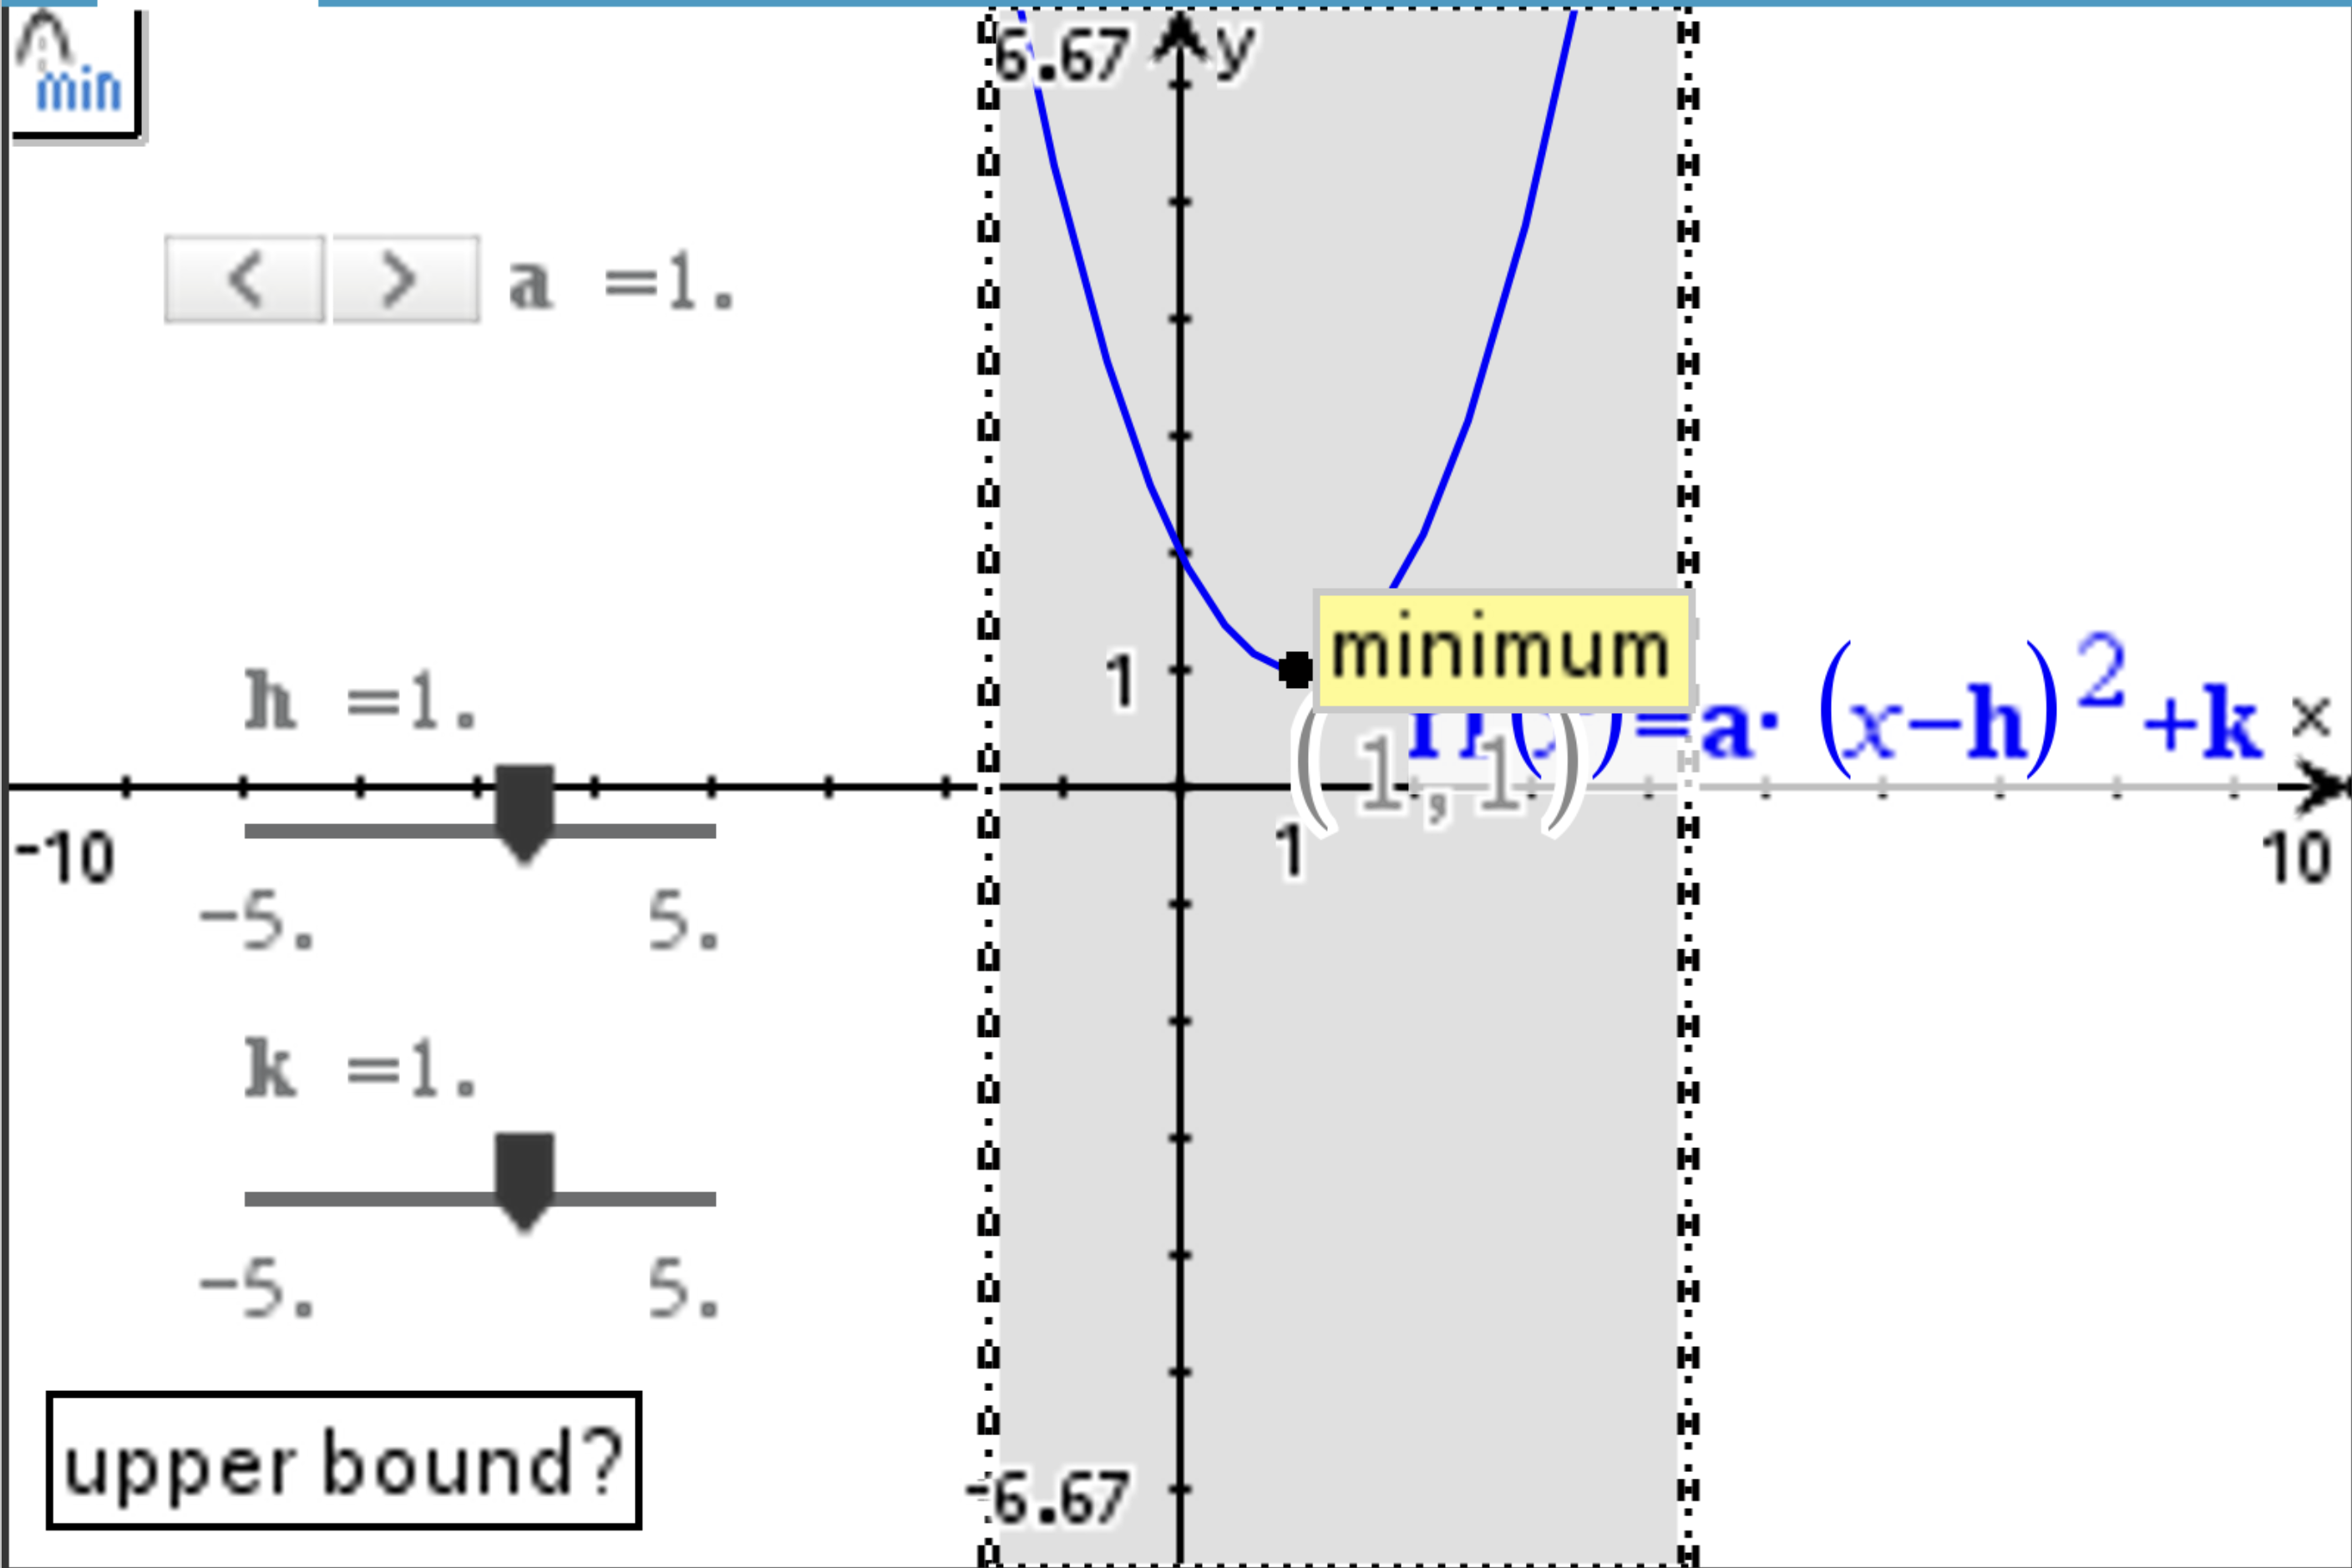

Slide 14
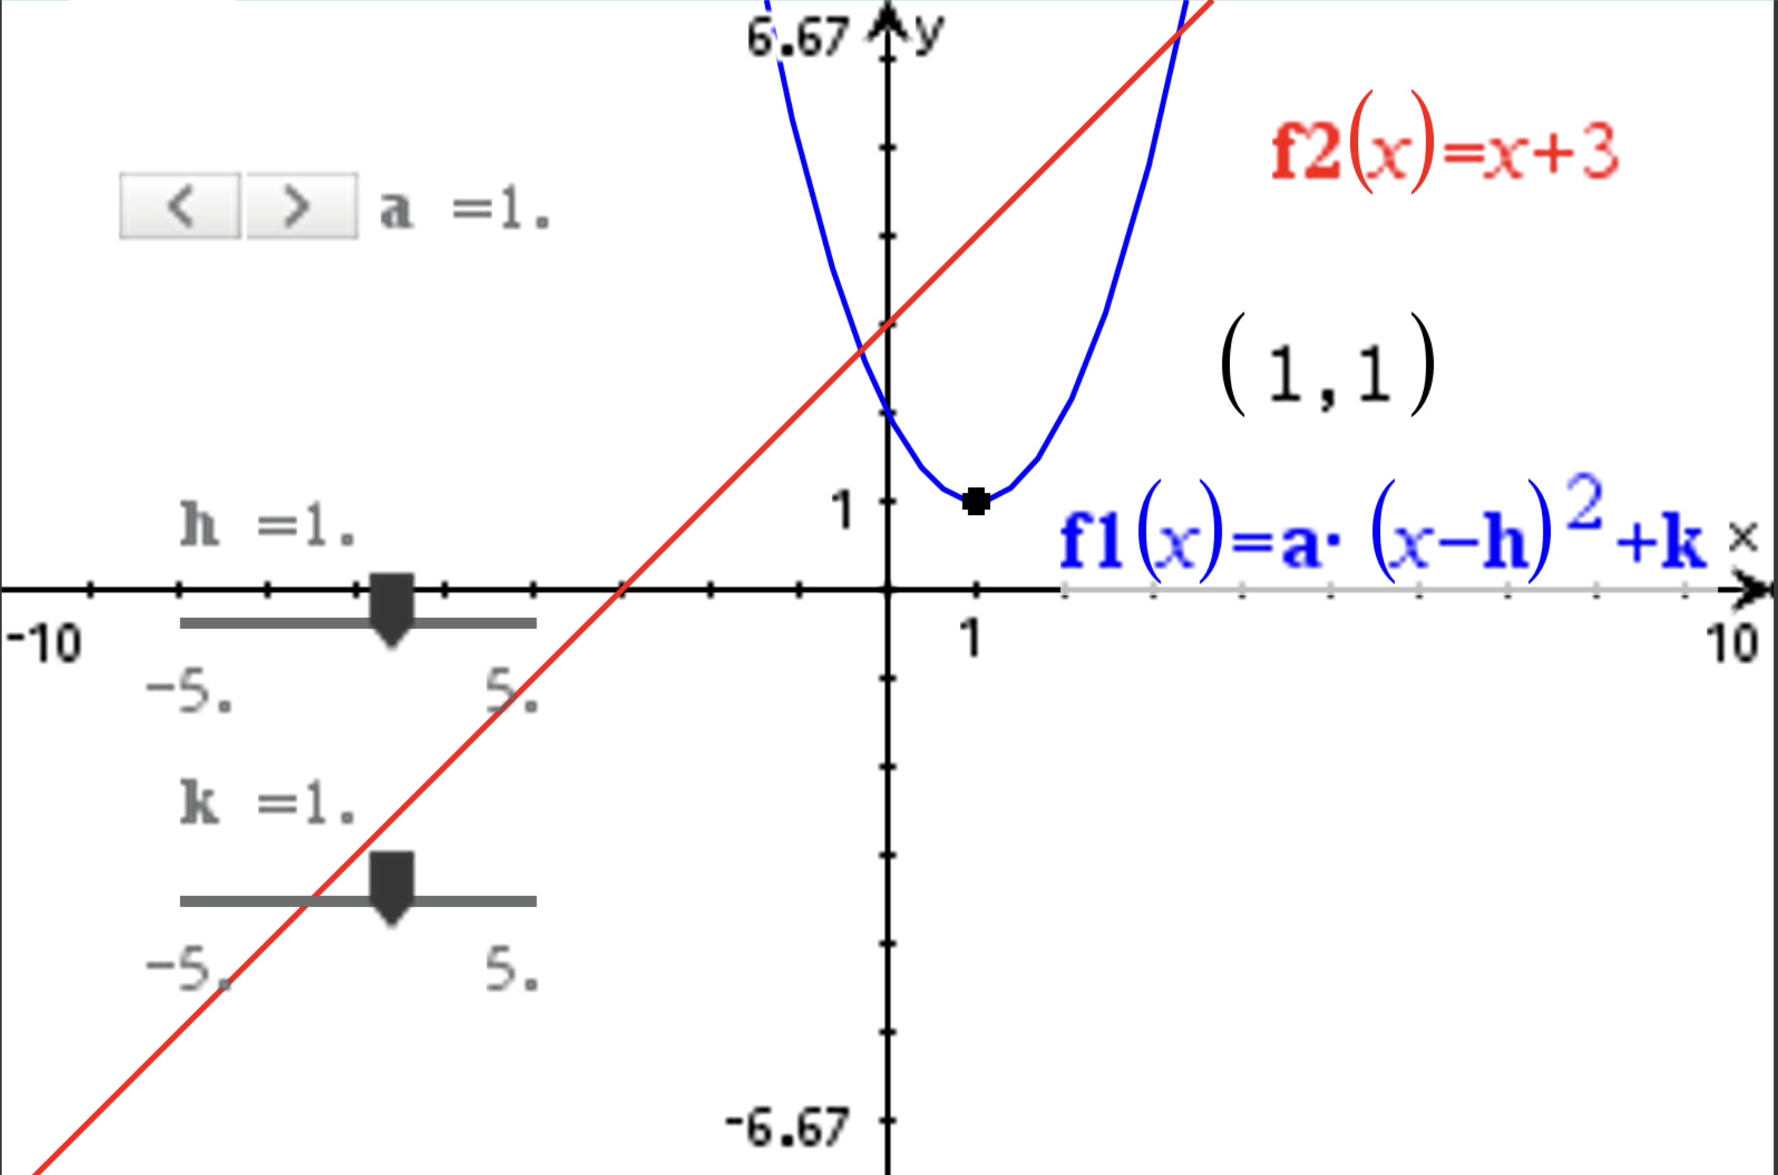

Slide 15
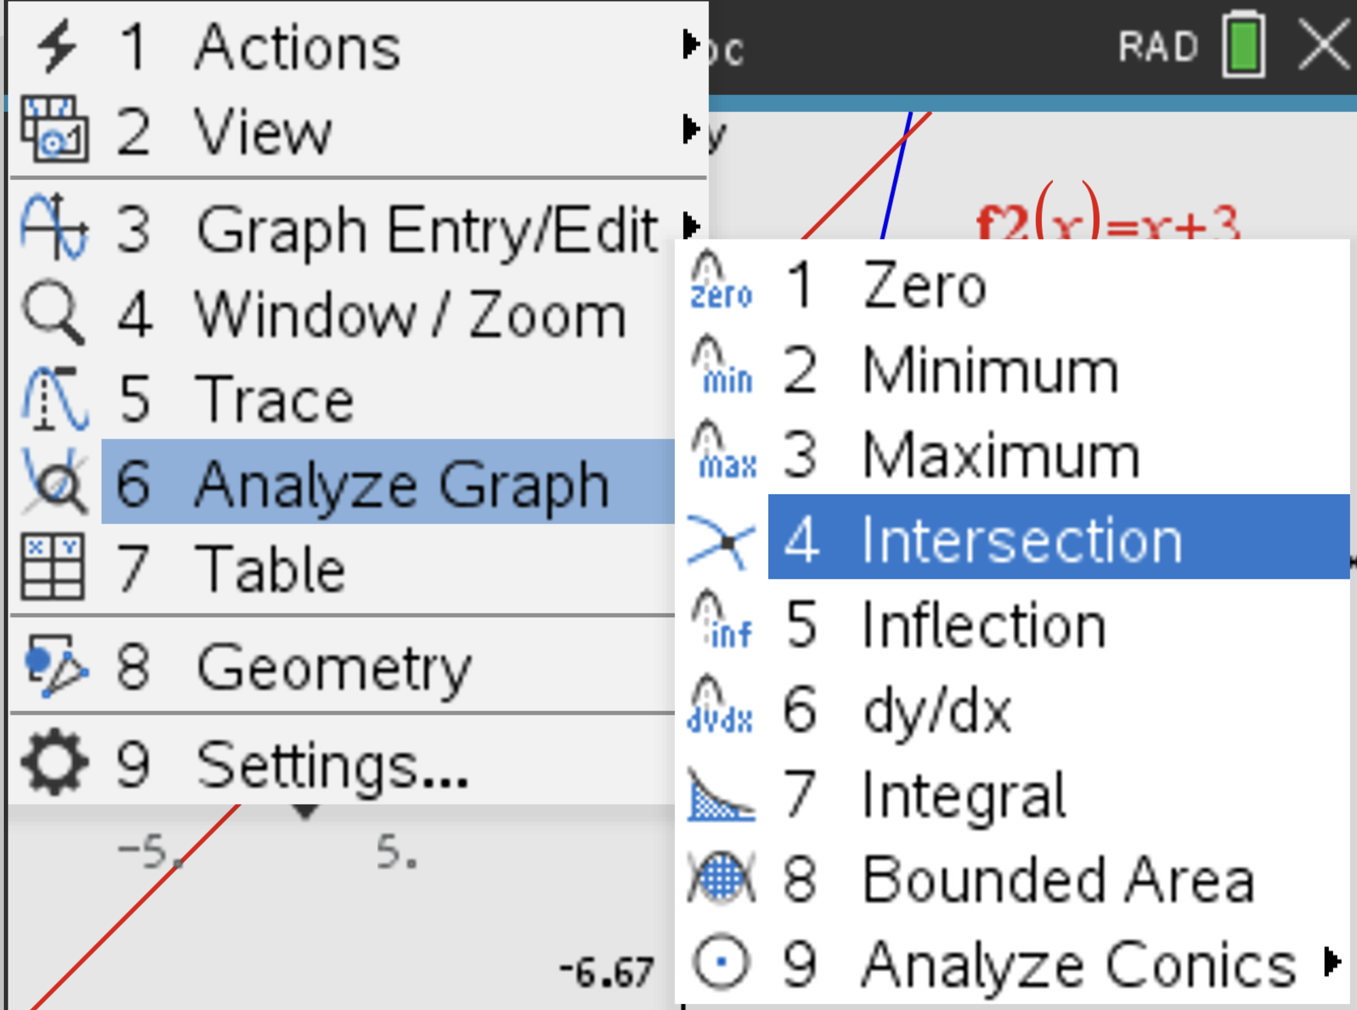

Slide 16
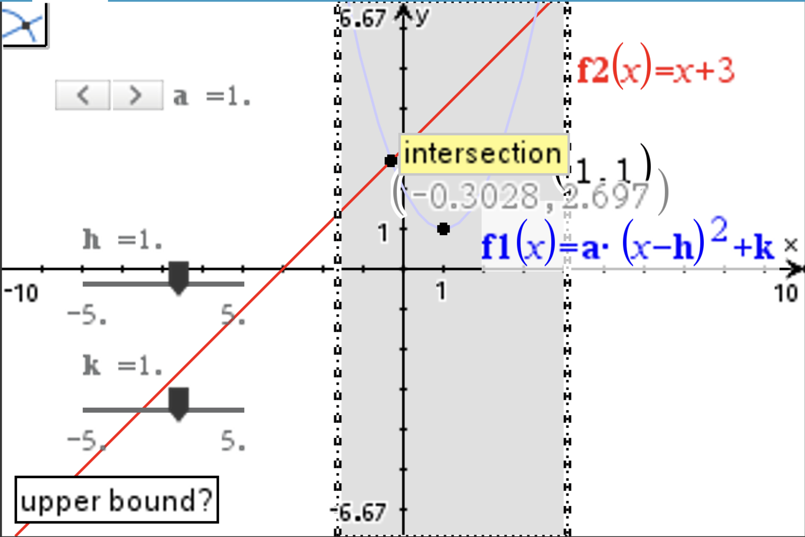

Slide 17
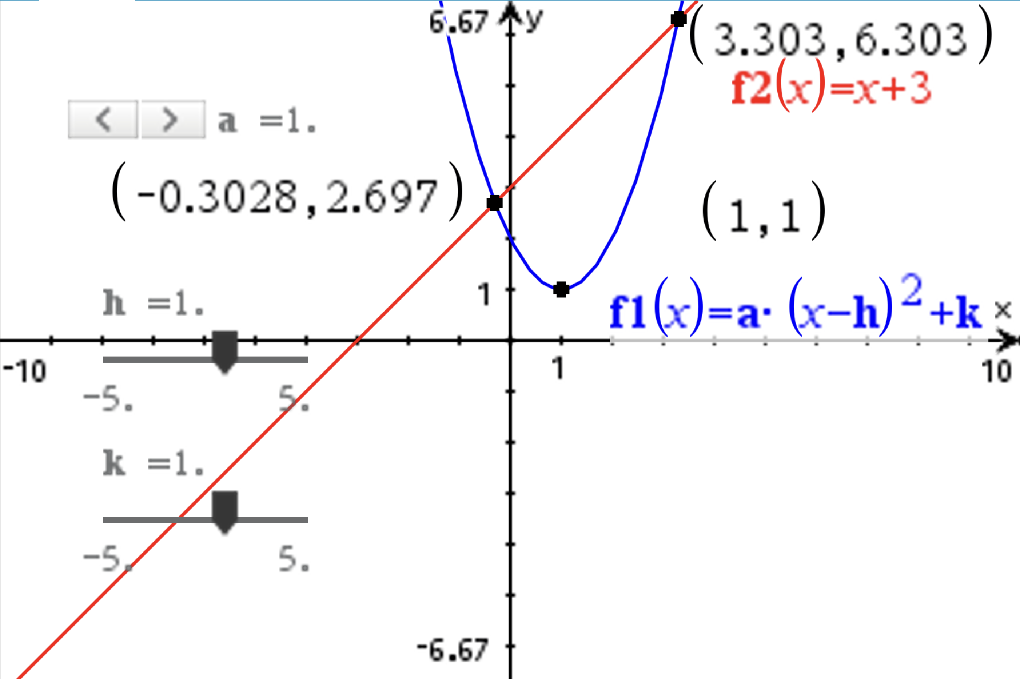

Slide 18


Slide 19
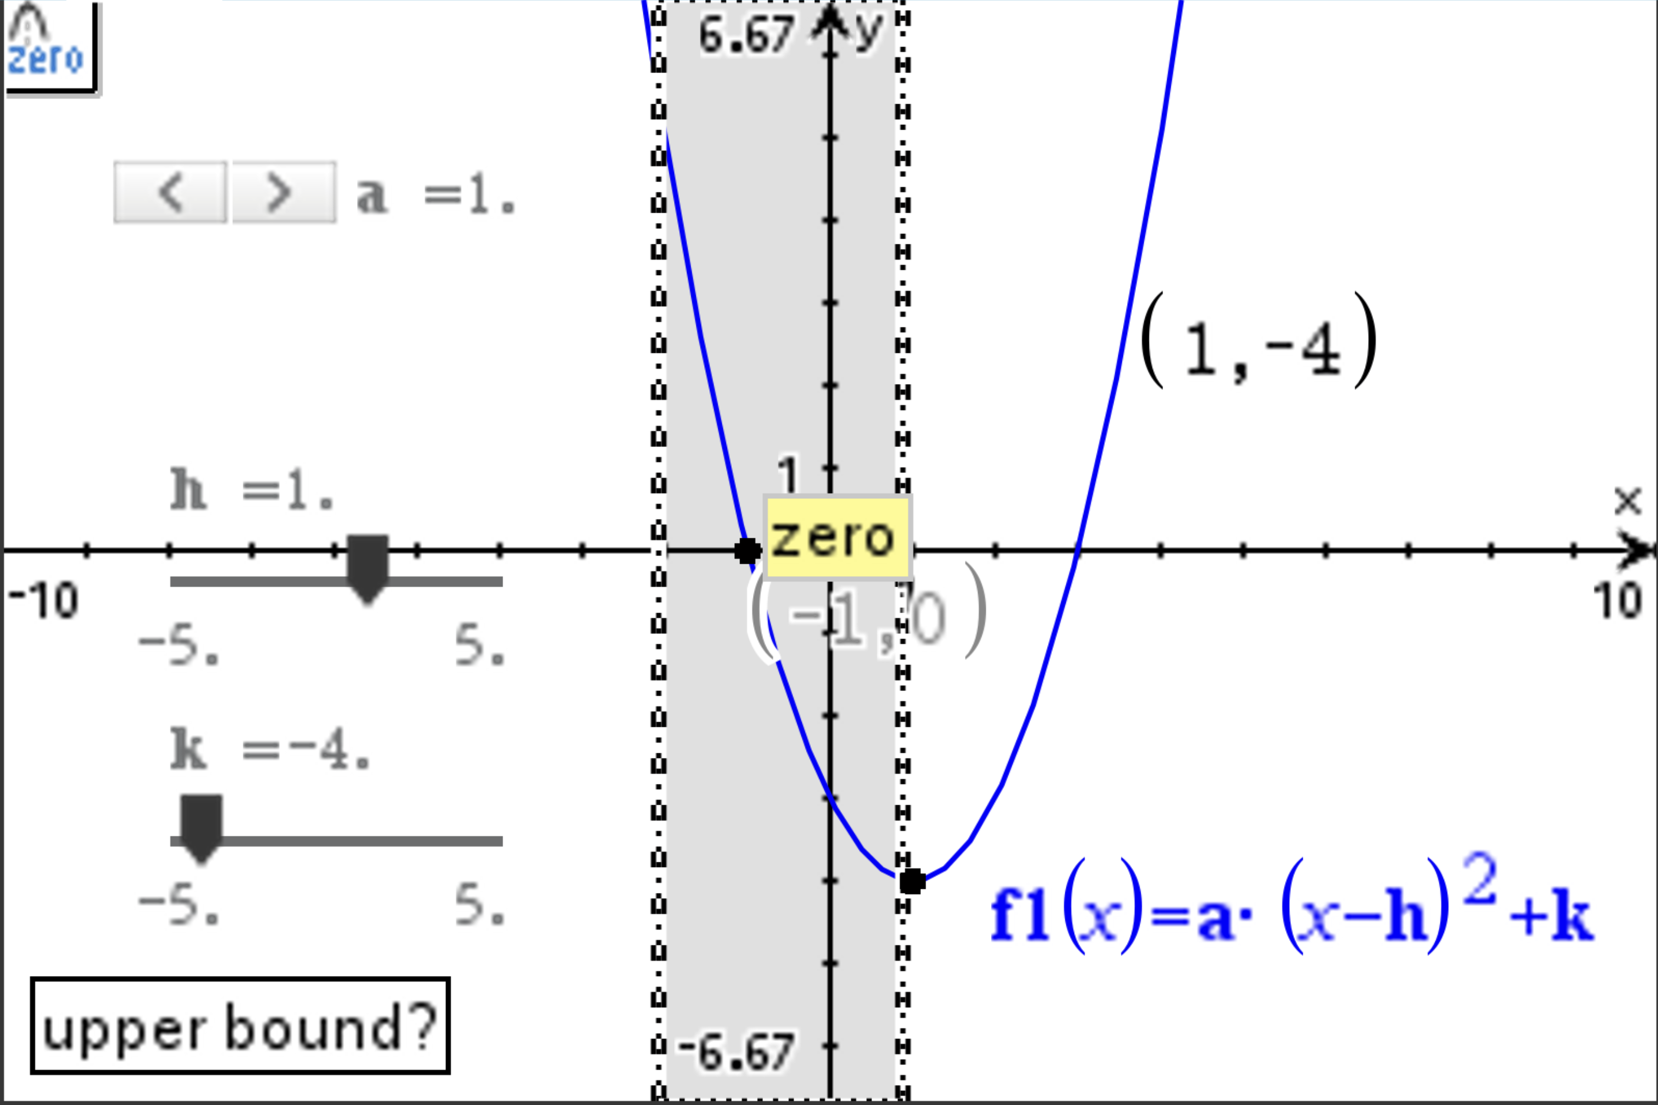

Slide 20
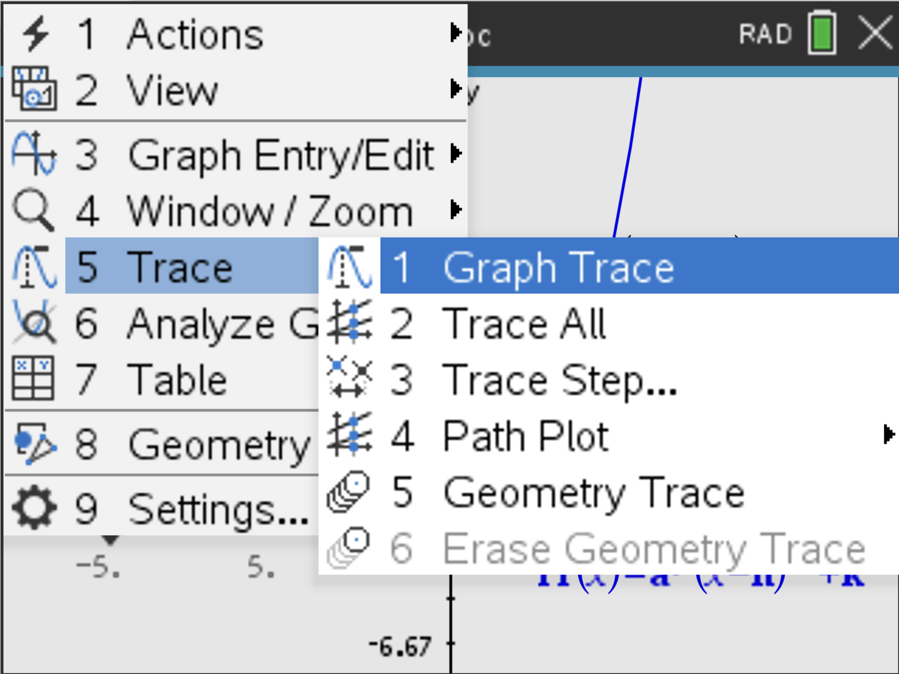
Finding the y-intercept

Slide 21
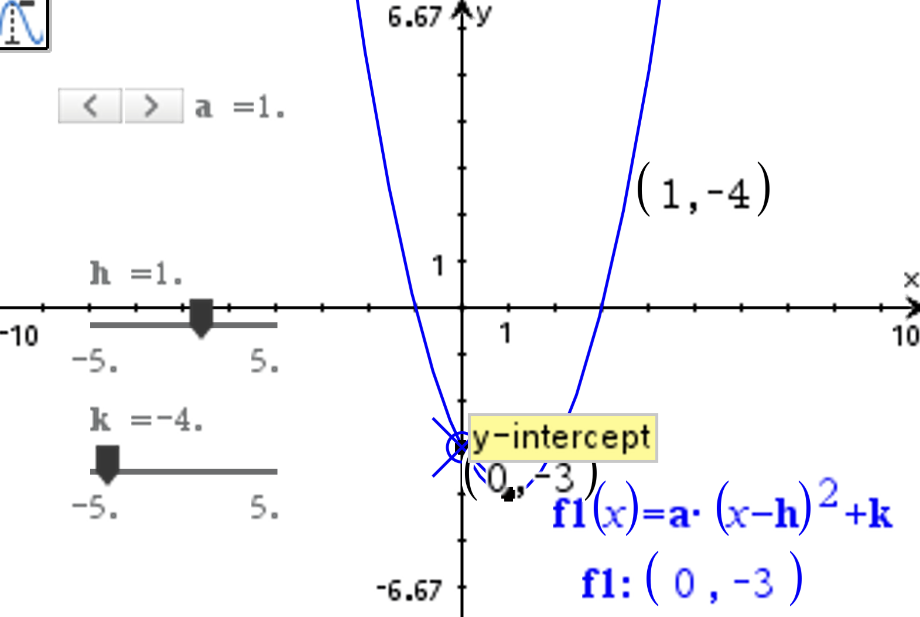
Graph Trace

Slide 22
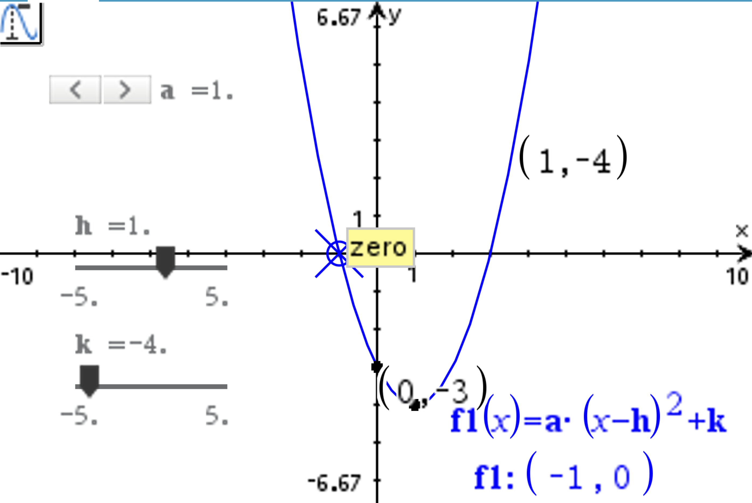
Graph trace can do a lot of things
Graph Trace feature on the TI-Nspire does not always find x-intercepts perfectly, but it can get very close. While Graph Trace can identify key points like x-intercepts, its accuracy is limited by the decimal display and the calculator's default step size. It is more reliable for finding x-intercepts using the Analyse Graph.

Slide 23
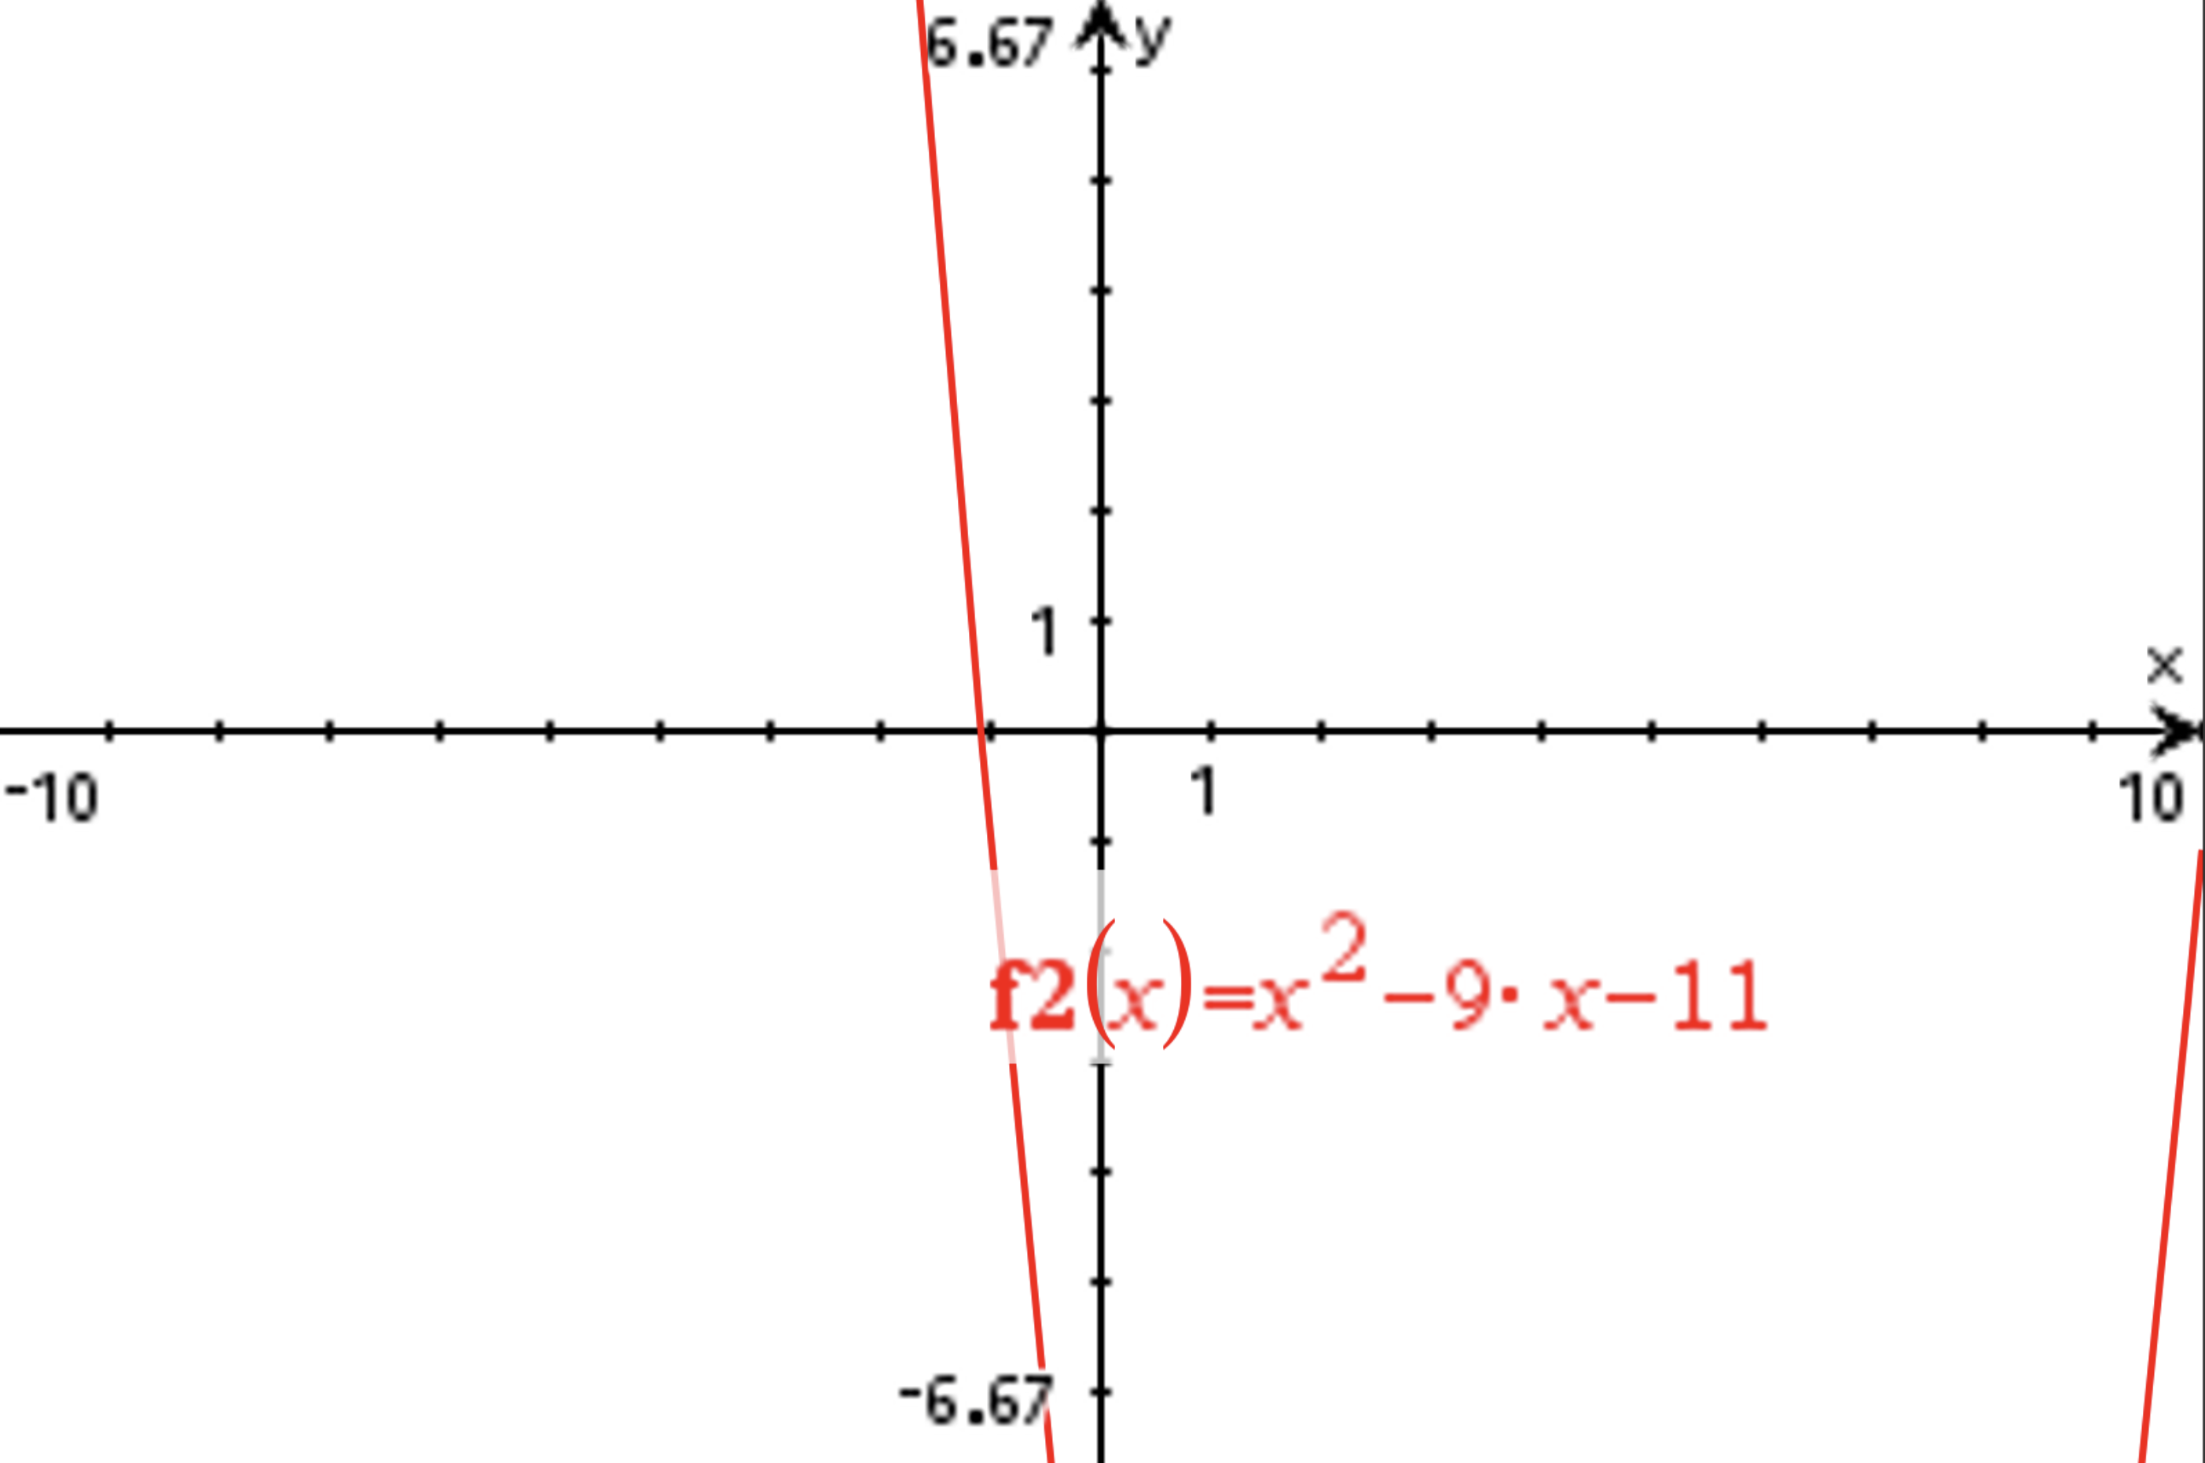
What happens if I can’t see all key points?

Slide 24
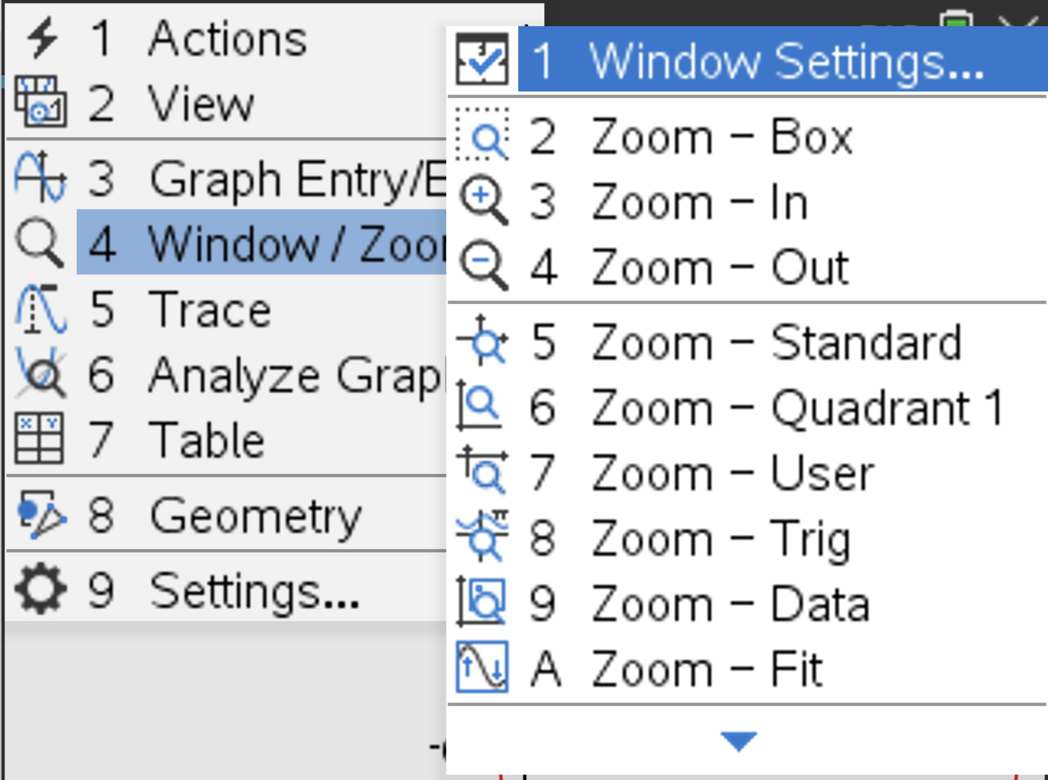
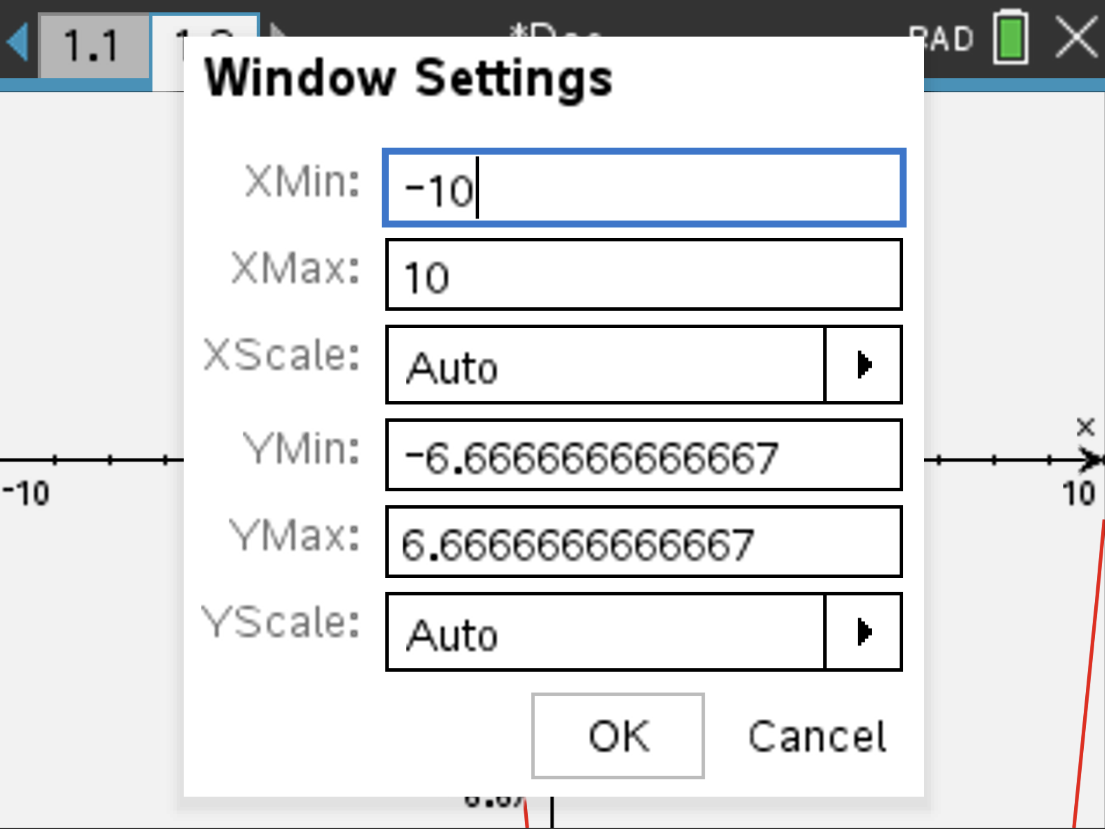
Resizing the Window

Slide 25
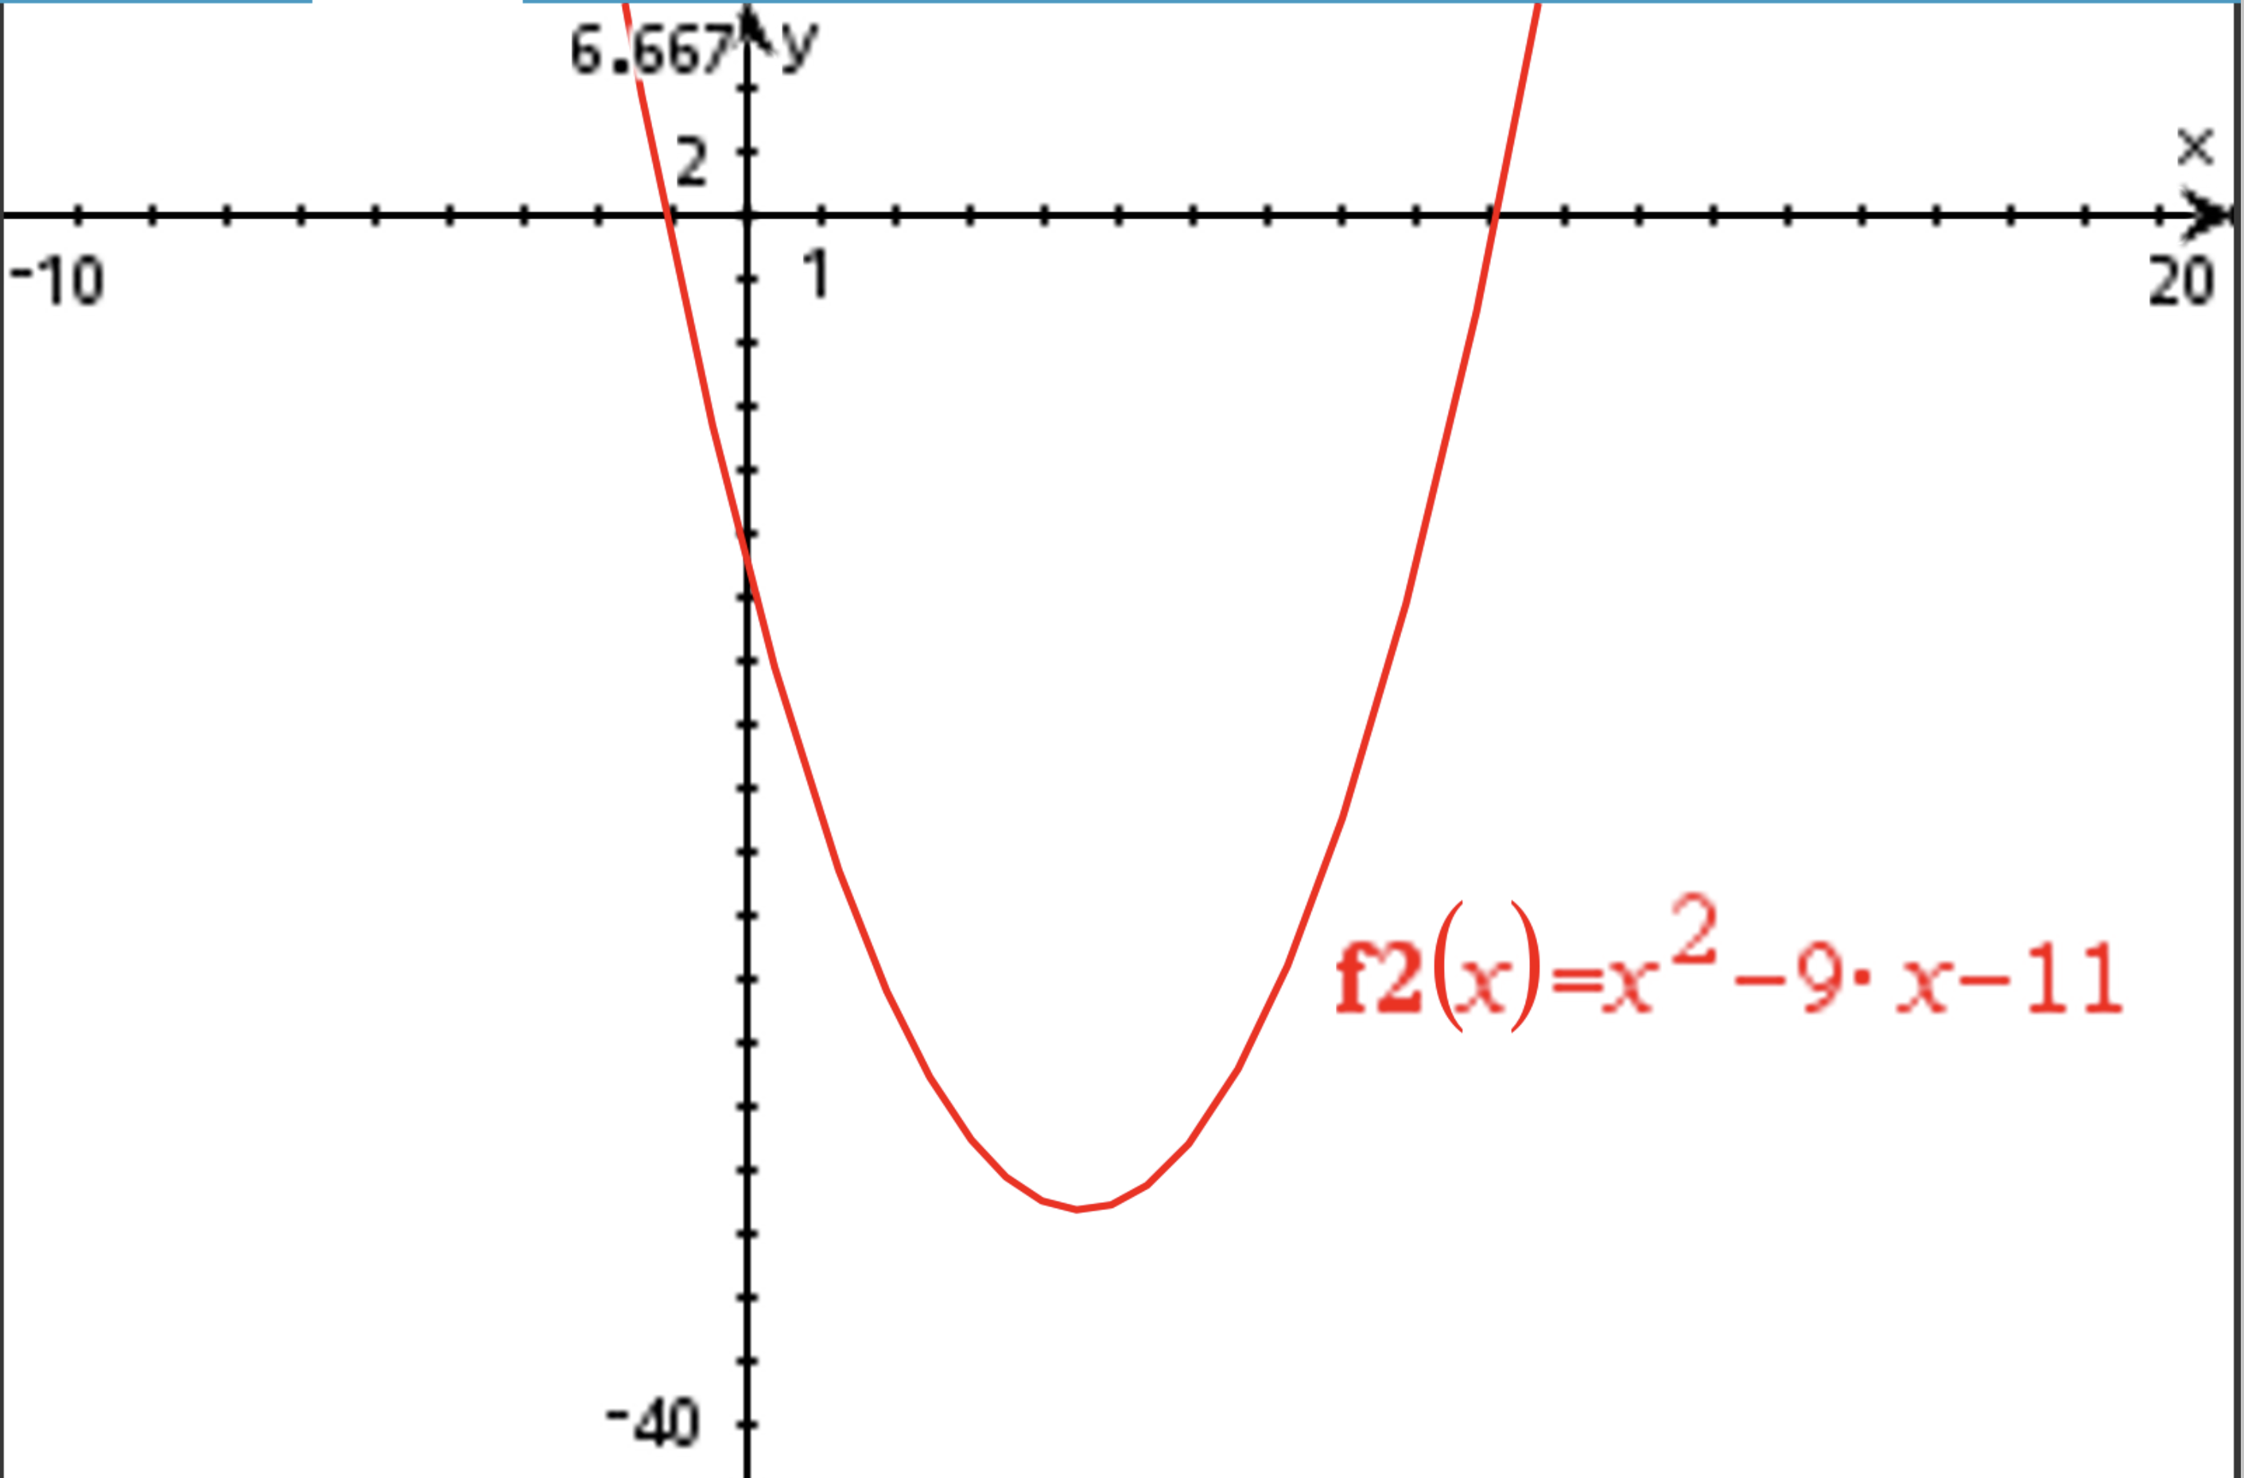

Slide 26

Find all key points of the following function
$f(x)=x^{2}−9x−11$

Slide 27
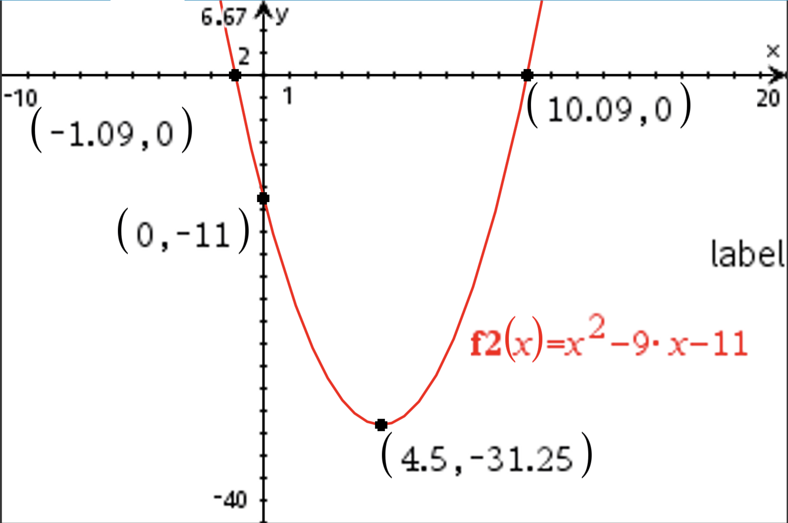
Solution

Slide 28
Unit 2 – Introduction to Differentiation
https://education.ti.com/en-au/seniornspiredcurriculum/aus-nz/qld-nspire/methods-yr-11?m=P8ngjvpCwU2_vbEswSvTCg.aFVCr8ZB8EC23v63gvzRlw

Slide 29
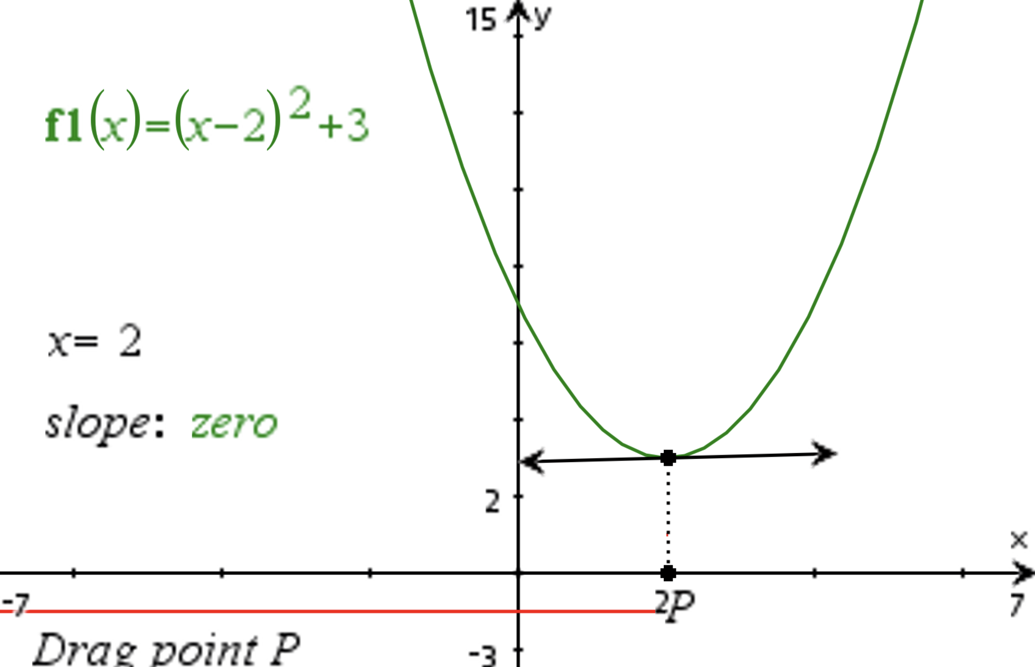
Showing gradient at a point

Slide 30
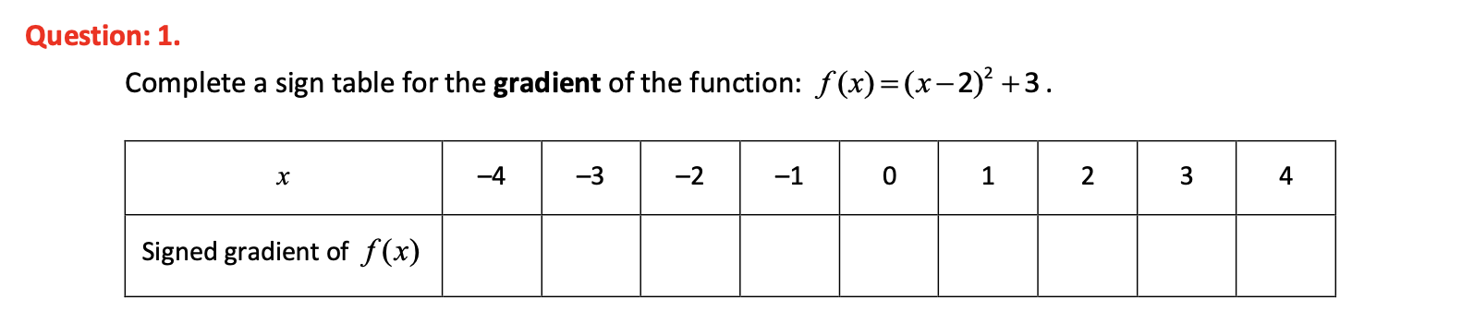
PDF to use activities

Slide 31
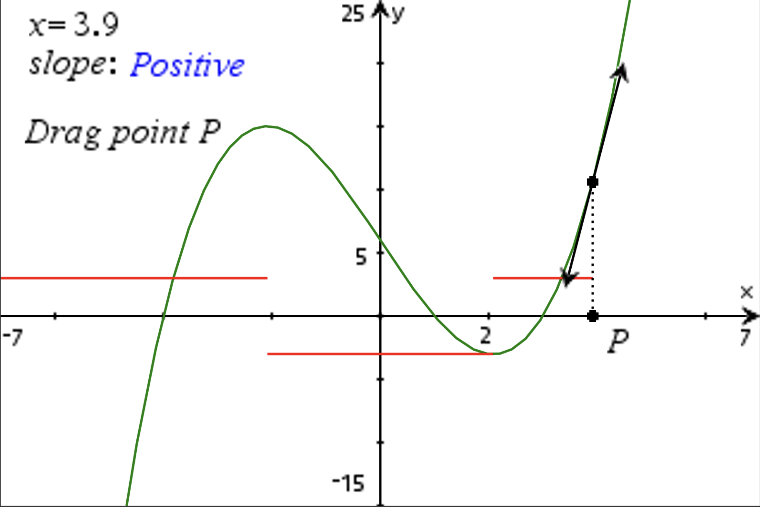

Slide 32
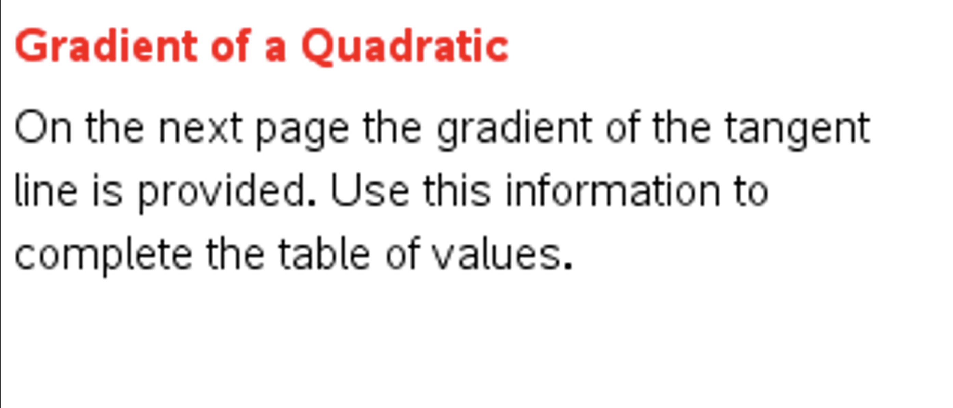

Slide 33
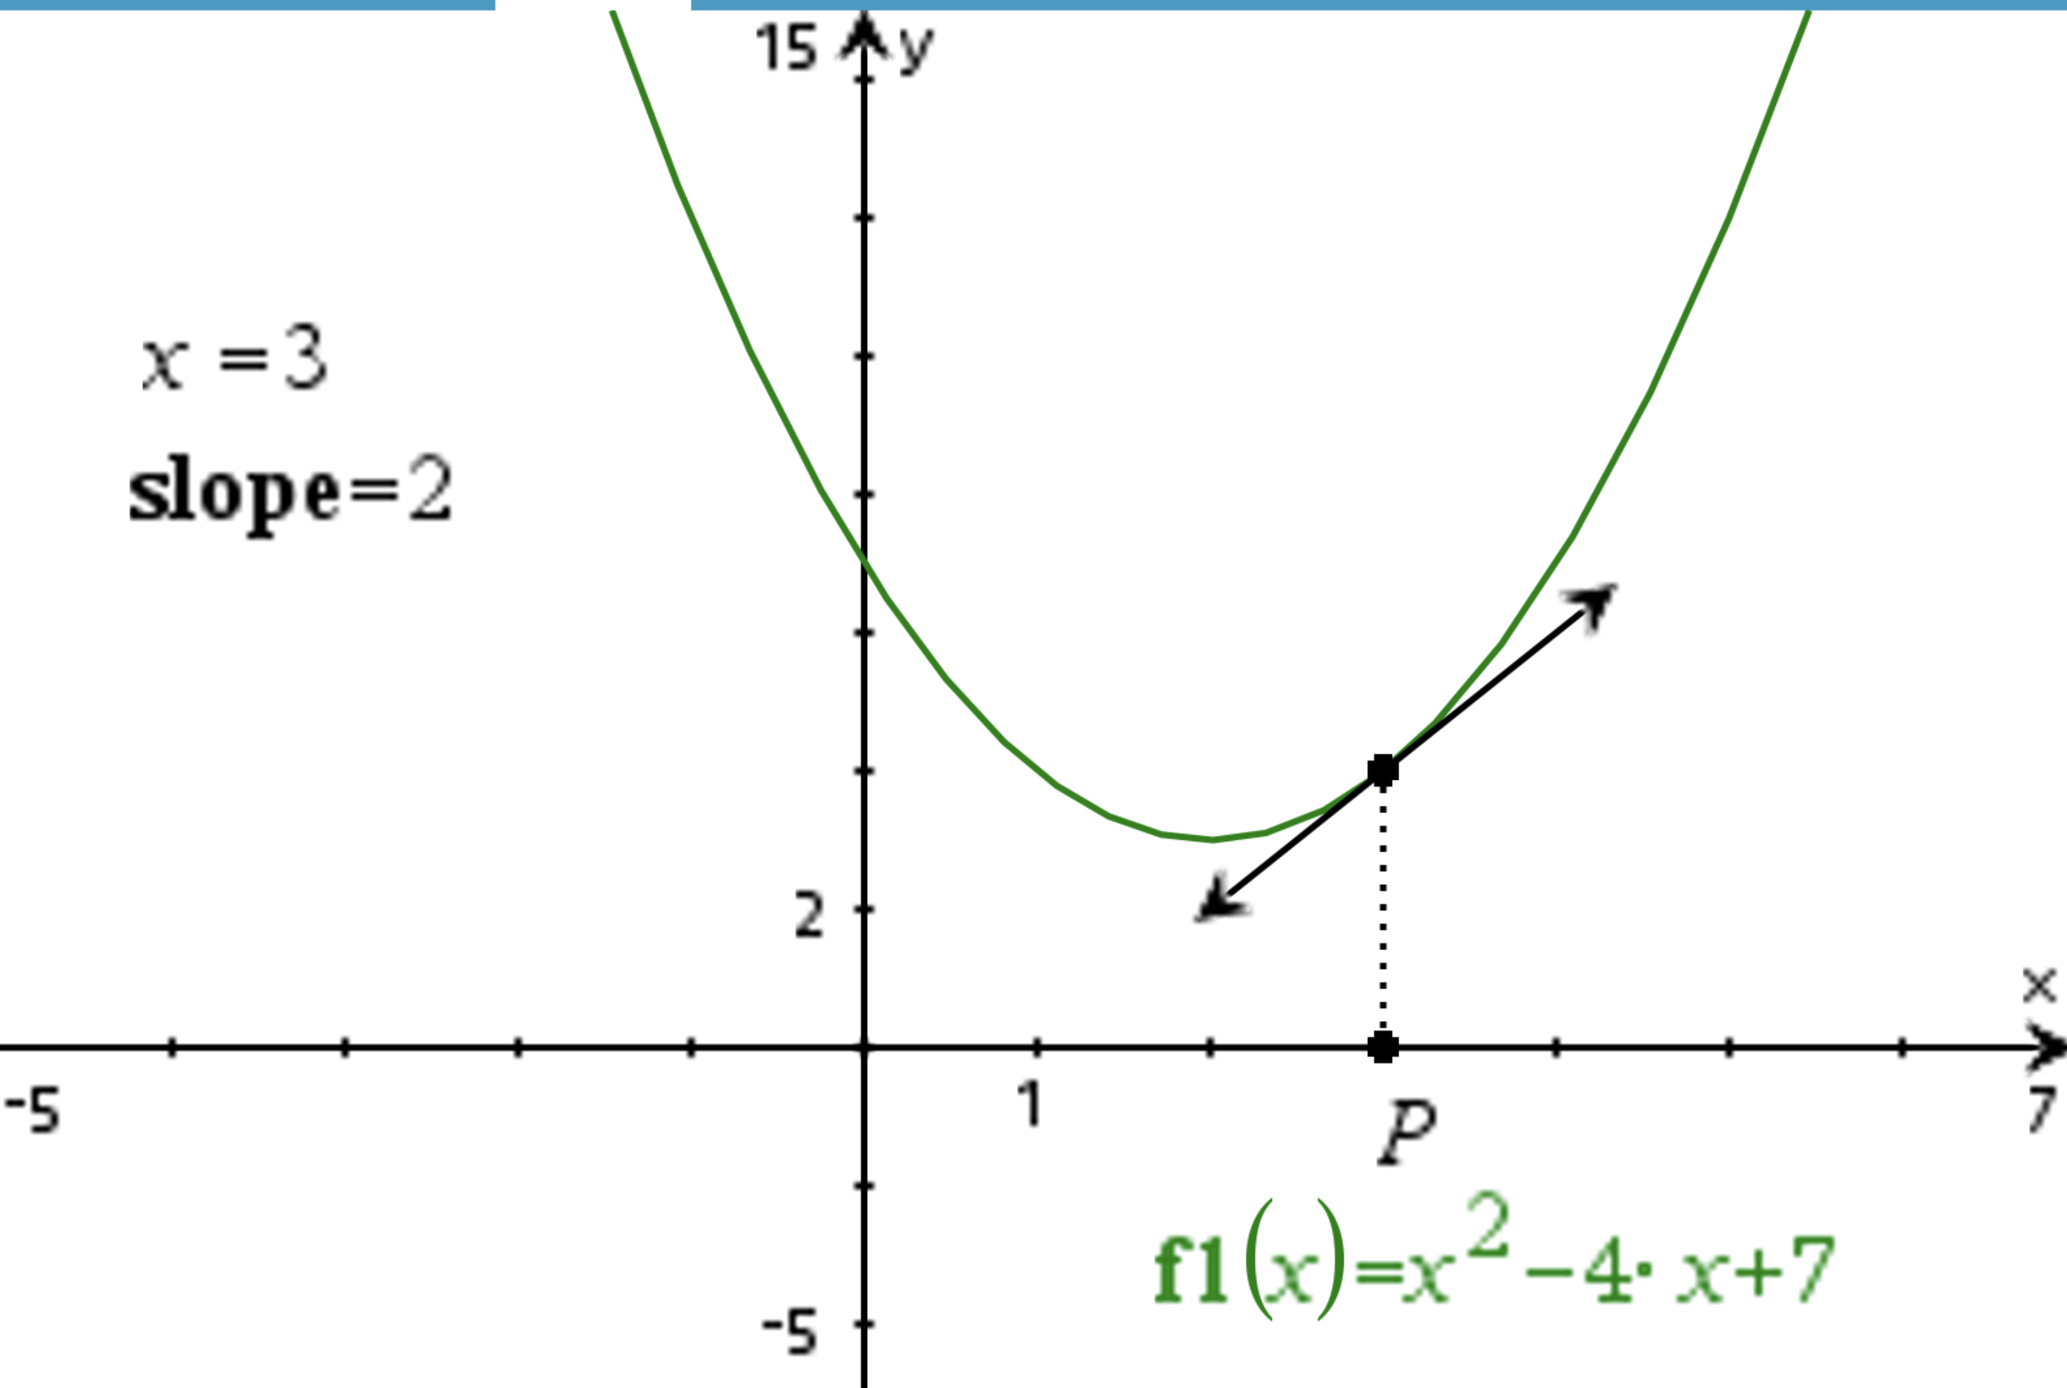

Slide 34
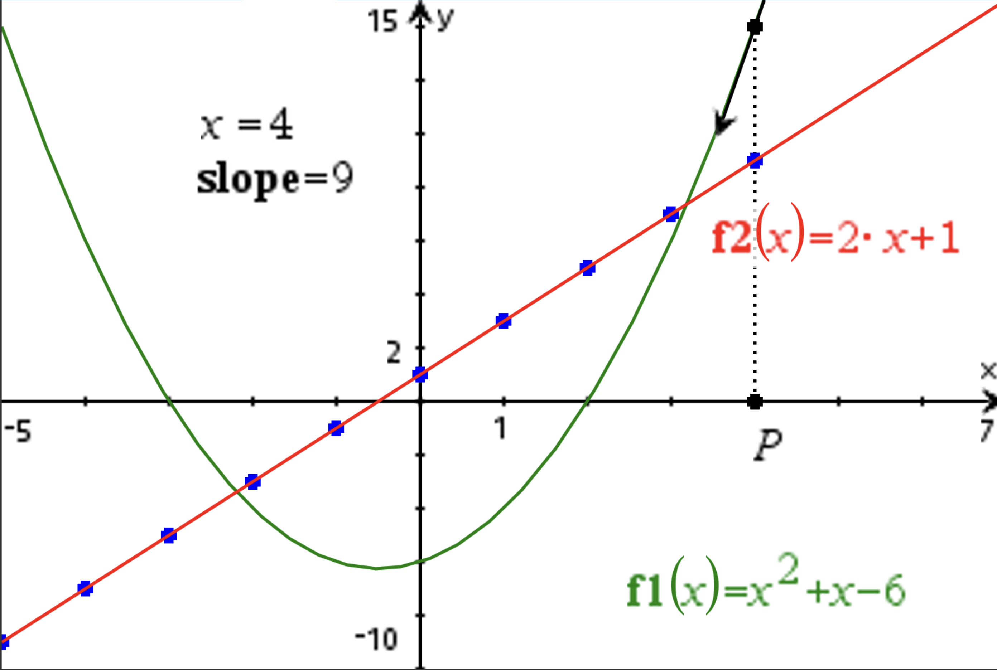
Plotting a graph of the first derivative

Slide 35
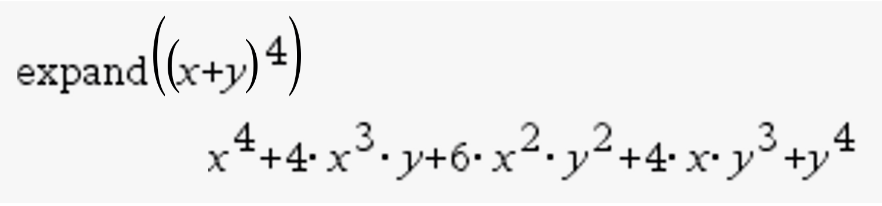
Back To Unit 1: Topic 2 Binomial Expansion
NOTE: expand is disabled in test mode, but works well for students checking work and as a teaching tool to quickly expand expressions/show binomial expansion patterns

Slide 36
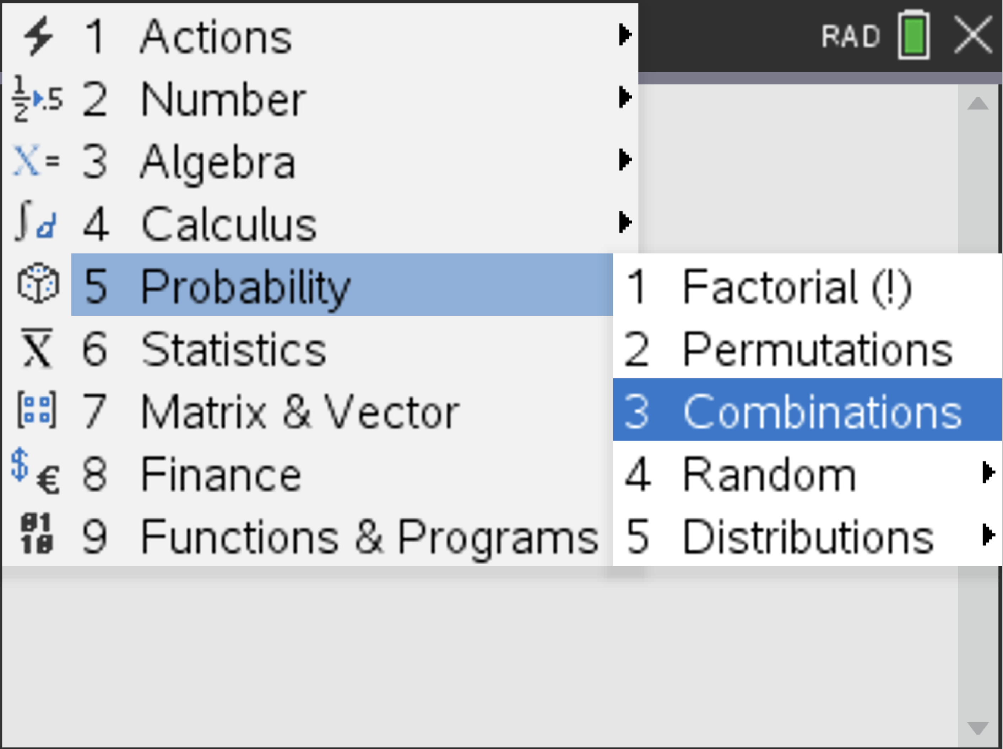
nCr notation

Slide 37
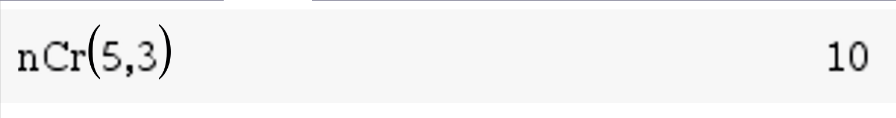
Students can also type ncr into the calculator using the keyboard

Slide 38

Practice Question
Consider the expression ${\left(2x−3\right)}^{8}$
Find the coefficient of $x^{4}$ in the expansion.

Slide 39
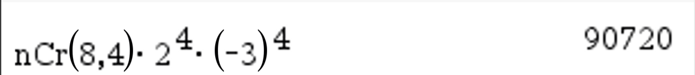
Solution

Slide 40
Topic 3: Domain and Range/Function vs Relation
https://education.ti.com/en-au/seniornspiredcurriculum/aus-nz/detail?id=825142C98B804262A41D65F54BE88C25&t=D044AFF4F38740A09A6396019FC12946

Slide 41
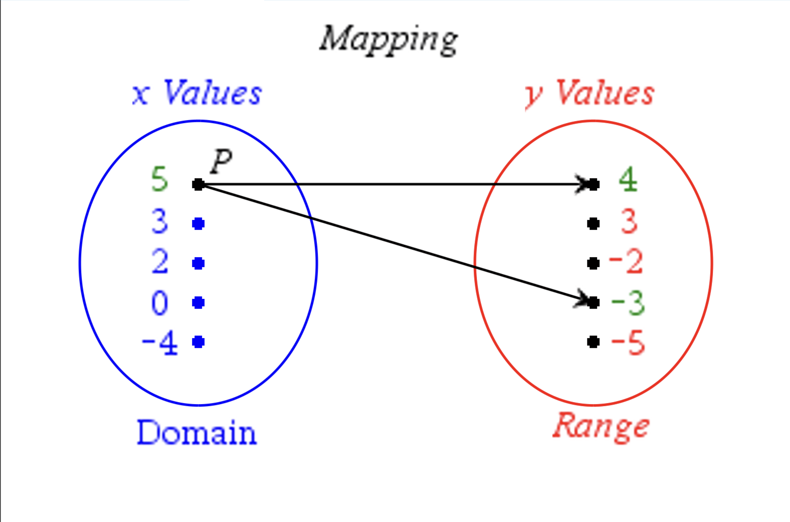

Slide 42
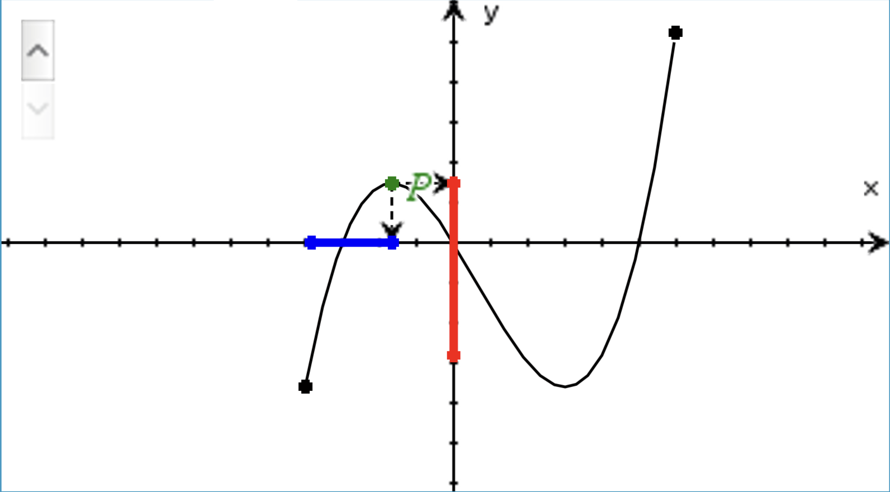
Showing the domain and range as axes

Slide 43
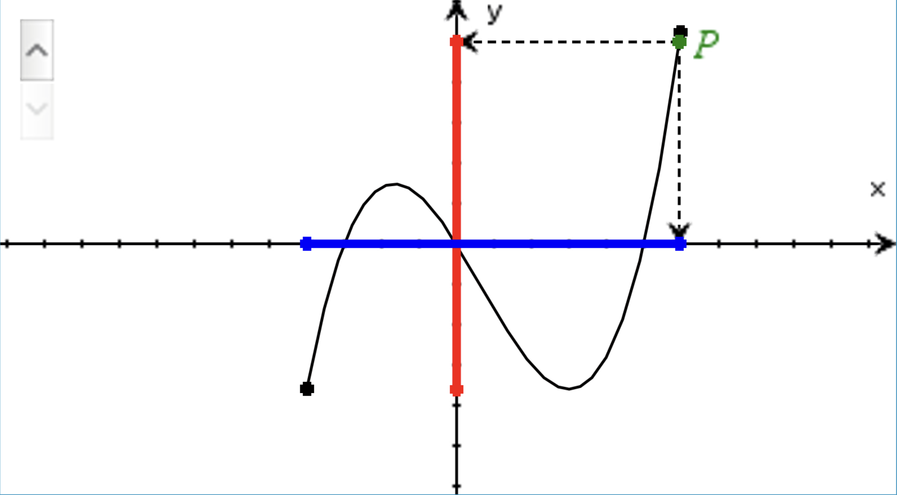

Slide 44

Unit 1: Using TI to find Roots on the calculator page
Polyroots vs nSolve
$f(x)=x^{2}−9x−11$

Slide 45
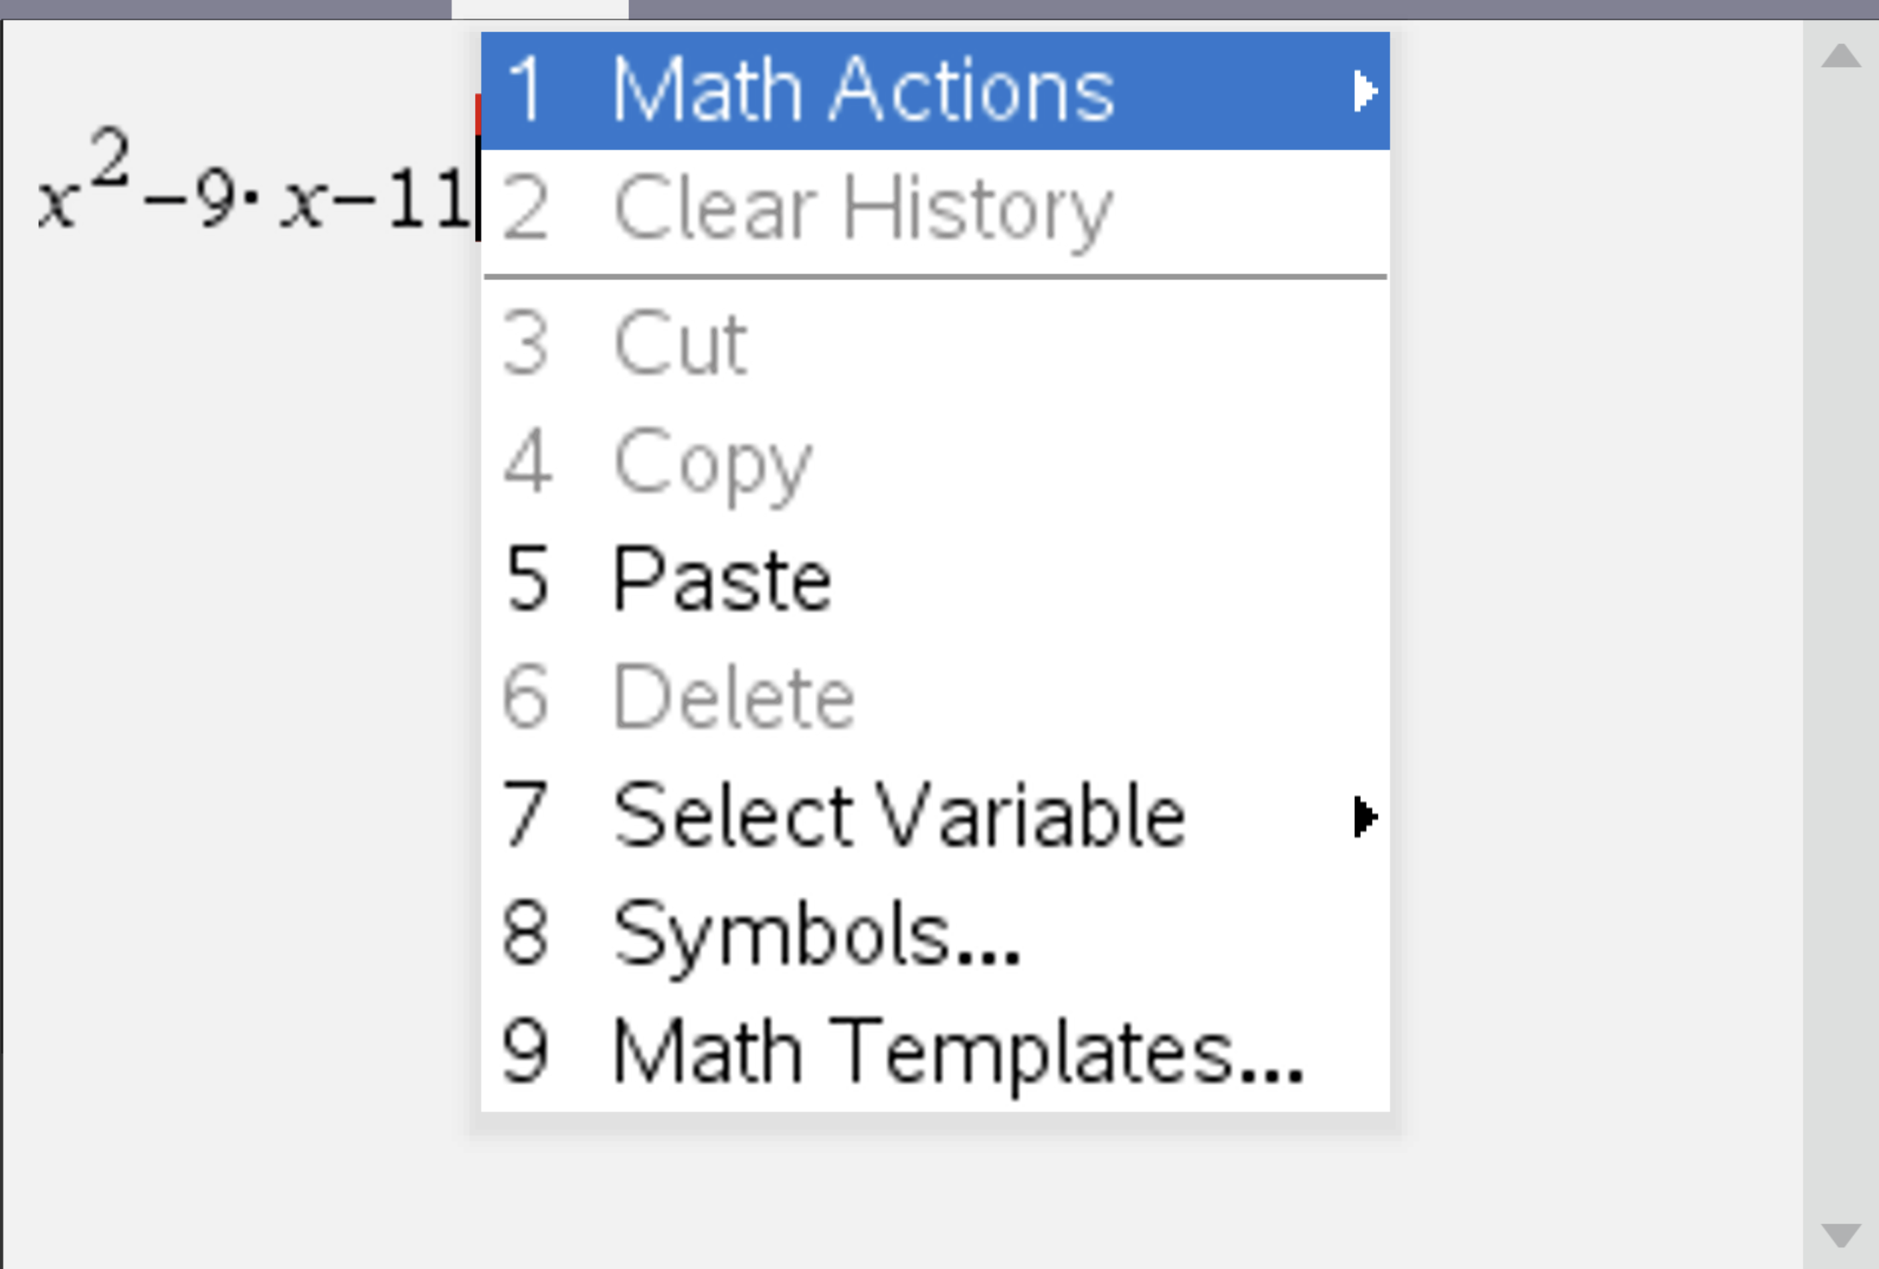
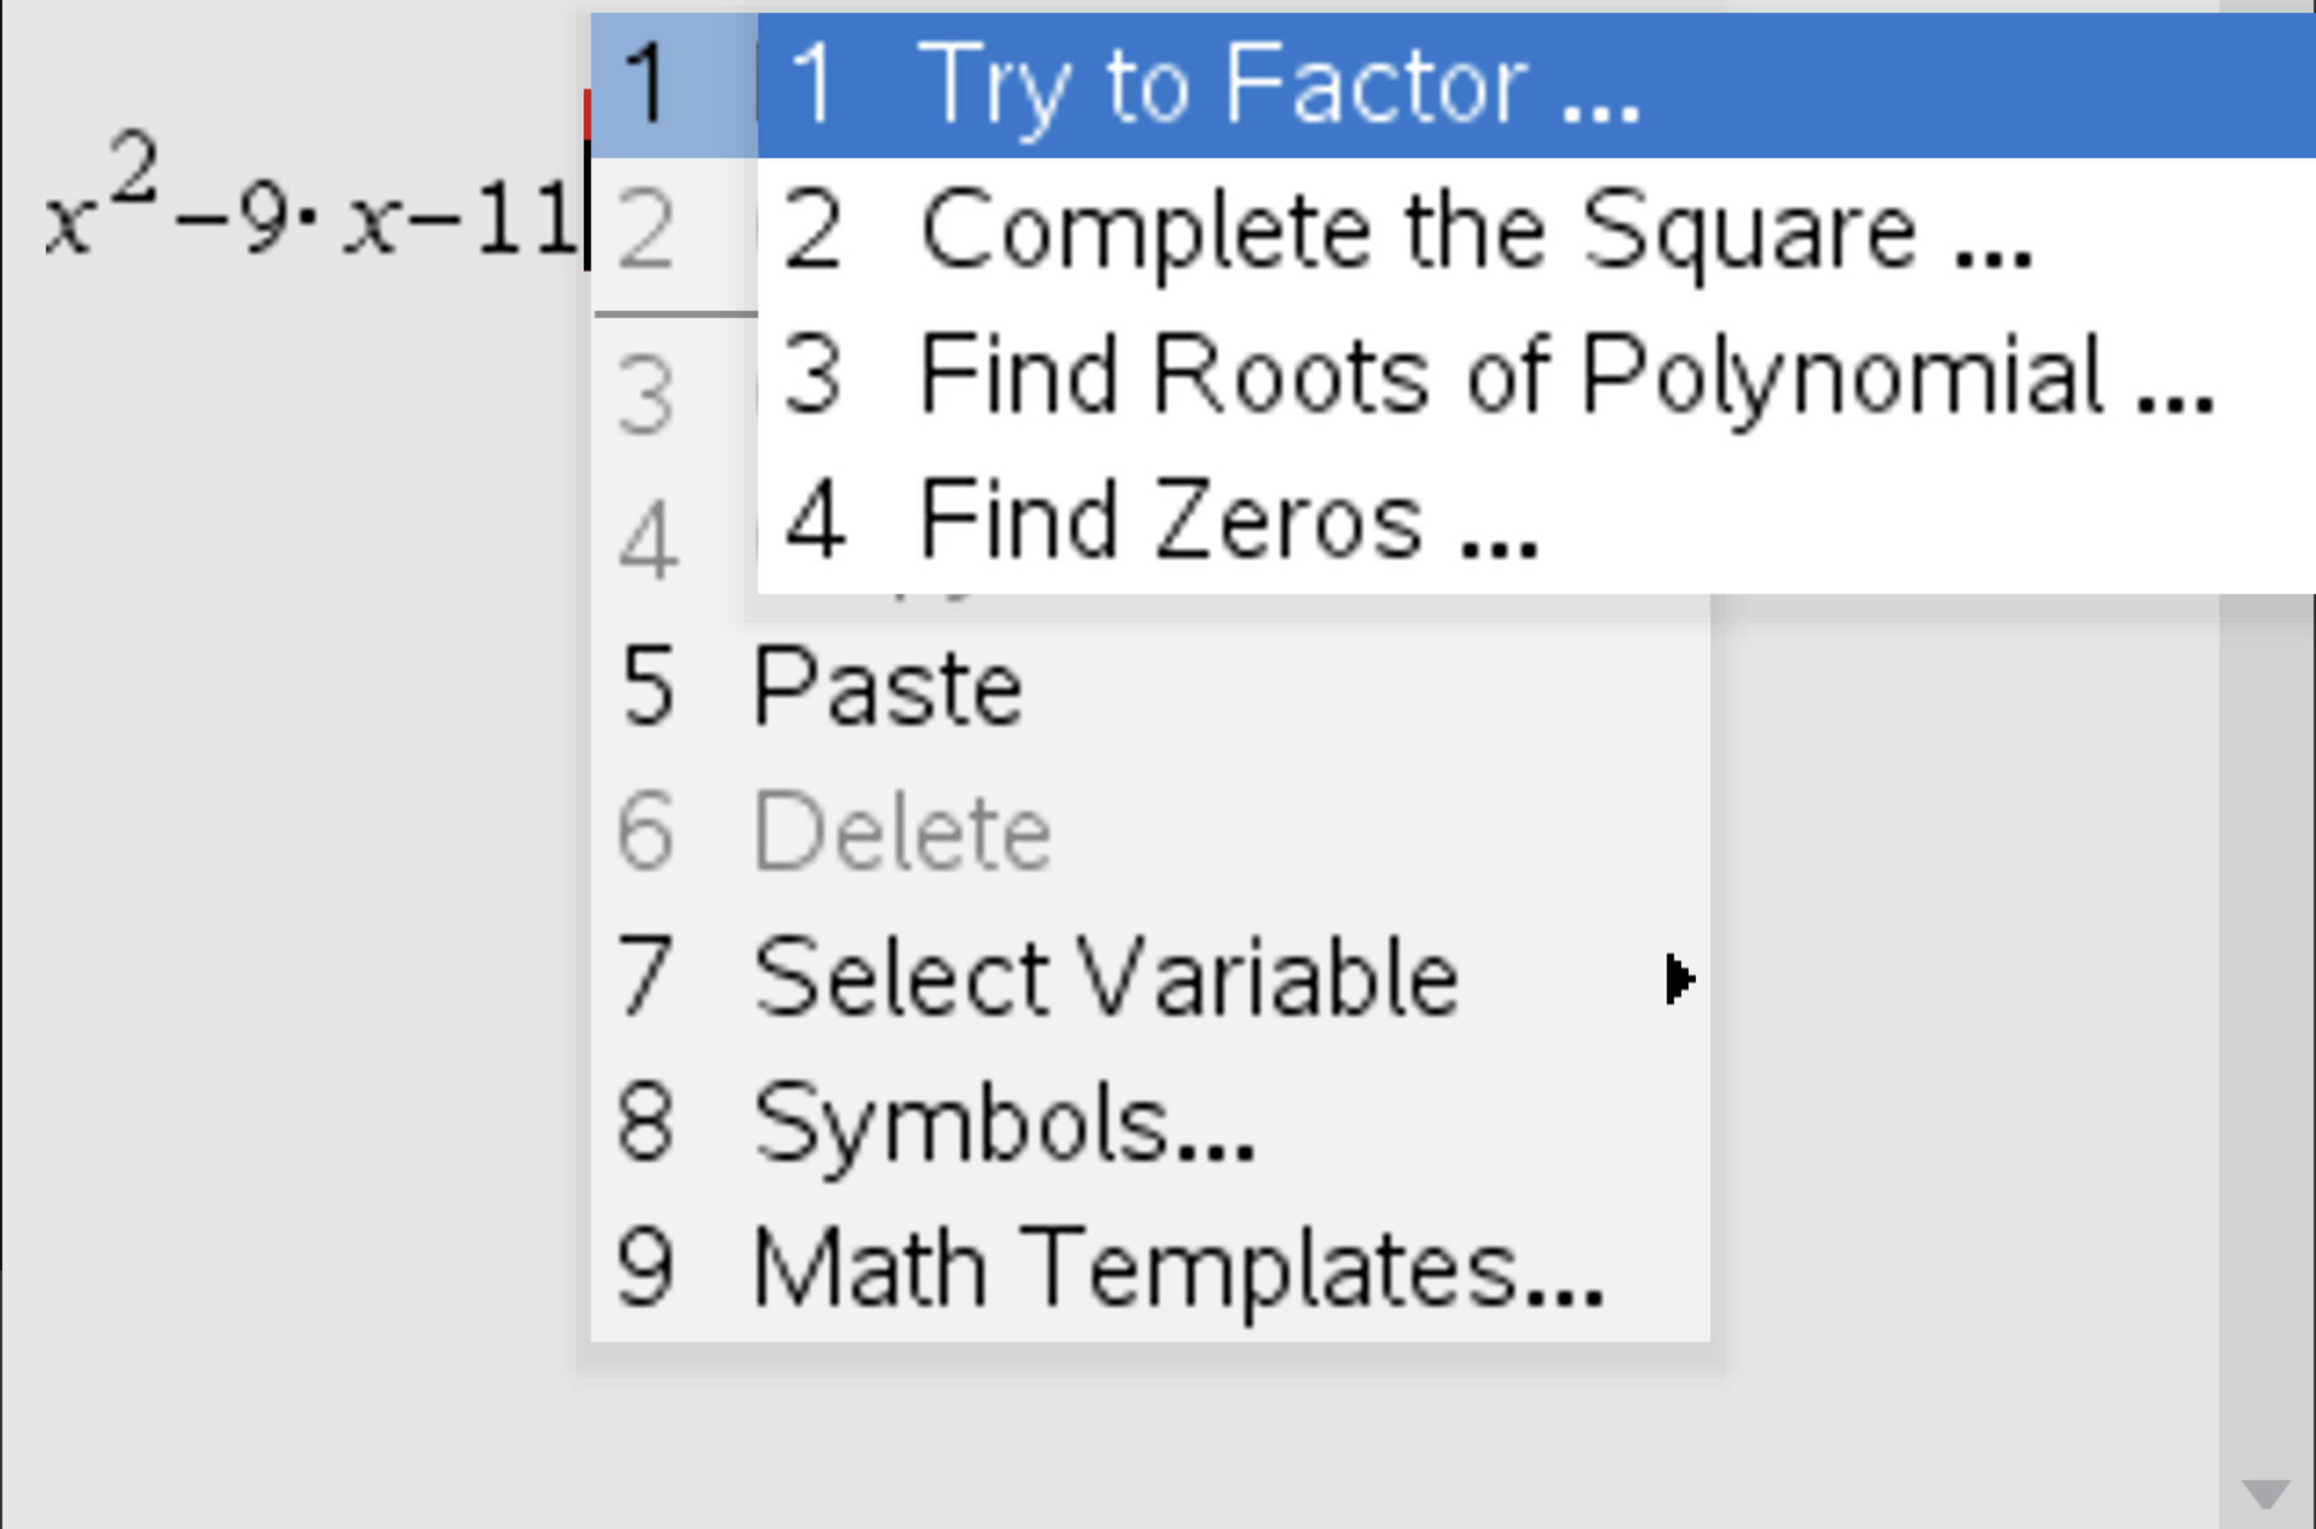

Slide 46
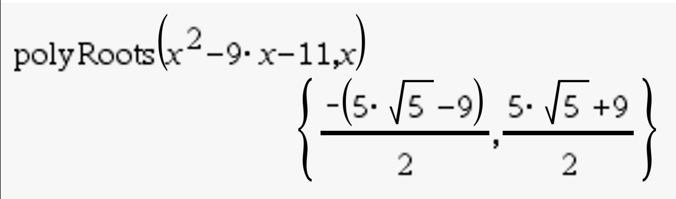
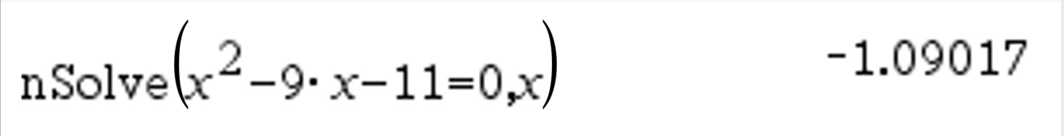
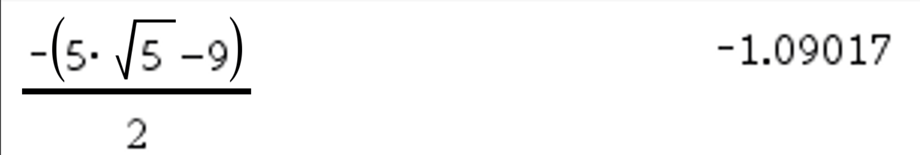
Polyroots find multiple solutions, nSolve find 1

Slide 47
Where nSolve shines
If it is not a polynomial and is likely to have just one solutions (so in probability questions, logarithmic questions or exponentials questions where the algebraic solution is difficult ot time consuming to find), nSolve is your best friend.

Slide 48
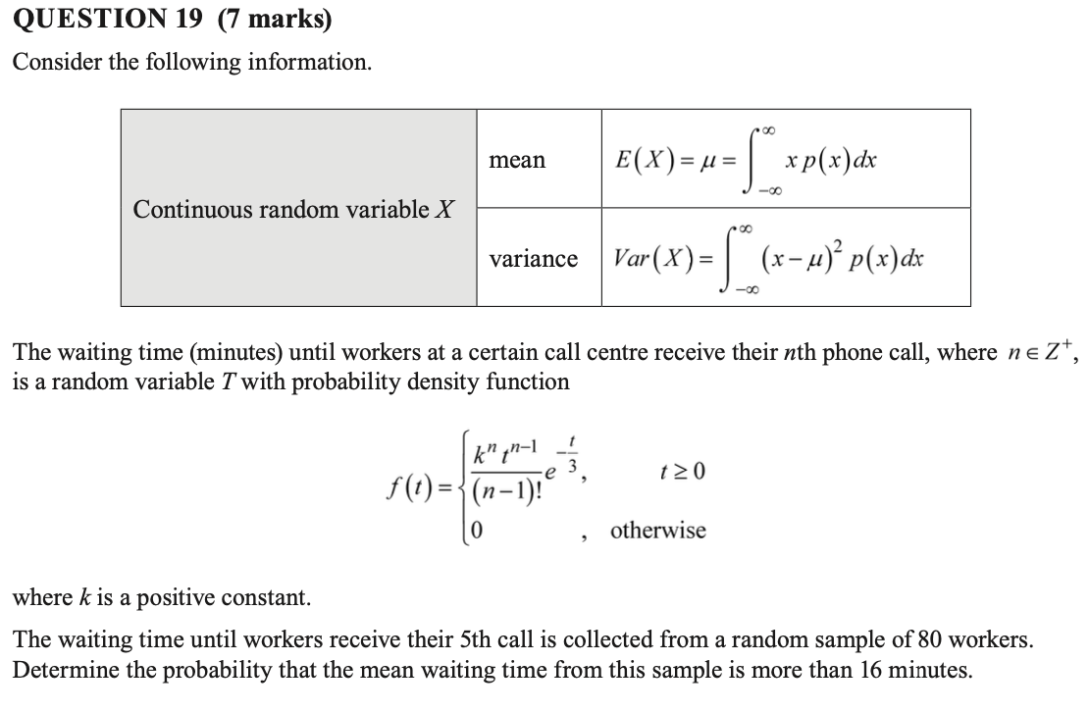
Paper 2 SR - 2021

Slide 49
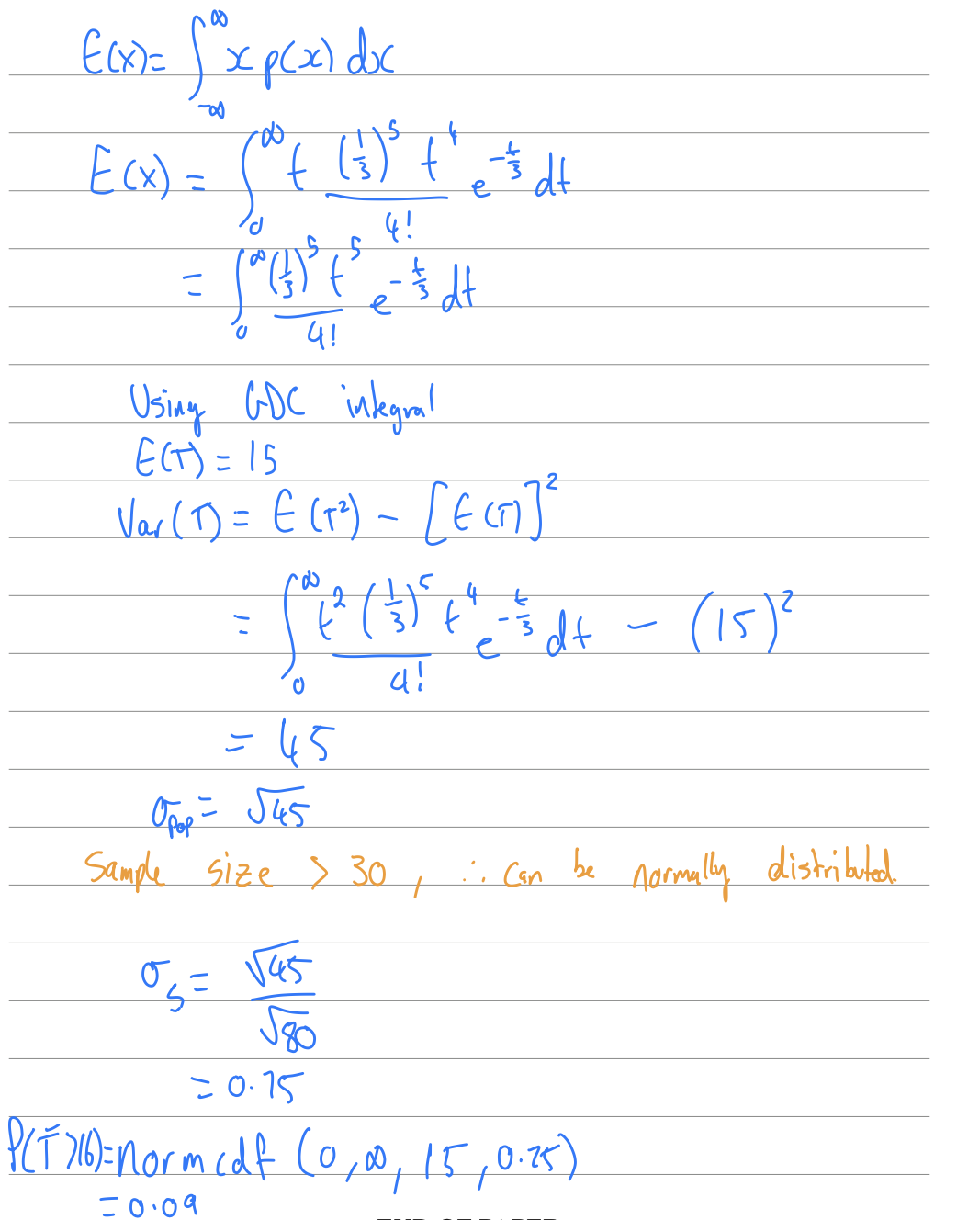
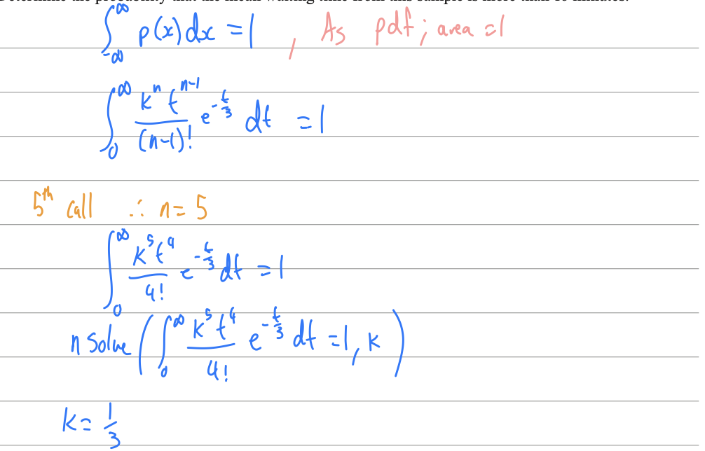
Paper 2 SR - 2021
Solution

Slide 50
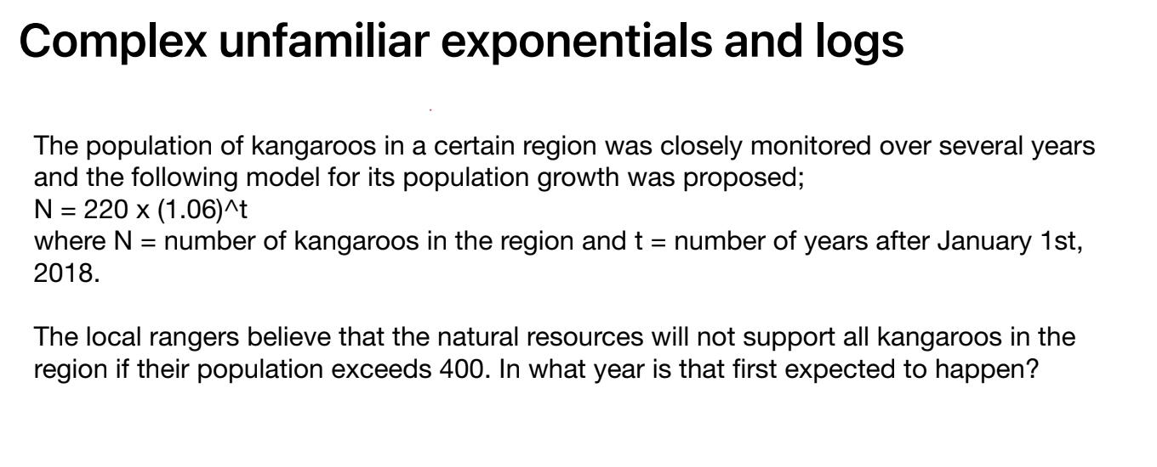
10A CU style Question

