Slide 1
Teacher Resources:
Pet Car Alarm Project
An TI-Innovator Project
for the TI-84 Plus CE

Slide 2
Overview of Teacher Resources
1. Project Overview
Overview
2. Preparing for the Project
Additional Tips for Success
3. Process of Engineering Design and Computational Thinking
Problem
Supply List
Image of Completed Project
Pacing Guide
Standards
Engineering Design process
Computational Thinking
Pseudocode: Planning your Program
Materials Purchasing
4. Science Background
Additive Color Model
5. Hands outs and Additional Resources
Templates for student use including, flow charts, planning diagrams, etc.
6. Example Project With Code
Sample project code.
Web Links for background info on heat stroke, animal health, etc.
Electromagnetic spectrum
Additional information on related STEM projects.

Slide 3
1. Project Overview

Slide 4
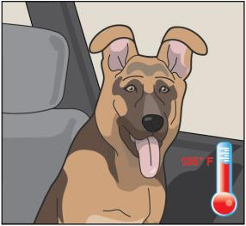
The Problem: Hot cars can be deadly to pets.
Pets suffer when left unattended in a car with the windows rolled up on a hot sunny day. Owners may do it on accident, or more likely, not realize how fast the temperatures will increase inside the car.
The temperatures inside a car may reach greater than 40◦C above the outside ambient temperature within an hour due to a greenhouse effect within the closed car.

Slide 5
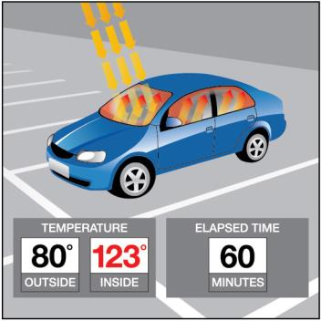
The “Greenhouse Effect” in a Closed Car
The sun's rays enter through your car's windows. Some of the heat from the sun is absorbed by the seats, the dashboard and the carpeting and floor mats. When those objects release this heat, it doesn't all get out through the windows. Some is reflected back in. The heat radiated by the seats is a different wavelength than the light of the sun that made it through the windows in the first place.
So a certain amount of energy is going in, and less energy is going out. The result is a gradual increase in the temperature inside your car.

Slide 6

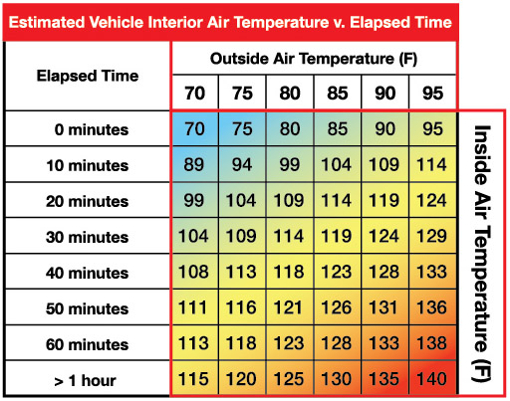
Doesn’t take much time for the heat inside the car to reach dangerous levels!
Greenhouse Effect:
Temperature increase:

Slide 7

EX: If Temperature outside is 95° F…
In ~45 mins, the inside temperature of a car will reach a deadly temperature of 135°!
Even on a relatively mild 65–75°F day, just 15–20 minutes of enclosure in a parked car can be enough to bring on a case of heat stroke in a dog.
Notes:
Heat Shttps://www.preventivevet.com/dogs/heat-stroke-in-dogs-what-is-heat-stroke-and-when-does-it-happen

Slide 8
Heat Stroke in Dogs
Increased Body Temperature and Heat Stroke in Dogs
  Hyperthermia is an elevation in body temperature that is above the generally accepted normal range. Although normal values for dogs vary slightly, it usually is accepted that body temperatures above 103° F (39° C) are abnormal.
  Heat stroke, meanwhile, is a form of non-fever hyperthermia that occurs when heat-dissipating mechanisms of the body cannot accommodate excessive external heat. Typically associated with temperature of 106° F (41° C) or higher without signs of inflammation, a heat stroke can lead to multiple organ dysfunction.
Notes:
If students are interested in learning more about why high heat is so dangerous to dogs/pets… have them research on the web:
https://www.petmd.com/dog/emergency/common-emergencies/e_dg_heat_stroke
http://www.petmd.com/dog/conditions/cardiovascular/c_dg_heat_strok

Slide 9
Design Challenge:
You can develop a solution to help save pets from unnecessary harm!
Understand the science behind the greenhouse effect and use math, computer programming and engineering to design and build a smart pet alarm system using a model car.

Slide 10
Technology Requirements
For TI-Nspire, update handhelds to OS 4.5
For TI-84 Plus CE, update calculators to OS 5.3
TI-Innovator *Hubs should all be updated to vs. 1.3
https://education.ti.com/en/software/update/ti-nspire-software-update
https://education.ti.com/en/software/update/84-ce-software-update
Notes:
For more information on the TI-Innovator and accessories technology required, visit https://education.ti.com/en/products/micro-controller/ti-innovator?category=accessories

Slide 11
Project Parts List
TI-Nspire CX family or TI-84 Plus CE Graphing Calculator
TI-Innovator™ Hub
External Battery for TI-Innovator™
Hall Effect (magnetic) Sensor
Temperature Sensor
*2 white LEDs
*Continuous Servo Motor in TI-Innovator™ I/O Pack
Car**
¾” Rare Earth Magnetic disk
Plastic pet toy
Plastic (Saran) wrap
Tape
Safety Scissors
*Included in TI-Innovator™ I/O Pack, or can be purchased in kits that contain 5 of the sensors.
** Google search for fashion doll car
*** Note: For optimal student engagement, have students work in groups of 2 or 3 for this project. If supplies are limited, groups of 4 are permissible, but each student should have their own calculator.
Notes:
Alternative materials that could be utilized for the Fashion Car include a shoebox or a plastic storage container. Students can accessorize their model to resemble a “car”.
Purchasing Info:
2-3 students per group, but could be up to 4. Each student should have their own calculator, and share the other parts listed here.

Slide 12
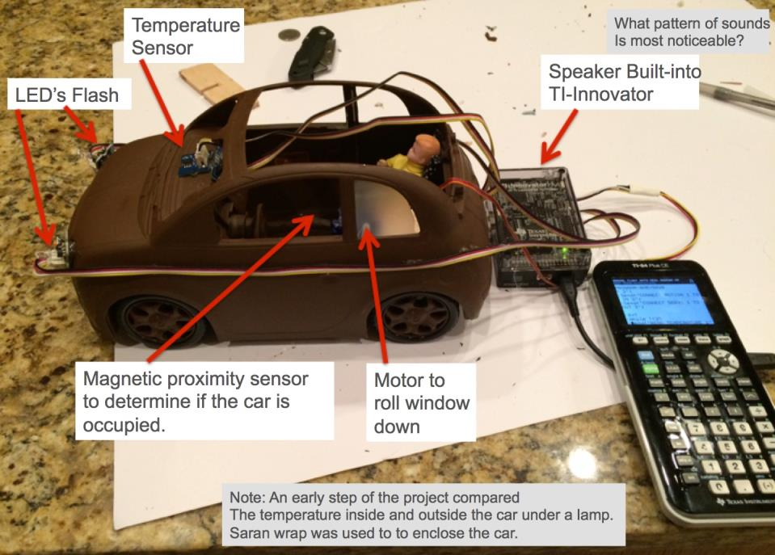
EXAMPLE:

Slide 13
2. Preparing for the project

Slide 14
Pet Car Alarm: Intermediate
Mood Ring
simple project designed to introduce students to programming with the TI-Innovator Hub
More complex project, using several sensors at once, and input/output scenarios
Smart Water
requires understanding of more difficult science concepts
time required: 2-3 day project
target audience: general/beginner
time required: ~ .5- 1 day project
target audience: middle grades/High school
target audience: High School
time required: ~ 3-4 days
requires more complex programming and coding skills
heavier emphasis on the E in STEM
Pet Car Alarm
Notes:
Projects are not necessarily dependent on each other, but completing projects in the above order, will ensure students are building their skills, and adding layers on as they progress through the three “core” projects.
Also note, that there is some overlap in Student Tasks in the Mood Ring and Pet Car Alarm. If your students have completed both projects, and in the prescribed order, students may be able to skip sections 1-3, as they are nearly identical.

Slide 15
Project Pacing Guide: Pet Car Alarm
To Extend project beyond 3 days
Project completed in 2-3 days*
Project completed in a .5-1 day* session (*camp day ~ 5-6 hours of working time)
students should have previous coding experience.
Students should complete all project tasks.
have students focus on personalization of their design
give students the task of creating a presentation to "sell" their design
consider the addition of other TI related STEM Projects
Mini-projects are optional, time permitting.
Teacher/Student guided building of the car and code.

Slide 16
Standards Covered:
NGSS 3-D Standards:
MS-PS1-4 Matter and its Interactions
  Develop a model that predicts and describes changes in particle motion, temperature and state of a pure substance when thermal energy is added or removed.
MS-PS3-3 Energy
  Apply scientific principles to design, construct and test a device that either minimizes or maximizes thermal energy transfer.
Science and Engineering Practice:
  Develop a model to predict and/or describe a phenomenon
Crosscutting Concepts:
  Within a natural system, the transfer of energy drives the motion of matter

Slide 17
Building student knowledge to prepare them for the project design challenge:
When structuring the club session agendas, start with the ultimate design challenge that the students would be taking on during the last few sessions of the project students understand the ultimate goal.
The suggested session breakdown (follows) allows students to build their knowledge and skills in a few different strands. There are strands for higher level concepts in programming/computer science, including sensors and control, along with the concepts in science that are the basis the design challenge.
In addition, there is a strand on the specific technology knowledge of TI-Nspire™ Basic, the TI-Innovator™ and the various devices that are used in the project.

Slide 18
Additional Tips for Success:
Have students work in teams of 2-3, sharing a TI-Innovator™ Hub, sensors, etc. Three is a good number to continue progress when a student misses a session.
Each student should have a graphing calculator and write their own programs. This enables all students to be actively engaged.
Have additional challenges beyond the main assignment in mind for the students who finish ahead of the others.
When you get to the stage of building the designs, large tables shared by multiple teams can spur discussion and sharing of ideas.
Try to save a few minutes at the end of each session for students or teams to present their designs or programs to the group.
Make sure that students save their programs (and .TNS TI-Nspire files) along the way. Also, whenever possible back up the student’s programs to a computer or another calculator.
The students really enjoyed using various patterns of tape to customize the look of their cars.
We found that students appreciate a certificate of completion for the project. Also, they are proud to share their project at “Techfests” and other events.
Be ready to extend the number of sessions and adapt the agenda based on progress, absences because of other school events, etc.

Slide 19
Purchasing specialized Sensors & Parts:
TI-Innovator™ Hub
External Battery for TI-Innovator™
Hall Effect (magnetic) Sensor
Temperature Sensor
*2 white LEDs
*Continuous Servo Motor in TI-Innovator™ I/O Pack
Car**
¾” Rare Earth Magnetic disk
*Included in TI-Innovator™ I/O Pack, or can be purchased in kits that contain 5 of the sensors.
** Google search for fashion doll car
Note: All listed sensors can be purchased in quantities of 5. Visit https://education.ti.com/en/products/micro-controller/ti-innovator?category=accessories
For more information.
Notes:
Alternative materials that could be utilized for the Fashion Car include a shoebox or a plastic storage container. Students can accessorize their model to resemble a “car”.
Purchasing Info:
2-3 students per group, but could be up to 4. Each student should have their own calculator, and share the other parts listed here.

Slide 20
3. Process of Engineering DESIGN and COMPUTATIONAL THINKING

Slide 21
Engineering Design Process
Define Problem
Design a proposed solution
Present group’s design to class.
Listen to feedback and make appropriate changes.
Build and test the design.
Use test results to make appropriate and informed changes to design.
Present your solution to class.

Slide 22
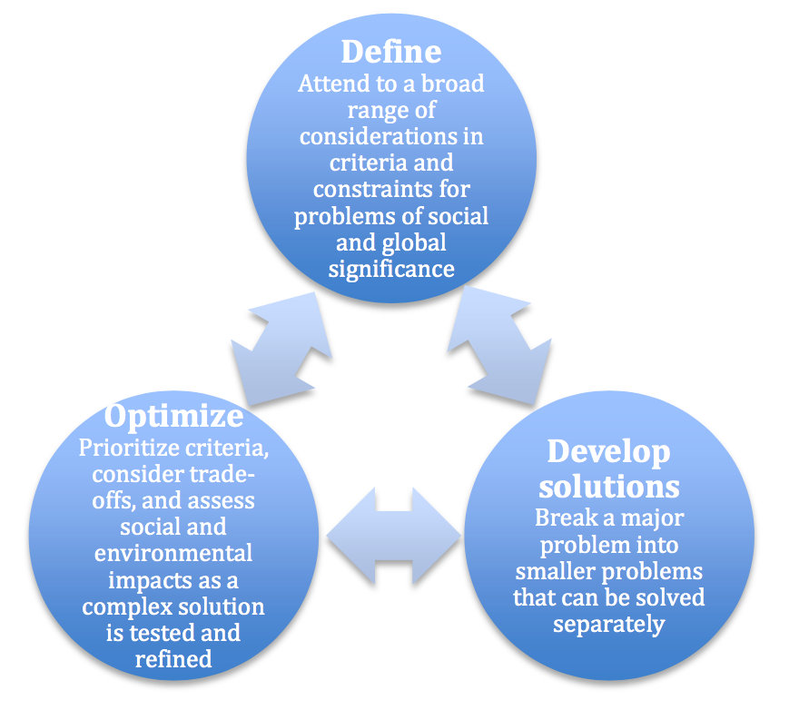
Engineering Design Process
Defining and delimiting engineering problems involves stating the problem to be solved as clearly as possible in terms of criteria for success, and constraints or limits.
Designing solutions to engineering problems begins with generating a number of different possible solutions, then evaluating potential solutions to see which ones best meet the criteria and constraints of the problem.
Optimizing the design solution involves a process in which solutions are systematically tested and refined and the final design is improved by trading off less important features for those that are more important.
It is important to point out that these component ideas do not always follow in order, any more than do the “steps” of scientific inquiry. At any stage, a problem-solver can redefine the problem or generate new solutions to replace an idea that just isn’t working out.
Authors: NGSS Lead States
Title: Next Generation Science Standards: For States, By States – Engineering Design
Copyright Date: 2013
Source: Next Generation Science Standards
http://www.nextgenscience.org/sites/default/files/Appendix%20I%20-%20Engineering%20Design%20in%20NGSS%20-%20FINAL_V2.pdf
Notes:
Permission received from NGSS. In fact, the said that as long as properly cited, no permission needed except for use of the NGSS Trademarked image.

Slide 23
Computational Thinking
NGSS Science and Engineering Practices
Using Mathematics and Computational Thinking
http://ngss.nsta.org/Practices.aspx?id=5

Slide 24
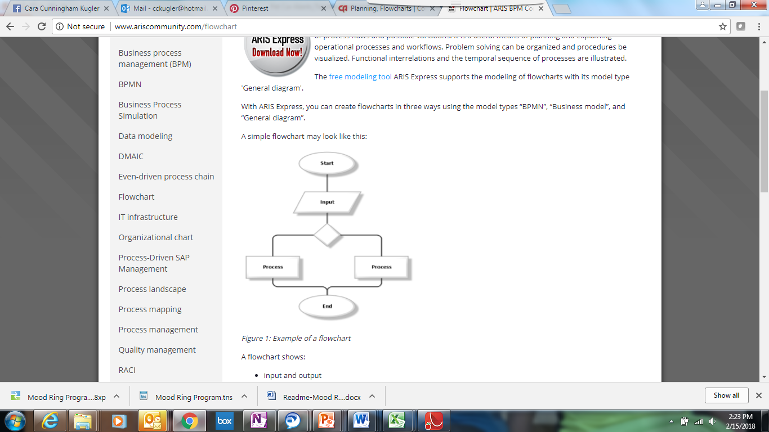
Things to Consider:
Setup
What inputs and outputs need to be connected?
Which ports are they connected?
Loop to monitor and decide
What loop will you use to repeatedly check the sensors
And to decide whether to trigger the alarm?
Checking the sensor values
What Sensors need to be read?
What variables will you “Get” the sensor values to?
Deciding whether to trigger the alarm or other outputs
What If-Then or If-Then-Else statements are needed?
What values of the sensors will activate the alarm?
Setting the alarm
What outputs are used to signal that aid is needed?
What outputs are used to reduce the temperature in the car?
Restoring the system to by ready again
What needs to be done to reset the system to be ready for a future event.
Notes:
More about using Flowcharts for planning:
https://www.codeavengers.com/notes/planning/flowcharts
http://www.ariscommunity.com/flowchart
draw.io is a good online tool you can use to create flowcharts. You can logon with a Google Drive account.

Slide 25
Value of Pseudocode
What is Pseudo code?
Pseudo code is basically written instructions of what a program should do to complete an operation. The pseudo code is written in your speaking language. You simply write down the steps of an algorithm or procedure to make it easier for you or someone else to read it and convert it to a real programming language.
Why was it made/is it used?
It was made to help you specify the steps of a procedure, process or an algorithm without using a programming language. One possible alternative is to use flowcharts.

Slide 26
Planning your program
Important steps in your program | TI-Basic commands to implement steps in your program
1.
2.
3.
4.
5…

Slide 27
4. Science Background

Slide 28
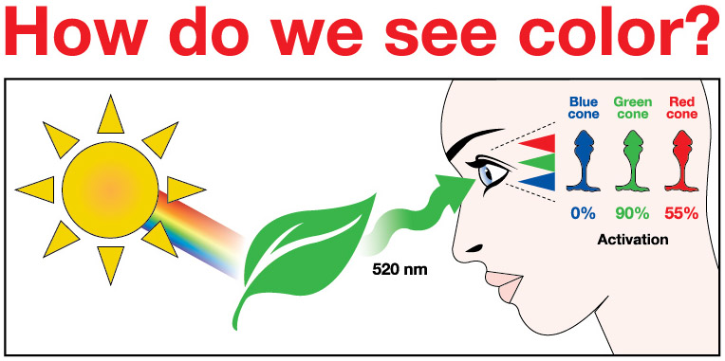
Notes:
The human eye has three different types of ‘cones’ on the retina- Red, Blue, and Green. These cones will be activated differently, by different wavelengths of light.
1. All the colors of the visible light spectrum shine on the leaf, but in this case, only light with 520 nm (green light) bounce off.
2. The surface of a green leaf absorbs all of the other colors of the spectrum, except for green, and reflects green to the human eye. Green light reflected stimulates the eye’s cone cells to varying degrees. Which wavelengths are reflected or absorbed depends on the properties of the object.
3. Humans would not be able to see color or objects without LIGHT! Light has to reflect off an object in order to see it.
Different combinations (%) of activation of the 3 types of rods will allow the brain to perceive signals from the retina as different colors. Some estimate that humans are able to distinguish about 10 million colors.

Slide 29
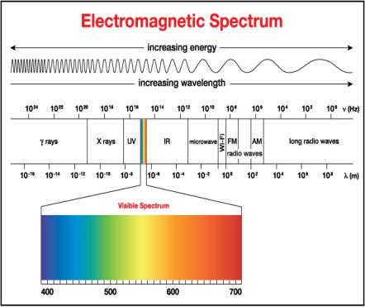
Background: The Electromagnetic Spectrum

Slide 30
Additional Web Resources:
  Read about this problem and watch the animation in the publication from American Veterinary Medical Association cited and linked below.
    https://www.avma.org/public/PetCare/Pages/pets-in-vehicles.aspx
  US National Weather Service, Heat Safety site: http://www.nws.noaa.gov/om/heat/index.shtml
  Explanation of the Greenhouse effect in relation to cars from the HyperPhysics site at Georgia State University
    http://hyperphysics.phy-astr.gsu.edu/hbase/thermo/grnhse.html
  Explanation of the Greenhouse effect in relation to cars from HOWSTUFFWORKS site.
    http://science.howstuffworks.com/environmental/green-science/global-warming2.htm

Slide 31
Additional Web Resources:
  Here is another explanation from a graduate student on the Quora site.
  https://www.quora.com/What-happens-inside-the-when-a-car-is-parked-in-the-hot-sun
  Study reported on by the Arizona Republic Newspaper
  http://www.azcentral.com/story/news/local/arizona-weather/2016/06/16/does-shaded-parking-keep-cars-cooler/85561580/
  NBC News Report from 2011 on automakers and the hot car problem
  http://www.nbcnews.com/storyline/hot-cars-and-kids/death-hot-cars-why-cant-automakers-prevent-danger-n152911
  Heat Strokes in Dogs http://www.petmd.com/dog/conditions/cardiovascular/c_dg_heat_stroke
  Heat Exposure in Children
  http://www.seattlechildrens.org/medical-conditions/symptom-index/heat-exposure-reactions

Slide 32
5. Student Hand outs and Additional Resources

Slide 33
Planning your program
Important steps in your program | TI-Basic commands to implement steps in your program
1.
2.
3.
4.
5…
Handout

Slide 34
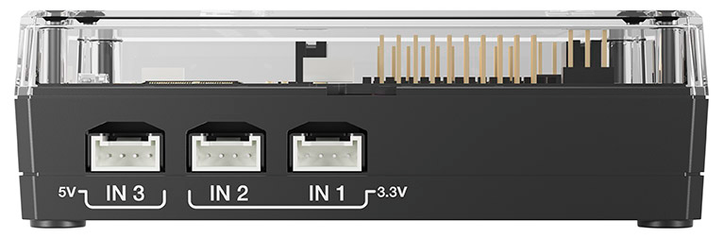
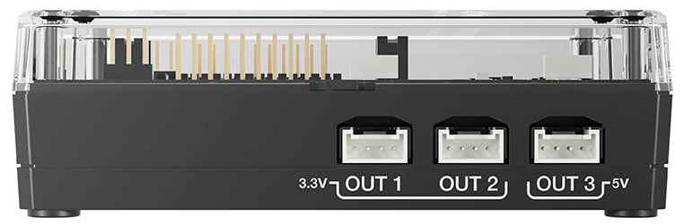
Diagram Your Plan:
Planning Diagram
Sketch where your input and output devices would go

Slide 35
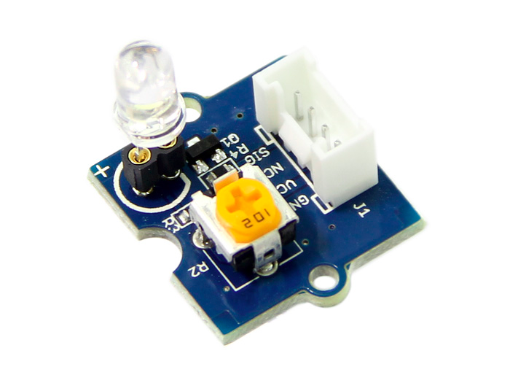
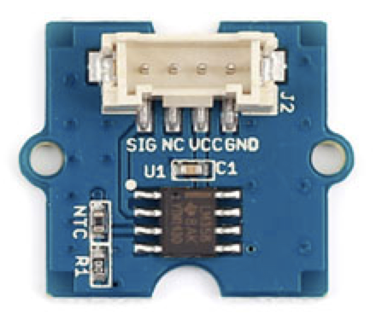
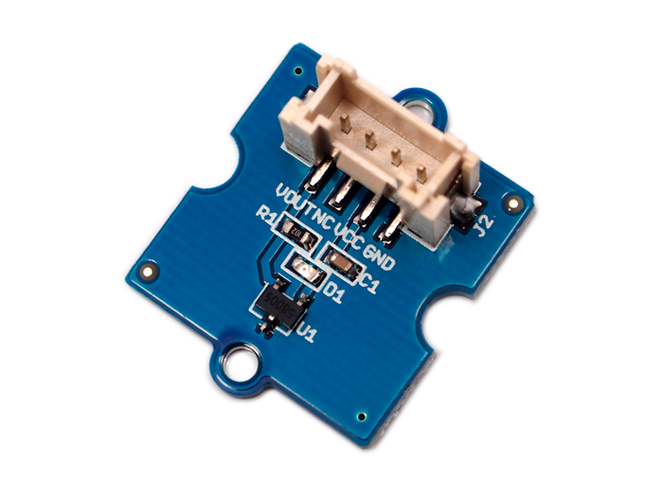
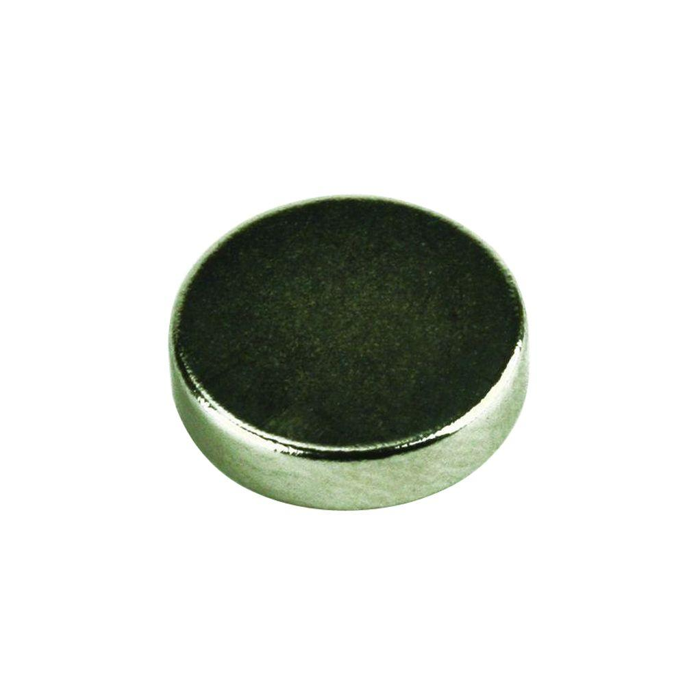

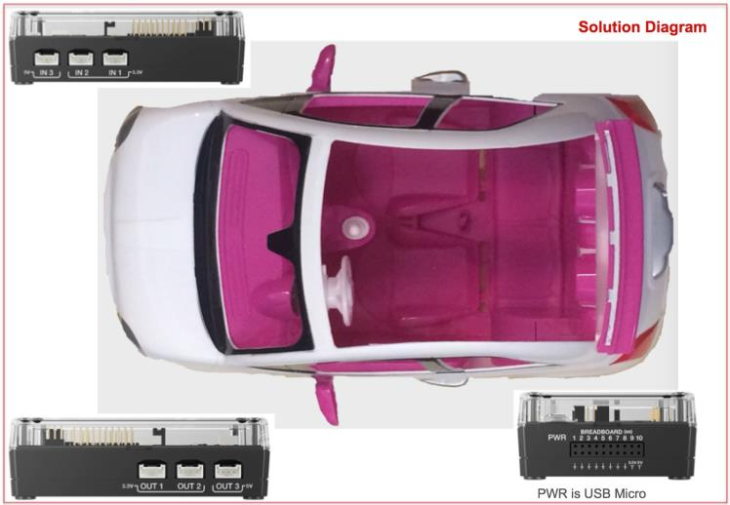


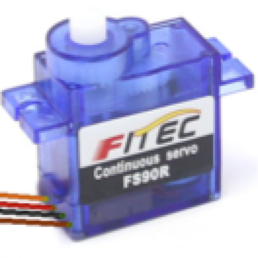
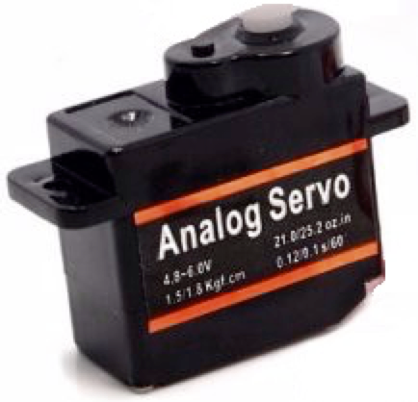
TI-Innovator Built-in Speaker
Temperature Sensor
Hall effect (magnetic proximity) Sensor
Rare Earth
Magnetic Disk
LED x 2
USB cable Standard to Micro
TI External Battery with USB Standard
Servo Motor (continuous) 5V
Notes:
This can be printed and students can use it as a basis to sketch their designs.

Slide 36
Things to Consider:
Setup
What inputs and outputs need to be connected?
Which ports are they connected?
Loop to monitor and decide
What loop will you use to repeatedly check the sensors
And to decide whether to trigger the alarm?
Checking the sensor values
What Sensors need to be read?
What variables will you “Get” the sensor values to?
Deciding whether to trigger the alarm or other outputs
What If-Then or If-Then-Else statements are needed?
What values of the sensors will activate the alarm?
Setting the alarm
What outputs are used to signal that aid is needed?
What outputs are used to reduce the temperature in the car?
Restoring the system to by ready again
What needs to be done to reset the system to be ready for a future event.
Notes:
More about using Flowcharts for planning:
https://www.codeavengers.com/notes/planning/flowcharts
http://www.ariscommunity.com/flowchart
draw.io is a good online tool you can use to create flowcharts. You can logon with a Google Drive account.

Slide 37
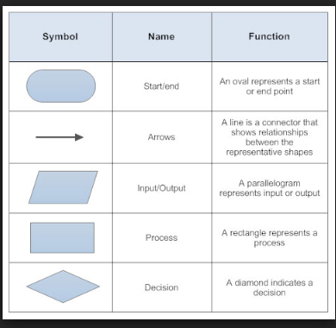
Using a flowchart to plan:
Create your own flowchart for this project.
Compare your flowchart with another group. What are the similarities and differences?
Adjust your flowchart, if necessary.
Notes:
Flowcharts can be helpful tools to think through what the program needs to do.
More about using Flowcharts for planning:
https://www.codeavengers.com/notes/planning/flowcharts

Slide 38
TI-Nspire CX Resources:
In addition to the 10 Minutes of Code lesson resources that were used in this project, the following links may be helpful as well:
10 Minutes of Code Teacher’s Lounge (TI-Nspire CX): For a single download of all lessons for 10 Minute of Codes for the TI-Nspire CX in PDF’s:
  https://education.ti.com/en/activities/ti-codes/nspire/teacher-lounge
TI-Innovator Technology eGuide
  https://education.ti.com/html/webhelp/EG_Innovator/EN/index.html
TI-Innovator Hub Commands
  https://education.ti.com/html/webhelp/EG_Innovator/EN/content/eg_innovsys/resources/pdf/ti-innovator_hub_commands_en.pdf
TI-Nspire CX Programming Editor Guide
  https://education.ti.com/html/webhelp/EG_TINspireCode/EN/index.html
YouTube Video (informal, but TI produced) gives you the basics of writing and running TI-Nspire programs that control the TI-Innovator.
  https://www.youtube.com/watch?v=2jjncu8Aba0

Slide 39
TI-84 Plus CE Resources:
In addition to the 10 Minutes of Code lesson resources that were used in this project, the following links may be helpful as well:
10 Minutes of Code Teacher’s Lounge (TI-84 Plus CE): Select link to download zip files with PDF’s of all of the 10 Minutes of code lessons, teacher and student documents.
  https://education.ti.com/en/activities/ti-codes/84/teacher-lounge
TI-Innovator Technology eGuide
  https://education.ti.com/html/webhelp/EG_Innovator/EN/index.html
TI-Innovator Hub Commands
  https://education.ti.com/html/webhelp/EG_Innovator/EN/content/eg_innovsys/resources/pdf/ti-innovator_hub_commands_en.pdf
TI-84 Plus CE TI-Basic Programming Guide
  https://education.ti.com/html/webhelp/EG_TI84PlusCECode/EN/index.html
TI-84 Plus CE Reference Guide
  https://education.ti.com/html/webhelp/EG_TI84PlusCECode/EN/index.html

Slide 40
6. Example Final Project With Code

Slide 41
Sample Code (basic)
Send("CONNECT TEMPERATURE 1 TO IN 1 ”)
Send("CONNECT ANALOG.IN 1 TO IN 2 ”)
Send("CONNECT LED 1 TO OUT 1 ”)
Send("CONNECT LED 2 TO OUT 2 ”)
Send("CONNECT SERVO.CONTINUOUS 1 TO OUT 3 ”)
For(C,1,25)
Send("READ TEMPERATURE 1”)
Get(T)
Disp T
Send ("READ ANALOG.IN 1”)
Get(M)
Disp M
Wait 1
If T>28 and M<90
Then
Disp “TEMPERATURE IS HIGH AND PET IN CAR”
For (B,1,5)
Send (“SET LED 1 ON”)
Send(“SET LED 2 ON”)
Wait 1
Send(“SET LED 1 OFF”)
Send(“SET LED 2 OFF”)
Wait 1
END
TI-84
Send ("SET SERVO.CONTINUOUS 1 CW 20 TIME 1“)
Else
Disp “NO NEED TO TRIGGER THE ALARM”
End
End
Send ("SET SERVO.CONTINUOUS 1 CW 20 TIME 1“)
Change Disp text to your own message.
Add COLOR or SOUND commands to indicate no need for the alarm.

Slide 42
Sample Code (basic)
Send "CONNECT TEMPERATURE 1 TO IN 1 "
Send "CONNECT ANALOG.IN 1 TO IN 2 "
Send "CONNECT LED 1 TO OUT 1 "
Send "CONNECT LED 2 TO OUT 2 "
Send "CONNECT SERVO.CONTINUOUS 1 TO OUT 3 "
For c,1,25
Send "READ TEMPERATURE 1"
Get t
Disp t
Send "READ ANALOG.IN 1"
Get m
Disp m
Wait 1
If t>28 and m<90 Then
Disp "Temperature is high and pet in car“
For b,1,5
Send "SET LED 1 ON"
Send "SET LED 2 ON"
Wait 1
Send "SET LED 1 OFF"
Send "SET LED 2 OFF"
Wait 1
EndFor
TI-Nspire CX
Send "SET SERVO.CONTINUOUS 1 CCW 20 TIME 1"
Else
Disp "No need to trigger the alarm"
EndIf
EndFor
Send "SET SERVO.CONTINUOUS 1 CW 20 TIME 1"
Change Disp text to your own message”
“Add COLOR or SOUND commands to indicate no need for the alarm.

Slide 43
Extension Code
TI-84
Send ("CONNECT TEMPERATURE 1 TO IN 1 “)
Send ("CONNECT TEMPERATURE 2 TO IN 3 “)
Send ("CONNECT ANALOG.IN 1 TO IN 2 “)
Send ("CONNECT LED 1 TO OUT 1 “)
Send ("CONNECT LED 2 TO OUT 2 “)
Send ("CONNECT SERVO.CONTINUOUS 1 TO OUT 3 “)
28→T
90→M
Disp T
Disp M
While T≤28 or M≥90
Send ("READ TEMPERATURE 1“)
Get (T)
Disp “TEMPERATURE INSIDE CAR ",T
Send "READ TEMPERATURE 2“
Get (S)
Disp “TEMPERATURE OUTSIDE CAR ",S
Send ("READ ANALOG.IN 1“)
Get (M)
Disp M
Wait 1
If T>28 and M<90
Then
Disp “TEMPERATURE INSIDE CAR IS HIGH AND PET IN CAR”
Send ("SET SOUND 440 2“)
For (B,1,5)
Send ("SET LED 1 ON“)
Send ("SET LED 2 ON“)
Wait 1
Send ("SET LED 1 OFF“)
Send ("SET LED 2 OFF“)
Wait 1
End
Send ("SET SERVO.CONTINUOUS 1 CCW 20 TIME 1“)
Else
Disp “NO NEED TO TRIGGER THE ALARM“
End
End
Send ("SET SERVO.CONTINUOUS 1 CW 20 TIME 1“)

Slide 44
Extension Code
TI-Nspire CX
Send "CONNECT TEMPERATURE 1 TO IN 1 “
Send "CONNECT TEMPERATURE 2 TO IN 3 “
Send "CONNECT ANALOG.IN 1 TO IN 2 “
Send "CONNECT LED 1 TO OUT 1 “
Send "CONNECT LED 2 TO OUT 2 “
Send "CONNECT SERVO.CONTINUOUS 1 TO OUT 3 “
©Set t and/or m to values to make sure program runs at least once
t:=28
m:=90
Disp t
Disp m
While t≤28 or m≥90
Send "READ TEMPERATURE 1“
Get t: Disp "Temperature inside car ",t
Send "READ TEMPERATURE 2“
Get t2
Disp "Temperature outside car ",t2
Send "READ ANALOG.IN 1“
Get m
Disp m
Wait 1
If t>28 and m<90 Then
Disp "Temperature inside car is high and pet in car“
Send "SET SOUND 440 2“
For b,1,5
Send "SET LED 1 ON“
Send "SET LED 2 ON“
Wait 1
Send "SET LED 1 OFF"
Send "SET LED 2 OFF"
Wait 1
EndFor
Send "SET SERVO.CONTINUOUS 1 CCW 20 TIME 1“
Else
Disp "No need to trigger the alarm“
EndIf
EndWhile
Send "SET SERVO.CONTINUOUS 1 CW 20 TIME 1"

Slide 46
Interested in additional projects or planning a ti STEM camp?

Slide 47
Suggested Sequence of TI STEM Projects
Mood Ring
simple project designed to introduce students to programming with the TI-Innovator Hub
More complex project, using several sensors at once, and input/output scenarios
Smart Water
requires understanding of more difficult science concepts
time required: 2-3 day project
target audience: general/beginner
time required: ~ .5- 1 day project
target audience: middle grades/High school
target audience: High School
time required: ~ 3-4 days
requires more complex programming and coding skills
heavier emphasis on the E in STEM
Pet Car Alarm
Increasing project complexity, and time required.
Notes:
You’ve just completed the Pet Car Alarm! Did your students love it? Are you looking for additional, similar projects to help build students coding skills and engagement in STEM Projects? Great news! We have more! The 3 projects listed above are not necessarily dependent on each other, but completing projects in the above order, will ensure students are building their skills, and adding layers on as they progress through the three “core” projects. Also note, that there is some overlap in Student Tasks in the three project. If your students have completed both projects, and in the prescribed order, students may be able to skip parts of sections 1-3, as they are nearly identical.

Slide 48
Choose your own STEM adventure!
Day 1: Coding Basics and Mood Ring
Day 2-2.5/3: Pet Car Alarm
Day 4-5: Mars Rover Challenge
Day 2-4: Smart Irrigation System
Day 4-5: Mars Rover Challenge
Day 3-5: Smart Irrigation System
Day 2-3: Mars Rover Challenge
Addtional On-Ramp to Robotics lessons (availability TBD)
Choose from several recommended combination of projects based on students’ experience and interests!

Slide 49
Additional Classroom Activities for TI-Innovator Hub can be found online:
Science through Engineering Design Lessons (SED)
  https://education.ti.com/en/tisciencenspired/us/stem/science-through-engineering-design
10 Minutes of Code with TI-Innovator
  https://education.ti.com/en/activities/ti-codes/innovator
Path to STEM Projects
  https://education.ti.com/en/activities/stem/path-to-stem

Slide 50
Required Supplies for each project - 32 students, groups of 4
 | Mood Ring | Pet Car Alarm | Smart Water | Mars Rover
TI graphing calculators (TI-84 Plus CE or TI-Nspire CX) | 32 | 32 | 32 | 32
TI-Innovators | 8 | 8 | 8 | 8
Input Devices | 8 Temperature sensors | 8 each: Temperature, Hall Effect Magnetic Sensors | 8 Each: Digital Humidity and Temperature, Soil Moisture, Light Level
Output Devices or Rovers |  | 8 each: Servo motor (with rechargeable battery) | 8 Each: Pump-MOSFET-Battery Holder kit, 4AA Batteries | 8 Rovers
Other materials | 8 Chenille wires (pipe cleaners) | 8 Cars, magnet, duct tape or other for decoration | Plant container, cistern, perlite or other growing medium, tubes, duct tape | Printouts of Mars surface, plastic obstacle cones, meter sticks, protractors, tape, markers
Notes:
For optimal student engagement, groups of 2-3 students would be ideal. We do not recommend having more than 4 students per TI-Innovator set-up. Each student should have their own graphing calculator.

