Slide 1
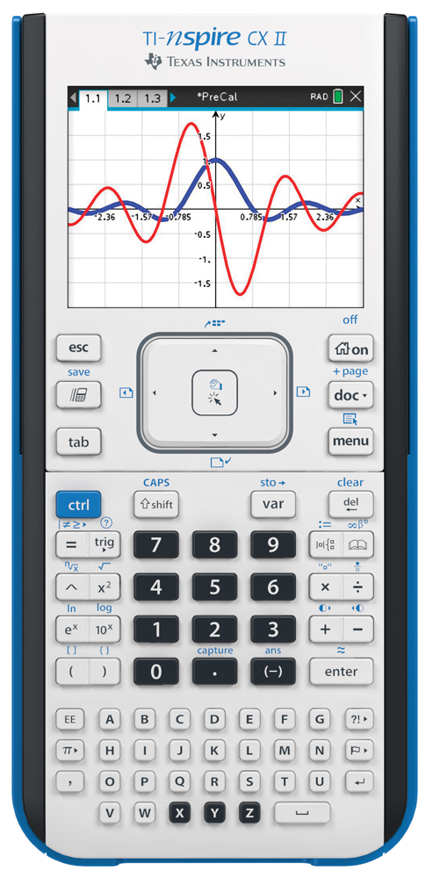
Cubes and Squares

Slide 2
1
n =
1
1
Square | Qty | Height | Width
Square | Qty | Height | Width
Cubes and Squares

Slide 3
1
n =
1
1
Square | Qty | Height | Width
 | 1 | 1 | 1
Cubes and Squares

Slide 4
1
n =
2
1
Square | Qty | Height | Width
 | 1 | 1 | 1
Square | Qty | Height | Width
 | 1 | 1 | 1
Cubes and Squares

Slide 5
1
2
n =
2
1
2
Square | Qty | Height | Width
 | 1 | 1 | 1
Square | Qty | Height | Width
 | 1 | 1 | 1
Cubes and Squares

Slide 6
1
2
n =
2
1
2
Square | Qty | Height | Width
Square | Qty | Height | Width
 | 1 | 1 | 1
Cubes and Squares

Slide 7
1
2
n =
2
1
2
Square | Qty | Height | Width
Square | Qty | Height | Width
 | 1 | 1 | 1
 | 2 | 2 | 2
Cubes and Squares

Slide 8
1
2
3
n =
3
1
2
Square | Qty | Height | Width
Square | Qty | Height | Width
 | 1 | 1 | 1
 | 2 | 2 | 2
3
Cubes and Squares

Slide 9
1
2
3
n =
3
1
2
Square | Qty | Height | Width
Square | Qty | Height | Width
 | 1 | 1 | 1
 | 2 | 2 | 2
3
Cubes and Squares

Slide 10
1
2
3
n =
3
1
2
Square | Qty | Height | Width
Square | Qty | Height | Width
 | 1 | 1 | 1
 | 2 | 2 | 2
 | 3 | 3 | 3
3
Cubes and Squares

Slide 11
1
2
3
4
n =
4
1
2
Square | Qty | Height | Width
Square | Qty | Height | Width
 | 1 | 1 | 1
 | 2 | 2 | 2
 | 3 | 3 | 3
3
4
Cubes and Squares

Slide 12
1
2
3
4
n =
4
1
2
Square | Qty | Height | Width
Square | Qty | Height | Width
 | 1 | 1 | 1
 | 2 | 2 | 2
 | 3 | 3 | 3
3
4
Cubes and Squares

Slide 13
1
2
3
4
n =
4
1
2
Square | Qty | Height | Width
Square | Qty | Height | Width
 | 1 | 1 | 1
 | 2 | 2 | 2
 | 3 | 3 | 3
 | 4 | 4 | 4
3
4
Cubes and Squares

Slide 14
1
2
3
4
n =
4
1
2
Square | Qty | Height | Width
Square | Qty | Height | Width
 | 1 | 1 | 1
 | 2 | 2 | 2
 | 3 | 3 | 3
 | 4 | 4 | 4
3
4
Cubes and Squares

Slide 15
1
2
3
4
n =
4
1
AREA:
2
Square | Qty | Height | Width
Square | Qty | Height | Width
 | 1 | 1 | 1
 | 2 | 2 | 2
 | 3 | 3 | 3
 | 4 | 4 | 4
3
4
Cubes and Squares

Slide 16
1
2
3
4
n =
4
AREA:
1
2
Square | Qty | Height | Width
Square | Qty | Height | Width
 | 1 | 1 | 1
 | 2 | 2 | 2
 | 3 | 3 | 3
 | 4 | 4 | 4
3
4
Cubes and Squares

Slide 17
1
2
3
4
n =
4
AREA:
1
2
Square | Qty | Height | Width
Square | Qty | Height | Width
 | 1 | 1 | 1
 | 2 | 2 | 2
 | 3 | 3 | 3
 | 4 | 4 | 4
3
4
Cubes and Squares

