Slide 1
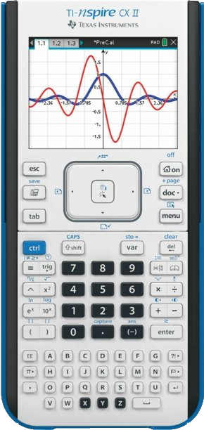
Induction for Whole Numbers

Slide 2
The sums of consecutive whole numbers is often referred to as “Triangular Numbers”.
In the following animations you will see why and intuitively develop a formula.
The formula can be generated a number of ways, then you need to prove that your formula works for all whole numbers.

Slide 3
n =
1
Triangular Numbers

Slide 4
n =
2
New dots are coloured orange.
Existing dots are coloured red.
Triangular Numbers

Slide 5
n =
3
Triangular Numbers

Slide 6
n =
4
Triangular Numbers

Slide 7
n =
5
Triangular Numbers

Slide 8
n =
6
Triangular Numbers

Slide 9
n =
6
Triangular Numbers

Slide 10
n =
6
Adding detail to a diagram can help.

Slide 11
n =
6

Slide 12
n =
6

Slide 13
n =
6

Slide 14
n =
6

Slide 15
n =
6

Slide 16
n =
5

Slide 17
n =
4

Slide 18
n =
3

Slide 19
n =
2

Slide 20
n =
1

Slide 21
1 + 2 + 3 + 4 + 5 + 6 + 7 + 8 + 9 + 10 + 11 + 12 + 13 + 14 + 15 + 16 + 17 + 18 + 19 + 20 + 21 + 22 + 23 + 24 + 25 + 26 + 27 + 28 + 29 + 30 + 31 + 32 + 33 + 34 + 35 + 36 + 37 + 38 + 39 + 40 + 41 + 42 + 43 + 44 + 45 + 46 + 47 + 48 + 49 + 50 + 51 + 52 + 53 + 54 + 55 + 56 + 57 + 58 + 59 + 60 + 61 + 62 + 63 + 64 + 65 + 66 + 67 + 68 + 69 + 70 + 71 + 72 + 73 + 74 + 75 + 76 + 77 + 78 + 79 + 80 + 81 + 82 + 83 + 84 + 85 + 86 + 87 + 88 + 89 + 90 + 91 + 92 + 93 + 94 + 95 + 96 + 97 + 98 + 99 + 100
Use your formula to calculate the sum of the first 100 whole numbers. Try and beat the animation!

Slide 22
Pascal’s Triangle
Hidden Gem!

Slide 23

1
row =
0

Slide 24
1
row =
1
1
1

Slide 25
1
row =
2
1
1
1
2
1

Slide 26
1
row =
3
1
1
1
2
1
1
3
3
1

Slide 27
1
row =
4
1
1
1
2
1
1
3
3
1
1
4
6
4
1

Slide 28
1
row =
5
1
1
1
2
1
1
3
3
1
1
4
6
4
1
1
5
10
10
5
1

Slide 29
1
row =
6
1
1
1
2
1
1
3
3
1
1
4
6
4
1
1
5
10
10
5
1
1
6
15
20
15
6
1

Slide 31
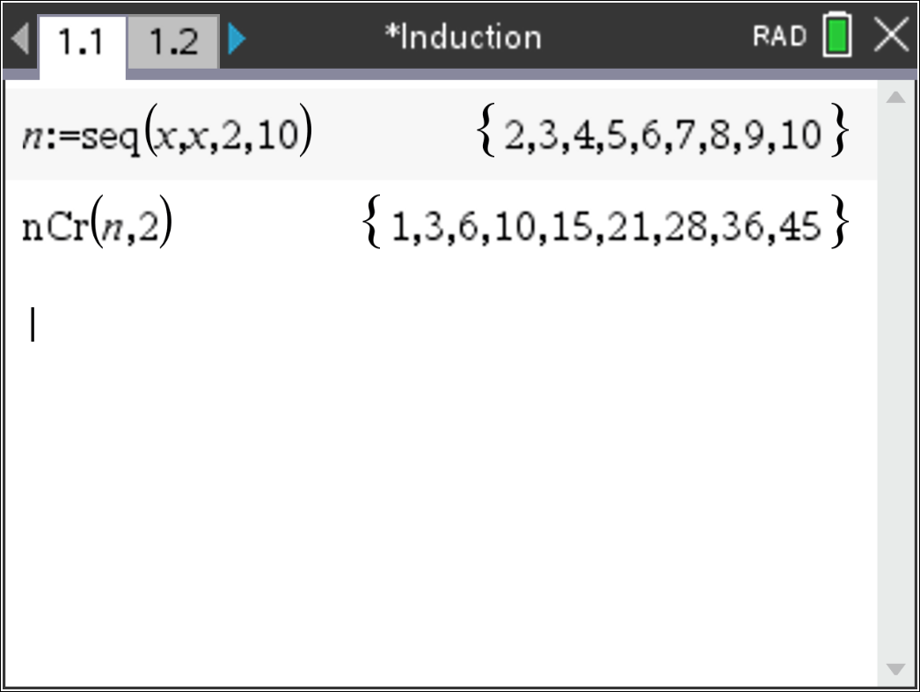

Slide 32
Induction
Use induction to prove that the sum of the first n whole numbers can be represented by the formula:

