Slide 1
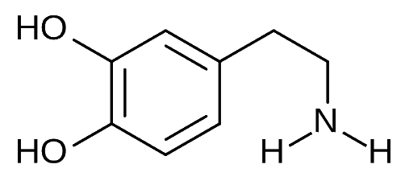
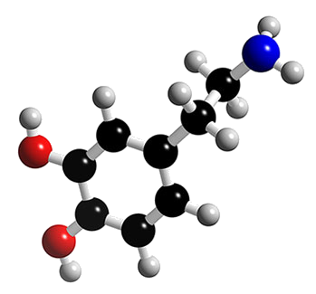
Mental Arithmetic!

Slide 2
Letters & Numbers
Six ‘random’ numbers are drawn consisting of a nominated quantity of ‘large’ and corresponding quantity of small numbers.
No Repeats
Repeats Allowed
Large: {25, 50, 75, 100}
Small: {1, 2, 3 … 9, 10}

Slide 3

Letters & Numbers
A three digit target number is generated.
Contestants use the numbers and basic operations:
{ + – × ÷ ( ) }
Form an equation equal, or as close as possible,
to the target number.

Slide 4
Letters & Numbers
Let’s play a game!
60 seconds on the clock!
100 Pts = Exactly correct
One point is deducted for each unit away from the target number.

Slide 5

Letters & Numbers
651
75
25
3
5
7
2
START
STOP

Slide 6
Letters & Numbers
478
75
50
2
4
9
4
START
STOP

Slide 7
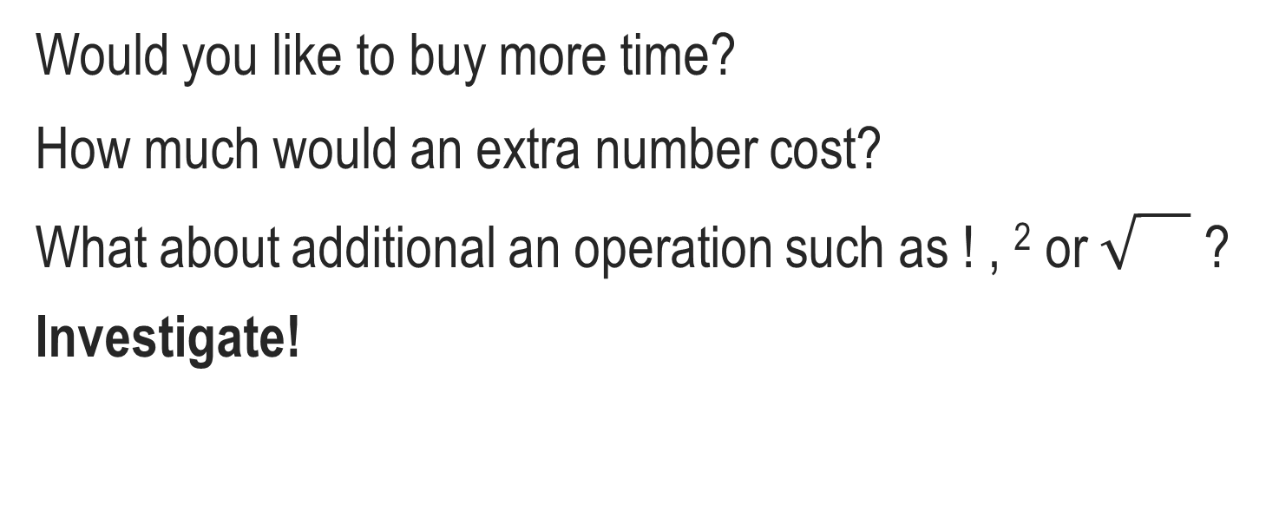
Letters & Numbers
Would you like to buy more time?
How much would an extra number cost?
What about additional an operation such as ! , ² or ?
Investigate!

