Slide 1
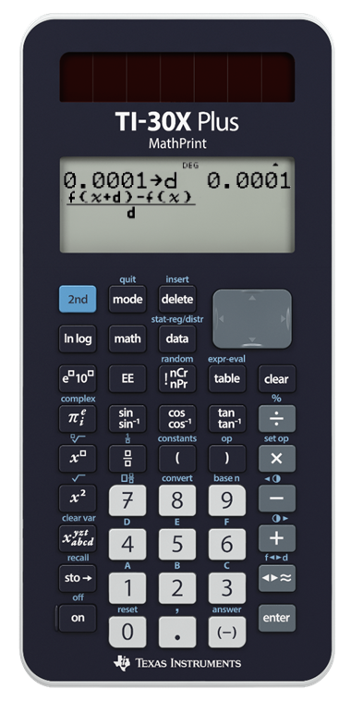
Approximate Areas

Slide 2
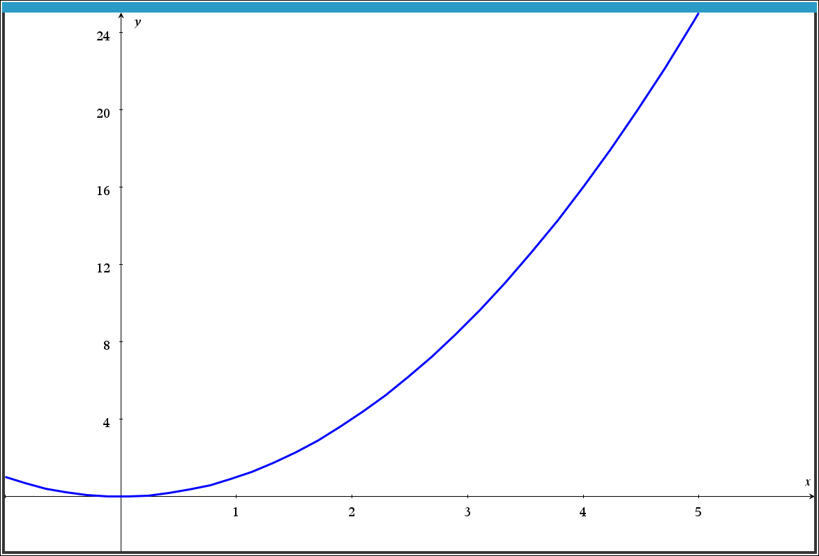
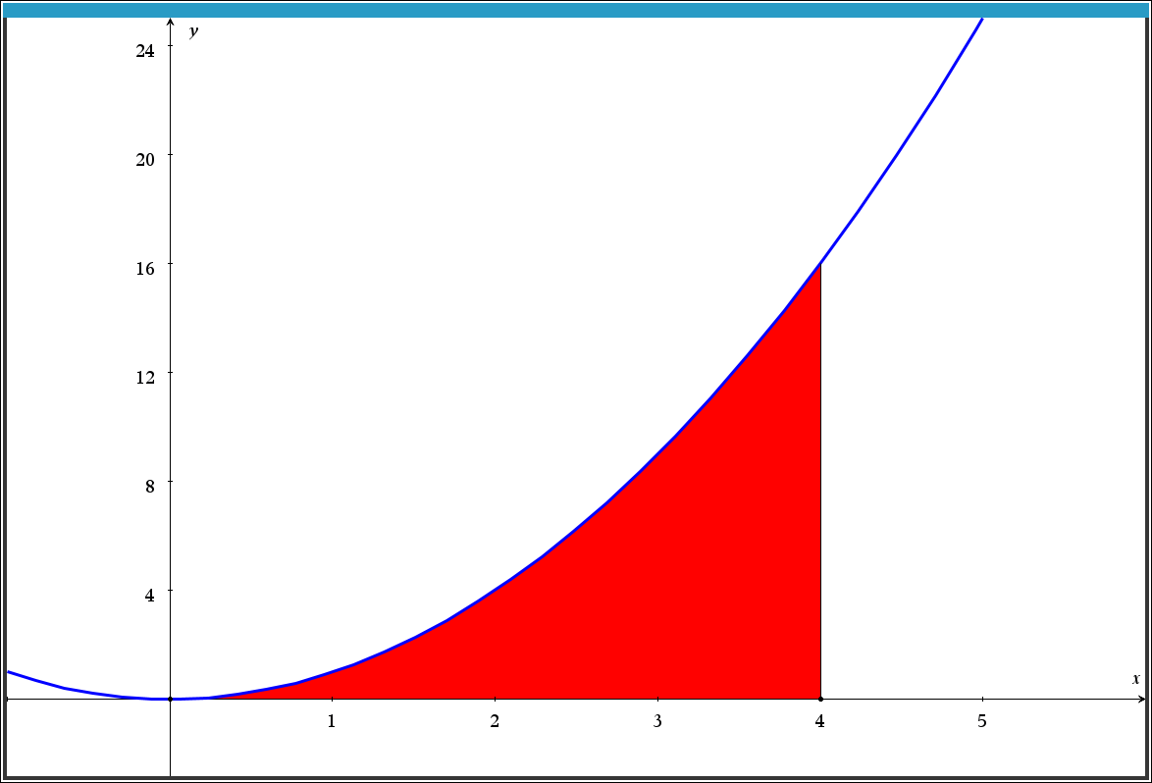
Approximate Areas
Find the area bounded by the curve f (x) = x², the
x axis and the line x = 4.

Slide 3
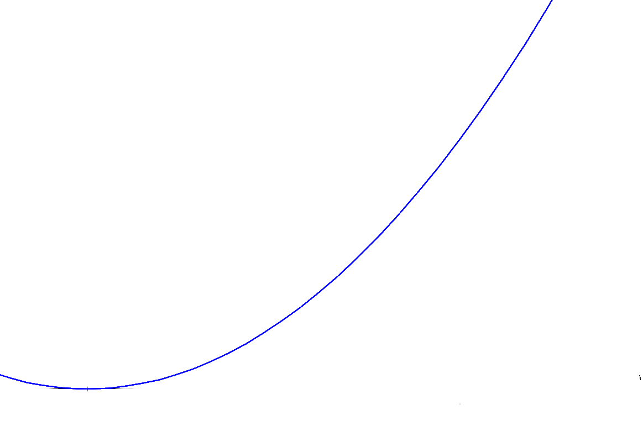
A single triangle
A relatively crude approximation

Slide 4
Left Bound Rectangles
x-values | Height | Area
0 to 1 | 0 | 0
1 to 2 | 1 | 1
2 to 3 | 4 | 4
3 to 4 | 9 | 9

Slide 5
Left Bound Rectangles
x-values | Height | Area
0 to 0.5 | 0 | 0
0.5 to 1 | 0.25 | 0.125
1 to 1.5 | 1 | 0.5
1.5 to 2 | 2.25 | 1.125
2 to 2.5 | 4 | 2
2.5 to 3 | 6.25 | 3.125
3 to 3.5 | 9 | 4.5
3.5 to 4 | 12.25 | 6.125

Slide 6
Right Bound Rectangles
x-values | Height | Area
0 to 0.5 | 0.25 | 0.125
0.5 to 1 | 1 | 0.5
1 to 1.5 | 2.25 | 1.125
1.5 to 2 | 4 | 2
2 to 2.5 | 6.25 | 3.125
2.5 to 3 | 9 | 4.5
3 to 3.5 | 12.25 | 6.125
3.5 to 4 | 16 | 8

Slide 7
Trapeziums
Calculate the average of the left & right bound rectangles.

Slide 8
Midpoint Rectangles
x-values | Height | Area
0.25 (0,0.5) | 0.0625 | 0.0132
0.75 (0.5,1) | 0.5625 | 0.2813
1.25 (1,1.5) | 1.5625 | 0.7812
1.75 (1.5,2) | 3.0625 | 1.5313
2.25 (2,2.5) | 5.0625 | 2.5312
2.75 (2.5,3) | 7.5625 | 3.7813
3.25 (3,3.5) | 10.5625 | 5.2812
3.75 (3.5,4) | 14.0625 | 7.0313

