Slide 1
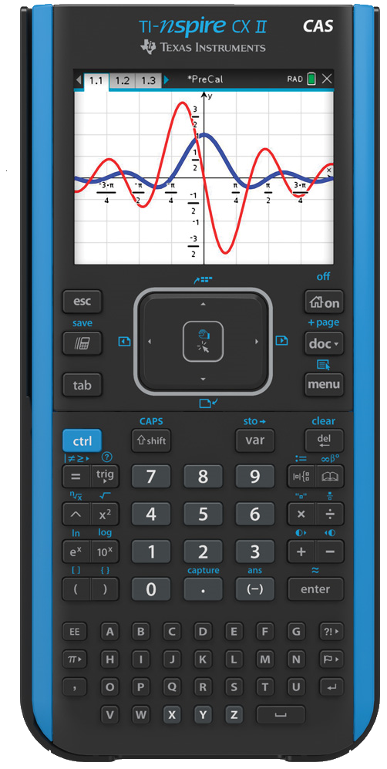
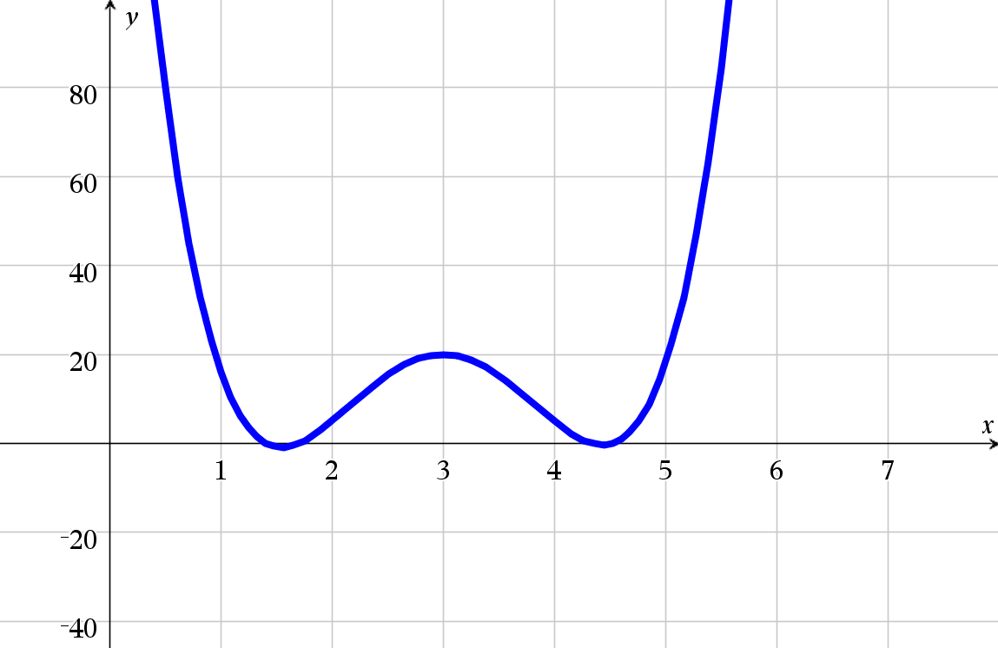
Personal Polynomials

Slide 2

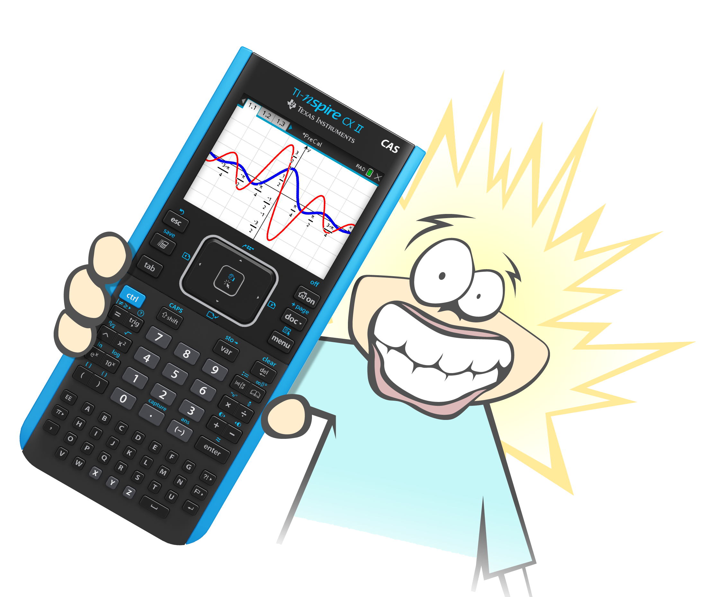
Introduction
Each letter in your name is assigned a value:
A = 1, B = 2, C = 3 ….
Write your first, last or abbreviation of your name as coordinates.
First point is the first letter: (1, #),
Second point is the second letter: (2, #).
Your personal polynomial must pass through each point.

Slide 3

Introduction
Insert a Notes Application.
In a Maths Box type:
ord(“T”) – 64 (Upper Case)
ord(“ t ”) – 96 (Lower Case)
Edit the letters as required.
Peter
A | B | C | D | E | F | G | H | I
1 | 2 | 3 | 4 | 5 | 6 | 7 | 8 | 9
J | K | L | M | N | O | P | Q | R
10 | 11 | 12 | 13 | 14 | 15 | 16 | 17 | 18
S | T | U | V | W | X | Y | Z
19 | 20 | 21 | 22 | 23 | 24 | 25 | 26
(1, 16)
(2, 5)
(3, 20)
(4, 5)
(5, 18)

Slide 4
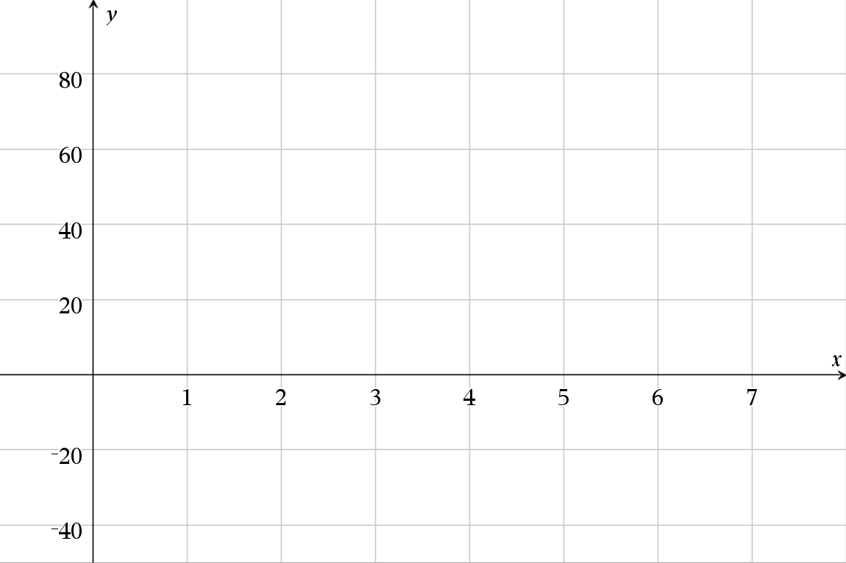
Introduction
Peter
(1, 16)
(2, 5)
(3, 20)
(4, 5)
(5, 18)

Slide 5
Introduction
Peter
(1, 16)
(2, 5)
y=mx+c
16=m+c
5=2m+c
m=_11
c=25

Slide 6
Introduction
Peter
(1, 16)
(2, 5)
(3, 20)

Slide 7
Introduction
$$p\left(x\right)=ax^{4}+bx^{3}+cx^{2}+dx+e$$
Peter
(1, 16)
(2, 5)
(3, 20)
(4, 5)
(5, 18)

Slide 8
Calculations
$$p\left(x\right)=ax^{4}+bx^{3}+cx^{2}+dx+e$$
Peter
$$p\left(1\right)=a+b+c+d+e=16$$
(1, 16)
$$p\left(2\right)=16a+8b+4c+2d+e=5$$
(2, 5)
$$p\left(3\right)=81a+27b+9c+3d+e=20$$
(3, 20)
$$p\left(4\right)=256a+64b+16c+4d+e=5$$
(4, 5)
$$p\left(5\right)=625a+125b+25c+5d+e=18$$
(5, 18)

Slide 9


Calculations
$$p\left(x\right)=ax^{4}+bx^{3}+cx^{2}+dx+e$$
Peter
$$p\left(1\right)=a+b+c+d+e=16$$
(1, 16)
$$p\left(2\right)=16a+8b+4c+2d+e=5$$
(2, 5)
$$−15a−7b−3c−d=11$$
$$p\left(1\right)−p\left(2\right)$$

Slide 10

Calculations
$$p\left(x\right)=ax^{4}+bx^{3}+cx^{2}+dx+e$$
Peter
$$p\left(2\right)=16a+8b+4c+2d+e=5$$
(2, 5)
$$p\left(3\right)=81a+27b+9c+3d+e=20$$
(3, 20)
$$−65a−19b−5c−d=−15$$
$$p\left(2\right)−p\left(3\right)$$

Slide 11

Calculations
$$p\left(x\right)=ax^{4}+bx^{3}+cx^{2}+dx+e$$
Peter
$$p\left(3\right)=81a+27b+9c+3d+e=20$$
(3, 20)
$$p\left(4\right)=256a+64b+16c+4d+e=5$$
(4, 5)
$$−175a−37b−7c−d=15$$
$$p\left(3\right)−p\left(4\right)$$

Slide 12

Calculations
$$p\left(x\right)=ax^{4}+bx^{3}+cx^{2}+dx+e$$
Peter
$$p\left(4\right)=256a+64b+16c+4d+e=5$$
(4, 5)
$$p\left(5\right)=625a+125b+25c+5d+e=18$$
(5, 18)
$$p\left(4\right)−p\left(5\right)$$
$$−369a−61b−9c−d=−13$$

Slide 13
Calculations
$$p\left(x\right)=ax^{4}+bx^{3}+cx^{2}+dx+e$$
Peter
$$−15a−7b−3c−d=11$$
$$−65a−19b−5c−d=−15$$
$$−175a−37b−7c−d=15$$
$$−369a−61b−9c−d=−13$$
Five equations with five unknowns becomes four equations with four unknowns. Keep going ...

Slide 14
Exploring
Fox
A | B | C | D | E | F | G | H | I
1 | 2 | 3 | 4 | 5 | 6 | 7 | 8 | 9
J | K | L | M | N | O | P | Q | R
10 | 11 | 12 | 13 | 14 | 15 | 16 | 17 | 18
S | T | U | V | W | X | Y | Z
19 | 20 | 21 | 22 | 23 | 24 | 25 | 26
(1, 6)
(2, 15)
(3, 24)
What degree polynomial is required?

Slide 15
Exploring - 3 Letter Names
Abe, Ace, Ada, Alf, Ali, Amy, Ann, Ari, Art, Ava, Ben, Bev, Bob, Bud, Cam, Con, Coy, Dan, Deb, Dee, Del, Don, Dot, Ela, Eli, Era, Eva, Eve, Fae, Fay, Fox, Gay, Gil, Gus, Guy, Hal, Ian, Ida, Ike, Ira, Iva, Ivy, Jan, Jay, Jed, Jim, Joe, Jon, Joy, Kai, Kay, Ken, Kia, Kim, Koa, Kye, Lea, Leo ...

Slide 16
Exploring - 3 Letter Names
Les, Liv, Liz, Lon, Lou, Lyn, Mac, Mae, Mal, Mat, Max, May, Meg, Mel, Mia, Moe, Mya, Nan, Nat, Ned, Noa, Nya, Pam, Pat, Rae, Ray, Red, Rex, Rob, Rod, Ron, Roy, Sal, Sam, Sky, Sue, Tai, Ted, Tex, Tia, Tim, Tod, Tom, Val, Vic, Wes, Zoe.

Slide 17
Exploring - Palindromes
Ava
(1, 1)
(2, 22)
(3, 1)
What degree polynomial is required?
What is special about this name?

Slide 18
Exploring - Palindromes
Ace
Anna
Hannah
Siris
Arora

Slide 19
Exploring – Similar Names
How often do Andrea and Andrew meet?
Do you need to work out their equations first?
(1, 1)
(2, 14)
(3, 4)
(4, 18)
(5, 5)
(6, ?)

Slide 20
Exploring
Find names that do not have a solution for p(x) = 0?

Slide 21
Good Luck!

