Slide 1
VCE Specialist Series:
Matrix Transformations
“Have you ever had a dream that you were sure was real?” Nothing imaginary about the tools we’ll be using in this version of the Matrix. Participants will see how to build student understanding of reflections, dilations, translations and rotations using some of the less frequently used features of TI-Nspire. Through this approach students develop a much richer understanding of Matrix Transformations.

Slide 2
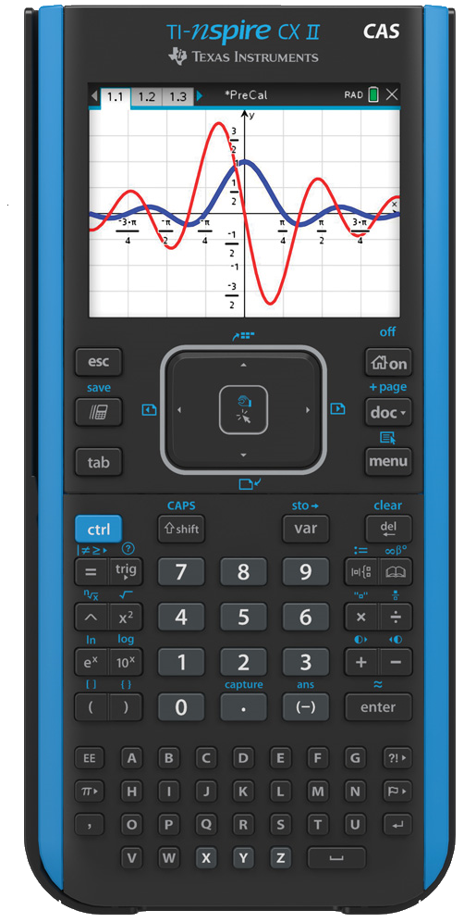
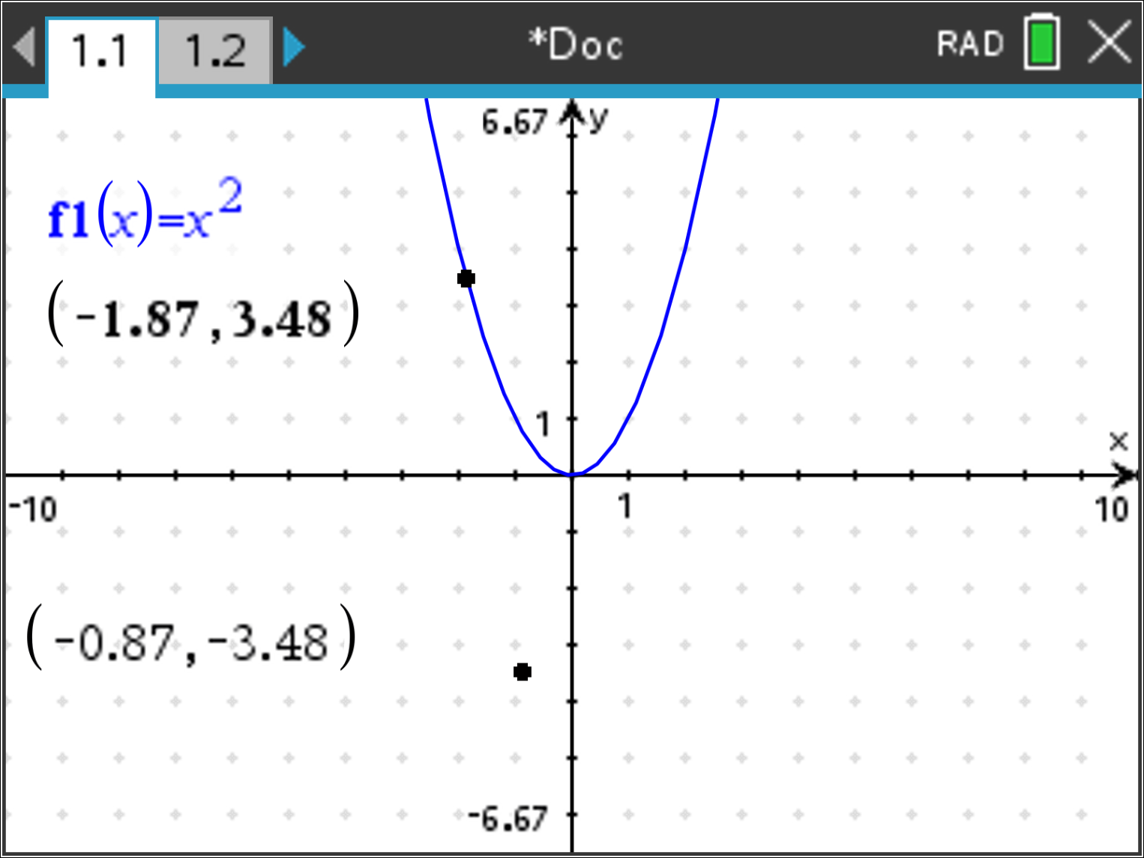
Matrix Transformations
Points in the plane, coordinates and their representation as 2 × 1 matrices (column vectors)
Mathematical Methods (2016 – 2021)
Points in the plane, coordinates and their representation as 2 × 1 matrices (column vectors)
(
3
,
4
)

Slide 3
Matrix Transformations
Translations of the plane $T(x, y)→(x+a, y+b)$
Mathematical Methods (2016 – 2021)
Describe the effect of transformations of the plane on the graphs of the sine, cosine, tangent and exponential functions, and apply matrices to transformations, by hand in simple cases

Slide 4
Matrix Transformations
Linear transformations of the plane: $T\left(x,y\right)→\left(ax+by, cx+dy\right) \& T\left(\begin{matrix}x \\ y\end{matrix}\right)=\left(\begin{matrix}a & b \\ c & d\end{matrix}\right)\left(\begin{matrix}x \\ y\end{matrix}\right)$ $\text{as} \text{a} \text{map} \text{of} \text{the} \text{plane} \text{onto} \text{itself}\text{, }\text{rotations} \text{about} \text{the} \text{origin} \text{and} \text{reflection} \text{in} \text{a} \text{line} \text{through} \text{the} \text{origin}$.
li
Mathematical Methods (2016 – 2021)
Linear transformations of the plane: (x, y) → (ax + by, cx + dy) as a map of the plane onto itself, dilations rotations about the origin and reflection in a line through the origin ...

Slide 5
Matrix Transformations
The effect of translation, linear transformations and their inverse transformations, and compositions of these transformations on subsets of the plane such as points, lines, shapes and graphs of functions and relations.

Slide 6
Matrix Transformations
Invariance of properties under transformation, and the relationship between the determinant of a transformation matrix and the effect of the linear transformation on the area of a bounded region of the plane.

Slide 7
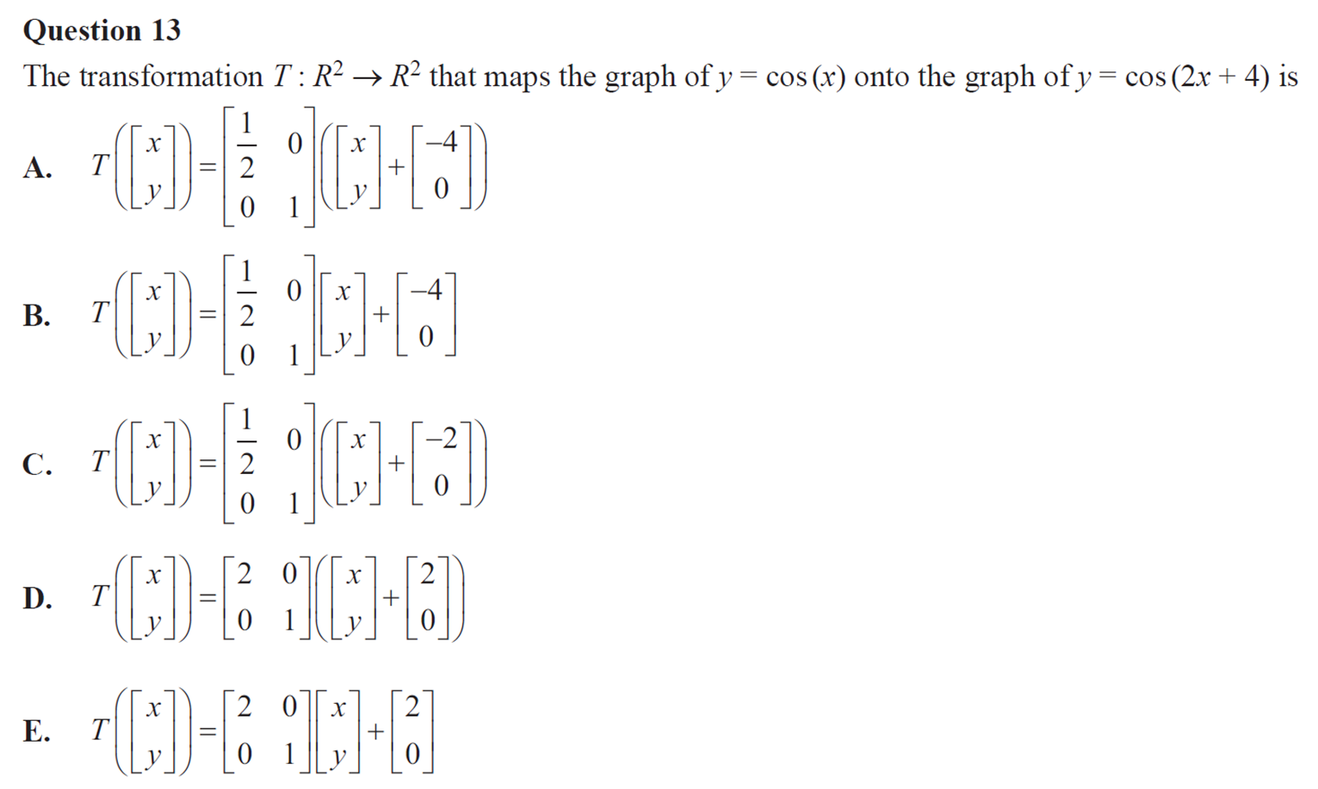
Matrix Transformations: VCE Mathematical Methods 2020 Exam 2
Q. | A | B | C | D | E | -- | Examiner’s Comments
VICTORIAN CURRICULUM
AND ASSESSMENT AUTHORITY

Slide 8
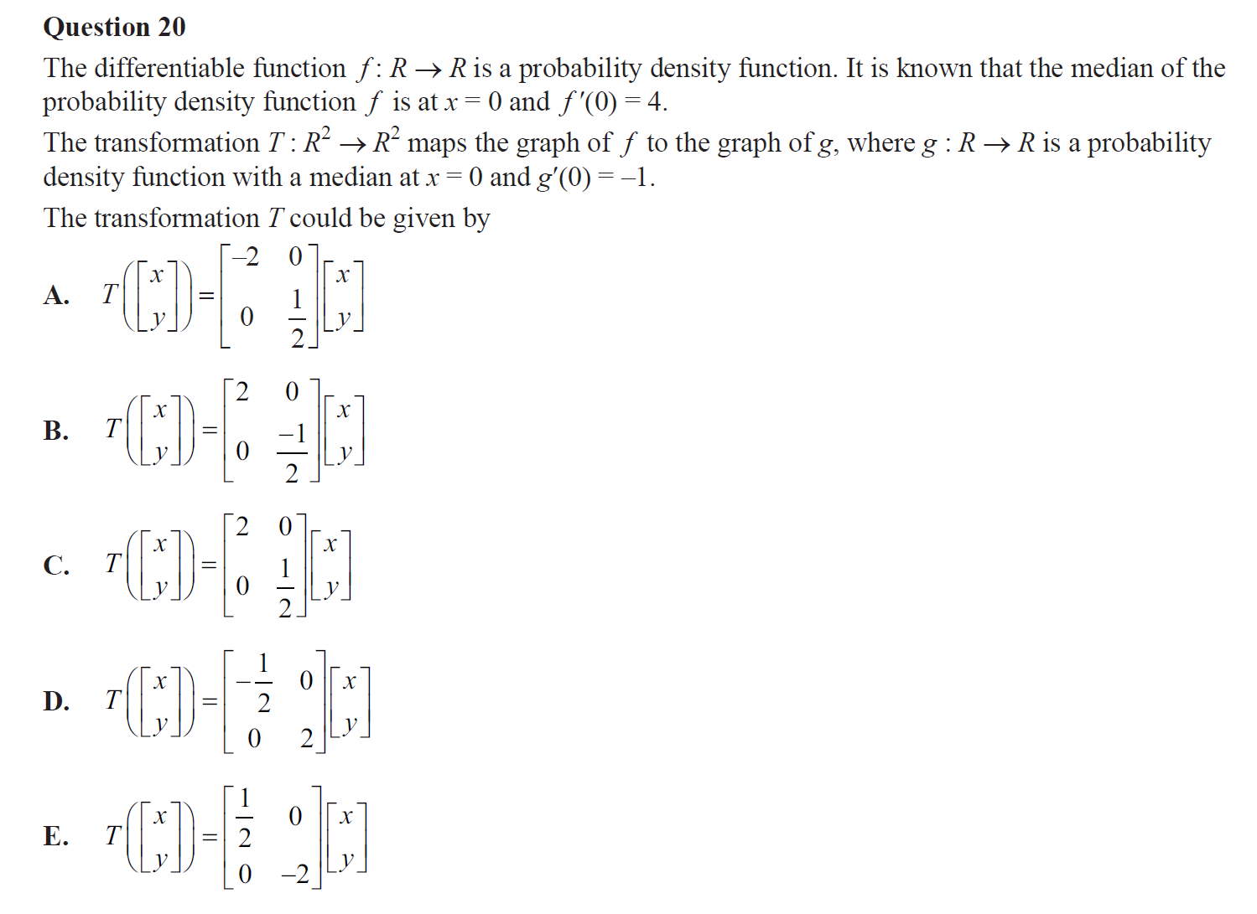
Matrix Transformations: VCE Mathematical Methods 2018 Exam 2
Q. | A | B | C | D | E | -- | Examiner’s Comments
VICTORIAN CURRICULUM
AND ASSESSMENT AUTHORITY

Slide 9
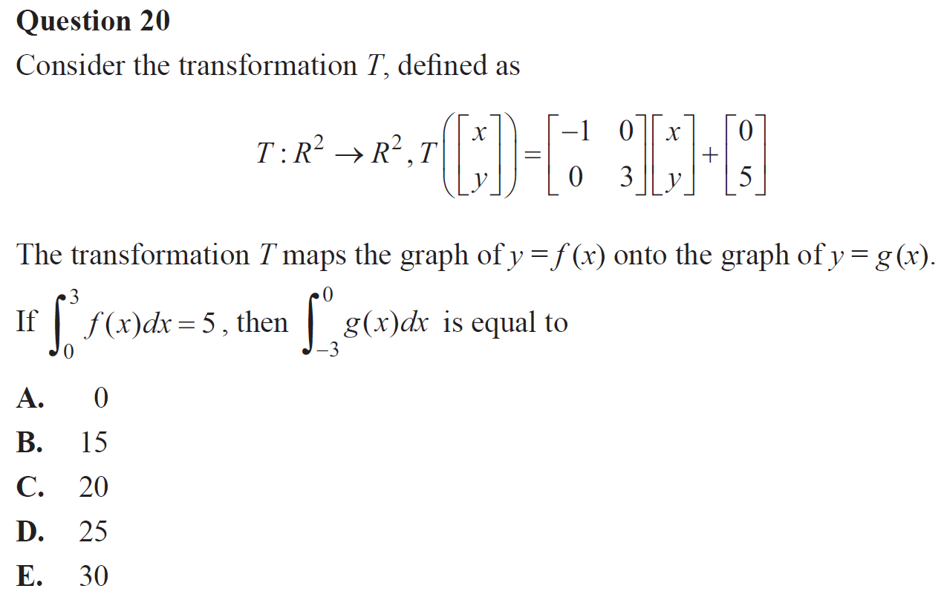
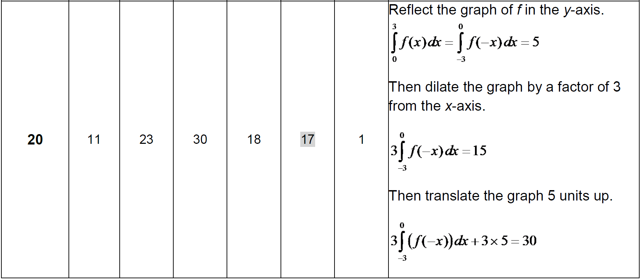
Matrix Transformations: VCE Mathematical Methods 2016 Exam 2
Q. | A | B | C | D | E | -- | Examiner’s Comments
VICTORIAN CURRICULUM
AND ASSESSMENT AUTHORITY

Slide 10
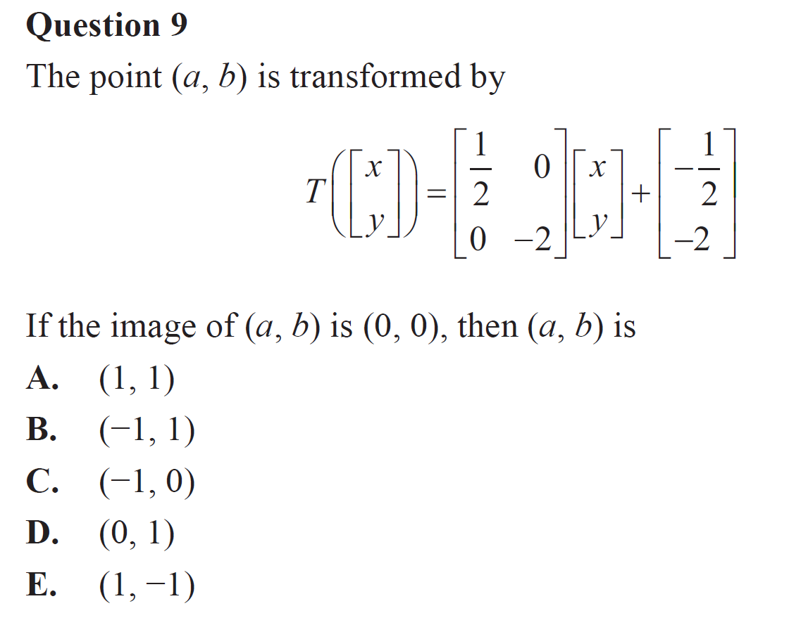
Matrix Transformations: VCE Mathematical Methods 2019 Exam 2
Q. | A | B | C | D | E | -- | Examiner’s Comments
VICTORIAN CURRICULUM
AND ASSESSMENT AUTHORITY

Slide 11
Matrix Transformations: VCE Mathematical Methods 2019 Exam 2
Q. | A | B | C | D | E | -- | Examiner’s Comments
VICTORIAN CURRICULUM
AND ASSESSMENT AUTHORITY

Slide 12
Matrix Transformations: VCE Mathematical Methods 2019 Exam 2
Q. | A | B | C | D | E | -- | Examiner’s Comments
VICTORIAN CURRICULUM
AND ASSESSMENT AUTHORITY

Slide 13
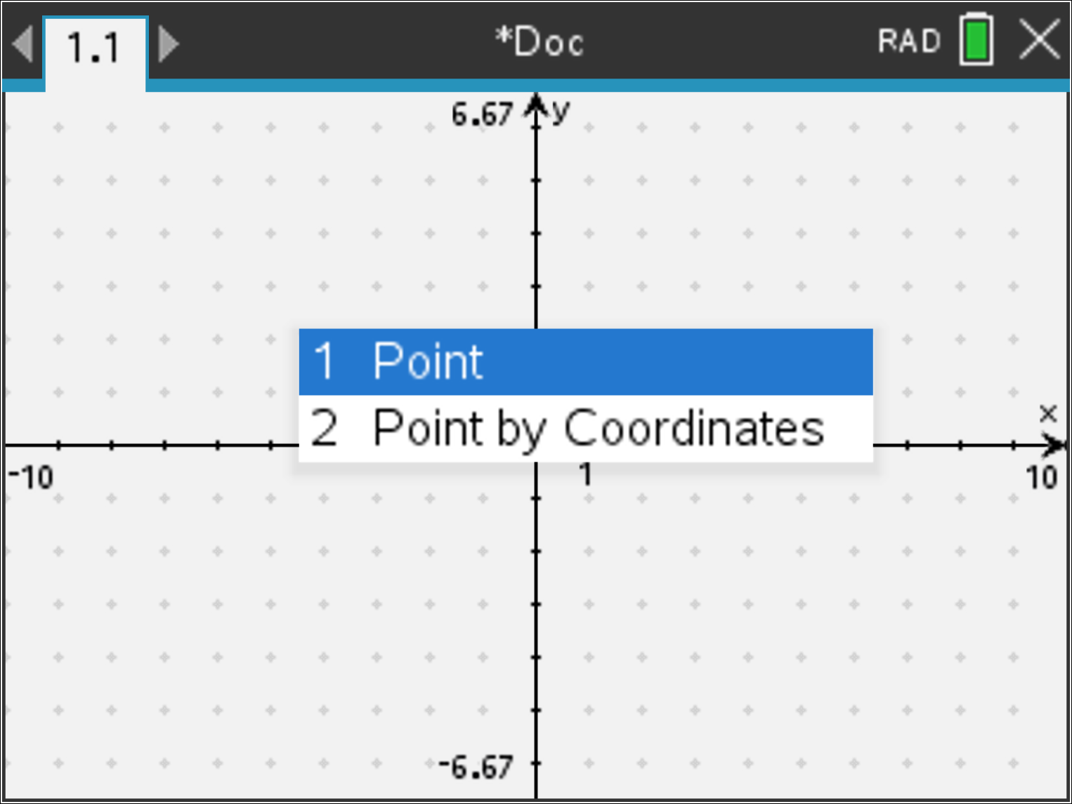
Matrix Transformations:

Slide 14
Matrix Transformations:
Press: P

Slide 15
Matrix Transformations:
Original Equation:
Required Equation:

Slide 16
Matrix Transformations:
Original Equation:
Required Equation:

Slide 17
Matrix Transformations:
Consider the transformation T:
The transformation T maps $y=x^{2}$ onto $g\left(x,y\right)=0$ determine $g(x,y)$.

Slide 18
Matrix Transformations:
Invariance of properties under transformation, and the relationship between the determinant of a transformation matrix and the effect of the linear transformation on the area of a bounded region of the plane.
The effect of translation, linear transformations and their inverse transformations, and compositions of these transformations on subsets of the plane such as points, lines, shapes and graphs of functions and relations.

Slide 19
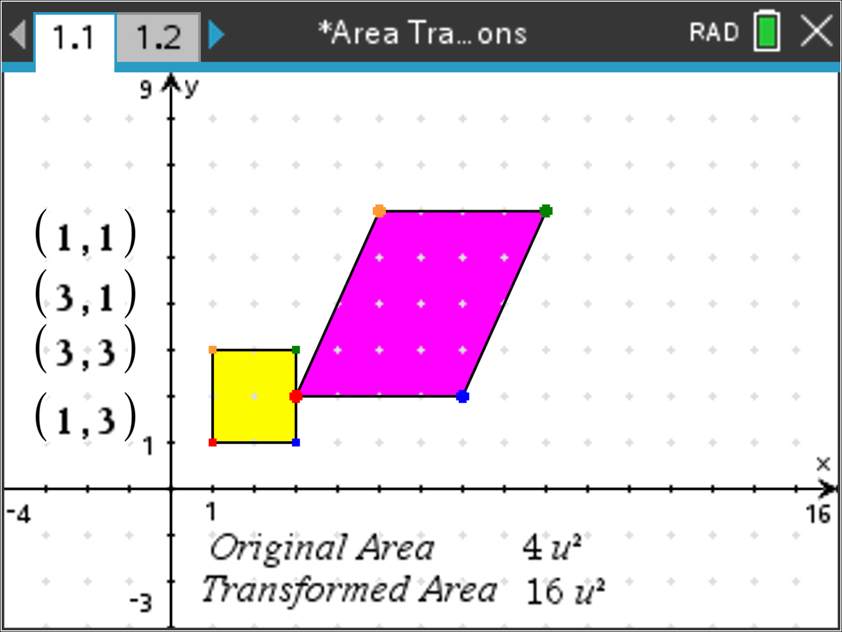
Matrix Transformations:
Invariance of properties under transformation, and the relationship between the determinant of a transformation matrix and the effect of the linear transformation on the area of a bounded region of the plane.

